Slide 1
Lab 9 – C# Programming Continued
CSCI 6303 Fall 2012
Dr. Abraham

Slide 2
Assignment
Student will make a program that asks the user to input 10 integers then the program will output the sum of the 10 integers using a loop. It can be either a For or While loop. It will be done through the C# Console Application.( Submit Code and Screen Shots of the working program)
Student will make a guessing game using C# Form Application. Create the form which will only have a button and a single text box where the user will input their guess. The button will submit their guess. The code will use a Random number generator(explained in ppt) and only contain If Else statements .( Submit Code and Screen Shots of the working program)

Slide 3
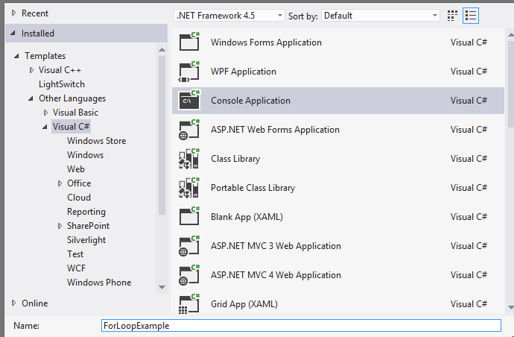
C# Console Application
Start up Visual Basic and click on create new project on the left. This screenshot is what must be selected to do Assignment 1 through the Console Application.

Slide 4
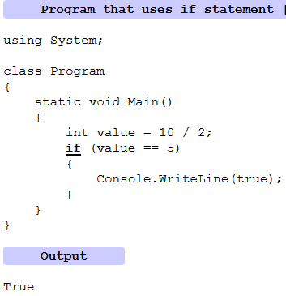
C# If
The if-statement is a selection statement. It directs control flow. It is translated to intermediate language instructions called branches. It makes a logical decision. Expressions in an if-statement evaluate always to true or false.

Slide 5
C# Else if
We next look at a method called Test that uses the if-statement with two else-if blocks and one else. It returns a value based on the formal parameter. The order the if-statement tests are written in is important.
So: We must test the more restrictive conditions first, or the less restrictive conditions will match both cases.
Example on next slide

Slide 6
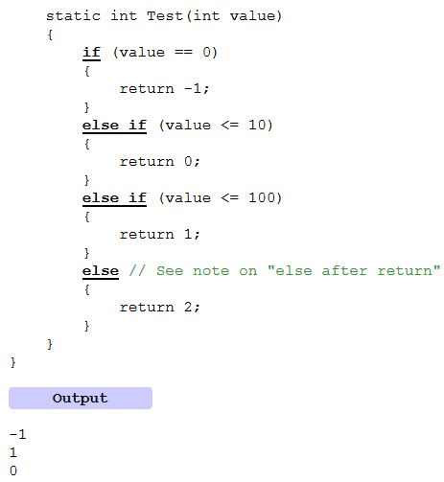

Slide 7
C# For Loops
Statements execute only once as control flow passes over them.
Loop constructs manipulate the flow of control to repeat certain statements over and over again. They include the for, while, do while, and for each loops.
Virtually every program spends most of its time in executing its loops.
What can go wrong with a loop? Any answer would have to include incorrect or omitted loop initialization, omitted initialization of accumulators or other variables related to the loop, improper nesting, incorrect termination of the loop....
Example on next slide

Slide 8
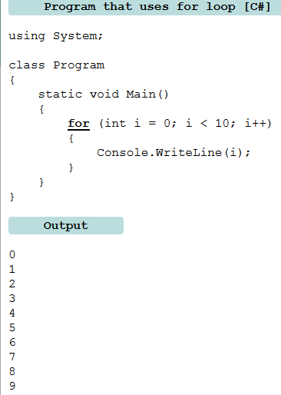

Slide 9
C# While Loop
The while-loop is a very clear loop structure, but it can lead to infinite loops unless you are careful. We draw on research about the while-loop. Continuing on, the do-while loop is explored.
Loops sometimes have complicated terminating conditions. They do not progress through a simple range of numbers. The while loop is an ideal choice for this situation. It uses a controlling expression. We must use care with infinite loops.
Example on next slide

Slide 10
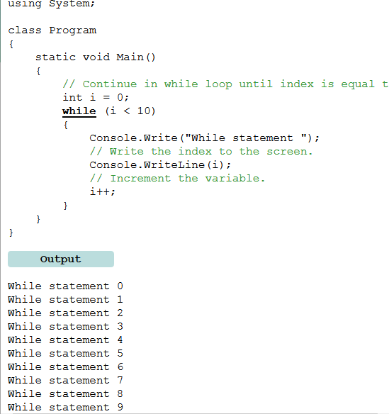

Slide 11
Random Number Generator
Random number generators cannot return truly random numbers. They return instead sufficiently random numbers. With the Random type in the .NET Framework, we generate in our C# programs numbers that appear very random.
First, the Random type is a class in the base class library. It is available in programs that include the System namespace. In this program, we see an example of using the Random class.
Example on Next slide

Slide 12
How to generate Random number and MessageBox in C#

Slide 13
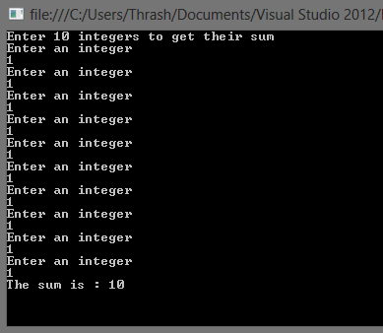
Example of Sum of 10 integers

Slide 14
C# Tutorial Sites
http://www.csharp-station.com/Tutorial.aspx
http://msdn.microsoft.com/en-us/library/aa288436%28v=vs.71%29.aspx
http://csharp.net-tutorials.com/
https://www.youtube.com/watch?v=UND0I7d84Sg&feature=bf_prev&list=SP97214C9A931B0A36

