Slide 1
Lab 8 – C# Programming Adding two numbers
CSCI 6303 – Principles of I.T.
Dr. Abraham
Fall 2012

Slide 2
Assignment
Create a windows application using C# that will add numbers from 2 text boxes and the result will be displayed on a third text box. Source code and screen shots are required. Please submit through BlackBoard
Extra credit: Your application will be able to perform all basic operations ( +, -, *, /). Source code and screen shots are required.

Slide 3
Example

Slide 4
Lets Get Started
First thing is to download Visual Basic Express edition for desktop which is free. Any version will work such as 2010 etc. http://www.microsoft.com/visualstudio/eng/downloads#d-2012-express
Once installed on your computer the next step is to start it up.
Once opened you will be greeted with the start up screen. The important part is on the left side of the screen, pictured on the next slide.

Slide 6
On the left side it will say New Project. Click it and it will take you to the next screen. Once on this screen you will be asked what programming language you want to use.
For this assignment we will use C#.
Make sure to highlight Windows Forms Application, and at the bottom to enter your assignment name for the file you will be creating.
Once you create your file then hit next.
The image of the above explanation is on the next slide

Slide 8
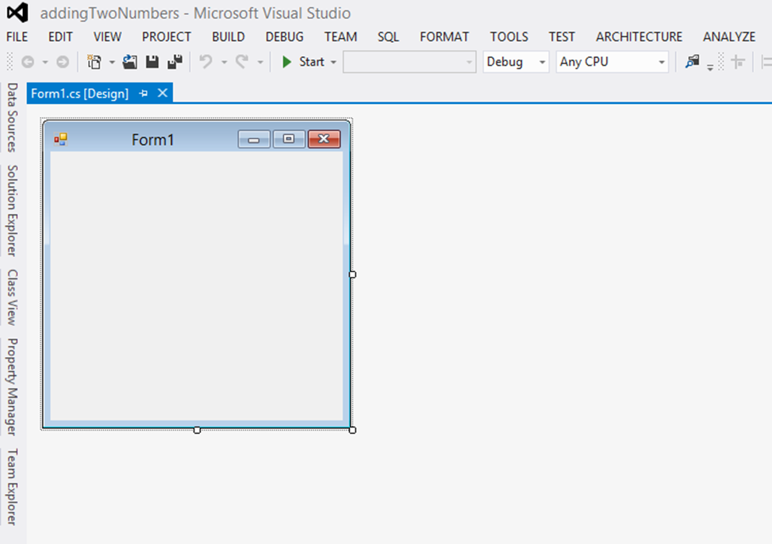
Once you hit the next button the project will open with the following image.

Slide 9
Notice that your form box will already be there waiting for the input.
Depending on certain settings, such as in the following image, the Toolbox will be on the right or left side of the screen. If you do not see it anywhere the simple fix is to go to the top and click on view and look for the Toolbox setting and enable it.
Once you click on the Toolbox tab you will be shown all kinds of tools that you can use to format your Form window. For this assignment we will use the following.
TextBox, Button,
You are free to use any other tools to add to your form to make it fancier. But it is not necessary.

Slide 11
To add the textboxes to the form all you have to do is drag and drop it on the Form Window. However you want to format it is up to you.
Once you are done adding the necessary textboxes now you can add the button, which is also where you found the Textbox tool
To add the button all you have to do again is drag and drop it onto the Form Window.
Once you have your Button and Text Boxes where you like them, now we need to change the properties of them to say what we want.
First click on the button that you just drag and dropped on the Form Window. Once it is highlighted or selected, look for the properties tab near the ToolBox tab usually it is right under it.
Click on the Properties tab and now we can give the button a proper label or name. Next slide is an example

Slide 13
Once you have labeled your button properly, next it is time to program.
Double click on the button you just created and gave a label to.
It should open up the Form1.cs where you will input your programming code. Just like in the image on the next slide.
This is where you will input the code so that your form will calculate an addition problem.
The assignment is for you to create the form and input the proper code so that the user can input two numbers and click on the button which will calculate the result and display it on a third textbox.

Slide 15
What is C#
C# (pronounced "C-sharp") is an object-oriented programming language from Microsoft that aims to combine the computing power of C++ with the programming ease of Visual Basic. C# is based on C++ and contains features similar to those of Java.
C# is designed to work with Microsoft's .Net platform. Microsoft's aim is to facilitate the exchange of information and services over the Web, and to enable developers to build highly portable applications.
C# simplifies programming through its use of Extensible Markup Language (XML) and Simple Object Access Protocol (SOAP) which allow access to a programming object or method without requiring the programmer to write additional code for each step.

Slide 16
What is C# continued
Because programmers can build on existing code, rather than repeatedly duplicating it, C# is expected to make it faster and less expensive to get new products and services to market
What Can a C# Program Do?
Typical programming tasks includes putting data into a database or pulling it out, displaying high speed graphics in a game or video, controlling electronic devices attached to the PC or even playing music and/or sound effects. You can even write software to generate music or help you compose.
C# is a general purpose language with features to make programs more robust. Compared with C++, it doesn't need pointers. Unlike C++ and to a lesser extent Java, the screen handling in C# is excellent, on both desktops and the web.

Slide 17
C# Tutorials sites
http://www.csharp-station.com/Tutorial.aspx
http://msdn.microsoft.com/en-us/library/aa288436%28v=vs.71%29.aspx
http://csharp.net-tutorials.com/

