Slide 1
Lab 5 – Shell Scripting
CSCI6303 – Principles of I.T.
Fall 2012

Slide 2
Lesson
Student will become familiar with scripting in shell using Linux/Ubuntu
Student will write a script and execute it.
Student must take screen shots and submit their code through blackboard

Slide 3
Lab Assignment 5 – shell Scripting
Write a shell script that says “Hello World”, using example 1. (remember to include quotations)
Modify the script in the last example in the tutorial which is the number guessing game, but instead have the user only guess from 1-25 instead of 1-100.
Make sure to take screens shots and include your code for submission through black board.

Slide 4
Beginning
Start up the virtual machine that was previously installed
Start up Ubuntu/Linux. Use the password from lab 3-virtual machines
Password = utpa123
Open up terminal by hitting the Meta(Windows key) to bring up the Dash
Type terminal and you should see the icon. Double click it

Slide 5
Installing VIM
In the terminal window type
sudo apt-get install vim
You should be prompted to enter the password next
It should install packages and ask you to accept. Y/N…type Y and let it finish
Once installed you are ready to begin shell scripting.

Slide 6
Shell Scripting Tutorial
First we will create a new folder directory by typing the following
mkdir shell-scripts
(mkdir is short for make directory) shell-scripts will be the folder we create to put all of our scripts in.
Second we will need to change directory(cd) to our shell-script folder by typing.
cd shell-scripts

Slide 7
Lets code
Now you will be in the shell-scripts directory. It should be displayed like so
:~shell-scripts$
Now we will open the VIM editor and create a new script file by typing
vim test1.sh
Test1.sh is our new file where the script is saved
You should now be in the vim editor. In order to write you must hit the INSERT key on the keyboard

Slide 8
Now type in the following
#!/bin/sh (←always start scripts with this)
Hit enter after typing the above command
Now type
clear (then hit enter)
Next type
echo “Hello, $USER.” (all caps on user)
Now hit the Esc key once to exit INSERT mode in VIM
Now we need to write, save and then quit. We do this by typing the following
:wq

Slide 9
Executing the script
In order to execute the script we need to give it executable permission by typing the following
chmod +x test1.sh
In order to run it, all we need to do is type the following
./test1.sh
If done correctly it should say Hello, and your name after it or in this case csci6303.

Slide 10
Number guessing Game
Use the previous example (slide 7) to create a new script called guessgame.sh, you should already be in the shell-script directory.
Don’t forget to hit the INSERT key so that you can type in the VIM editor.
Don’t forget to also start the script with the most important piece of code. (slide 8)

Slide 11
Guessing Game code
Type the following code and modify for question two. Don’t forget to take screens shots and also to include your modified code to turn in. (must type exactly and also must have proper spacing and indention or it will not run)

Slide 13
Objectives
Define the role and features of the Linux shell
Use the shell as a command interpreter
Create user-defined variables
Use shell environment variables
Create shell scripts in Linux

Slide 14
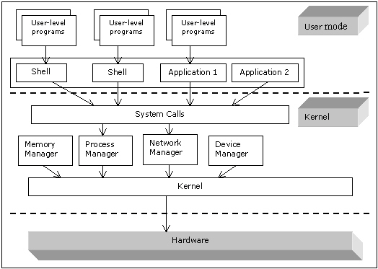
A shell:
Is a utility program with the Linux system that serves as an interface between the user and the kernel
Plays an important role of command interpretation for the kernel

Slide 15
Features of a Shell
The shell has the following features:
Interactive processing
Background processing
Input/output redirection
Pipes
Shell scripts
Shell variables
Programming language constructs
Command history
Job control
File name completion
Command completion

Slide 16
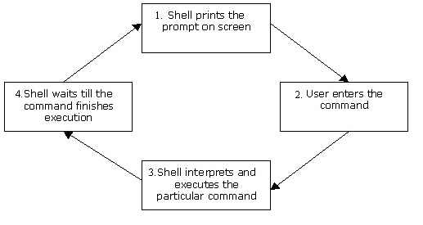
Shell as a Command Interpreter
The shell:
Reads the command
Locates the file in the directories containing utilities
Loads the utility into memory
Executes the utility

Slide 17
Shell as a Command Interpreter (Contd.)
The shell creates a child shell for the execution of a utility
The shell requests the kernel for any hardware interaction

Slide 18
Unix Shells
Some of the popular Unix Shells are:
Bourne Shell: sh is the executable filename for this shell
C Shell: csh is the executable filename for this shell
Korn Shell: The executable filename is ksh
Restricted Shell: Is typically used for guest logins

Slide 19
Linux Shells
Some of the popular shells available in Linux are:
Bash:
Is an acronym for ‘Bourne Again Shell’ and is the default shell for most Linux systems
Uses the symbolic link sh
Tcsh:
Is an acronym for ‘Tom’s C shell’ also known as the TC shell
It is an enhancement of the C shell
Uses the symbolic link csh
Can be executed by using either csh or tcsh at the shell prompt
ASH:
Is usually suitable on machines that have very limited memory
Uses the symbolic link, bsh in Fedora Core 2

Slide 20
Shell Scripts
Stores a sequence of frequently used Linux commands in a file
Enables the shell to read the file and execute the commands in it
Allows manipulation of variables, flow-of-control and iteration constructs that make programming possible

Slide 21
The echo Command
The echo Command
Displays messages on the screen
Displays the text, enclosed within double-quotes
Puts a newline character at the end of the text by default
$ echo "This is an example of the echo command" ↵
This is an example of the echo command
$ _

Slide 22
Executing a Shell Script
A shell script can be executed:
In a new shell by
First granting the execute permission to the specified shell script
Then invoking its name at the $ prompt
$ chmod +x filename.sh [Change File Access Permission]
$ ./filename.sh [Execute the shell script]

Slide 23
Creating Variables
Variables in shell scripts:
are not declared as integers or characters
are treated as character strings
can be mathematically manipulated
do not have to be explicitly declared
can be created at any point of time by a simple assignment of value
The syntax for creating a variable is:
<variable name>=<value>
Variables can be created:
In shell scripts: A variable created within a shell script is lost when the script stops executing.
At the shell prompt: A variable created at the prompt remains in existence until the shell is terminated.

Slide 24
Referencing Variables
The $ symbol is used to refer to the content of a variable
variable1=${variable2}
The braces are essentially used to delimit the variable name.
The command to assign the value of today variable to x variable is:
$ x=$today

Slide 25
Reading a Value into a Variable
The read command is used to enter a value from the keyboard into a variable during the execution of a shell script.
The syntax to use the read command is:
$ read <variable_name>
The read command, on execution, waits for the user to enter a value for the variable.
When the user presses <Enter> key after entering the value, the remaining part of the shell script, if any, is executed.

Slide 26
The if Construct
Linux provides the if Construct to perform decision making in shell scripts.
The if construct is usually used in conjunction with the test command
if <condition>
then <command(s)>
[else <command(s)>]
fi
Linux also provides the if...elif construct, the syntax of which is as follows:
if condition(s)
then command(s)
elif condition
then command(s)
else command(s)
fi

Slide 27
The exit Command
The exit command is used to stop execution of the shell script and return to the $ prompt based on the result of the test command.
The following example of the exit command example,
echo "Do you wish to quit?"
read ans
if [ $ans = "y" ]
then exit
fi
The exit command can also be used in the then part of the if…else construct.

Slide 28
The case…esac Construct
The case...esac construct in Linux:
Is often used in place of the if construct if a variable is tested against multiple values
Evaluates the value of the variable and compares it with each value specified
The syntax to use the case ... esac construct is:
case $variable-name in
value1) command
.
command;;
value2) command
.
command;;
*) command;;
esac

Slide 29
The while Construct
The while Construct in Linux supports iteration in shell scripts
The while construct has the following syntax:
while <condition>
do
<command (s)>
done
The while true command, creates an infinite loop.
An example of the while construct is:
reply=y
while test "$reply" != "n"
do
echo –n "Enter file name?"
read fname
cat ${fname}
echo –n "wish to see more files :"
read reply
done

Slide 30
The for Construct
The for construct takes a list of values as input, and executes the loop for every value in the loop.
The for construct has the following syntax:
for variable_name in <list_of_values>
do
…
done
The for construct supports wildcard characters in the list of values such as, *.c
An example of the for construct is:
for name in Ruby Samuel
do
echo "${name}"
done

Slide 31
Debugging Shell Scripts
Linux facilitates debugging of shell scripts by using the following two options:
The –v option: Echoes the statements written in a shell script on the terminal, before actually executing them
The –x option: Echoes the statements in the script preceded by a + symbol, if the statement has successfully been executed
To debug the shell script, you can use the sh <filename> command with the –v and –x options at the shell prompt:
$ sh –v <filename>
or
$ sh –x <filename>

Slide 32
Some Command line Terms
apt-get Search for and install software packages (Debian/Ubuntu)
bash GNU Bourne-Again SHell
chmod Change access permissions
clear Clear terminal screen
echo Display message on screen
mkdir Create new folder(s)
mount Mount a file system
su Substitute user identity
umount Unmount a device
"#!”, is the name of a program which should be used to interpret the contents of the file.
/bin/sh is to tell the contents that it will be a shell script

Slide 33
Contact Information
Mike Gomez
magomez5@broncs.utpa.edu
Juan Prado
jdprado@broncs.utpa.edu
Sonny Kodali
skodali@broncs.utpa.edu

