Slide 1
Lab 4 - Networking
CSCI 6303 – Principles of I.T.
Fall 2012

Slide 2
Lab 4 assignment
Students will be able to gain networking knowledge in this lab, by solving network connectivity issues, sharing files, and accessing other computers remotely.
Verify if your computer has internet connectivity
If not, troubleshoot the problem and fix it
Join a workgroup called Net6303
Share a directory and try opening and modifying files from a different workstation.
Use remote desktop connection to access a different workstation.

Slide 3
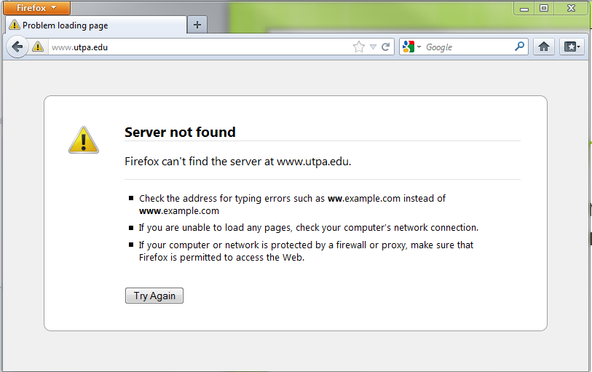
Network Connectivity
You can verify if your computer has internet access by browsing the Internet

Slide 4
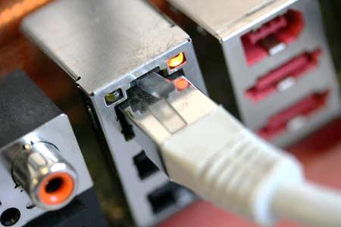
Network Connectivity Issues
Start with the simplest problems, like checking your network card to see if the network cable is plugged in.

Slide 5
Network Connectivity Issues
The network connectivity issue may be caused by a different problem, like a configuration issue in your computer, or your network card could be disabled. To enable/disable a network card, go to:
Control Panel > Network and Sharing Center > Change Adapter Settings
This screen will show you all the network adapters in your computer and their settings.

Slide 6
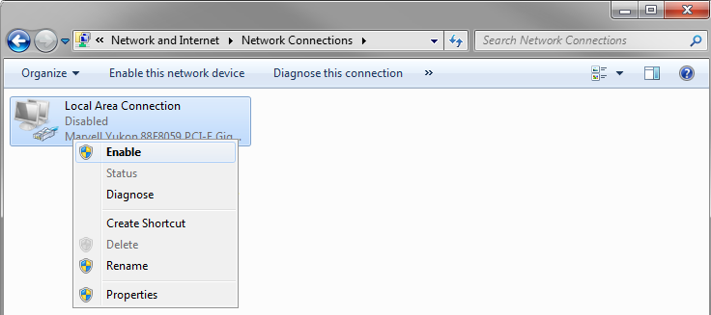
Network Connectivity Issues
Enable your network card by right clicking it and clicking on Enable

Slide 7
Network Connectivity Issues
Once your network card is enabled, and the network cable is plugged in, check if you have internet.
If the problem persists, there may be a configuration issue.
To be able to communicate in the network, your computer needs an IP Address. The IP address allows other clients to reach your computer, similar to your home address. Each computer in a particular network should have a unique IP Address. IP Conflicts occur when two network devices have the same IP address, which causes one or both of the devices to lose network connectivity. Without an IP address, no device can be part of the network.

Slide 8
Network Connectivity Issues
The best way to find out your IP address is to use the windows command prompt.
Go to the start menu and click on Run…
Type in ‘cmd’ and hit enter.
In the windows command prompt, type ‘ipconfig’ and press enter.
Your IP address should be displayed as IPv4 Address, under Local Area Connection.
Without an IP Address, your computer will not have network access.

Slide 9
Network Connectivity Issues
Your computer can get an IP address automatically, or you can assign it manually.
For your computer to get an automatic IP address, there must be a server in the network that assigns them dynamically as devices join the network. This server is called a DHCP server.
If there is no server, no IP address will be assigned to your computer. To access the network, you must assign a static IP address to your computer. You must do it carefully to avoid IP address conflicts.
You must also know the IP address of the router, which will allow you to communicate with computers outside of your local network, which is indispensable for internet access. The IP address of the router is used as your ‘default gateway’.

Slide 10
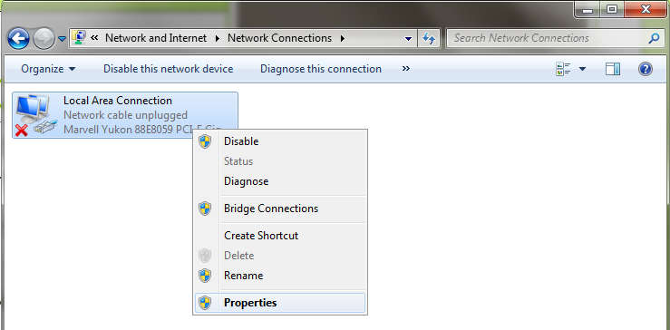
Network Connectivity Issues
Set a static IP address for your Local Area Connection.
To do this, under the “Network Connections” window, right click on “Local Area Connection” and click properties.

Slide 11
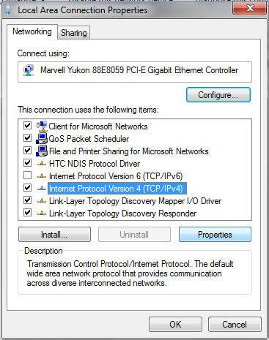
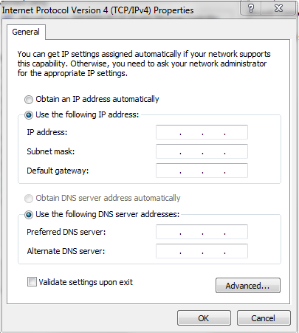
Network Connectivity Issues
Click on “Internet Protocol Version 4” and click on Properties. Click on “Use the following IP address”.

Slide 12
Network Connectivity Issues
Once you have entered the IP address and Default Gateway provided by the T.A.’s, try again to browse the internet.
Open the windows command prompt again and check to see if you have an IP address.

Slide 13
Network Connectivity Issues
Now that you can access the network, you can take advantage of some of its benefits, like sharing files.
You can start by joining a workgroup.
A Workgroup is a peer-to-peer computer network used by Windows computers.
To join a workgroup, go to:
Control Panel > System > Advanced System Settings
Under the Computer Name tab, click Change…

Slide 14
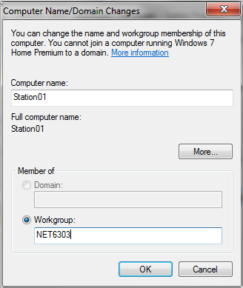
Network Connectivity Issues
Enter NET6303 as a Workgroup. Then click OK.

Slide 15
Network Connectivity Issues
You can share files and folders with other members of the network.
Create a folder in your C: drive called Share##, using your station number. For example, if you are using station 7, name your folder Share07. This will make it easier to find your folder from other workstations.
Add some files to your folder like a sample text file, image, or any file of your choice.
To share the new folder, right click it and click “Properties”.

Slide 16
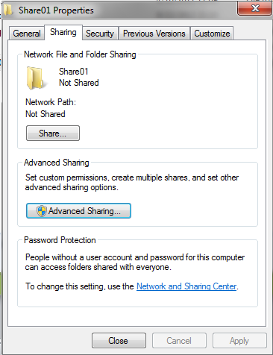
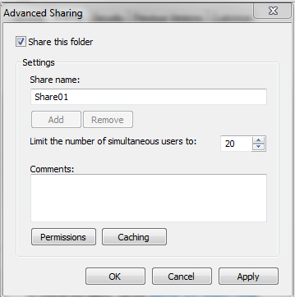
Network Connectivity Issues
Under the “Sharing” tab, click “Advanced Sharing”
Check the “Share this folder” box, and click on “Permissions”

Slide 17
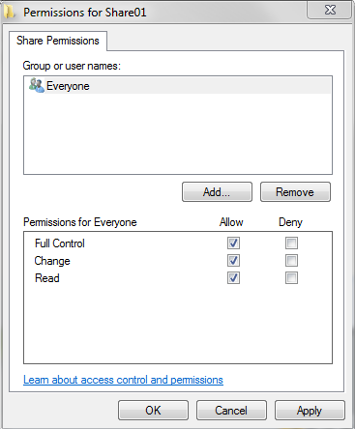
Network Connectivity Issues
This will allow you to specify how other users can access your files. In this case we will allow any user with access to the network to Read, Write, or delete this folder and its files.
To allow this, click on “Allow” next to “Full Control”
Save your changes and try to access your files from a different workstation

Slide 18
Network Connectivity Issues
We can now try to access other computers remotely by using Remote Desktop Connection. To do this, you will need the IP address of the workstation you want to access.
You can use the same method as before to get the IP address of a different computer.
Go to:
Start Menu > All Programs > Accessories> Remote Desktop Connection
Enter the IP address of the computer you intend to access remotely. You will be asked to enter valid credentials.

Slide 19
Contact Information
Mike Gomez magomez5@broncs.utpa.edu
Juan Prado
jdprado@broncs.utpa.edu
Sonny Kodali
skodali@broncs.utpa.edu

Slide 20
Networking Basics

Slide 21
Computer Network
A computer network is a group of computers connected to each other.
This means that the computers can "talk" to each other and that every computer in the network can send information to the others. Usually, the speed of the connection is faster than a normal connection to the Internet.

Slide 22
Types
LAN
Local area network, connects 2 or more computers together such as in an office.
MAN
Metropolitan area network, large network that spans a city or large campus
WAN
Wide area network, connects 2 or more smaller networks together. The largest being the Internet.

Slide 23
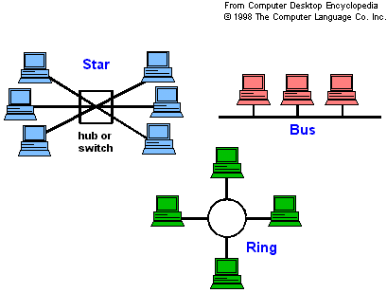
Network Topology

Slide 24
Bus Topology
A bus network uses a multi-drop transmission medium, all node on the network share a common bus and thus share communication.
This allows only one device to transmit at a time. A distributed access protocol determines which station is to transmit.
Data frames contain source and destination addresses, where each station monitors the bus and copies frames addressed to itself.
Read more about Bus here

Slide 25
Ring Topology
Under the network, a signal is transferred sequentially via a "token" from one station to the next. When a station wants to transmit, it "grabs" the token, attaches data and an address to it, and then sends it around the ring.
The token travels along the ring until it reaches the destination address. The receiving computer acknowledges receipt with a return message to the sender. The sender then releases the token for the token for use by another computer.
Each station on the ring has equal access but only one station can talk at a time. To allow an orderly access to the ring, a single electronic token passes from one computer to the next around the ring as seen in (token ring). A computer can only transmit data when it capture the token.
Read more here

Slide 26
Star Topology
A star network uses a central server to route data between clients.
The central server (or the switching hub) switches data around the network.
The hub, switch, or concentrator manages and controls all functions of the network. It also acts as a repeater for the data flow.
Read more here

Slide 27
Network Devices
Repeater
Amplifies electrical signal
Hub
Mult-port repeater
Switch
Device which can make decisions on which port to send frames to avoid collisions during high traffic.
Router
Forwards data between multiple computer networks.

Slide 28
IP Address
Every machine on a network has a unique identifier. Just as you would address a letter to send in the mail, computers use the unique identifier to send data to specific computers on a network.
An IP address can be either dynamic or static. A static address is one that you configure yourself by editing your computer's network settings. Dynamic addresses are assigned by the Dynamic Host Configuration Protocol (DHCP), a service running on network hardware such as routers or dedicated DHCP servers.

Slide 29
IPv4 vs IPv6
There are two standards for IP addresses: IP Version 4 (IPv4) and IP Version 6 (IPv6).
All computers with IP addresses have an IPv4 address, and many are starting to use the new IPv6 address system as well.

Slide 30
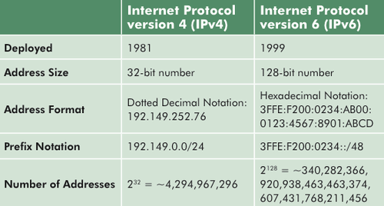

Slide 31
IPv4
IPv4 uses 32 binary bits to create a single unique address on the network. An IPv4 address is expressed by four numbers separated by dots. Each number is the decimal (base-10) representation for an eight-digit binary (base-2) number, also called an octet. For example: 216.27.61.137

Slide 32
IPv6
IPv6 uses 128 binary bits to create a single unique address on the network. An IPv6 address is expressed by eight groups of hexadecimal (base-16) numbers separated by colons, as in 2001:cdba:0000:0000:0000:0000:3257:9652. Groups of numbers that contain all zeros are often omitted to save space, leaving a colon separator to mark the gap (as in 2001:cdba::3257:9652).

Slide 33
DNS
Domain Name System – DNS
Translates human friendly hostname into an IP address for communication
For example, the domain name www.example.com may translate to the addresses 192.0.43.10.
This allows the user to remember the URL instead of IP addresses

Slide 34
DHCP
Dynamic Host Configuration Protocol
Assigns a new device an IP address so that it can communicate the network/Internet.
Grants a client an IP address for limited intervals and is responsible for renewing when lease expires.
DHCP service is usually provided by a router or separate DHCP server

