Slide 1
Virtualization
Lab 3 – Virtualization
Fall 2012
CSCI 6303 Principles of I.T.

Slide 2
Lab 3 Assignment
(make sure to take screen shots of your progress)
1. Student will download and install Vmware player.
2. Student will then setup Vmware player and install an O.S. (linux).
Questions
What is Virtualization?
What are the inherent benefits of virtualization?
What are the different types of virtualization?
What is hosted virtualization, guest operating system, and virtual machine?
What is the difference between emulation, native virtualization, and paravirtualization?
Explain in detail how you installed Vmware and the Operating System for virtualization. Include screenshots.

Slide 3
Getting Started
STEP 1
First, download and install VMware Player.
You may see some prompts about installing drivers; simply approve them.
When you are finished installing VMware Player, you will have to restart your computer.

Slide 4
Install O.S. in VMware
STEP 2
Open VMware Player, and choose “Create a New Virtual Machine.”
You can install Ubuntu from a disk, or directly from the ISO file. For this lab we will use the install disk.
VMware Player will automatically detect Ubuntu and will show that it will be installed with Easy Install. Click next to continue.
Now enter your name, user name, and password. All fields are required. (use the following)
Name = ubuntu
User Name = csci6303
Password = utpa123

Slide 5
Install O.S. in VMware continued
Now, choose a name for your virtual machine and where to save it. Simply click next to accept the defaults. (use the following)
Name = ubuntu
You can choose how large you want your virtual hard drive to be; the default is 20Gb. Please note that the entire 20Gb will not be used up on your hard drive initially.
review your settings, click Finish to start installing Ubuntu!
During the install, you may be prompted to download and install VMware tools for Linux. Simply click Download and the tools will automatically download and install.

Slide 6
Virtualization
virtualization broadly describes the separation of a resource or request for a service from the underlying physical delivery of that service.
A key benefit of virtualization is the ability to run multiple operating systems on a single physical system and share the underlying hardware resources – known as partitioning.

Slide 7
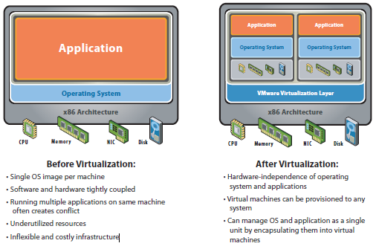

Slide 8
Virtualization Addresses Challenges
Server Consolidation and Containment – Eliminating ‘server sprawl’ via deployment of systems as virtual machines (VMs) that can run safely and move transparently across shared hardware, and increase server utilization rates from 5-15% to 60-80%.
Test and Development Optimization – Rapidly provisioning test and development servers by reusing pre-configured systems, enhancing developer collaboration and standardizing development environments.

Slide 9
Business Continuity – Reducing the cost and complexity of business continuity (high availability and disaster recovery solutions) by encapsulating entire systems into single files that can be replicated and restored on any target server, thus minimizing downtime.
Enterprise Desktop – Securing unmanaged PCs, workstations and laptops without compromising end user autonomy by layering a security policy in software around desktop virtual machines.

Slide 10
Approaches of Virtualization
virtualization can apply to a range of system layers, including hardware-level virtualization, operating system level virtualization, and high-level language virtual machines.
Hardware-level virtualization was pioneered on IBM mainframes in the 1970s, and then more recently Unix/RISC system vendors began with hardware-based partitioning capabilities before moving on to software-based partitioning.

Slide 11
For Unix/RISC and industry-standard x86 systems, the two approaches typically used with software-based partitioning are hosted and hypervisor architectures
Hosted approach provides partitioning services on top of a standard operating system and supports the broadest range of hardware configurations.
Hypervisor architecture is the first layer of software installed on a clean x86-based system (hence it is often referred to as a “bare metal” approach). Since it has direct access to the hardware resources, a hypervisor is more efficient than hosted architectures, enabling greater scalability, robustness and performance.

Slide 12
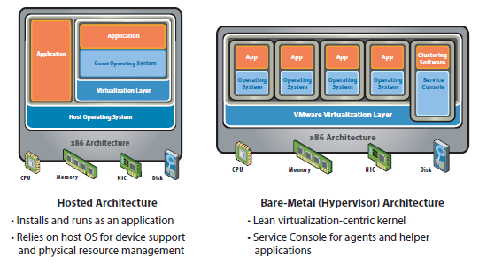

Slide 13
Approaches Continued
Application-level partitioning is another approach, whereby many applications share a single operating system, but this offers less isolation (and higher risk) than hardware or software partitioning, and limited support for legacy applications or heterogeneous environments.
Other benefits include the isolation of virtual machines and the hardware-independence that results from the virtualization process.
Virtual machines are highly portable, and can be moved or copied to any industry-standard (x86-based) hardware platform, regardless of the make or model.

Slide 14
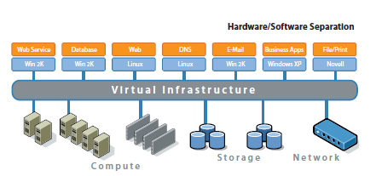

Slide 15
Virtualization for Servers
Virtual infrastructure initiatives often spring from data center server consolidation projects, which focus on reducing existing infrastructure “box count”, retiring older hardware or life-extending legacy applications.
Server consolidation benefits result from a reduction in the overall number of systems and related recurring costs (power, cooling, rack space, etc.)
Virtual infrastructure initiatives often spring from data center server consolidation projects, which focus on reducing existing infrastructure “box count”, retiring older hardware or life-extending legacy applications. Server consolidation benefits result from a reduction in the overall number of systems and related recurring costs (power, cooling, rack space, etc.)

Slide 16
New Generation Virtualization
multi-tier application architectures are becoming increasingly common, and the adoption of smaller form-factor blade servers is growing dramatically
virtualization is an ideal complement for blade servers, delivering benefits such as resource optimization, operational efficiency and rapid provisioning.
The latest generation of x86-based systems feature processors with 64-bit extensions supporting very large memory capacities. This enhances their ability to host large, memory-intensive applications, as well as allowing many more virtual machines to be hosted by a physical server deployed within a virtual infrastructure.

Slide 17
Useful Information
For lab 4 lookup information about What is a Network? (components used, cables, Architecture, topologies)
Remote desktop
Connecting to a domain
Sharing folders in a workgroup

