Slide 1
Lab 10 – Loan Spreadsheet Calculator
CSCI 6303 – Principles of I.T.
Dr. Abraham
Fall 2012

Slide 2
Assignment
For your assignment, you are to create a spreadsheet in excel for a fixed-rate loan that is for 30 years, the loan specifies an initial principal balance of $180,000(the amount borrowed) and an APR of 8.5%. Payments will be made monthly. You are required to figure out the monthly payment, how much the payment will be interest, and how much will be principal, as well as showing the monthly balances for each(example will be shown in class). Student will submit screenshots of working spreadsheet and the excel file itself.
Your spreadsheet should be able to automatically adjust monthly payments when the principal, loan term, rate, and payments per year are changed, as well as create the spreadsheet automatically for the months.

Slide 3
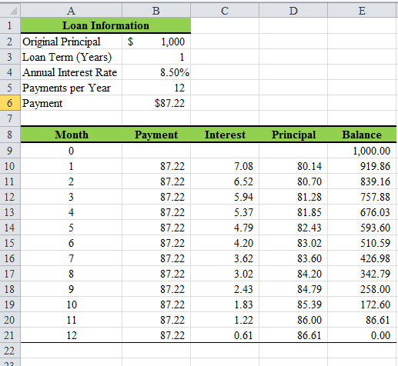
Example

Slide 4
Amortized Loan
A loan with scheduled periodic payments of both principal and interest. This is opposed to loans with interest-only payment features, balloon payment features and even negatively amortizing payment features.
Borrowers who choose amortized loans are less likely to experience "payment shock" than borrowers who choose loans which are not fully amortized.
Payments on loans that are not initially fully amortized must at some point become amortized over the remaining term of the loan in order to repay the outstanding principal balance.
The shorter the remaining term, the larger the increase required in the periodic payments to amortize the loan over the remaining term.

Slide 5
What is an Amortization Calculator
An amortization calculator is used to determine the periodic payment amount due on a loan (typically a mortgage), based on the amortization process.
The amortization repayment model factors varying amounts of both interest and principal into every installment, though the total amount of each payment is the same.
An amortization schedule calculator is often used to adjust the loan amount until the monthly payments will fit comfortably into budget, and can vary the interest rate to see the difference a better rate might make in the kind of home or car one can afford.

Slide 6
An amortization calculator can also reveal the exact dollar amount that goes towards interest and the exact dollar amount that goes towards principal out of each individual payment. The amortization schedule is a table delineating these figures across the duration of the loan in chronological order.
The Formula:
The calculation used to arrive at the periodic payment amount assumes that the first payment is not due on the first day of the loan, but rather one full payment period into the loan.
While normally used to solve for A, (the payment, given the terms) it can be used to solve for any single variable in the equation provided that all other variables are known. One can rearrange the formula to solve for any one term, except for i, for which one can use a root-finding algorithm.

Slide 7
Where:
A = periodic payment amount
P = amount of principal, net of initial payments, meaning "subtract any down-payments"
i = periodic interest rate
n = total number of payments
This formula is valid if i > 0. If i = 0 then simply A = P / n.
For a 30-year loan with monthly payments,
n= 30years X 12months/year = 360 months

