Slide 1
Lab 1 – Computer Hardware
CSCI 6303 Principles of I.T.
Fall 2012

Slide 2
What’s inside your computer?

Slide 3
Hardware
Hardware – physical parts of a computer.
Anything you can touch and see.
Motherboard, internals.
Chassis
Monitor
Keyboard
Mouse
Etc.

Slide 4
Case - Chassis
Protects all components of a computer
Provides airflow
Noise insulation

Slide 5
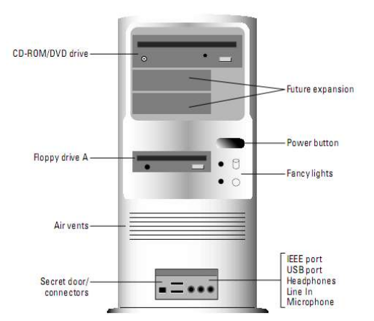

Slide 6
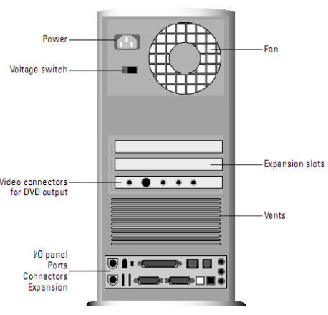

Slide 7
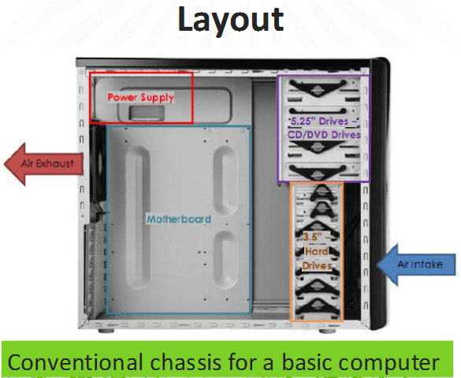

Slide 8
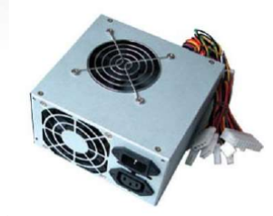
Power Supply
Can be considered the heart of the computer.
It provides power to computer hardware.

Slide 9
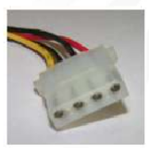
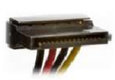
Power Supply Connectors
Molex Connector (Standard)
SATA Connector

Slide 10
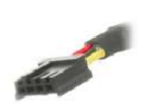
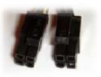
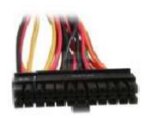
Floppy Connector
4+4 pin(CPU) connector
20+4 pin(Motherboard) Connector
PCIe (6+2 pin) Connector

Slide 11
Motherboard
Motherboard – is a printed circuit board which holds the crucial components of the system.
Also known as: mainboard, logic board, mobo, system board.

Slide 12
Motherboard key parameters:
Form Factors
Chipset
CPU Support
Video Support
Memory Support
Audio Support
Memory Slots
Ports and Slots

Slide 13
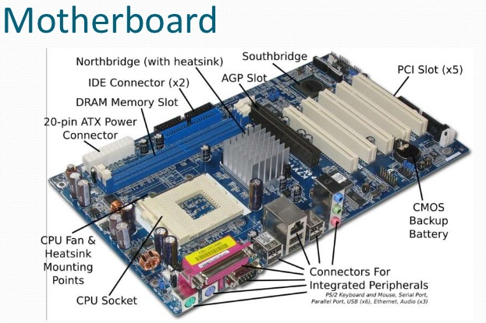

Slide 14
Most Common Motherboard Form Factors:
ATX (Advanced Technology Extension)form factor is the most common form factor for full-sized computers.
ATX boards measure 12" x 9.6".
The CPU sits at the back top below the power supply. The power supply blows air into the case or pulls air from the case to cool the processor.

Slide 15
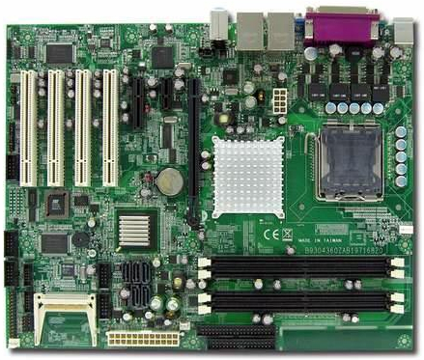
ATX

Slide 16
Motherboard Form Factors Continued:
mini-ATX motherboard is a slightly smaller variation of the full ATX size that measures 11.2" x 8.2".
The main difference between ATX and mini-ATX is the number of bus and possibly memory slots on the motherboard.
Mounting holes for both are located in the same place, making them interchangeable in most cases. A case that supports an ATX motherboard can also support a mini-ATX motherboard.

Slide 17
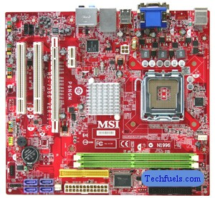
Mini ATX

Slide 18
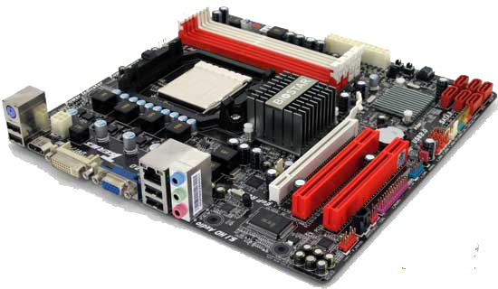
The micro-ATX form factor is an even smaller version of the ATX standard, with a maximum size of 9.6" x 9.6". Mounting holes are in the same position as ATX motherboards

Slide 19
NLX is an older form factor used for slimline desktop-style computers. NLX is an improvement over an even earlier LPX form factor.
Uses a riser card in the middle of the system board (expansion slots are located on the riser card rather than the system board).
The riser card does not have built-in ports for audio, joystick, USB, network, and modem.
Supports AGP video cards.
Includes the ability to mount the motherboard so it can slide in or out of the system case easily.

Slide 20
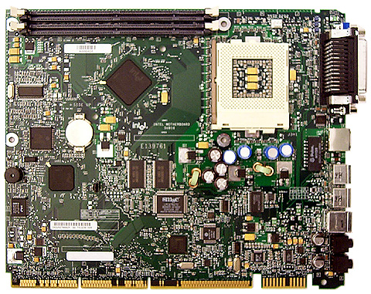
NLX view

Slide 21
The BTX (Balanced Technology Extended) form factor was designed to give developers better options for managing system performance and balancing thermal management. With BTX:
The processor is at the front and turned on an angle to increase air flow across the processor.
A thermal module or shroud fits over the processor to move heat directly out of the system.
Many BTX cases are also ATX compatible.
Although BTX was developed as an improvement to ATX, it has not gained widespread adoption. BTX is implemented mainly by computer manufacturers such as Dell.

Slide 22
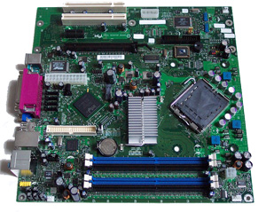
BTX view

Slide 23
Chipsets
Components which are connected to the motherboard are controlled and connected by the chipset
Usually comprised of a Northbridge and Southbridge chip

Slide 24
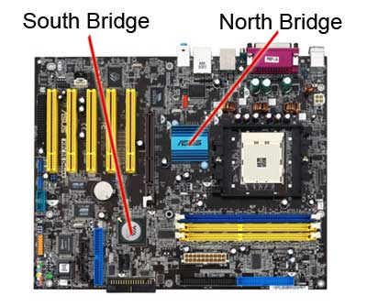
Chipset Map

Slide 25
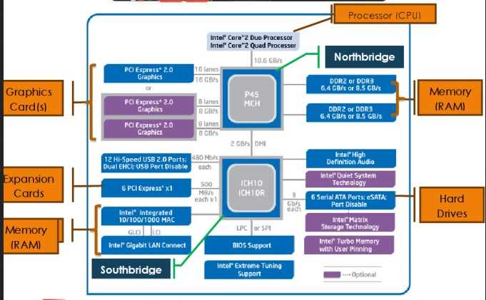

Slide 26
Northbridge
Allows CPU, RAM and Graphics Card to communicate between each other. Before it used AGP lanes)
On new systems the northbridge no longer exists as chip on the motherboard. Instead PCIExpress and RAM controllers have been incorporated into the processor itself

Slide 27
Southbridge
Responsible for the communication between other components, external devices, audio and network

Slide 28
Peripheral Device Connections
A peripheral device is a device that connects through an external port to your computer. The following connection types are common:
PS/2
USB
Firewire
Serial
Parallel
PC Card (PCMCIA)
PCI Express (ExpressCard)

Slide 29
PS/2 connectors are 6-pin mini-din connectors. Keyboard and mouse are common devices that use PS/2 connections.
USB is a serial interface that supports low- and high-speed devices. USB supports almost any kind of peripheral device, including keyboards, mice, scanners, digital cameras, printers, and storage device
Firewire is a serial interface. Common Firewire devices include digital video cameras and recorders, hard drives, and network adapters
Serial devices transmit data one bit at a time on a single cable. Serial devices use COM ports for system resources.
Parallel devices transmit multiple bits at a time over multiple wires. Parallel devices use LPT ports for resources. Common parallel devices include printers and scanners.

Slide 30
PC Cards are expansion slots in laptop and portable devices. PC Cards can be used by devices like modems, network cards for wired or wireless networks, CD-ROMs, sound cards, SCSI host adapters, IEEE 1394 controllers, USB controllers, and others.
PCI Express (ExpressCard) is replacing PC Card for laptop expansion devices. ExpressCard slots connect directly to the PCIe or USB bus. Cards use either PCI Express or USB 2.0 standards (the slot supports both).
Many of these ports and interfaces are included as part of the motherboard faceplate connectors.

Slide 31
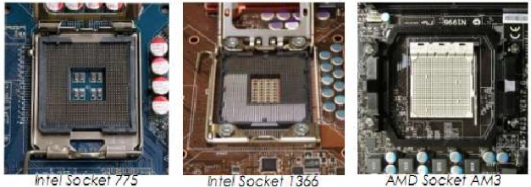
Mother Board CPU Sockets

Slide 32
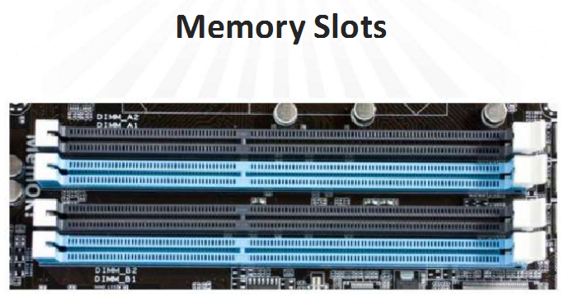

Slide 34
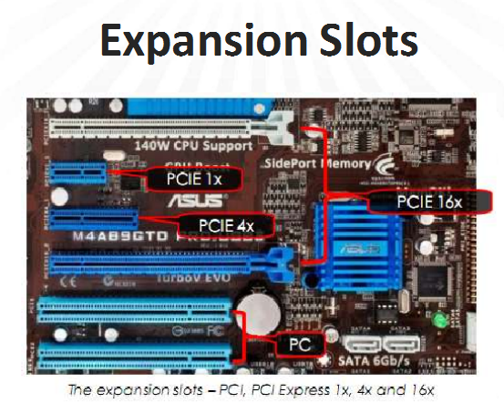

Slide 35
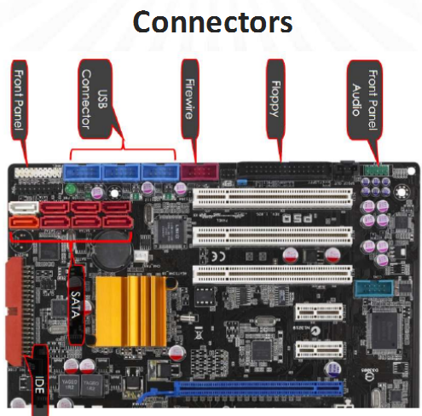

Slide 37
Motherboard HINT!!!
When selecting CPU, RAM, Video Card etc. The motherboard spec page will tell you what types are required.

Slide 38
CPU
When selecting a CPU, be aware that you will need to match the motherboard and the CPU. Matching the socket type used by the motherboard and CPU is the easiest way.
Intel and AMD are the two producers of processors used in modern PCs.
Both Intel and AMD processors work in PC systems and support Windows software.
Intel has a larger market share, while AMD processors generally cost less.
Processor performance and special features vary between models and manufacturers.

Slide 39
CPU continued:
A 32-bit processor can process 32-bits of information at a time.
64-bit processor can process 64-bits of information.
32-bit system will work on 64-bit system, but 64-bit system will not work on 32-bit system.
Processors operate using an internal clock that is the same as, or is a multiple of, the motherboard bus speed.

Slide 40
CPU continued:
A multiple core processor has multiple processors within a single processor package.
Dual-core, triple-core, and quad-core processors are typical in desktop systems
Multi-core systems enable the operating system to run multiple applications simultaneously. Without multiple processors, applications appear to run at the same time, but must wait their turn for processing time from the single processor.

Slide 41
CPU Cache
Level 1 (L1) cache is integrated on the processor die itself and stores instructions for the processor. On multi-core systems, each processor typically has its own L1 cache. Some processors might have two L1 caches, one for instructions and one for data.
Level 2 (L2) cache is additional cache used for both instructions and data. Depending on the processor, L2 cache might be shared between two or more cores, or exclusive to a single core.
Level 3 (L3) cache is additional cache beyond the level 2 cache. For multi-core systems, L3 cache is shared between all cores.

Slide 42
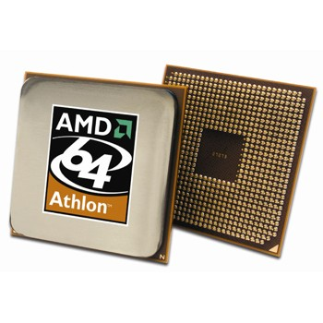
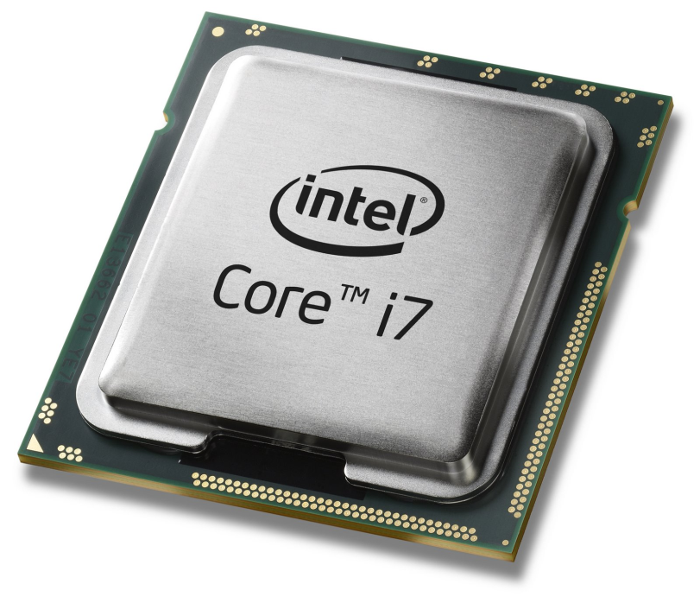
Most Commonly used CPU Brands

Slide 43
Hard Drive - Storage
Parallel ATA - The Oldest and most common interfaces is parallel ATA (PATA also referred to as IDE. This was the original specification that was used for hard disks as well as CD and DVD drives. Parallel ATA is strictly an internal interface, used for connecting devices internally to your computer.
Uses parallel communication (meaning devices share the same data transfer channel).
maximum speed of 133 MB/s.
phased out and replaced.

Slide 44
Serial ATA - is a newer specification that is now replacing the parallel ATA. It is also used for hard disks and optical drives, however it can be either internal or external. The external specification referred to as eSATA.
successor to PATA.
Uses serial communication (meaning each device is on its own channel).
Is faster than PATA. They have a speed starting at 150 MB/s. up to 600 MB/s
Provides built-in support for disk protection methods.
Provides for easy configuration--just connect the device to the SATA port.

Slide 45
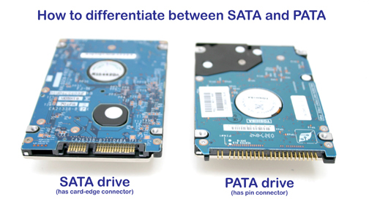

Slide 46
SCSI has been around for some time and includes connectors that connect to multiple devices in a chain. so for instance you may have 8 devices connected in a chain to a single port. SCSI is typically used in high-end workstations and servers.
SCSI is a standard for transferring data between devices on internal and external computer buses. Though SCSI devices are most commonly used for tape storage devices and hard disks.
Is typically used in servers that have high availability and speed requirements.
Connects multiple devices onto a single bus or chain.
Provides better performance than PATA or SATA.
Is relatively difficult to configure. Devices must be configured with a device ID, and the bus must be terminated.
Is more expensive than PATA/SATA.

Slide 47
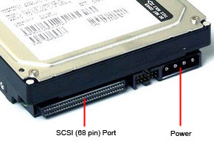

Slide 48
Random Access Memory (RAM)
RAM is the place in a computer where programs and data currently being used are stored.
CPU can access any part in the memory storage, any address in the memory storage directly at any time
In modern PC Systems RAM is implemented as a series of DRAM chips soldered onto an interface board, which we usually call a stick of RAM

Slide 49
Types of RAM
SD RAM - main characteristics of SD RAM is that the frequency of the memory is synchronized with the frequency of the system clock
SD RAM uses 3.3 volts and operates at frequencies between 33 and 166 Mhz, the frequency must match the frequency of the system board.

Slide 50
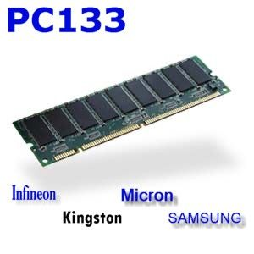
SD RAM

Slide 51
Double Data Rate Memory (DDR RAM) - DDR can accept double the amount of data as SD RAM.
It accepts one command per clock cycle plus two data sets.
So for each cycle the DDR RAM can accept two 64 bit words of data and because of this DDR RAM has twice the bandwidth as SD RAM.
DDR operates at 2.5 volts and at frequencies between 100 and 200 Mhz.

Slide 52
DDR2 - doubles the bandwidth of DDR1
It accepts four data sets per cycle, it operates at 1.8 volts and a frequency of 200 to 533 Mhz.
Another improvement with DDR2 is that there is now a buffer between the data BUS and the memory.
This buffer helps to achieve these four data sets and increased speed per clock cycle.

Slide 53
DDR3 - doubles the data rate of DDR2, so it can accept eight data sets per cycle, it also has a buffer and it operates at 1.5 volts with frequencies between 400 and 1,000Mhz.
As you can see as we move from SD RAM through to DDR3 we lower the voltage in each case, while increasing the operating frequency We also take the amount of data that can be submitted in each cycle and double it.

Slide 54
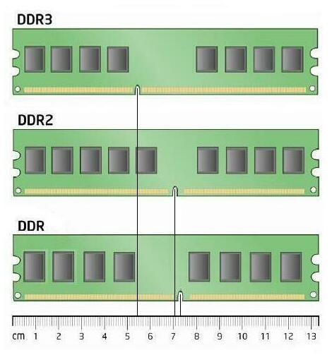

Slide 55
Rambus RAM - Rambus was an alternative to DDR.
Rambus was actually the first specification to double the data over SD RAM. DDR was a competing standard that eventually became the accepted specification and evolved into DDR3
RD RAM instead of transferring data in 64 bits transfers data in 32bits or 16 bit at a time, but it does send two data sets per cycle.
Another consideration with RD RAM is that in addition to having a memory module installed in your motherboard any spare memory sockets must be filled with continuity modules. This is a module that does not contain RAM chips.

Slide 56
Rambus View

Slide 57
NOTE!!!
It's important to note that when using dual or triple channel memory configuration that this is a configuration specific to the motherboard and not the memory itself. The memory you purchase would be the same.

Slide 58
Optical Drives
When selecting an optical drive (CD, DVD, Blue-Ray), consider the following factors.
PATA, SATA, SCSI
For external drives, USB is the most common with some Firewire drives available.
The most important consideration when choosing an optical drive is the types of discs that will be used with the drive as well as the function the drive will perform:
Will the drive be used for both CDs and DVDs? Is Blu-ray support required?
Will the drive be used for read-only discs (ROM)?
Will the drive be used for recording (CD-R, DVD-R)?
Will the drive be used for rewriting (CD-RW, DVD-RW)?

Slide 59
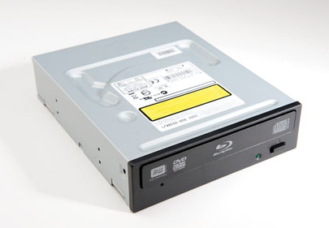

Slide 61
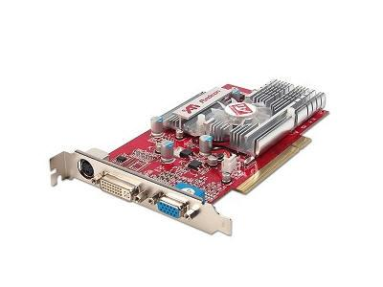
Video Card
Card which generates output to a display device
Can be embedded in motherboard or added separately
GPU – Graphics processing unit, dedicated processor for floating point calculation used in graphic rendering

Slide 62
Lab Assignment 1
Show that you have understood the architecture and all different aspects of computer hardware.
Print a shopping cart from a computer parts vendor.
Shopping cart must have all the necessary components to build a custom computer.
The components should be compatible.
Add a short justification for each part explaining why you chose it, and why it’s compatible
Each student needs to turn in their own work. This is not a group assignment.

Slide 63
Useful Information
Your Text Book provides extensive information
Computer Parts Vendors
www.newegg.com
www.tigerdirect.com
www.compusa.com
Build your own computer Tutorials
Many tutorials can be found online at www.youtube.com
Search “Build your own computer”

Slide 64
Contact Information
Mike Gomez (Main Contact)
magomez5@broncs.utpa.edu
Juan Prado
jdprado@broncs.utpa.edu
Sonny Kodali
skodali@broncs.utpa.edu

