Slide 1
University of Texas Rio Grande Valley Systems Administration CSCI 6175.01 Fall 2016
Instructor Robert C. Jackson

Slide 2
Systems Administration CSCI 6175.01 Fall 2016
Working with Disks and Filesystems

Slide 3
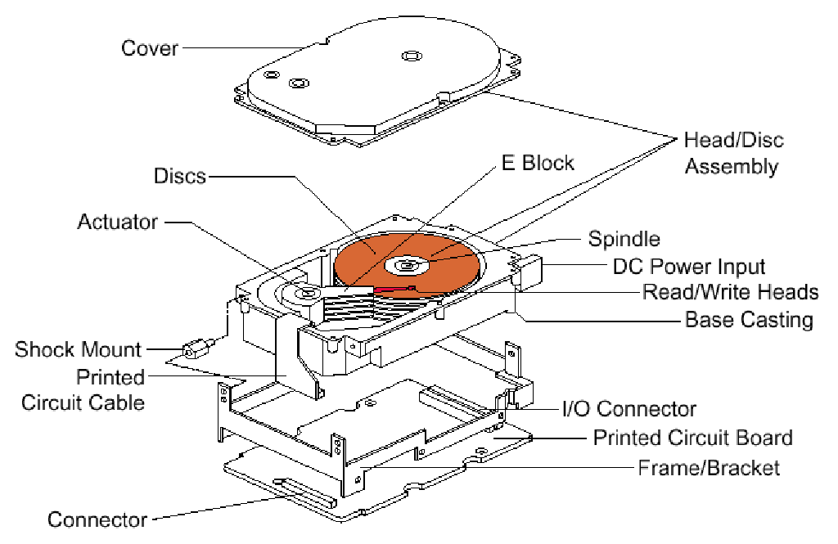
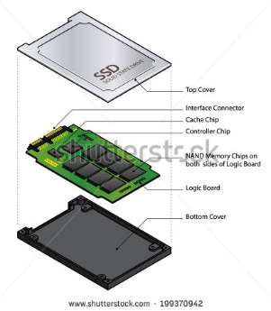
Systems Administration CSCI 6175.01 Fall 2016
Disks (hard drives, floppy, SDD) – are storage devices for storing and retrieving data. Disk drives use 1 or more rotating platters with a magnetic coating. Data heads hovering over the platters read and write digital information from/to the platters. Solid Sate Drives (SDD) use flash memory as their storage medium and have a high data transfer rate.
Figure# 1A Disk Drive Internals Figure# 1B SSD Internals

Slide 4
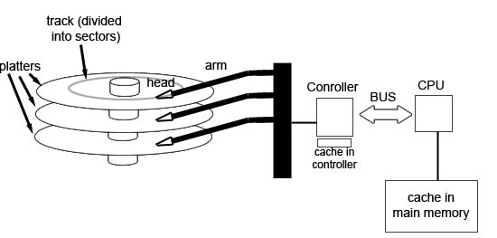
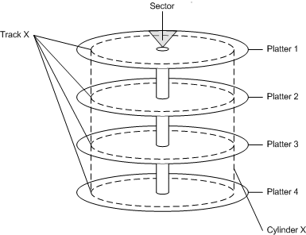
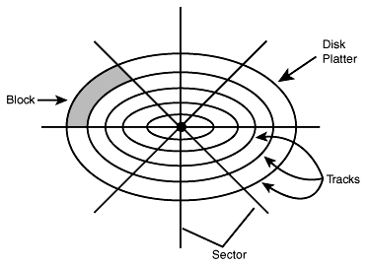
Systems Administration CSCI 6175.01 Fall 2016
Disk Drive physical layout
Fig. 2A Cylinders Fig. 2B Func. HD Fig. 2C Platter layout

Slide 5
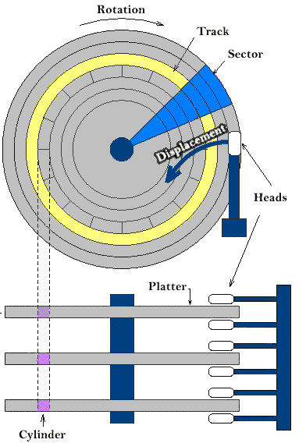
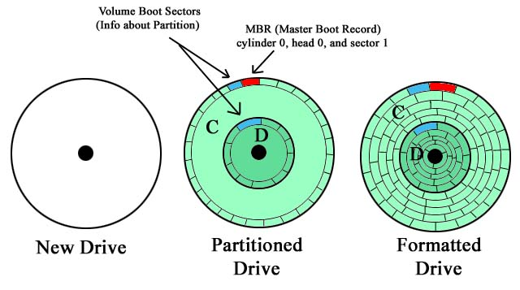
Systems Administration CSCI 6175.01 Fall 2016
Disk Drive platter logical layout
Fig. 3A HD Layout Fig. 3B Platter Layout
Head 0

Slide 6
Systems Administration CSCI 6175.01 Fall 2016
Disk Drive Theory 101:
- Data is written by magnetizing the thin film of ferromagnetic material on a disk platter. A sequence of changes (flux reversals) in the orientation of the magnetism represent binary bits. Data is read by detecting this sequence of changes (flux reversals).
- Modified Frequency Modulation (MFM), and Run Length Limited (RLL) are recording/encoding schemes for writing data to disk drives
- Hard Drive platters are setup (low level format) with tracks, cylinders and sectors. Sectors like pizza slices hold several bytes of data space. Tracks are concentric circular paths on a disk drive platter with data magnetically written on them. Cylinders represent track boundaries spanning all platters of the drive with each platter having 1-r/w head on each side.
- Error Correction Code (ECC) circuitry detects and corrects the errors.
- Platter rotational rates are 4200 rpm, 5400 rpm, 7200 rpm and 10000 rpm.
- Current Disk drive technology offers drive capacities up to several Terabytes.
- Common form factors are 2.5” and 3.5”.
- Hard drives are connected to Systems by Parallel ATA (PATA), Serial ATA (SATA) and Serial Attached SCSI (SAS) cabling and interfaces.

Slide 7
Systems Administration CSCI 6175.01 Fall 2016
Disk Drives are prepared in 2 ways:
Low level formatting:
Low Level Formatting (LLF) writes the track, sector and block boundaries and information unto disk platters. These control structures form the physical layout of the disk.
High level formatting:
High Level Formatting writes partitions and filesystems onto the disk, and tells the OS Kernel about this structure for storing and retrieving information.

Slide 8
Systems Administration CSCI 6175.01 Fall 2016
Disk Drives Types:
Parallel ATA (PATA) Hard Drive (HD) interface standard originated from the Integrated Drive Electronics (IDE) standard. Using an 18” maximum cable length this interface was primarily used for internal PC connections. Data transfers occur in parallel through a 40 or 80 pin connector across a 16 bit data bus. Multiple drives are configured as Master/Slave drives.
Serial ATA (SATA) is the most popular current disk drive interfacing technology. As the successor to PATA, SATA offers reduced cable size (7 data pins), a faster data transfer rate and hot swapping. SATA does support ATA and ATAPI command sets. The Advanced Host Controller Interface (AHCI) hosts SATA disks and is the de-facto standard for SATA.
Serial Attached SCSI (SAS) is a serial protocol for serially moving data from/to SAS type disks. SAS succeeds Parallel SCSI, but uses PSCSI commands. SAS offers backwards compatibility to SATA so SATA drives can be plugged into SAS connections and still work, although plugging SAS drives into SATA connections will not work.
ATAPI is a protocol used with Parallel ATA and Serial ATA allowing for a greater variety of devices to be connected to a computer than ATA would allow. ATAPI allows the ATA interface to carry SCSI commands which further allows SCSI devices to be interfaced by ATA. CDROM’s and DVD’s are the most common ATAPI drives.
USB Drives or Flash Drives are storage devices that integrate flash memory with a Universal Serial Bus (USB) interface. USB drives are good for up to 5000 rewrites.

Slide 9
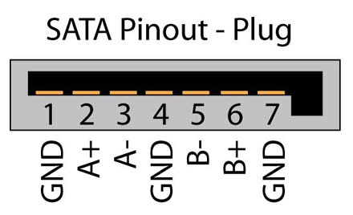
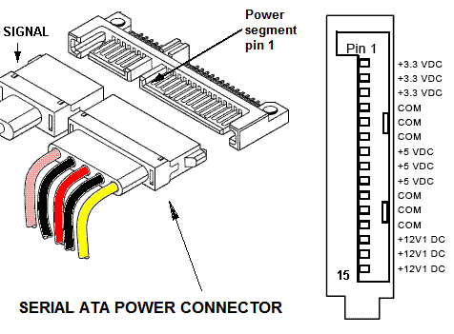
Systems Administration CSCI 6175.01 Fall 2016
Disk Drives Connections:
USB Connector SATA D-Connector SATA P-Connector
1) +5V (Red) 1) 12v – yellow
2) −Data (White) 1) Gnd 2) Gnd – black
3) +Data (Green) 2) A+/Xmit+ 3) 5v – red
4) GND (Black) 3) A-/Xmit- 4) Gnd – black
Fig. 4A 4) Gnd 5) 3.3v – gray/or
5) B-/Recv-
6) B+/Recv-
7) Gnd Fig. 4C
Fig. 4B

Slide 10
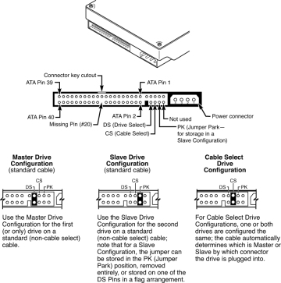
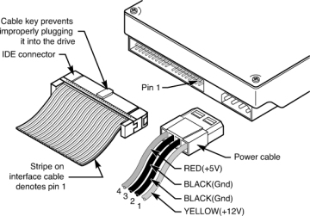
Systems Administration CSCI 6175.01 Fall 2016
Disk Drives Connections Con’t:
Fig. 5A PATA Connections Fig. 5B PATA Connectors

Slide 11
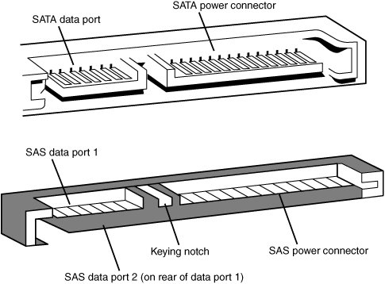
Systems Administration CSCI 6175.01 Fall 2016
Disk Drives Connections Con’t:
SAS and SATA drive pins the same. The connectors are slightly different.
Figure 6 SATA vs SAS Connections

Slide 12
Systems Administration CSCI 6175.01 Fall 2016
Storage Arrays (array of disks)
Disk Arrays come in 2-primary types: Storage Area Networks (SAN) and Network Attached Storage (NAS). RAID controllers manage arrays of disks and can group them logically in volumes, or manage them as individual disks. SAS and SATA expanders can also manage arrays of disks.
Hardware RAID – HW Redundant Array of Independent Disks, is a hardware mechanism with it’s own processor and memory that virtualizes multiple physical disk drives into a larger logical disk drive or volume.
Software RAID – SW Redundant Array of Independent Disks, is implemented by the system OS or Kernel. Linux has a command ‘mdadm’ which manages Software RAID. GPFS and ZFS filesystems have SW RAID components added to their capabilities.
Firmware RAID – RAID which is managed and controlled by the firmware on inexpensive add-on RAID controllers which pass on RAID control to the OS after a certain phase in the boot cycle.

Slide 13
Systems Administration CSCI 6175.01 Fall 2016
Storage Arrays (array of disks)
RAID Types:
RAID 0: striping – consecutive data is sequentially located across different disks, data can be accessed concurrently increasing throughput.
RAID 1: mirroring – same data is written to more than one drive, read is faster than write, only one drive of the set needs to be functional.
RAID 2: bit level striping with parity.
RAID 3: Byte level striping with parity.
RAID 4: Block level striping with parity.
RAID 5: Block level striping with distributed parity, needs at least 3 physical drives, provides fault tolerance to one drive only.
RAID 6: Block level striping with double distributed parity, requires 4 disks, provides fault tolerance for two drives only.

Slide 14
Systems Administration CSCI 6175.01 Fall 2016
Disk Drives – device drivers
Device Driver – is a computer program (software interface) that acts as a translator between the OS and hardware devices. Applications communicate with devices via systems calls to the OS Kernel, which in-turn engage a device drive to fulfill the request.
Hard Drive Specifiers:
- Linux:
/dev/sda1 – 1st SATA HD, /dev/hda3 – 3rd IDE HD
Windows:
C:, D:, E:, - 1st , 2nd, and 3rd HD’s.
Disk device driver tools
- Linux :
lsmod – list kernel modules
modprobe – load and unload kernel modules
modinfo – get module information e.g. modinfo modulename
- Windows :
Msinfo32 – e.g. press cntrl+esc→type ‘msinfo32’→click System Information→expand Software Environment→click System Drivers

Slide 15
Systems Administration CSCI 6175.01 Fall 2016
Filesystems:
Filesystem (FS) - is just a computer filing system used to categorize, store and retrieve information. Several Different filesystem types are currently used:
- FAT: DOS/Windows, File Allocation Table is a legacy 16 bit filesystem.
- FAT32: DOS/Windows, File Allocation Table 32bit filesystem.
- ext2,3,4: 2nd, 3rd, 4th, Linux extended filesystem, 3 and 4 are journaled 2 is not.
- UFS: UNIX File System.
- NTFS: New Technology File System, is a Micro Soft proprietary filesystem successor to FAT, that has improved metadata support and uses advanced data structures to improve performance.
- GPFS: General Parallel File system is a high performance, clustered FS, deployed to shared disk or stateless distributed systems.
- XFS: XFS is a 64bit, journaling FS.
- NFS: Network File system is a file system that allows remote system access over the network which behaves just like local storage.

Slide 16
Systems Administration CSCI 6175.01 Fall 2016
Filesystems:
Filesystem (FS) tools:
Linux
$ df –k ; reports FS disk space usage.
# lsblk ; list block device information.
# blkid ; list block device UUID and type.
# fdisk –l ; lists all disks partitioning.
# fdisk /dev/sda1 ; loads disk partitioning information for modification.
$ sudo parted –l ; list disk partitioning.
# e2fsck /dev/sdb2 ; file system check 2nd SATA/SAS hard drive.
Windows
Chkdsk.exe e.g. press cntl+esc→type cmd→right click Command Prompt icon→click Run as administrator→type chkdsk /? in the cmd window→type chkdsk /scan
Fsutil e.g. run fsutil volumeinfo c: to get information for the C drive.
Diskpart – used for diskpartioning and managing disks and volumes.
Diskmgmt.msc – GUI-based disk management tool

Slide 17
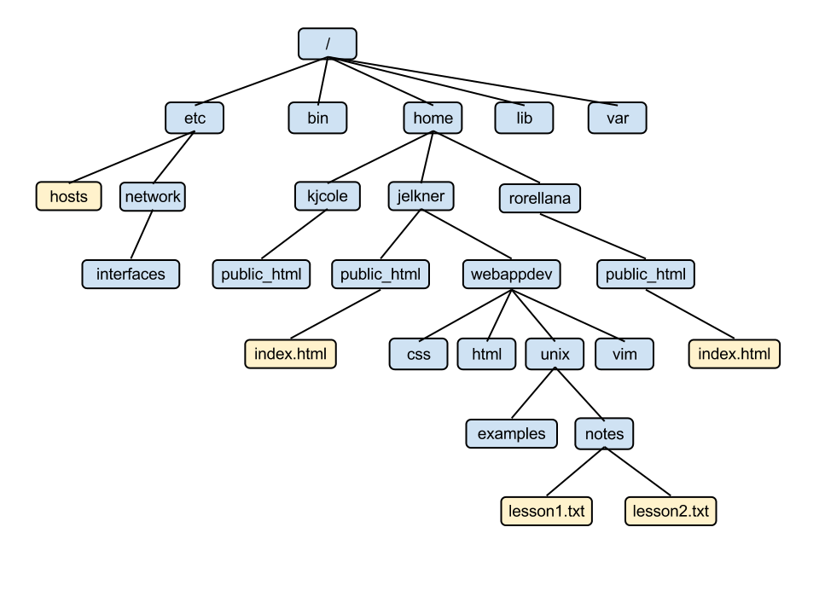
Systems Administration CSCI 6175.01 Fall 2016
Filesystems:
Directories, folders and files
Directories catalog filesystems and contains references to files, directories and other FS. Directories are known as folders on the Windows OS. Directories (Folders) are arranged in a hierarchical structure that resembles an inverted tree. Files store data or information and can be found in directories usually suffixed by a file extension.
Figure 7 Directory Tree
- Windows Directory Command:
Open a CMD window type ‘tree’
Linux Directory Commands:
ls, ll, pwd, cd, md, type ‘man command’ for help

Slide 18
Systems Administration CSCI 6175.01 Fall 2016
/dev/<xxx> / <fff> defaults 1 1
Mounting and Unmounting File Systems
Mounting Filesystems makes them available for use.
- Mounting Linux FS
# mount /dev/sda1 /mnt ; manually mount local hard drive.
# umount /mnt ; unmount local harddrive.
Automatically mount Linux FS on boot
Add mount commands in /etc/fstab file (mount file):
/dev/sda2 / ext2 defaults 1 1
Add FS to be remote mounted in the /etc/exports file (share file):
/home bob.example.com(rw)
Mounting Windows FS:
C:\> mountvol ; creates, deletes or lists a volume mount point.

Slide 19
Systems Administration CSCI 6175.01 Fall 2016
Automounting File Systems
Linux Automounting:
- /etc/auto.master file:
# Sample auto.master file
# Format of this file:
# mountpoint map options
# For details of the format look at autofs(8).
## /misc /etc/auto.misc --timeout=60
## /net /etc/auto.net --timeout=60
/vol /etc/auto.vol --timeout=3
/etc/auto.vol file:
# This is an automounter map and it has the following format
# key [ -mount-options-separated-by-comma ] location
# Details may be found in the autofs(5) manpage
a -fstype=auto,rw,sync,umask=002 :/dev/fd0
d -fstype=iso9660,ro,nosuid,nodev :/dev/cdrom
Start automountd:
# service autofs start; chkconfig autofs on

Slide 20
Systems Administration CSCI 6175.01 Fall 2016
Shares, Soft links and hard links
Windows shares are computer resources made available to other hosts on the network via interprocess communication mechanisms.
Examples of shareable resources are computer applications and data, printers and storage devices.
Windows uses SMB and CIFS as its sharing application protocols and TCP, NBT, NBF or NETBIOS as its transport protocols.
Windows Shares can be accessed with through the Universal Naming Convention (UNC) → \\ServerComputerName\ShareName
Windows soft links or symbolic links are Filesystem objects that point to other Filesystem objects.
The mklink command creates symbolic links.
C:\> mklink /J “C:\Program Files (x86)\ccleaner” “C:\Users\rjack\Desktop”
C:\> mklink /d documents_d \\machine1\documents
Shortcuts allow a user to find resources located in another location and use .lnk and .URL file extensions.
Right click on a blank space on the desktop→click new→click shortcut.

Slide 21
Systems Administration CSCI 6175.01 Fall 2016
Shares, Soft links and hard links
Linux shares are computer resources made available to other hosts on the network via interprocess communication mechanisms.
Examples of shareable resources are computer applications and data, printers and storage devices.
Linux uses SMB (samba) and NFS as its sharing application protocols and TCP, UDP, or SMB/CIFS as its transport protocols.
Linux Shares can be accessed by NFS mounting the shared resource (/etc/exports) or accessing the share via the samba environment.
Linux soft links or symbolic links are Filesystem objects that point to other Filesystem objects.
The ‘ln –s’ command creates symbolic links.
# ln –s old_source new_destination
The ‘ln’ command creates hard links, inode#’s are the same for both files.
# ln old_file new_file
Check inode numbers.
# ls –i file_name

Slide 22
Systems Administration CSCI 6175.01 Fall 2016
Disk and FileSystems Tools
Windows:
Computer Management – click start→rgt click computer→click manage
Msconfig – system configuration
Msinfo32 – system information
Cleanmgr – disk cleanup
Dfrgui – defragmenter
Format – high level disk formatter
Diskpart – disk manager and configurator
Fsutil – file system utility
Tree – list directory structure
Linux:
fdisk – file system management
parted – filesystem manager
fsck – file system check(er) (e2fsck)
tune2fs – fsck scheduler
badblocks – badblocks detector, e.g.
1) badblocks /dev/sda > out_file ←discover bad blocks and save them to a file.
2) fsck –l out_file /dev/sda ← mark sectors as bad on /dev/sda using bad blocks file.
mkfs – make filesystem on partitioned disk

Slide 23
Systems Administration CSCI 6175.01 Fall 2016
Q&A

