Slide 1
University of Texas Rio Grande Valley Systems Administration CSCI 6175.01 Fall 2016
Instructor Robert C. Jackson

Slide 2
Systems Administration CSCI 6175.01 Fall 2016
System hardware, software, boot up and Kernel basics

Slide 3
Systems Administration CSCI 6175.01 Fall 2016
System hardware – consists of the physical components that make up a computer system. For Personal Computers (PC’s) these are:
Case: Metal or Plastic enclosure that houses PC components.
Power Supply: Converts AC electricity to DC used by the system.
Motherboard: Main board of the computer that integrates all of the other components.
Expansion Cards: adds functionality to PC’s via an expansion bus.
Storage Devices: Computing hardware used for storing data and application software.
Fixed media: Hard-drives, Solid State Drives (SSD’s), Disk Arrays.
Removable media: Flash, DVD ROM, Floppy Drive
I/O peripherals: keyboard, mouse, Monitor, printers

Slide 4
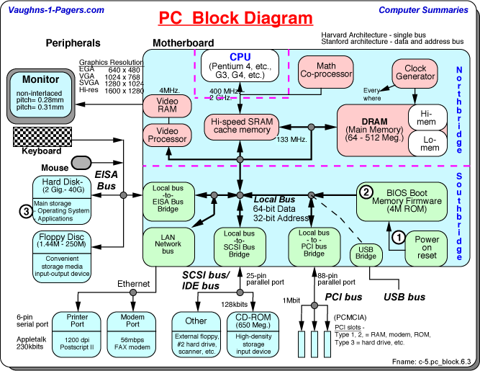
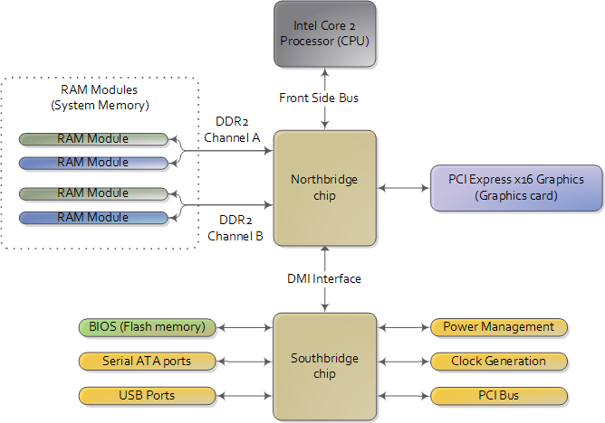
Systems Administration CSCI 6175.01 Fall 2016
System Hardware (HW) and Firmware
Figure 1 PC Block Diagram Figure 1A HW Intern.

Slide 5
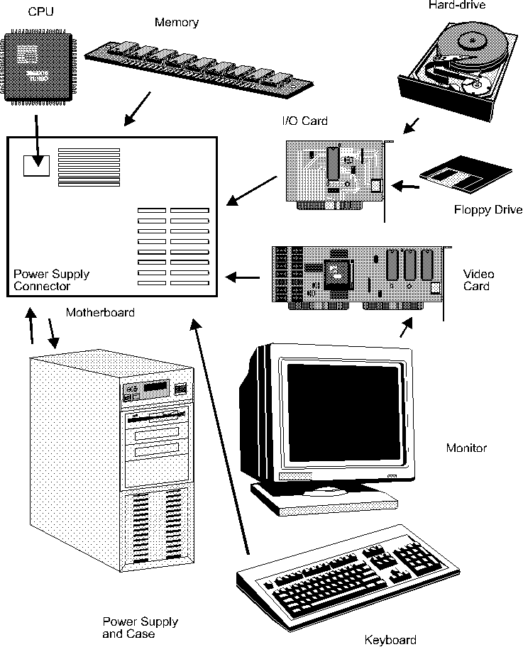
Systems Administration CSCI 6175.01 Fall 2016
System Hardware (HW)
Figure 2 Parts Breakdown
Computer hardware manufacturers
https://en.wikipedia.org/wiki/List_of_computer_hardware_manufacturers

Slide 6
Systems Administration CSCI 6175.01 Fall 2016
PC Firmware
Firmware is a software program or instructions programmed (embedded) onto a hardware device. On PC’s firmware is typically programmed into Read Only Memory (ROM). On modern PC’s firmware is programmed onto Flash ROM, which is re-writeable.
Other firmware is programmed onto disk drive controllers, network interface cards (NIC) and other device controllers and interfaces.
Basic Input/Output System (BIOS) is a type of ROM-based firmware used on PC’s to initialize and test hardware (POST) and startup the Operating System (OS).
Unified Extensible Firmware Interface (UEFI) and Extensible Firmware Interface (EFI) are enhanced BIOS’ used on modern PC’s.
BIOS settings are stored in Complementary Oxide Semiconductor (CMOS) RAM memory chips located on the PC motherboard.
A small coin-style battery is used to maintain the contents of CMOS when a PC is powered down.

Slide 7
Systems Administration CSCI 6175.01 Fall 2016
PC Firmware
Finding BIOS version and type:
boot/reboot system press pause/break key in BIOS splash screen to read version, type and date.
Windows: Click start type ‘System Information’ in search box, click System Information, observe BIOS version, type and date in System Information menu
Windows: click start, type ‘regedit’ in search box, click regedit, navigate to HKEY_LOCAL_MACHINE\HARDWARE\DESCRIPTION\System registry key, click system.
Linux: as root type ‘dmidecode’ in a Linux terminal window.
Linux: as root type ‘lshw’ in a terminal window.

Slide 8
Systems Administration CSCI 6175.01 Fall 2016
PC Firmware – Upgrading BIOS
Dell Optiplex 330:
Run the BIOS update utility from Windows environment 1. Double click the Icon on your desktop labeled O330-AXX.exe.The Dell BIOS Flash window appears 2. Click the Continue button. The message Pressing OK will close all applications, shut down Windows, Flash the BIOS, then reboot. appears. 3. Click the OK button. The system will restart and the BIOS Flash will be completed. Run the BIOS update utility from DOS environment (Non-Windows users) NOTE: You will need to provide a bootable DOS USB key. This executable file does not create the DOS system files. 1. Copy the file O330-AXX.exe to a bootable USB key. 2. Boot from the USB key to the DOS prompt. 3. Run the file by typing Y:\O330-AXX.exe (where y is the drive letter where the executable is located).
http://www.dell.com/support/home/us/en/04/product-support/product/optiplex-330/drivers

Slide 9
Systems Administration CSCI 6175.01 Fall 2016
PC Firmware – Upgrading BIOS
Dell Optiplex 360:
Run the BIOS update utility from Windows environment 1. Double click the Icon on your desktop labeled O360-AXX.exe.The Dell BIOS Flash window appears 2. Click the Continue button. The message Pressing OK will close all applications, shut down Windows, Flash the BIOS, then reboot. appears. 3. Click the OK button. The system will restart and the BIOS Flash will be completed. Run the BIOS update utility from DOS environment (Non-Windows users) NOTE: You will need to provide a bootable DOS USB key. This executable file does not create the DOS system files. 1. Copy the file O360-AXX.exe to a bootable USB key. 2. Boot from the USB key to the DOS prompt. 3. Run the file by typing Y:\O360-AXX.exe (where y is the drive letter where the executable is located).
http://www.dell.com/support/home/us/en/04/product-support/product/optiplex-360/research

Slide 10
Systems Administration CSCI 6175.01 Fall 2016
PC Firmware BIOS Setup
Launching the BIOS
Power off the computer.
Power on the computer.
Press F2 when the Dell logo appears and you see the F2 key option appear at the bottom of the screen.
About the Bios
Access the BIOS on a Dell computer to change low-level hardware settings such as:
The order the computer checks devices when it's booting.
The configuration of floppy drives, optical drives and hard drives.
The configuration of the sound, network, USB and cards you add to the computer.
Printer and serial port configuration.
The primary video device and the amount of memory allocated to the video card.
Whether to enable the computer to be woken up when it's powered off.
What to do when power is restored to a system that lost power.
Whether to halt during the boot process if the system encounters errors.
The power-on password for the computer.

Slide 11
Systems Administration CSCI 6175.01 Fall 2016
PC Firmware BIOS Setup Continued
Navigating the BIOS
The mouse does not work when you're editing the BIOS. Use the designated keys to navigate the screens and look at the bottom of each screen for a list of other function keys that are active on that screen:
Press the Left and right arrow keys to move between tabs.
Use the Up and Down arrow keys to move between options on a tab.
Press Enter to select an option for the feature you're editing.
Select Esc to take you back one screen or to exit the BIOS if on the main screen.
Choose F10 to save your changes and exits the BIOS editor.
Warning
Do not change BIOS options if you're unsure of the impact of the change on your computer. You can make a computer unable to boot or cause physical damage to the computer's hardware with some BIOS settings.

Slide 12
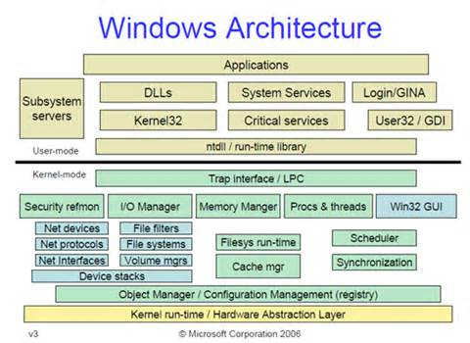
Systems Administration CSCI 6175.01 Fall 2016
System Software (SW)
The Windows Operating System (OS) is a graphical OS that manages computer hardware and software, provides services and allows execution of application programs. Windows is a multitasking, multiuser OS.
Figure 3 Windows Architecture Diagram

Slide 13
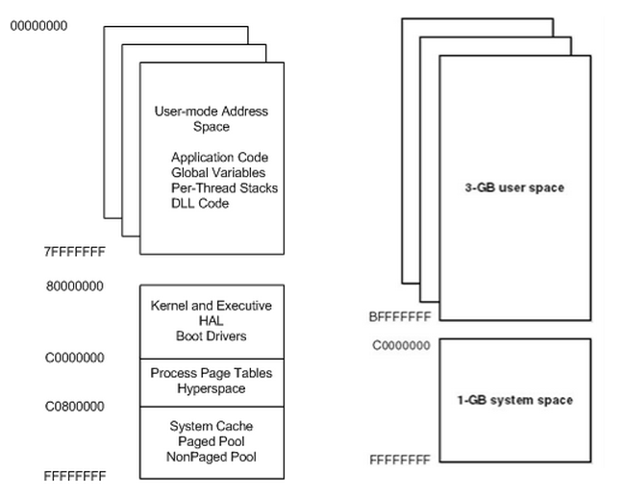
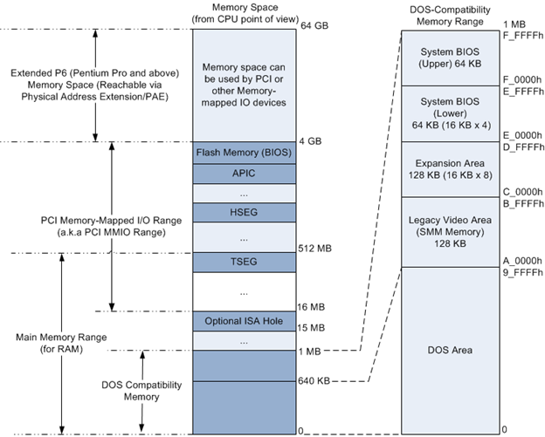
Systems Administration CSCI 6175.01 Fall 2016
System Software (SW)
On boot-up the Windows Operating System (OS) loads drivers, OS kernel and initialization routines, and systems applications into memory.
Figure 4A x86 Virtual Address Space Figure 4B x86 Physical Address Space

Slide 14
Systems Administration CSCI 6175.01 Fall 2016
System Software (SW)
Some Windows OS (and Linux) services are:
DNS – Domain Name Service resolves IP addresses to fully qualified domain names, and fully qualified domain names to IP addresses (reverse lookup).
DHCP – Dynamic Host Control Protocol, automatically assigns IP addresses to PC hosts.
HTTP – Hyper Text Transfer Protocol, is the structured language that is the basis for communication (web pages) on the World Wide Web (WWW)
SNMP – Simple Network Management Protocol, is an internet protocol for gathering information about managed devices, and for managing those devices.
SSH – Secure Shell, is an encrypted application for secure communications between networked hosts, it is the successor to ‘telnet’ which communicates in plain text.
RDP – Remote Desktop Protocol (Windows Proprietary), is a client/server Graphical User Interface – based application that allows a connection from one windows host to another over the network.
SMTP – Simple Mail Transfer Protocol, is a standard internet protocol for electronic mail transmission.
CMD – Windows CoMmanD shell (cmd.exe), is the Windows text-based command-line interface and is the successor to it’s DOS counterpart command.com, offering the similar capability and advanced functionality.
BASH – Bourne Again Shell, is a UNIX/Linux command-line interpreter, where users type commands in a text-based terminal window, that causes actions. Command Scripting is a capability of BASH.

Slide 15
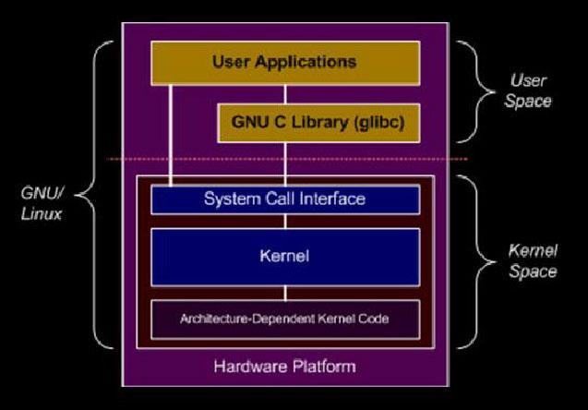
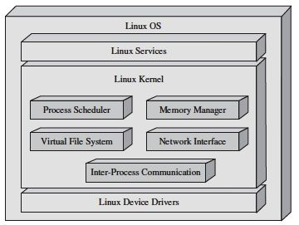
Systems Administration CSCI 6175.01 Fall 2016
System Software (SW)
Linux OS developed by Linus Torvalds in 1991 is a UNIX-like, open source, computer OS, that manages computer hardware and software.
The Linux Kernel is the primary component of the Linux OS. The Android OS is built from a modified Linux Kernel.
Figure 5A Linux Architecture Figure 5B Linux Architecture

Slide 16
Systems Administration CSCI 6175.01 Fall 2016
System Boot Process
The Windows boot process consists of several different phases:
System startup/restart
BIOS Initialization – POST performed to initialize HW.
OS Loader – winload.exe reads disk, starts kernel, loads registry hive, and primary drivers are loaded (BOOT_START drivers).
OS Initialization – a) kernel initializes its data structures, starts PnP manager, initializes primary drivers, b) session manager (smss.exe) initializes the registry, secondary drivers are loaded, subsystem processes started, c) duing winlogon (winlogon.exe) the user screen appears, service control manager (SCM) starts services, Group Policy Scripts run, d) explorer.exe starts, desktop window manager (DWM) process starts, desktop is initialized and displayed for the first time.
PostBoot – Desktop is available to the user, services, tray icons and applications are starting/running in the background.
ReadyBoot Prefetcher – quantity of data read from disk during boot is called I/O pressure, ReadyBoot pre-reads this data into memory prior to its usage, predicting what is needed on every reboot affecting boot performance.

Slide 17
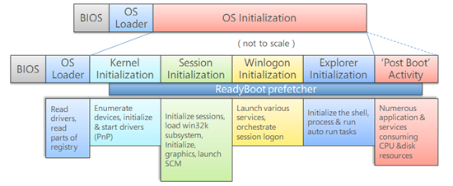
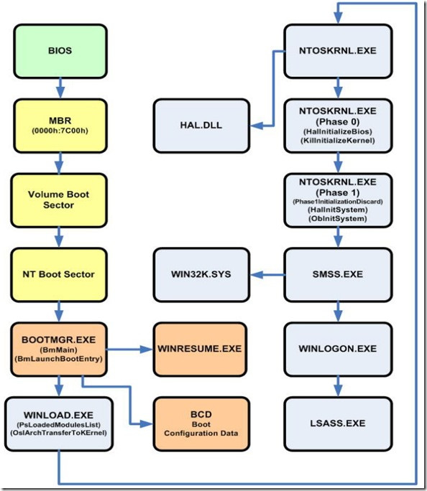
Systems Administration CSCI 6175.01 Fall 2016
System Boot Process
The Windows boot process diagram of the preceding page:
Figure 6A Windows Boot Diagram Figure 6B Windows Boot Flow

Slide 18
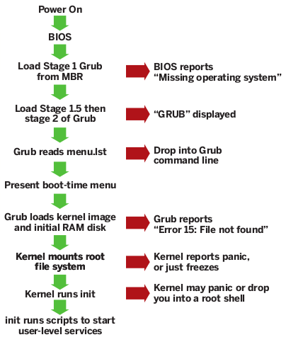
Systems Administration CSCI 6175.01 Fall 2016
System Boot Process
The Linux boot sequence consists various steps to bring the Linux OS into operating mode:
Figure 7 Linux Boot Flow
POST here
Desktop Starts, login screen available

Slide 19
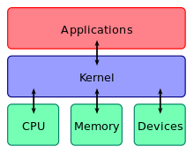
Systems Administration CSCI 6175.01 Fall 2016
OS Kernels
Operating Systems Kernel also known as the OS nucleus is the central core of the OS. It controls everything that occurs in a computer system. It manages memory, translates SW requests into CPU instructions and allows communication between users, applications and computer hardware.
Figure 8 Kernel Interconnectivity

Slide 20
Systems Administration CSCI 6175.01 Fall 2016
OS Kernels
Linux Kernel tools note – linux kernel modules have a ‘.ko’ extension:
- ls -R /lib/modules/$(uname -r) Command to list all modules available for a given linux system
- modinfo /path/to/module.ko Display module information
- insmod kernel-module-name Install a module to a running kernel. NOTE: this command does not resolve module dependencies
- modprobe kernel-module-name Install a module to a running kernel inlcuding dependencies
- depmod -a Rebuild module dependency database using /lib/modules/$(uname -r)/modules.dep
- insmod --force kernel-module-name Force insmod to load module even if its build for a defferent module version
- modprobe -n -v kernel-module-name Display insmod commands to load module and its dependencies. Useful when modprobe gives up due to dependency problem
- lsmod Display all modules currently loaded into a kernel
- rmmod kernel-module-name Command to remove a module from a running kernel
Windows Kernel Tools note – debuggers and the registry can access kernel:
Windbg – windows debugger
Regedit – view and edit the registry.

Slide 21
Systems Administration CSCI 6175.01 Fall 2016
Windows Registry
The Windows registry is a database of low level windows settings and registered applications, contained in registry keys and values.
The Predefined Registry root keys are:
HKEY_LOCAL_MACHINE or HKLM – settings specific to local machine.
HKEY_CURRENT_CONFIG or HKCC (only in Windows 9x and NT) – contains runtime information.
HKEY_CLASSES_ROOT or HKCR – contains information about registered applications.
HKEY_CURRENT_USER or HKCU – stores information related to ‘logged in’ users.
HKEY_USERS or HKU – contains actively loaded user profiles.
HKEY_PERFORMANCE_DATA (only in Windows NT, but invisible in the Windows Registry Editor) – contains performance data for the kernel, running systems drivers, programs and services.
HKEY_DYN_DATA (only in Windows 9x, and visible in the Windows Registry Editor) – this key contains HW, PnP and network performance statistics for Windows 95, 98 and ME.

Slide 22
Systems Administration CSCI 6175.01 Fall 2016
Windows Registry
Data types
Type# Name Desc
0 REG_NONE No type (the stored value, if any)
1 REG_SZ A string value, normally stored and exposed in UTF-16LE (when using the Unicode version of Win32 API functions), usually terminated by a NUL character
2 REG_EXPAND_SZ An "expandable" string value that can contain environment variables, normally stored and exposed in UTF-16LE, usually terminated by a NUL character
3 REG_BINARY Binary data (any arbitrary data)
4 REG_DWORD/REG_DWORD_LITTLE_ENDIAN A DWORD value, a 32-bit unsigned integer (numbers between 0 and 4,294,967,295 [232 – 1]) (little-endian)
5 REG_DWORD_BIG_ENDIAN A DWORD value, a 32-bit unsigned integer (numbers between 0 and 4,294,967,295 [232 – 1]) (big-endian)
6 REG_LINK A symbolic link (UNICODE) to another Registry key, specifying a root key and the path to the target key
7 REG_MULTI_SZ A multi-string value, which is an ordered list of non-empty strings, normally stored and exposed in UTF-16LE, each one terminated by a NUL character, the list being normally terminated by a second NUL character.
8 REG_RESOURCE_LIST A resource list (used by the Plug-n-Play hardware enumeration and configuration)
9 REG_FULL_RESOURCE_DESCRIPTOR A resource descriptor (used by the Plug-n-Play hardware enumeration and configuration)
10 REG_RESOURCE_REQUIREMENTS_LIST A resource requirements list (used by the Plug-n-Play hardware enumeration and configuration)
11 REG_QWORD/REG_QWORD_LITTLE_ENDIAN A QWORD value, a 64-bit integer (either big- or little-endian, or unspecified) (introduced in Windows XP)

Slide 23
Systems Administration CSCI 6175.01 Fall 2016
Windows Registry
Registry tools
Regedit – graphical registry editor
Windows group policy can change Registry keys for a number of machines or individual users based on policies.
Command-line (cmd window): reg command
- Query the DNS hive
reg query HKLM\SYSTEM\CurrentControlSet\Services\DNS
reg save HKLM\SYSTEM\CurrentControlSet\Services\DNS “DNSkey.hiv”
reg COMMAND /? ← displays help for command.
http://www.computerhope.com/reg.htm
Query system information 2-ways
reg query HKEY_LOCAL_MACHINE\HARDWARE\DESCRIPTION\System
regedit→click HKEY_LOCAL_MACHINE→click HARDWARE→click DESCRIPTION→click SYSTEM

Slide 24
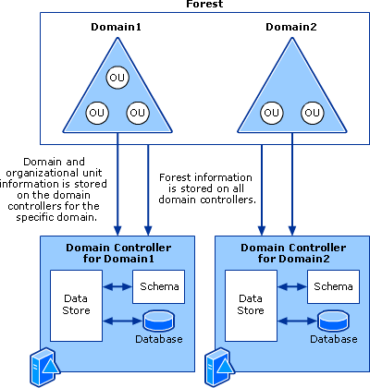
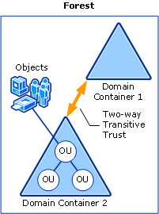
Systems Administration CSCI 6175.01 Fall 2016
Windows Systems Management
Microsoft Active Directory (AD) is a directory service for Windows Domain Networks that has a hierarchical structure consisting of Forest’s, tree’s, sites, domains and Organizational Units (OU’S) held together by schema, replication, trusts and a Global Catalog with rules implemented by group policy.
Forests – Complete AD instance containing domains, top level container.
Domains – Containers that contain OU’s and other containers.
Trees – collection of domains grouped together in Hierarchical structures.
OU’s – container object used to group other objects together.
Sites – container objects used to implement replication
Figure 10A Active Directory Architecture Diagram #1 Figure 10B Active Directory Architecture Diagram #2
https://technet.microsoft.com/en-us/library/cc759073(v=ws.10).aspx

Slide 25
Systems Administration CSCI 6175.01 Fall 2016
Linux Systems Management
Linux Systems Management is performed thru the Shell (BASH) and various automation mechanisms including scripts, text processing, and GUI Systems configuration tools.
Ubuntu – Landscape
http://www.ubuntu.com/management/landscape-features
SUSE – SUSE Manager (can manage SUSE Linux and RedHat Linux)
https://www.suse.com/products/suse-manager
RedHat – Spacewalk
http://spacewalk.redhat.com/
Linux Systems Management Commands
http://www.comptechdoc.org/os/linux/commands/linux_crsysman.html

Slide 26
Systems Administration CSCI 6175.01 Fall 2016
Linux Systems Management
Linux Systems Management BASH script example:
# Script to add a user to Linux system #
#!/bin/bash
if [ $(id -u) -eq 0 ]; then
read -p "Enter username : " username
read -s -p "Enter password : " password
egrep "^$username" /etc/passwd >/dev/null
if [ $? -eq 0 ]; then
echo "$username exists!"
exit 1
else
pass=$(perl -e 'print crypt($ARGV[0], "password")' $password)
useradd -m -p $pass $username
[ $? -eq 0 ] && echo "User has been added to system!" || echo "Failed to add a user!"
fi
else
echo "Only root may add a user to the system"
exit 2
fi

Slide 27
Systems Administration CSCI 6175.01 Fall 2016
Windows Control Keys
Windows system key combinations
F1: Help
CTRL+ESC: Open Start menu
ALT+TAB: Switch between open programs
ALT+F4: Quit program
SHIFT+DELETE: Delete item permanently
Windows Logo+L: Lock the computer (without using CTRL+ALT+DELETE)

Slide 28
Systems Administration CSCI 6175.01 Fall 2016
Windows Control Keys
Windows program key combinations
CTRL+C: Copy
CTRL+X: Cut
CTRL+V: Paste
CTRL+Z: Undo
CTRL+B: Bold
CTRL+U: Underline
CTRL+I: Italic
Mouse click/keyboard modifier combinations for shell objects
SHIFT+right click: Displays a shortcut menu containing alternative commands
SHIFT+double click: Runs the alternate default command (the second item on the menu)
ALT+double click: Displays properties
SHIFT+DELETE: Deletes an item immediately without placing it in the Recycle Bin

Slide 29
Systems Administration CSCI 6175.01 Fall 2016
Windows Control Keys
General keyboard-only commands
F1: Starts Windows Help
F10: Activates menu bar options
SHIFT+F10 Opens a shortcut menu for the selected item (this is the same as right-clicking an object
CTRL+ESC: Opens the Start menu (use the ARROW keys to select an item)
CTRL+ESC or ESC: Selects the Start button (press TAB to select the taskbar, or press SHIFT+F10 for a context menu)
CTRL+SHIFT+ESC: Opens Windows Task Manager
ALT+DOWN ARROW: Opens a drop-down list box
ALT+TAB: Switch to another running program (hold down the ALT key and then press the TAB key to view the task-switching window)
SHIFT: Press and hold down the SHIFT key while you insert a CD-ROM to bypass the automatic-run feature

Slide 30
Systems Administration CSCI 6175.01 Fall 2016
Windows Control Keys
General keyboard-only commands continued
ALT+SPACE: Displays the main window's System menu (from the System menu, you can restore, move, resize, minimize, maximize, or close the window)
ALT+- (ALT+hyphen): Displays the Multiple Document Interface (MDI) child window's System menu (from the MDI child window's System menu, you can restore, move, resize, minimize, maximize, or close the child window)
CTRL+TAB: Switch to the next child window of a Multiple Document Interface (MDI) program
ALT+underlined letter in menu: Opens the menu
ALT+F4: Closes the current window
CTRL+F4: Closes the current Multiple Document Interface (MDI) window
ALT+F6: Switch between multiple windows in the same program (for example, when the Notepad Find dialog box is displayed, ALT+F6 switches between the Find dialog box and the main Notepad window)

Slide 31
Systems Administration CSCI 6175.01 Fall 2016
Windows Control Keys
Shell objects and general folder/Windows Explorer shortcuts
For a selected object: F2: Rename object
F3: Find all files
CTRL+X: Cut
CTRL+C: Copy
CTRL+V: Paste
SHIFT+DELETE: Delete selection immediately, without moving the item to the Recycle Bin
ALT+ENTER: Open the properties for the selected object
To copy a file
Press and hold down the CTRL key while you drag the file to another folder.
To create a shortcut
Press and hold down CTRL+SHIFT while you drag a file to the desktop or a folder.

Slide 32
Systems Administration CSCI 6175.01 Fall 2016
Windows Control Keys
Windows Explorer tree control
Numeric Keypad *: Expands everything under the current selection
Numeric Keypad +: Expands the current selection
Numeric Keypad -: Collapses the current selection.
RIGHT ARROW: Expands the current selection if it is not expanded, otherwise goes to the first child
LEFT ARROW: Collapses the current selection if it is expanded, otherwise goes to the parent
Properties control
CTRL+TAB/CTRL+SHIFT+TAB: Move through the property tabs

Slide 33
Systems Administration CSCI 6175.01 Fall 2016
Windows Control Keys
Accessibility shortcuts
Press SHIFT five times: Toggles StickyKeys on and off
Press down and hold the right SHIFT key for eight seconds: Toggles FilterKeys on and off
Press down and hold the NUM LOCK key for five seconds: Toggles ToggleKeys on and off
Left ALT+left SHIFT+NUM LOCK: Toggles MouseKeys on and off
Left ALT+left SHIFT+PRINT SCREEN: Toggles high contrast on and off

Slide 34
Systems Administration CSCI 6175.01 Fall 2016
Windows Control Keys
Microsoft Natural Keyboard keys
Windows Logo: Start menu
Windows Logo+R: Run dialog box
Windows Logo+M: Minimize all
SHIFT+Windows Logo+M: Undo minimize all
Windows Logo+F1: Help
Windows Logo+E: Windows Explorer
Windows Logo+F: Find files or folders
Windows Logo+D: Minimizes all open windows and displays the desktop
CTRL+Windows Logo+F: Find computer
CTRL+Windows Logo+TAB: Moves focus from Start, to the Quick Launch toolbar, to the system tray (use RIGHT ARROW or LEFT ARROW to move focus to items on the Quick Launch toolbar and the system tray)
Windows Logo+TAB: Cycle through taskbar buttons
Windows Logo+Break: System Properties dialog box
Application key: Displays a shortcut menu for the selected item

Slide 35
Systems Administration CSCI 6175.01 Fall 2016
Windows Control Keys
Microsoft Natural Keyboard with IntelliType software installed
Windows Logo+L: Log off Windows
Windows Logo+P: Starts Print Manager
Windows Logo+C: Opens Control Panel
Windows Logo+V: Starts Clipboard
Windows Logo+K: Opens Keyboard Properties dialog box
Windows Logo+I: Opens Mouse Properties dialog box
Windows Logo+A: Starts Accessibility Options (if installed)
Windows Logo+SPACEBAR: Displays the list of Microsoft IntelliType shortcut keys
Windows Logo+S: Toggles CAPS LOCK on and off

Slide 36
Systems Administration CSCI 6175.01 Fall 2016
Windows Control Keys
Dialog box keyboard commands
TAB: Move to the next control in the dialog box
SHIFT+TAB: Move to the previous control in the dialog box
SPACEBAR: If the current control is a button, this clicks the button. If the current control is a check box, this toggles the check box. If the current control is an option, this selects the option.
ENTER: Equivalent to clicking the selected button (the button with the outline)
ESC: Equivalent to clicking the Cancel button
ALT+underlined letter in dialog box item: Move to the corresponding item

Slide 37
Systems Administration CSCI 6175.01 Fall 2016
Q&A

