Slide 1
Traditional Internet Applications
Dr. John P. Abraham
Professor
UTRGV

Slide 2
Application Layer Protocols
Two broad types of protocols for this layer:
  Private communication: programmer creates a pair of applications that communicate over the internet with intention it is for private use.
  Standardized service. Example is a server service. All types of users will use it. The specification must be precise and unambiguous so that all can interoperate correctly.

Slide 3
Application layer protocols
State In An Application Protocol
Big decision: should state information be kept?
Stateful protocol assumes previous requests have been honored
Stateless protocol assumes each request is independent
Example of stateful interaction
– Request 1 specifies “read from file X”
– Request 2 specifies “read next 128 bytes”
Example of stateless interaction
– Request 1 specifies “read bytes 0-127 from file X”
– Request 2 specifies “read bytes 128-255 from file X”

Slide 4
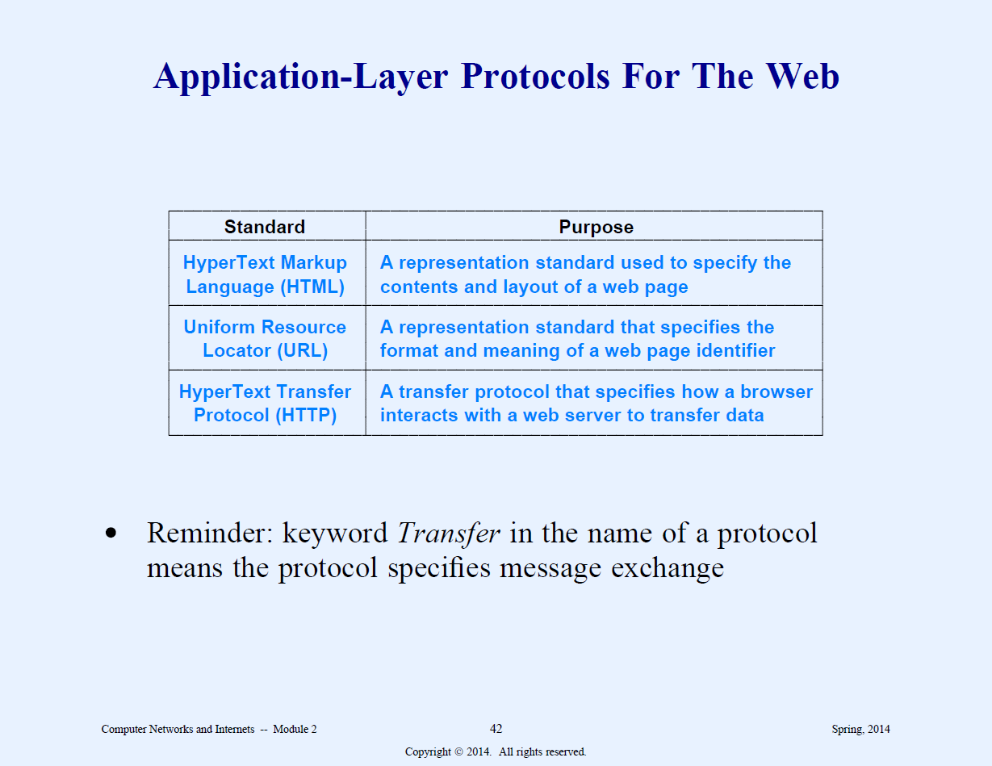

Slide 5
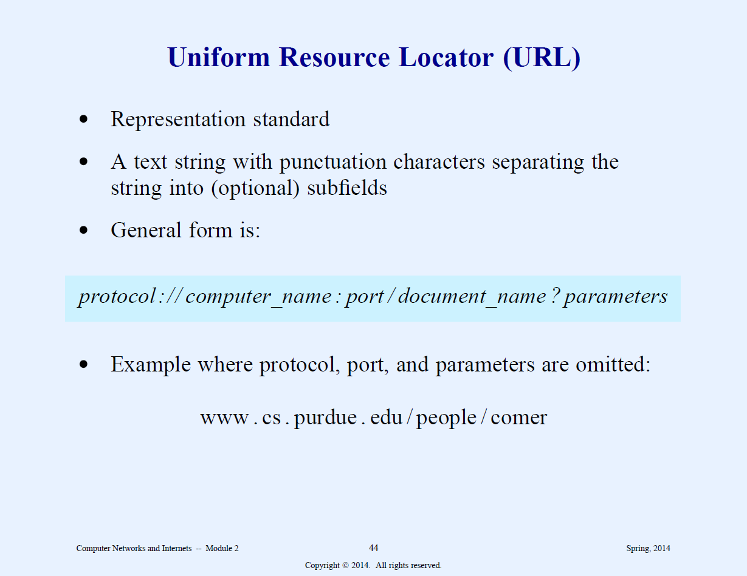

Slide 6
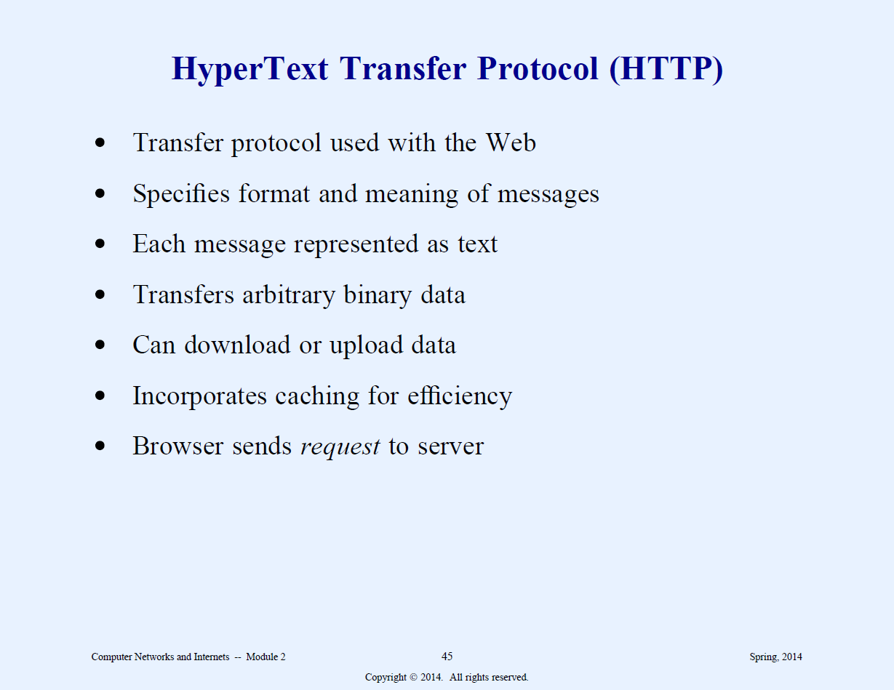

Slide 7
HTTP Requests
GET: requests a document. Server send status information and the document.
HEAD: Requests status information. Server sends just the status not the document.
POST: Sends data to the server. The server appends the data to a specified item.
PUT: Same as above, except, instead of appending it replaces previous data.

Slide 8
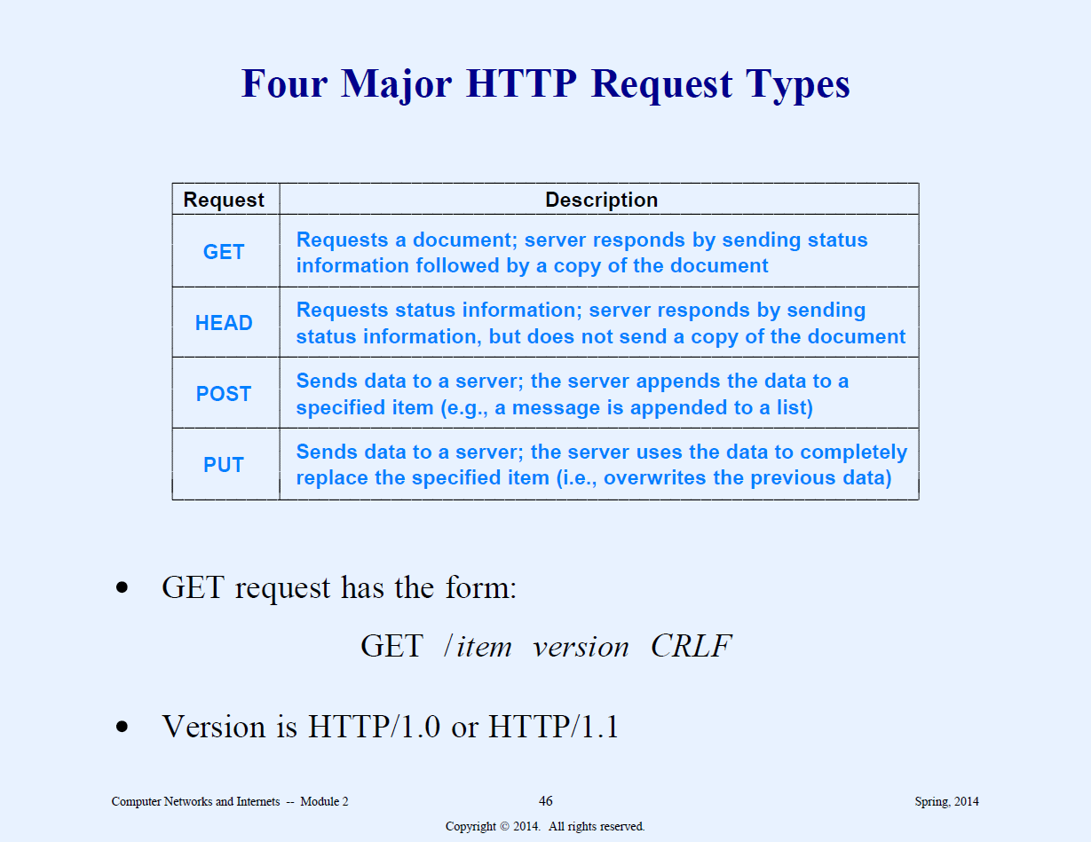

Slide 9
Response Header
Version of the HTTP protocol.
Status code (whether the server handled the request – code 200). Code 404 means item can’t be found, 400 means bad request.
Other information. Server identification. Last Modified. Content length and Content Type. All followed by CRLF.

Slide 10
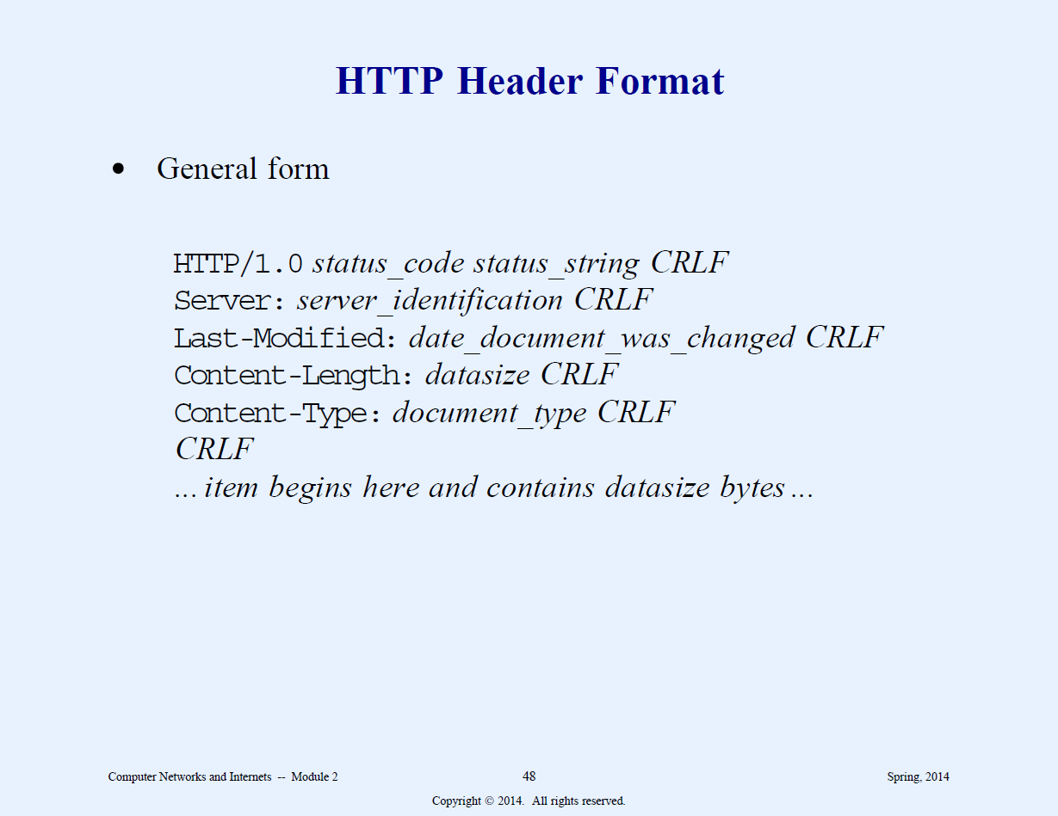

Slide 11
Caching In Browsers
Important optimization technique to reduce download times by saving a copy of each image in a cache on the user’s disk.
If the document changes the ‘Head request to server’ will sent last modified date and time which is compared with the cached copy. If the local copy is stale a new one is downloaded.

Slide 12
Email
Terms you need to familiar with
MIME
SMTP
POP
IMAP
Main components: User agents, message access agent, and transfer agents

Slide 13
Components of email
User agent: used to compose mail, read mail, store in local computer (if two users are on the same LAN, we only need two user agents). Eg. Eudora, Outlook, Netscape.
MTAs (message transfer agents) to transfer from local machine to a server, server to another server and so on. SMTP
Message Access agent – to retrieve from the local server to the local recipient computer. Pop and IMAP, MIME

Slide 14
Mime (multipurpose internet mail extenstion)
Allows non-ASCII characters. Used for all languages, video, and audio.

Slide 15
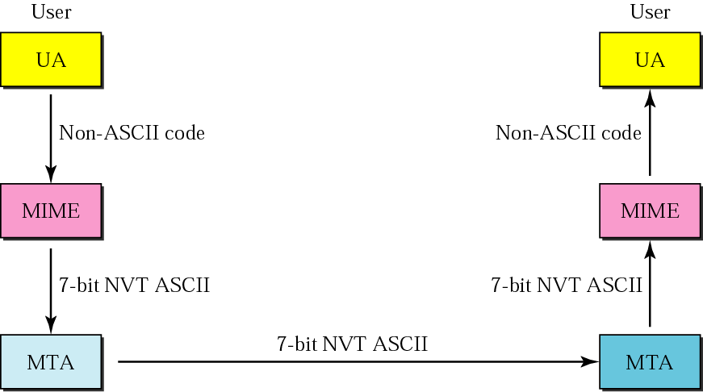
Figure 20.9 MIME

Slide 16
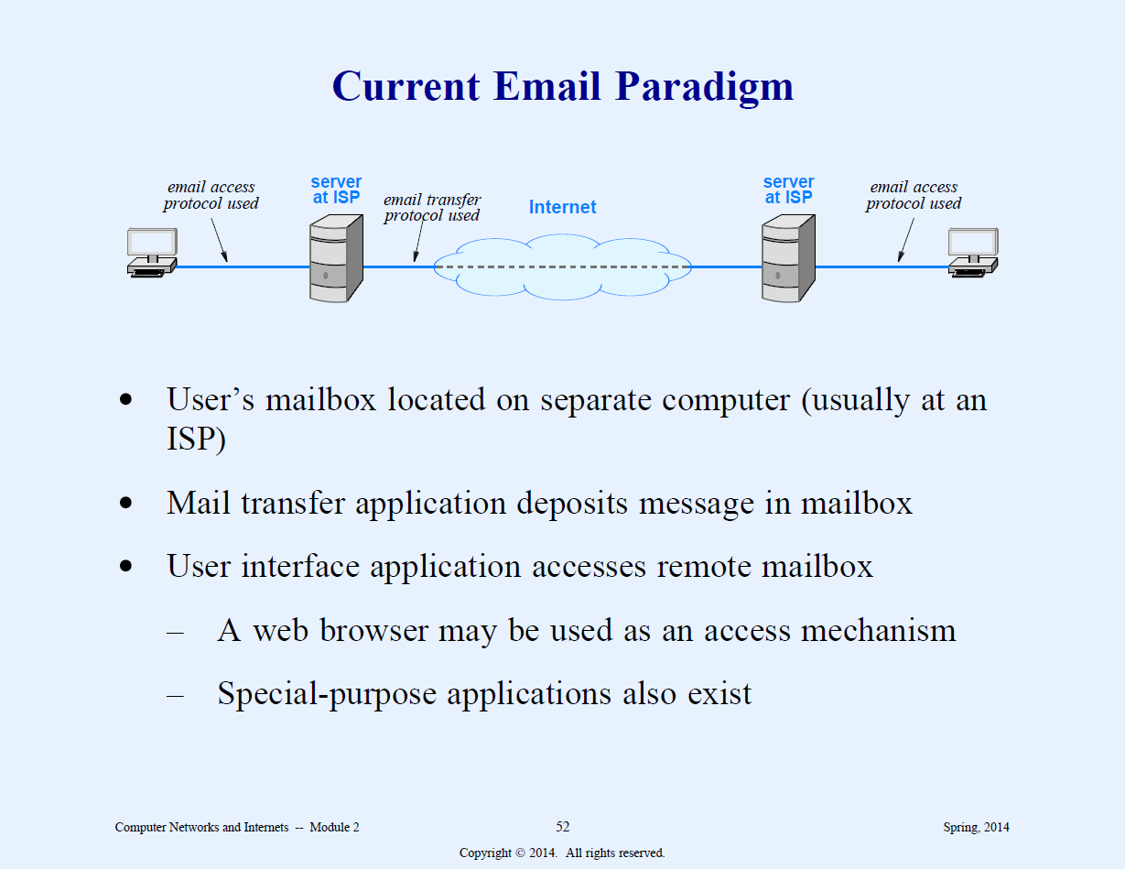

Slide 17
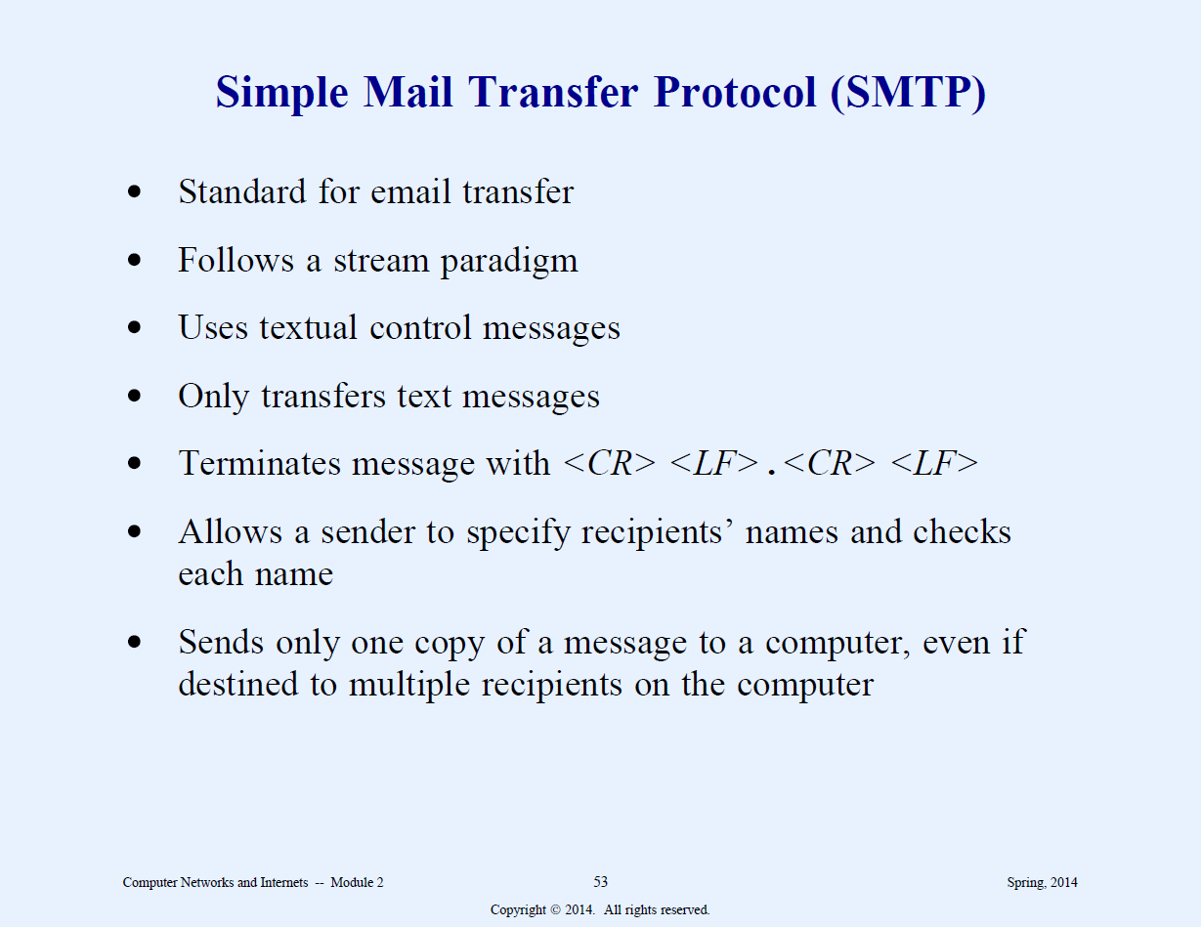

Slide 18
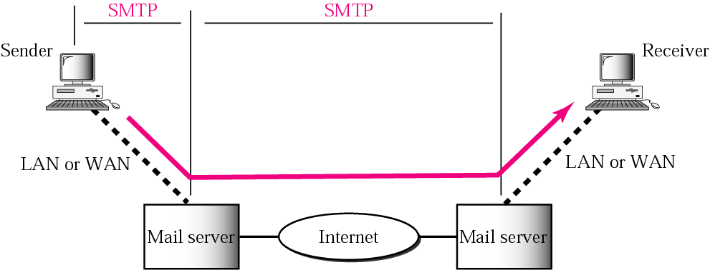
Figure 20.13 SMTP range

Slide 19
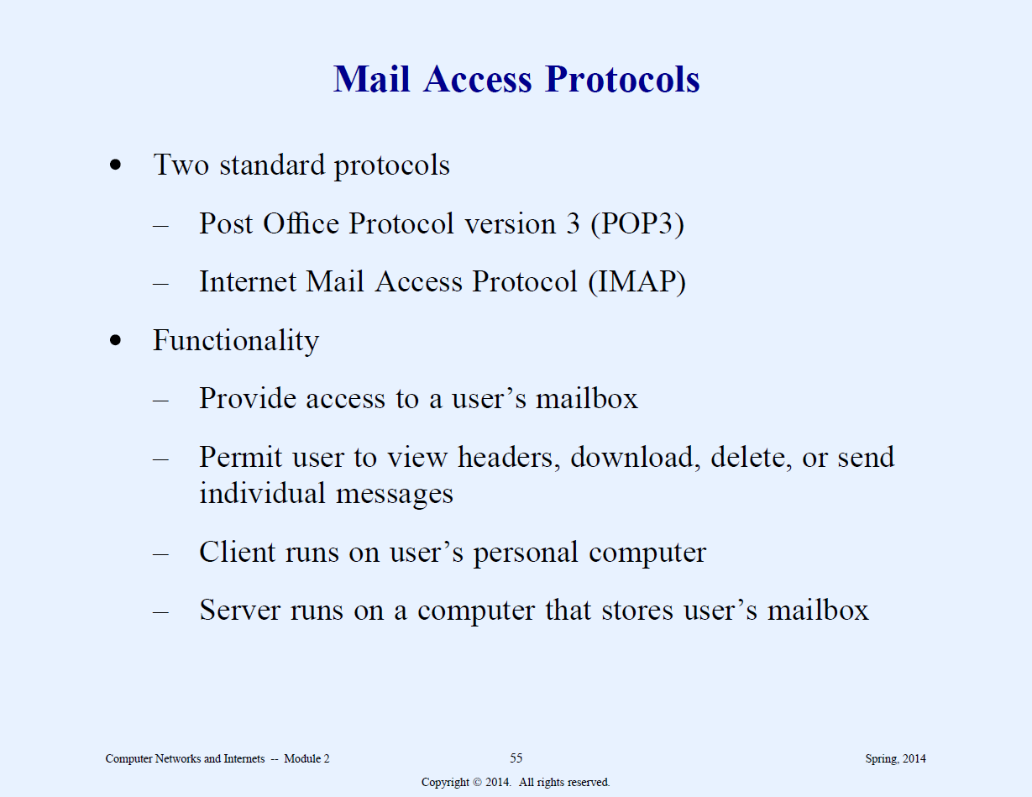

Slide 20
POP3 and IMAP4
Message access protocols. (pull)
Post Office protocol. Simple with limited functionality. Uses port 110. Has two modes: delete or keep.
Internet Mail Access Protocol is used to check mail directly from the web.

Slide 21
FTP
Can transfer any type of data
Bidirectional transfer
Supports access restrictions
Ability to browse folders
Control messages are exchanged in ASCII
Supports heterogeneity

Slide 22
FTP connections
Two connections
  Control
  Data
  Use different port numbers: Server uses port 21 and waits for the client (Passive open). Client uses ephemeral port and issues an active open. The server then issues an active open (client takes and active role by sending a TCP message to start the connection – SYN) using port 20 and the received port from the client and data transfer begins.
  Transmission modes: stream, block and compressed.

Slide 23
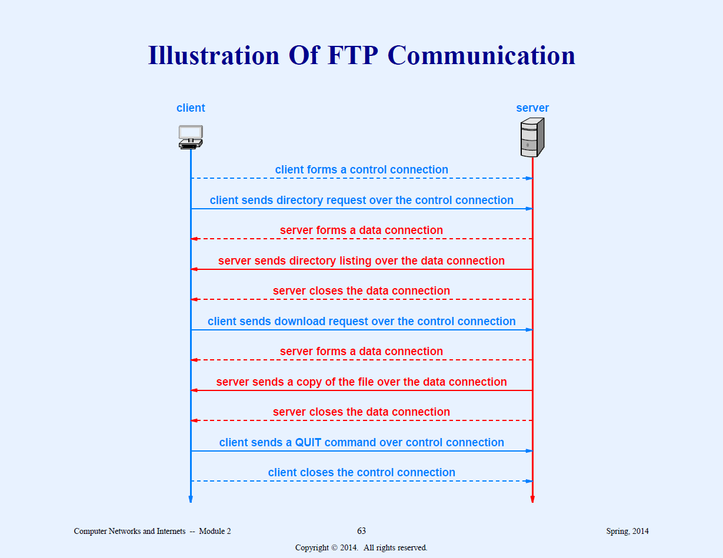

Slide 24
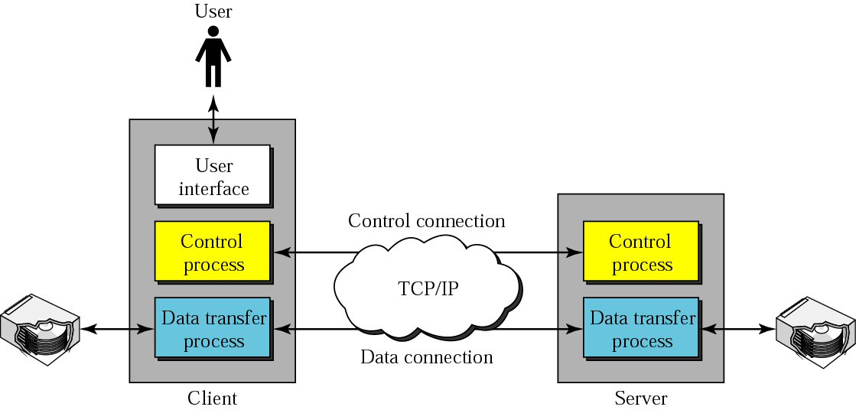
Figure 19.1 FTP
The following two slides are very important. Please know the contents.

Slide 25
FTP Active Passive Opens
FTP can be run in active or passive mode, which determine how the data connection is established. In active mode, the client sends the server the IP address and port number on which the client will listen, and the server initiates the TCP connection. In situations where the client is behind a firewall and unable to accept incoming TCP connections, passive mode may be used. In this mode the client sends a PASV command to the server and receives an IP address and port number in return. The client uses these to open the data connection to the server.

Slide 26
FTP active passive contd.
A client makes a TCP connection to the server's port 21. This connection, called the control connection, remains open for the duration of the session, with a second connection, called the data connection, either opened by the server from its port 20 to a negotiated client port (active mode) or opened by the client from an arbitrary port to a negotiated server port (passive mode) as required to transfer file data. The control connection is used for session administration (i.e., commands, identification, passwords) exchanged between the client and server using a telnet-like protocol. Due to this two-port structure, FTP is considered an out-of-band, as opposed to an in-band protocol such as HTTP.

Slide 27
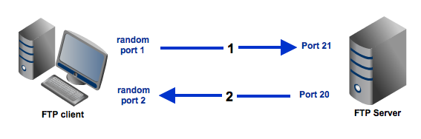
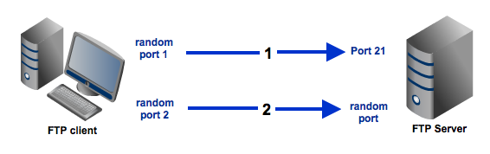
Active vs. Passive Open
Active
Passive

Slide 28
DNS (Domain Name Server)
Maps human readable symbolic names to computer addresses
Domain names are hierarchical with most significant part of the name on the right. Root is a dot.
Software that performs the address resolution is known as the resolver. The resolver holds one or more DNS addresses.
The Domain Name System distributes the responsibility of assigning domain names and mapping those names to IP addresses by designating authoritative name server for each domain.

Slide 29
Authoritative Name Server
gives original, first-hand, definitive answers (authoritative answers) to DNS queries and not just cached answers that were obtained from another name server. Therefore it only returns answers to queries about domain names that are installed in its configuration system.
An authoritative name server can either be a master server or a slave server. A master server is a server that stores the original (master) copies of all zone records. A slave server uses an automatic updating mechanism of the DNS protocol in communication with its master to maintain an identical copy of the master records.

Slide 30
How DNS works
When you type a domain into your browser (or "client") the client needs to find the IP address where this site is located. The first place it will check is the operating system (hosts file). The operating system routes the search (or "query") to the Resolving Name Server.
The resolving name server serves two purposes: 1. To direct queries out to the root, TLD (top level domain), and authoritative name servers, and 2. To cache DNS information once it is located.

Slide 31
Types of DNS entries
Each DNS entry consists of three items: a domain name, a record type and a value.
The record type: IP address ( A type, to be used with FTP, ping, browser etc), MX (for mail exchanger), NS (main machine incharge of the domain zone), etc.

Slide 32
NS Record
NS Record
A Name Server Record, or NS Record, indicates which name servers are authoritative for the zone. This will either be set to a default by the DNS provider for the domain or be customized to use Vanity NS. NS Records can also be used to assign authoritative name servers for a subdomain.
Vanity nameservers, sometimes called custom nameservers, are a way to assign your own vanity names to our nameservers. This offers several potential benefits:

Slide 33
A Record
An A record maps a domain name to an IP address. This is the most basic function of DNS. There are three values that must be specified for an A record:
Name - The domain name. For example, dnsuniversity.com is the name of an A record. It is also the host of the domain
TTL - The time of live, or amount of time, in seconds, the record will be stored in the cache of a resolving name server. For example, 1800 is a standard TTL.
IP - Indicates the IP which this domain is mapped to. For example, 192.168.1.2.
Some DNS providers allow multiple IPs per host for routing, which is called Round Robin.
A records are used for IPv4 addresses. IPv6 addresses use AAAA Records.

Slide 34
MX Record
Mail Exchange Records, or MX Records, tell mail servers where to deliver mail. Tee name field of an MX record contains the host name which appears in the email address, and the data field contains the host name of the server to which the mail should be delivered. For example:
Name - dnsuniversity.com
This means that mail sent to user@dnsuniversity.com is directed to the mail exchangers defined by these records.
MX Level - 10
This sets the preference for the MX record. The lower the number, the higher the preference. If the mail server with the highest preference is inaccessible, the mail will be delivered to the mail server next in preference.

Slide 35
DNS autonomy
Each organization is allowed to assign names to computers or change those names without informing a central authority.
Each organization is permitted to operate DNS servers for its parts of the hierarchy.
A given DNS can be replicated.

Slide 36
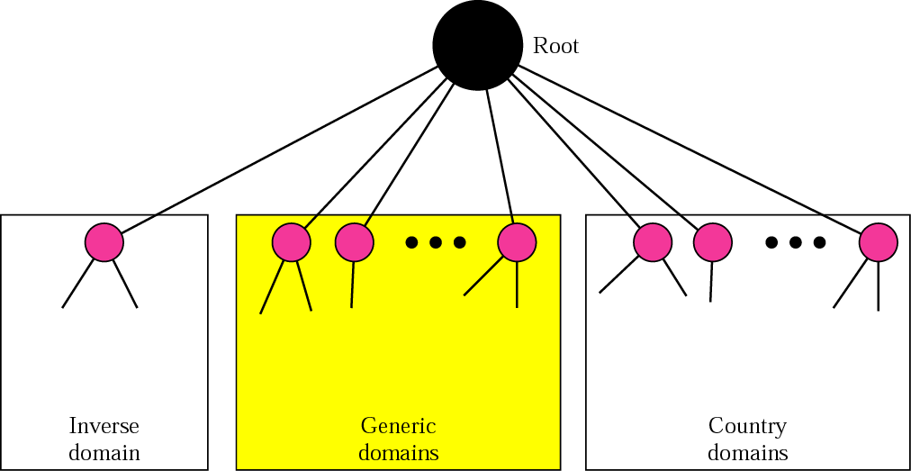
Figure 17.7 DNS used in the Internet

Slide 37
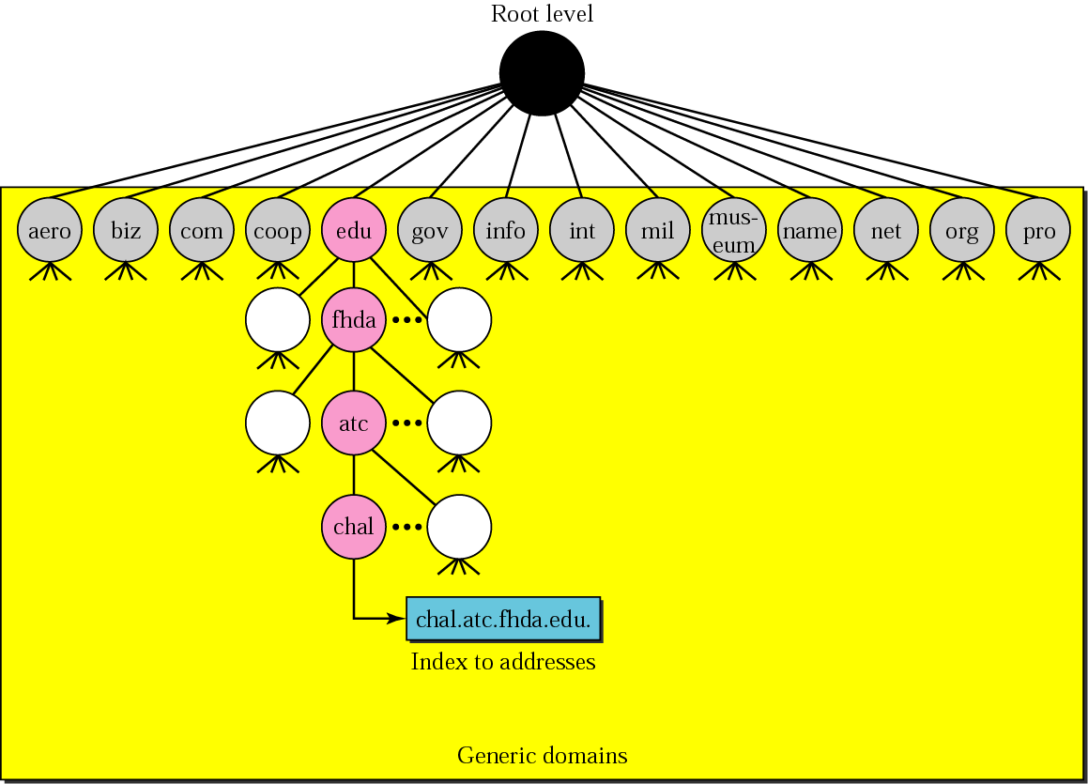
Figure 17.8 Generic domains

Slide 38
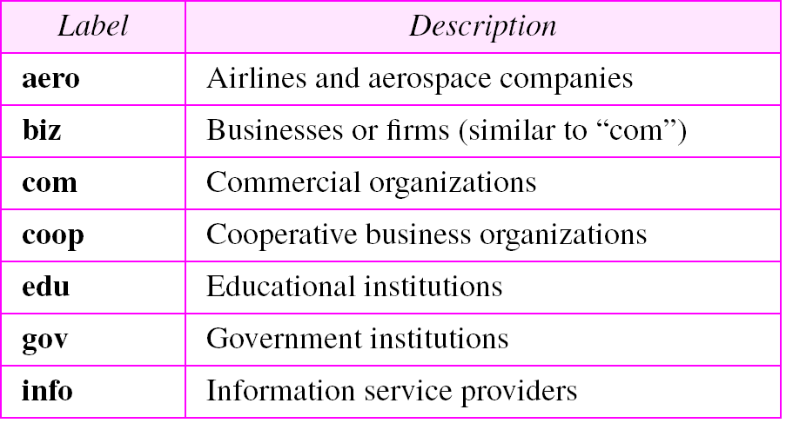
Table 17.1 Generic domain labels

Slide 39
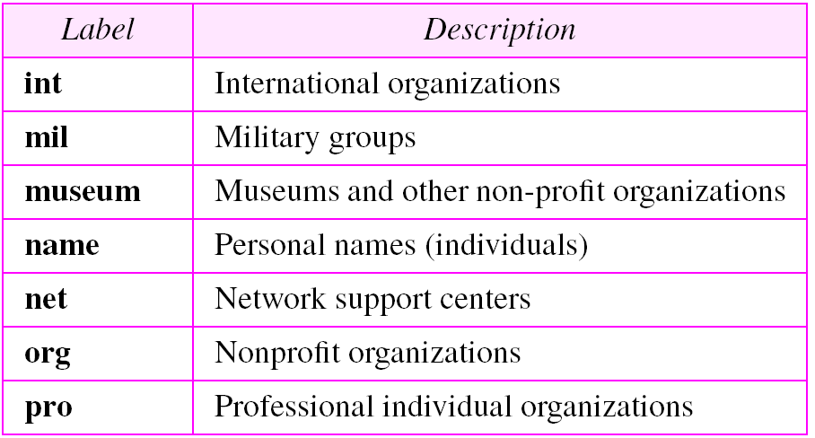
Table 17.1 Generic domain labels (Continued)

Slide 40
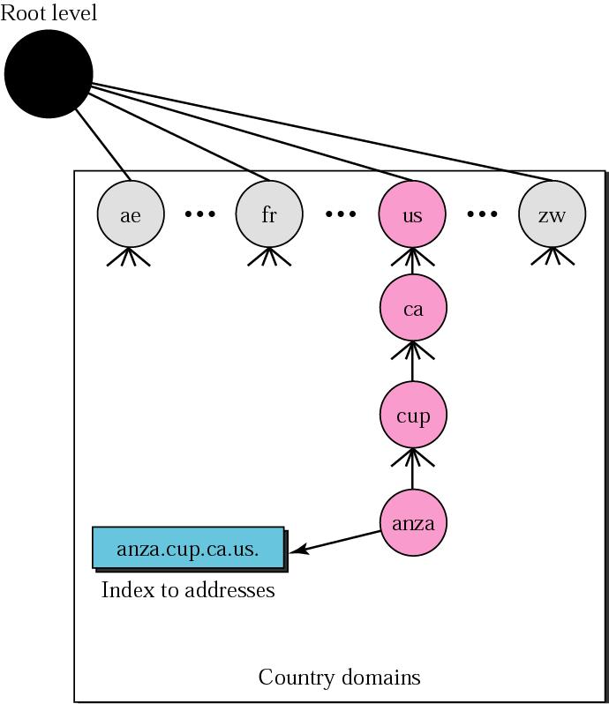
Figure 17.9 Country domains

Slide 41
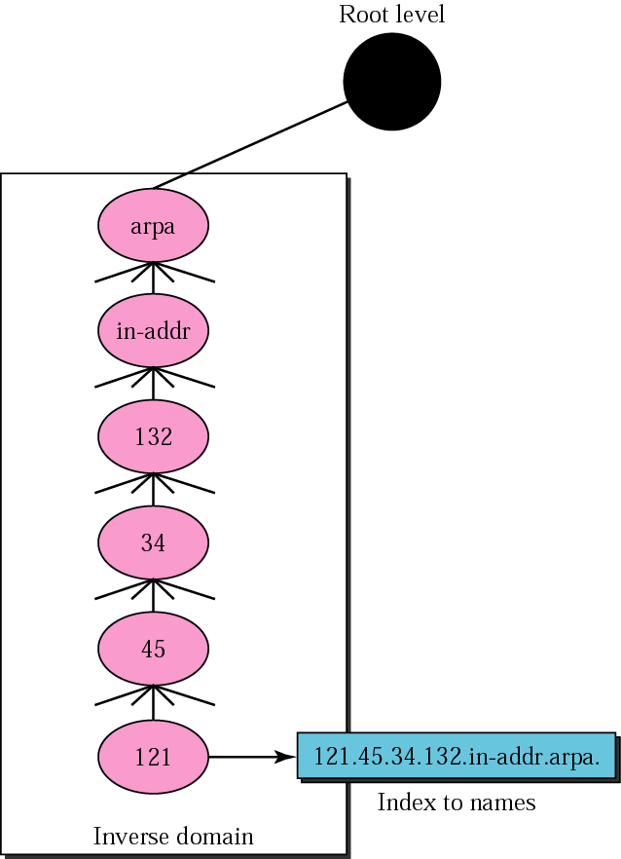
Figure 17.10 Inverse domain

Slide 42
17.5 RESOLUTION
Mapping a name to an address or an address to a name is called name-address resolution.
The topics discussed in this section include:
Resolver
Mapping Names to Addresses
Mapping Addresses to Names
Recursive Resolution
Iterative Resolution
Caching

Slide 43
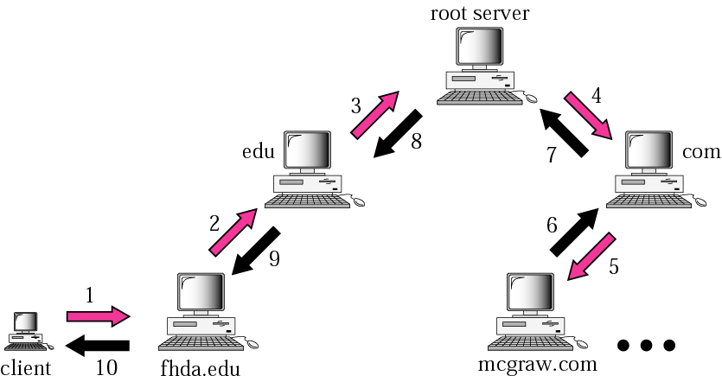
Figure 17.11 Recursive resolution

Slide 44
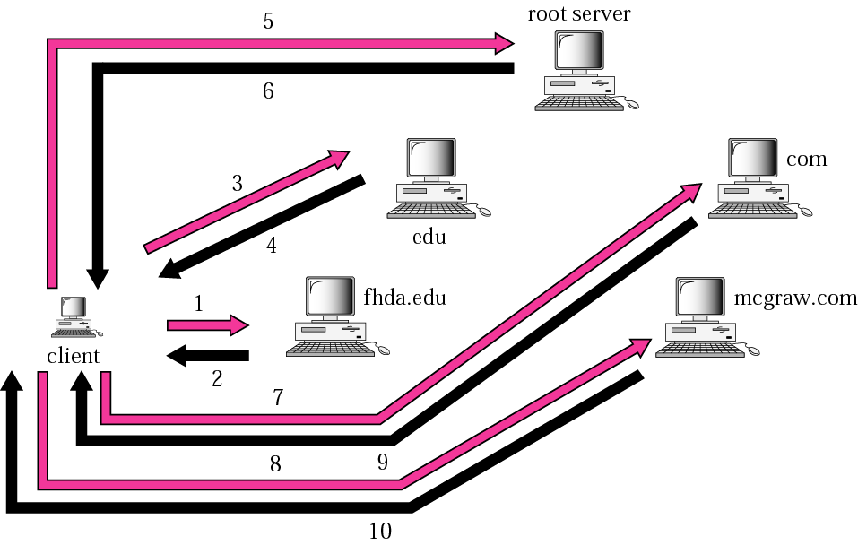
Figure 17.12 Iterative resolution

Slide 45
DNS Caching
To exploit temporal locality (repeated requests) DNS server caches all lookups. Cache timeouts cleans the items.

