Slide 1
12-Access and Interconnection Technologies
Dr. John P. Abraham
Professor
UTPA

Slide 2
Internet Access Technology
Asymmetric pattern
  A typical user - receives more data than sends.
  A company hosting a web server – sends more data than receives.
  Downstream – receiving
  Upstream – sending

Slide 3
Narrowband and Broadband Access Technologies
Narrow <= 128Kbps ISDN or POTS giving 64Kbps
  Dialup telephone lines
  Leased circuit using modems
  Fractional t1 datalines
  ISDN and other telco data services
Broadband >1Mbps
  DSL, Cable modem
  Wireless access technologies
  T1 or higher

Slide 4
The local loop and ISDN
POTS is designed for 4KHz of bandwidth.
A subscriber closer to the telco central office can get >1MHz, this portion is called the local loop.
ISDN integrated services digital network- offers three separate digital channels, 2B and D. The B channels operate at 64Kbps each. D channel at 16Kbps, is a control channel. When first introduced it was big deal.

Slide 5
Digital Subscriber Line (DSL)
High speed data communication over a local loop.
  ADSL asymmetric DSL – home use 1.5
  ADSL2 about 3 times faster
  SDSL – symmetric for business that export data
  HDSL – High bitrate DSL
  VDSL – Very high bit rate DSL up to 52-Mbps
  Uses FDM, so voice and data can be sent simultaneously.

Slide 6
Local Loop characteristics and adaptation
Different customers receive different speeds depending on distance for central office.
ADSL is adaptive using Discrete Multi Tone modulation (a combination of FDM and inverse multiplexing). The home modem and telco office DSL modems probe each other and agree on techniques that are optimal.
  FDM is implemented by dividing the bandwidth into 286 separate frequencies: 255 are allocated for downstream, 31 for upstream (two of which are used for control)

Slide 7
Data Rate of ADSL
ADSL can achieve downstream rate of 8.448 Mbps and upstream of 640-64 Kbps (64 is used for control)
ADSL2 can download up to 20Mbps
Telco’s do not guarantee a data rate.

Slide 8
ADSL installation and splitters
Telephone operation (lifting handset, hanging up, dialing, etc) can create interference to dsl. Therefore, uses an FDM device known as a splitter that divides the bandwidth by passing low frequencies to one output and high frequencies to another. This can be installed at the entrance of telephone line, or for each device attached.
Twisted pair wiring is susceptible to interference and substantially degrade performance.

Slide 9
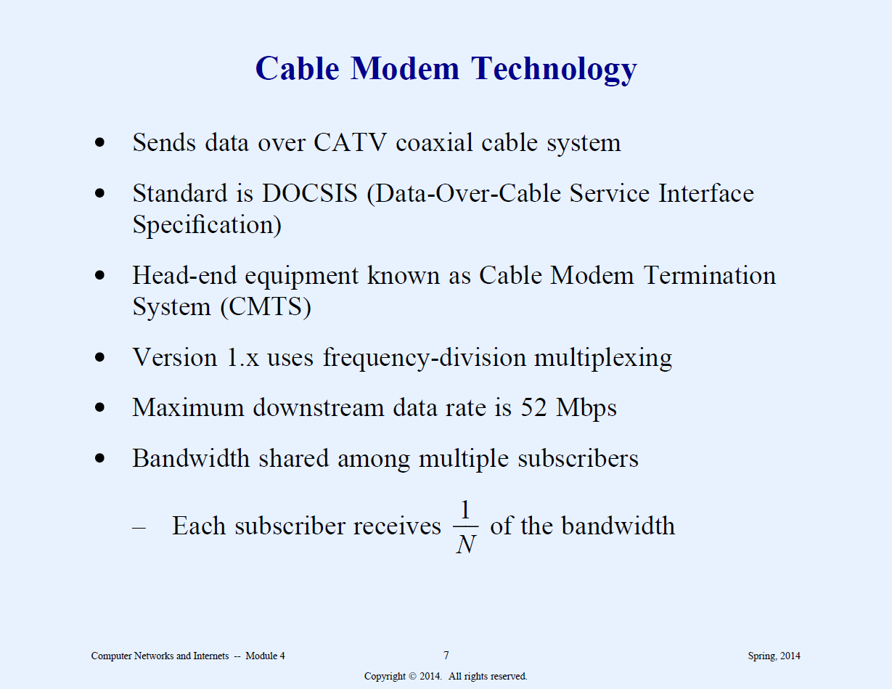

Slide 10
Cable Modem Technologies
Usually provided by cable television companies.
Coaxial cable is less prone to interference.
Uses FDM and statistical multiplexing, different channels are assigned for groups of users. Each subscriber is assigned a unique address, a subscriber modem listens to assigned frequency and the address.

Slide 11
The data rate of cable modems
In theory it can support up to 52Mbps downstream and 512 Kbps upstream. However, since the bandwidth is shared by many subscribers yielding 1/N speed, if everyone uses the line simultaneously. Since users access internet at different times, the data rate varies.

Slide 12

Hybrid Fiber Coax
Uses a combination of optical fibers and coaxial cables.
    Fiber used for the central facilities
    Coax is used for connections to subscribers.
    Trunk is used for connection from central facilities to neighborhood box. A trunk can be 15 miles long.
  Other terminologies:
  FTTC fiber to the curb
  FTTB fiber to the building
  FTTH fiber to home
  FTTP fiber to the premises
  Head-End modem – modem used at central office (Cable Modem Termination system- CMTS)
  Tail-End modem – modem used at subscriber location

Slide 13
T1
Dates back to 1957
1.5Mbit/s
Carries 24 voice or data channels
May also obtain fractional T1 starting with 56 kbits/s

Slide 14
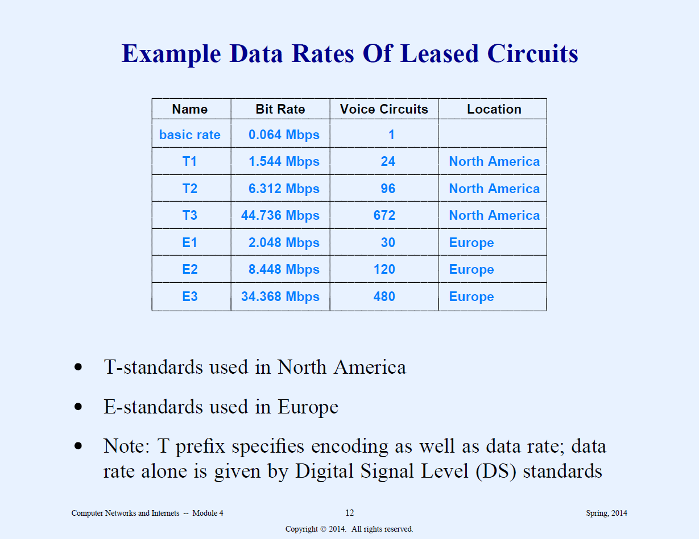

Slide 15
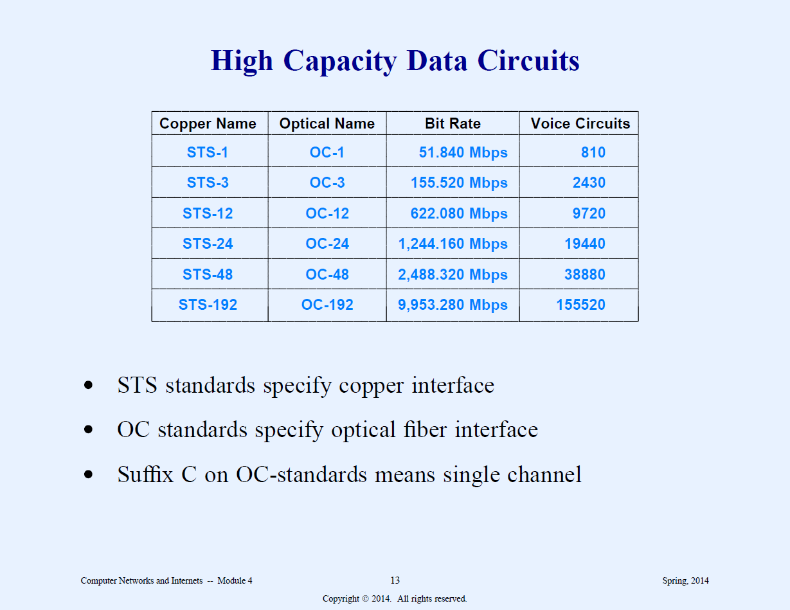

Slide 16
Circuit termination, DSU/CSU and NIU
Data Service Unit/Channel Service Unit (DSU/CSU) – a device with two functional parts.
CSU handles line termination and diagnostics (eg. did the party hang up?). Also prevents continous 1’s being transmitted increasing voltage on the line.
DSU handles formatting required for data between the user’s side and carrier’s side.
Network Interface Unit (NIU) – forms a boundary between equipment owned by the telephone company and the subscriber (demarc).

Slide 17
T3
Also known as DS3
45 Mbits/s
Carries 28 T1
In Japan it is called J1/J3 instead of T1/T3
In Europe they are E, with 32 channels (64 kbit/s each)

Slide 18
SONET
Synchronous Optical Networking
Standard multiplexing protocols used to carry high datarate digital bit streams over fiber (LED)

Slide 19
Fiber to Home (FTTH)
Speed varies up to 100 Mbits/sec

Slide 20
Power-line Internet
BPL (broadband over Power)
Speed to 2.7 Mbits/s

Slide 21
ATM and Frame Relay
Asynchronous Transfer mode
Frame Relay
Both are wide-area networking standards

Slide 22
Wireless Access
3g services – third generation cellular services for data.
WIMAX – wireless technology up to 155 Mbps using radio
Satellite – various commercial vendors offer service.

