Slide 1
Computer Networking Course
2023
Computer Networks
Dr. John P. Abraham, Professor

Slide 2
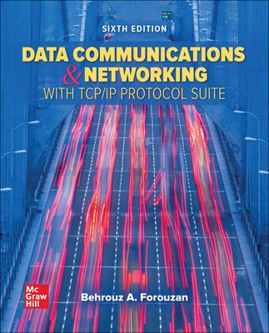
Textbook
Required Textbook: Forouzan, Behrouz, Data Communications & Networking with TCP/IP protocol Suite, 6th Edition, McGraw Hill 2022.
ISBN10: 0078022096, ISBN13: 9780078022098

Slide 3
What is covered in the course
Lecture Portion
  Network Applications & Network programming
  Data communications (low level details)
  Packet switching and network technologies
  Internetworking with TCP/IP
  Other concepts such as interoperability standards, protocol suites and layering models
Practical portion
  Virtual Machine networking
  Some additional latest topics

Slide 4
Socket programming
  All underlying network applications such as email, ftp, web, etc. use underlying technologies and programs
  The goal of this course is not to teach you programming. Students should write three socket programs in a language of their choice

Slide 5
Data Communication
Technologies used to send data across communication lines
  Modulation
  Digital to analog
  Light
  Multiplexing
  Encryption

Slide 6
Website used
All assignments and study questions will be posted at
http://faculty.utpa.edu/jabraham/schcurrent.htm
Also check the Blackboard

Slide 7
Multiple choice questions
I will post multiple choice questions for each chapter. Please check your answers with the key I will post.
Many of the exam questions will be taken from these quizzes. If you do not do them, more than likely you fail the exams.

Slide 8
Attendance
Attendance and class participation is required to pass the course. If you must miss an exam, make prior arrangements. No make-up exams will be given unless you contact me in advance!
Late homework will be levied heavy penalties. Penalty:
  Fall: One day late 10%, 1 week late 20%, 2 weeks late 50%. Not accepted afterwards.
  Summer: 1 day late 10%, 2 days late 20%, 1 week late 50%, not accepted after 1 week.

Slide 9
Grading
Midterm and Final Exams 60%
Practical portion (labs), programming 35%
Attendance 5%

Slide 10
Practical portion (lab)
  Virtual Machine
  Share files - SAMBA
  Peer to Peer
  Ethical Hacking
  Socket Programming
  RDP
  Domain
  Netadmin (Tools)
  Join the domain
  Create Security groups
  Grant local Admin rights
  Packet analyzer Cisco Academy
  WSUS
  Backup
  IIS
  Current topics

Slide 11
INTRO TO VIRTUAL MACHINES

Slide 12
Single machine, single OS
Each OS is bound to the underlying hardware
Each application program is bound to the OS
If the hardware fails in order to restore the backup, same hardware and OS are needed.

Slide 13
Single machine, single OS
Only one OS may run at a time. If more than one OS is installed, you will need to choose the OS at boot up.
CPU use of a stand-alone server or computer is only about 10%
90% of the time it is idle. Implied waste of money is 90% of investment plus manpower needed to keep up the hardware and software.

Slide 14
Virtual Machine
Each virtual machine is treated as a process and a file
So virtual memory table can be modified to include a VM number and virtual page number.
Each virtual machine can now have a virtual page 0.
CPU gives a time slice to each virtual machine
Virtual machines take away dependence on the hardware. Virtual drivers are generic drivers that can be used by any operating system or version

Slide 15
Virtual Machine
Creates pools
  CPU pool
  Memory Pool
  Storage Pool
  Interconnection Pool
Hypervisor manages allocation of these pools to Virtual Machines

Slide 16
Virtual machine lifecycle
Create, Suspend, Resume, Save, migrate, and destroy
Each VM can have an OS and a VM Monitor (hypervisor).
Virtual Infrastructure Managers (VIM) are used to manage, deploy and monitor Virtual Machines.

Slide 17
Two approaches to virtualization
"hosted" (paravirtualization) and "bare-metal“ (full virtualization).
Hosted virtualization software runs as an application or "guest" on top of a general-purpose operating system. Host treats each Virtual OS as a process. Guest works as if it is on an actual hardware.
Bare-metal virtualization interfaces directly with computer hardware, without the need for a host operating system. Even BIOS is virtualized (emulated).

Slide 18
Virtual Machine Software functions
Partitioning – Multiple VM on a single hardware pool
Isolation - Each VM is isolated from others
Encapsulation – VM encapsulates hardware, OS and application
Hardware independence – RUN VM on any machine without modification

Slide 19
VM software
Vmware
VirtualBox
Microsoft HyperV for windows 10 Pro
Citrix XenServer Hypervisor
Xen – open source
Others: 5G core Labs, Azure Virtual Machine
Some are free, others have paid and free releases.

Slide 20
Core Mechanism behind a VM software
None of the high level languages can use the hardware directly.
HL programs need to be compiled. Compiler creates Machine executable Code
High level languages such as Python, JAVA, and Ruby have their own Virtual Machines
For VMs, create bytecodes. Bytecodes can be compiled (runtime) to machine codes.

Slide 21
Advantages of VM
Host machine is not affected by misbehaving software.
VMs can be networked – thus, we use this feature for this networking class
Can access Internet
Some older software requiring specific older hardware software configurations can be virtualized. For example a software that runs on windows 98 or XP.

Slide 22
More information on actual building of VM
If you are interested in finding out more about internal workings of VM, look at my ppt in my graduate class or the following presentations.
University of San Francisco, Terence Parr
  https://www.youtube.com/watch?v=OjaAToVkoTw
  https://www.youtube.com/watch?v=DelO8tZFMrc

Slide 23
Installing virtualBox
Download and install virtualBox
Extensions can be download as VMDK file
  For example Kali Linux can be downloaded as a VMDK file
Allocating memory space and hardware space: be careful to leave enough memory for the host computer
You should allow cut and paste between host and VM
Should have shared file (read only) that is mounted on boot by VM
Most network assignments work in bridged mode of the network rather than NAT. May not work at UTRGV WIFI
Special attention must be paid to assign IP addresses (covered shortly)

Slide 24
Network setting on VirtualBox
Network Address Translation (NAT)
Bridged networking
Internal networking
Host-only networking –NAT with Port-forwarding

Slide 25
NAT- default mode
Virtual box will create a separate IP pool for virtual machines thus creating a private network. VirtualBox acts as a DHCP server, does not use host DHCP server.
All traffic in out will be done using a NAT table
Can’t run servers on this mode and reach the servers from outside, unless port forwarded.
Initially when you setup a virtual machine use NAT and make sure that you can connect to the Internet using NAT.
Once you can connect to Internet, it is time to change from NAT to Bridged

Slide 26
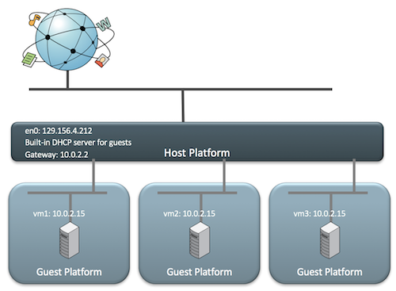
NAT diagram

Slide 27
Bridged
Bridged will automatically assign you IP address through DHCP within your host-machine IP range
You can also assign a static IP within your host-machine IP range
In Bridged mode the host-machine and virtual machines act as independent machines for the purpose of a LAN (virtual machine having same status as host for networking purposes)
Most of our assignments require a LAN setup

Slide 28
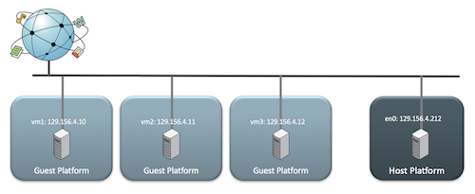
Bridged Diagram

Slide 29
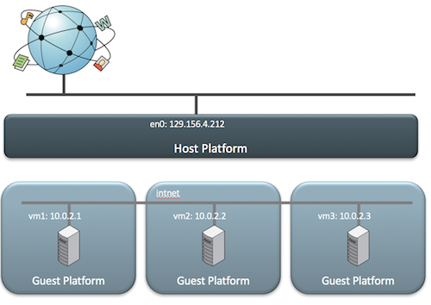
Internal networking
All traffic stays within the virtual machines. Good for testing hacking, etc.

Slide 30
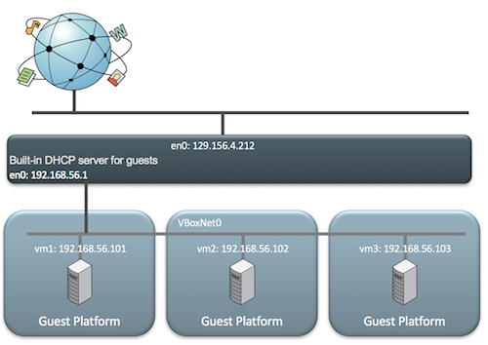
Host only
VirtualBox creates a private internal network for gusts and host and provides a virtual DHCP. Guest cannot see outside world.

Slide 31
What is Cloud Computing
a model for enabling convenient, on-demand network access to a shared pool of configurable computing resources (e.g., networks, servers, storage, applications, and services) that can be rapidly provisioned and released with minimal management effort or service provider interaction.
Cloud Computing makes computer infrastructure and services available "on-need" basis.

Slide 32
Pros and Cons
Users do not pay for hardware infrastructure or software. Less hardware means less noise and electricity
Pay for usage as you would for electricity usage. Lower IT cost.
You need much wider bandwidth. Latency concern.
If Internet service goes down at either end
If the provider goes down
Security of data – gov. regulations
Hardware dependent software may not run

Slide 33
Components of Cloud computing
Client computers – mobile, thin/thick computers
Provider site
  Server farm (distributed servers)
  Storage farm (distributed storage)
  Data farm (distributed datacenter)

Slide 34
Cloud Computing Characteristics
This cloud model promotes availability and is composed of five essential characteristics
  On-Demand Self-Service: User can essentially set up a server on the cloud. Availability of large computing infrastructure on need basis
  Resource Pooling: Users of the cloud can provision computing resources based on their needs, and then destroy those resources, giving them back to the shared pool once their needs are met. Additionally, users can share resources amongst themselves. For example, if an institution has developed a new piece of software and would like to share it with other institutions, they can create a template for that system in the cloud and allow other institutions to use that template as they see fit.

Slide 35
Cloud Computer Characteristics
3. Rapid Elasticity: If a system requires more computing resources, an IT department can easily scale the technology to meet those demands
4. Broad Network Access: The whole computer and programs available from anywhere (like google docs).
5. Measured Service: both cloud providers and IT departments to monitor usage. “pay-per-use" billing model

Slide 36
Hadoop
https://www.youtube.com/watch?v=Fyxi0qlyTaQ&list=PLAwxTw4SYaPkXJ6LAV96gH8yxIfGaN3H-&index=2
Hadoop is a fault-tolerant distributed system for data storage which is highly scalable.
The scalability is the result of a Self-Healing High Bandwidth Clustered Storage, known by the acronym of HDFS (Hadoop Distributed File System) and a specific fault-tolerant Distributed Processing, known as MapReduce.

Slide 37
Map Reduce
Map Reduce can be programmed with standard programming languages like C++, Java, or Python.
There are utilities such as PIG or HIVE. We can write statements similar to SQL and these utilities will translate them into Map Reduce.
Instead of Map Reduce one could use Impala to manipulate HDFS
Sqoop can be used to input data from a relational database into HDFS

Slide 38
Use of Hadoop
Traditionally data moves to the computation node. In Hadoop, data is processed where the data resides . The types of data Hadoop helps to manipulate are those unstoppable streams created by human and machines:
  Computer logs
  Satellite telemetry (espionage or science)
  GPS outputs
  Temperature and environmental sensors
  Industrial sensors
  Video from security cameras
  Outputs from medical devises
  Seismic and Geo-physical sensors

Slide 39
Host and Virtual Machine IP configuration
Please note that the networks may not work on campus. It should work at home.

Slide 40
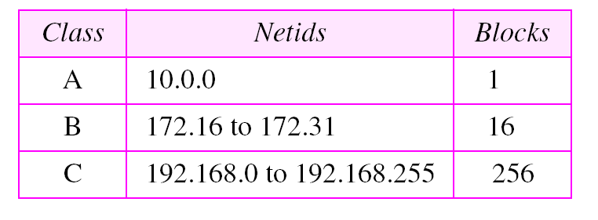
PRIVATE IP RANGES

Slide 41
HOST IP
CHECK YOUR HOST IP USING IPCONFIG
WRITE DOWN THE IP, DEFAULT GATEWAY, AND DNS
THE HOST IP CAN BE DYNAMIC OR STATIC. IF YOU SET IT STATIC, WHEN YOU MOVE YOUR COMPUTER AROUND IT WILL NOT WORK.

Slide 42
NAT AND BRIDGED
Make sure you read up on it
All our network assignments should work on bridged mode if you follow these instructions

Slide 43
Virtual machine IP
You need to set up static IP
Use all the numbers exactly as the host IP, except change the last octet of the IP address to something between 230 to 250

Slide 44
Ping both directions
Ping from host to virtual machine
Ping from virtual machine to host
If does not ping, solve the problems
Once pinging, share folders
Connect to the shared folder like this \\192.168.1.28\sharedfolder

