Slide 1
Chapter 12
Network Management
Data Communications and Networking, With TCP/IP protocol suite Sixth Edition
Behrouz A. Forouzan
© 2022 McGraw Hill, LLC. All rights reserved. Authorized only for instructor use in the classroom.
No reproduction or further distribution permitted without the prior written consent of McGraw Hill, LLC.

Slide 2
Chapter 12: Outline
12.1 Introduction
12.2 SNMP
12.3 ASN.1

Slide 3
12-1 INTRODUCTION
We can define network management as monitoring, testing, configuring, and troubleshooting network components to meet a set of requirements defined by an organization. These include the smooth, efficient operation of the network that provides the predefined quality of service for users. To accomplish this task, a network management system uses hardware, software, and humans.

Slide 4
Figure 12.1 Areas of network management
Access the text alternative for slide images.

Slide 5
12.1.1 Configuration Management
A large network is usually made up of hundreds of entities that are physically or logically connected to each other. These entities have an initial configuration when the network is set up, but can change with time. Desktop computers may be replaced by others; application software may be updated to a newer version; and users may move from one group to another. The configuration management system must know, at any time, the status of each entity and its relation to other entities. Configuration management can be divided into two subsystems: reconfiguration and documentation.

Slide 6
Reconfiguration
Reconfiguration can be a daily occurrence in a large network. There are three types of reconfiguration: hardware reconfiguration, software reconfiguration, and user-account reconfiguration.

Slide 7
Documentation
The original network configuration and each subsequent change must be recorded meticulously. This means that there must be documentation for hardware, software, and user accounts..

Slide 8
12.1.2 Fault Management
Complex networks today are made up of hundreds and sometimes thousands of components. Proper operation of the network depends on the proper operation of each component individually and in relation to each other. Fault management is the area of network management that handles this issue. An effective fault management system has two subsystems: reactive fault management and proactive fault management.

Slide 9
Reactive Fault Management
A reactive fault management system is responsible for detecting, isolating, correcting, and recording faults. It handles short-term solutions to faults.

Slide 10
Proactive Fault Management
Proactive fault management tries to prevent faults from occurring. Although this is not always possible, some types of failures can be predicted and prevented. For example, if a manufacturer specifies a lifetime for a component or a part of a component, it is a good strategy to replace it before that time. As another example, if a fault happens frequently at one particular point of a network, it is wise to carefully reconfigure the network to prevent the fault from happening again.

Slide 11
12.1.3 Performance Management
Proactive fault management tries to prevent faults from occurring. Although this is not always possible, some types of failures can be predicted and prevented. For example, if a manufacturer specifies a lifetime for a component or a part of a component, it is a good strategy to replace it before that time. As another example, if a fault happens frequently at one particular point of a network, it is wise to carefully reconfigure the network to prevent the fault from happening again.

Slide 12
Capacity
One factor that must be monitored by a performance management system is the capacity of the network. Every network has a limited capacity and the performance management system must ensure that it is not used above this capacity. For example, if a LAN is designed for 100 stations at an average data rate of 2 Mbps, it will not operate properly if 200 stations are connected to the network. The data rate will decrease and blocking may occur.

Slide 13
Traffic
Traffic can be measured in two ways: internally and externally. Internal traffic is measured by the number of packets (or bytes) travelling inside the network. External traffic is measured by the exchange of packets (or bytes) outside the network. During peak hours, when the system is heavily used, blocking may occur if there is excessive traffic.

Slide 14
Throughput
We can measure the throughput of an individual device (such as a router) or a part of the network. Performance management monitors the throughput to make sure that it is not reduced to unacceptable levels..

Slide 15
Response Time
Response time is normally measured from the time a user requests a service to the time the service is granted. Other factors such as capacity and traffic can affect the response time. Performance management monitors the average response time and the peak-hour response time. Any increase in response time is a very serious condition as it is an indication that the network is working above its capacity.

Slide 16
12.1.4 Security Management
Security management is responsible for controlling access to the network based on predefined policy. In Chapter 13 we will discuss security tools such as encryption and authentication. Encryption allows privacy for users; authentication forces the users to identify themselves.

Slide 17
12.1.5 Accounting Management
Accounting management is the controlling of users’ access to network resources through charges. Under accounting management, individual users, departments, divisions, or even projects are charged for the services they receive from the network. Charging does not necessarily mean cash transfer; it may mean debiting the departments or divisions for budgeting purposes.

Slide 18
12-2 SNMP
Several network management standards have been devised during the last few decades. The most important one is Simple Network Management Protocol (SNMP), used by the Internet. We discuss this standard in this section. SNMP is a framework for managing devices in an internet using the TCP/IP protocol suite.

Slide 19
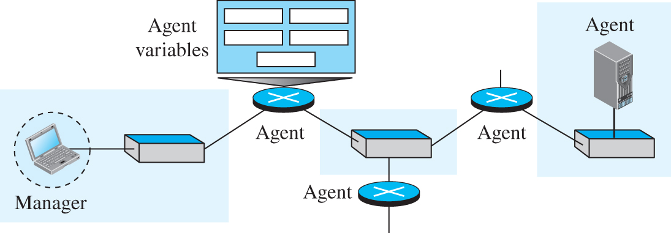
Figure 12.2 SNMP concept
Access the text alternative for slide images.

Slide 20
12.2.1 Managers and Agents
A management station, called a manager, is a host that runs the SNMP client program. A managed station, called an agent, is a router (or a host) that runs the SNMP server program. Management is achieved through simple interaction between a manager and an agent.

Slide 21
12.2.2 Management Components
To do management tasks, SNMP uses two other protocols: Structure of Management Information (SMI) and Management Information Base (MIB). In other words, management on the Internet is done through the cooperation of three protocols: SNMP,
SMI, and MIB, as shown in Figure 12.3.

Slide 22
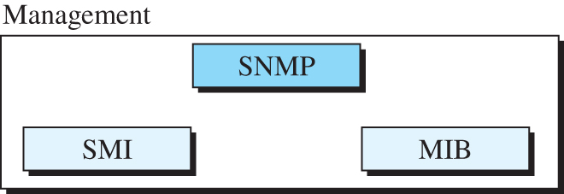
Figure 12.3 Components of network management on the Internet

Slide 23
Role of SNMP
SNMP has some very specific roles in network management. It defines the format of the packet to be sent from a manager to an agent and vice versa. It also interprets the result and creates statistics (often with the help of other management software). The packets exchanged contain the object (variable) names and their status (values). SNMP is responsible for reading and changing these values.

Slide 24
Role of SMI
To use SNMP, we need rules for naming objects. This is particularly important because the objects in SNMP form a hierarchical structure (an object may have a parent object and some child objects). Part of a name can be inherited from the parent. We also need rules to define the types of objects. What types of objects are handled by SNMP? Can SNMP handle simple types or structured types? How many simple types are available? What are the sizes of these types? What is the range of these types? In addition, how are each of these types encoded?

Slide 25
Role of MIB
We hope it is clear that we need another protocol. For each entity to be managed, this protocol must define the number of objects, name them according to the rules defined by SMI, and associate a type to each named object. This protocol is MIB. MIB creates a set of objects defined for each entity in a manner similar to that of a database (mostly metadata in a database, names and types without values).

Slide 26
An Analogy
Before discussing each of these protocols in more detail, let us give an analogy. The three network management components are similar to what we need when we write a program in a computer language to solve a problem. Figure 12.4 shows the analogy.

Slide 27
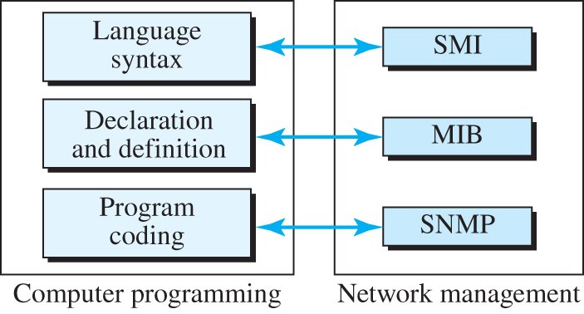
Figure 12.4 Comparing computer programming and network management
Access the text alternative for slide images.

Slide 28
12.2.3 An Overview
Before discussing each component in more detail, let us show how each of these components is involved in a simple scenario. This is an overview that will be developed later, at the end of the chapter. A manager station (SNMP client) wants to send a message to an agent station (SNMP server) to find the number of UDP user datagrams received by the agent. Figure 12.5 shows an overview of steps involved.

Slide 29
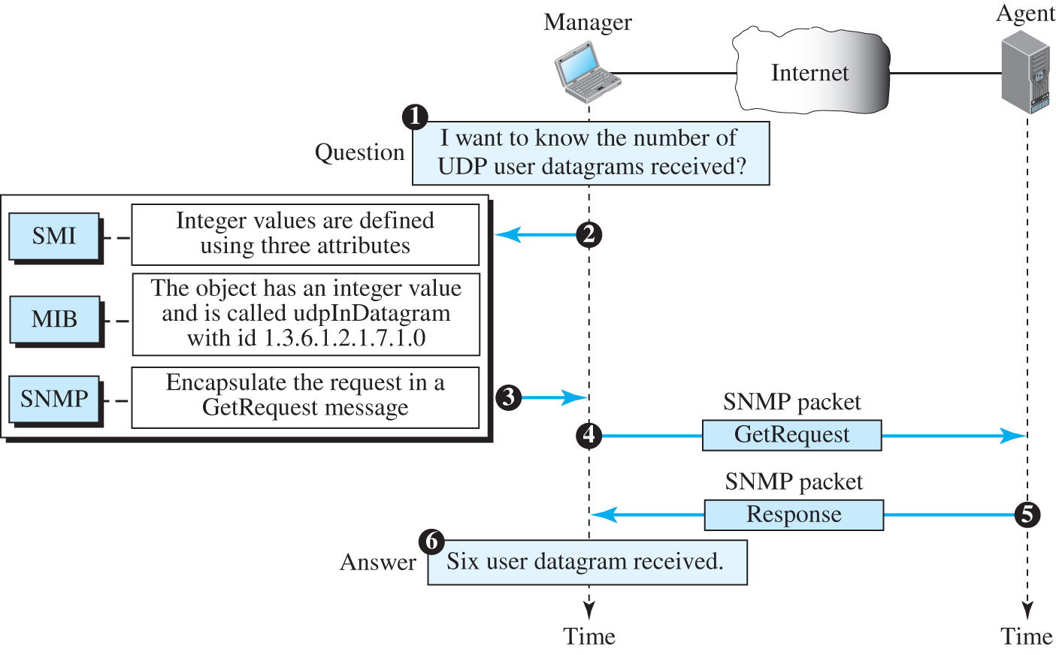
Figure 12.5 Management overview
Access the text alternative for slide images.

Slide 30
12.2.4 SMI
The Structure of Management Information, version 2 (SMIv2) is a component for network management. SMI is a guideline for SNMP. It emphasizes three attributes to handle an object: name, data type, and encoding method. Its functions are:
To name objects
To define the type of data
To show how to encode data.

Slide 31
Name
SMI requires that each managed object (such as a router, a variable in a router, a value, etc.) have a unique name. To name objects globally, SMI uses an object identifier, which is a hierarchical identifier based on a tree structure (see Figure 12.6).

Slide 32
Type
The second attribute of an object is the type of data stored in it. To define the data type, SMI uses Abstract Syntax Notation One (ASN.1) definitions and adds some new definitions. In other words, SMI is both a subset and a superset of ASN.1. SMI has two broad categories of data type: simple and structured. We first define the simple types and then show how the structured types can be constructed from the simple ones.

Slide 33
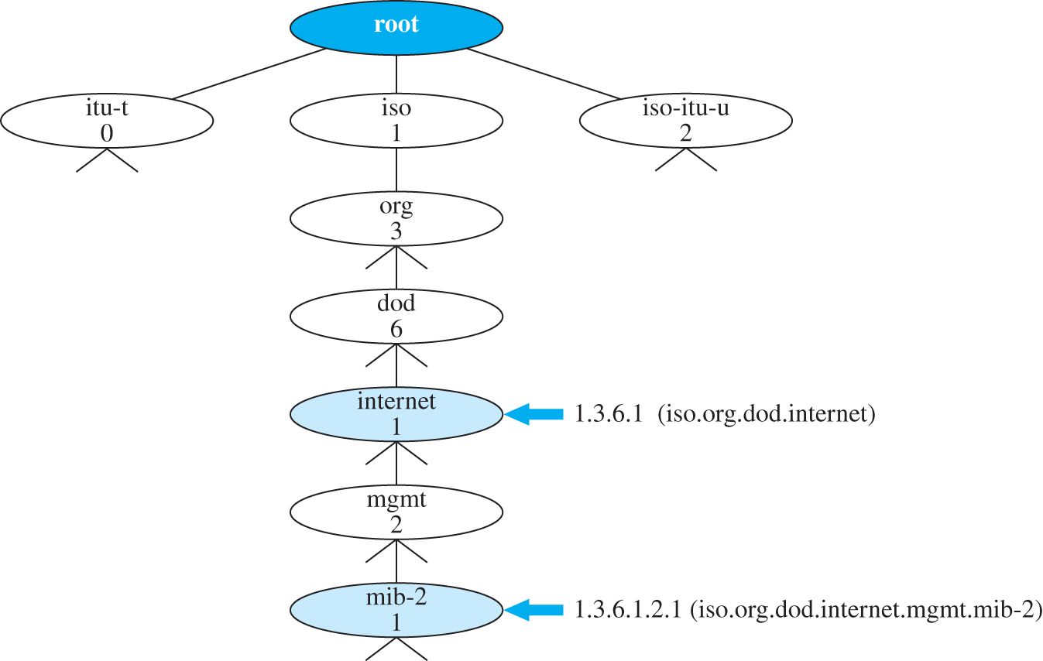
Figure 12.6 Object identifier in SMI
Access the text alternative for slide images.

Slide 34
Table 12.1 Data types
Type | Size | Description
INTEGER | 4 bytes | An integer with a value between −231 and 231 − 1.
Integer32 | 4 bytes | Same as INTEGER.
Unsigned32 | 4 bytes | Unsigned with a value between 0 and 232 − 1.
OCTET STRING |  | Byte-string up to 65,535 bytes long.
OBJECT IDENTIFIER |  | An object identifier.
IPAddress | 4 bytes | An IP address made up of four integers.
Counter32 | 4 bytes | An integer whose value can be incremented from zero to 232; when it reaches its maximum value, it wraps back to zero.
Counter64 | 8 bytes | 64-bit counter.
Gauge32 | 4 bytes | Same as Counter32, but when it reaches its maximum value, it does not wrap; it remains there until it is reset.
TimeTicks | 4 bytes | A counting value that records time in 1/100ths of a second.
BITS |  | A string of bits.
Opaque | Variable | Uninterpreted string.

Slide 35
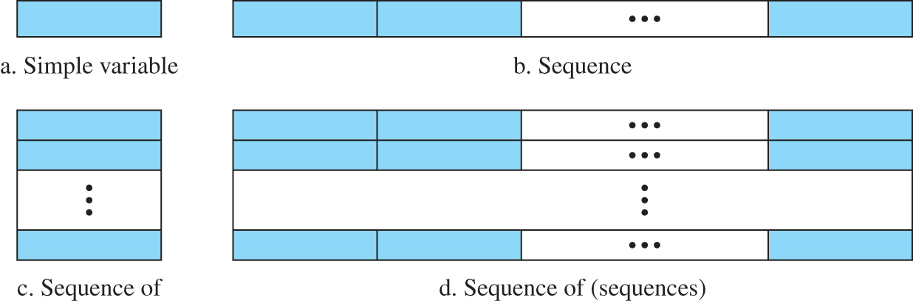
Figure 12.7 Conceptual data types
Access the text alternative for slide images.

Slide 36
Encoding Method
SMI uses another standard, Basic Encoding Rules (BER), to encode data to be transmitted over the network. BER specifies that each piece of data be encoded in triplet format: tag, length, and value (TLV), as illustrated in Figure 12.8.

Slide 37
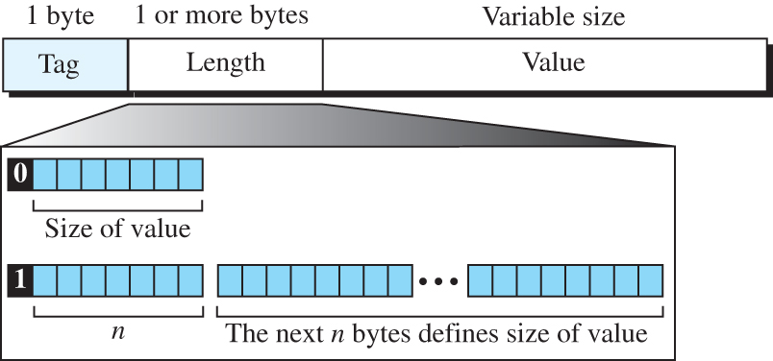
Figure 12.8 Encoding format
Access the text alternative for slide images.

Slide 38
Table 12.2 Codes for data types
Data Type | Tag (Hex) | Data Type | Tag (Hex)
INTEGER | 02 | IPAddress | 40
OCTET STRING | 04 | Counter | 41
OBJECT IDENTIFIER | 06 | Gauge | 42
NULL | 05 | TimeTicks | 43
SEQUENCE, SEQUENCE OF | 30 | Opaque | 44

Slide 39
Example 12.1
Figure 12.9 shows how to define INTEGER 14.

Slide 40
Figure 12.9 Example 12.1: INTEGER 14
Access the text alternative for slide images.

Slide 41
Example 12.2
Figure 12.10 shows how to define the OCTET STRING “HI.”

Slide 42
Figure 12.10 Encoding format
Access the text alternative for slide images.

Slide 43
Example 12.3
Figure 12.11 shows how to define ObjectIdentifier 1.3.6.1 (iso.org.dod.internet).

Slide 44
Figure 12.11 Encoding format
Access the text alternative for slide images.

Slide 45
Example 12.4
Figure 12.12 shows how to define IPAddress 131.21.14.8.

Slide 46
Figure 12.12 Encoding format
Access the text alternative for slide images.

Slide 47
12.2.5 MIB
The Management Information Base, version 2 (MIB2) is the second component used in network management. Each agent has its own MIB2, which is a collection of all the objects that the manager can manage. (See Figure 12.13.)

Slide 48
Figure 12.13 Some MIB-2 groups
Access the text alternative for slide images.

Slide 49
Accessing MIB Variables
To show how to access different variables, we use the udp group as an example. There are four simple variables in the udp group and one sequence of (table of) records. Figure 12.14 shows the variables and the table. We will show how to access each entity

Slide 50
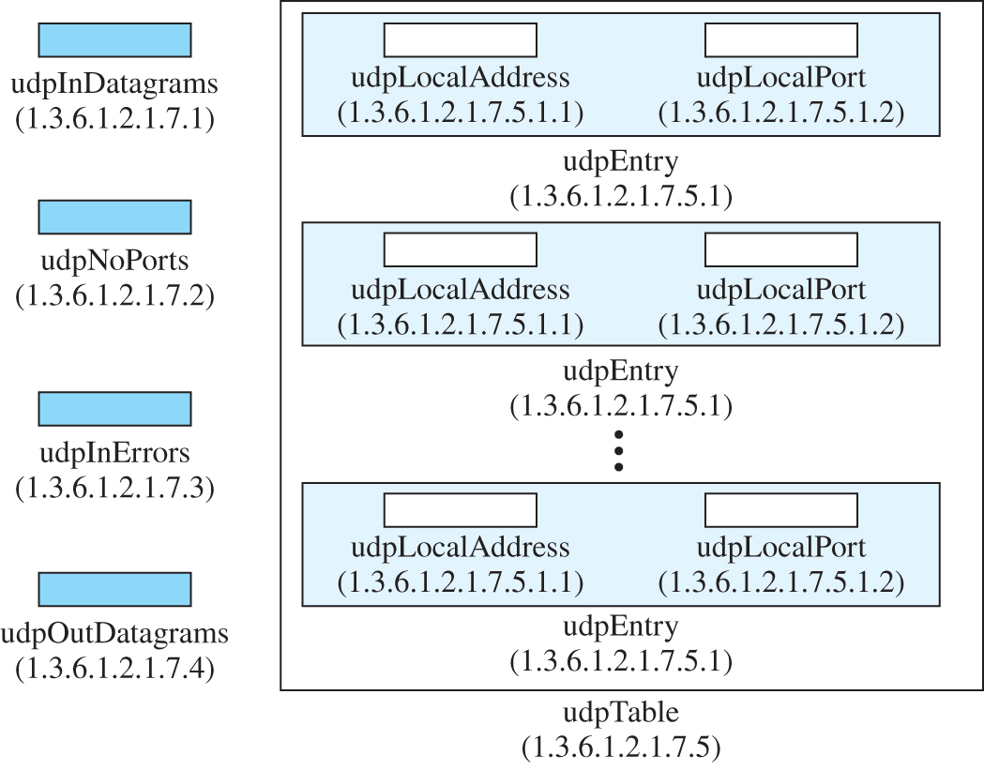
Figure 12.15 UDP variables and tables
Access the text alternative for slide images.

Slide 51
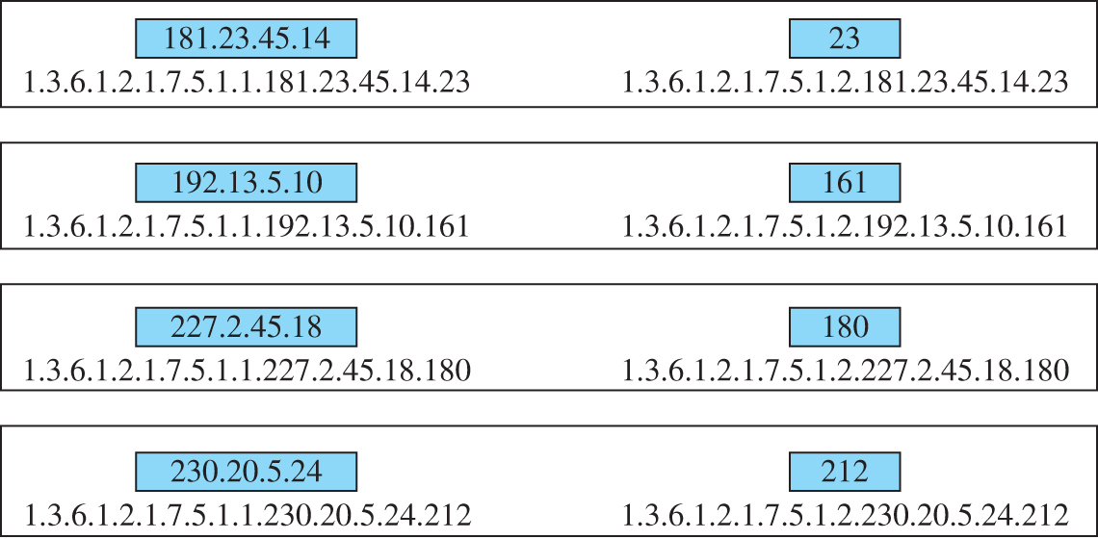
Figure 12.16 Indexes for UDP table
Access the text alternative for slide images.

Slide 52
12.2.6 SNMP
SNMP uses both SMI and MIB in Internet network management. It is an application program that allows:
A manager to retrieve the value of an object defined in an agent.
An agent to send an alarm message about an abnormal situation to the manager.
An agent to send an alarm message about an abnormal situation to the manager.

Slide 53
PDUs
SNMPv3 defines eight types of protocol data units (or PDUs):GetRequest, GetNextRequest, GetBulkRequest, SetRequest, Response, Trap, InformRequest, and Report (see Figure 12.17).

Slide 54
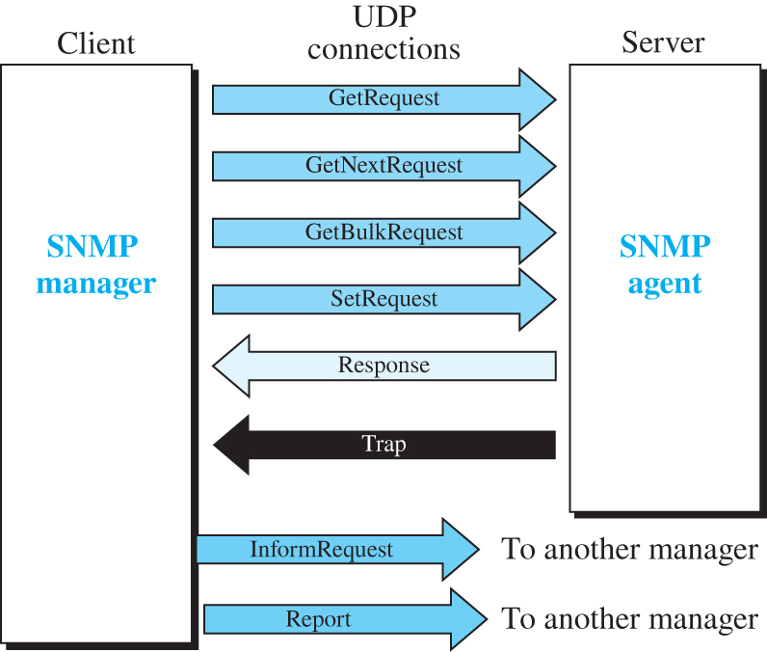
Figure 12.17 SNMP PDUs
Access the text alternative for slide images.

Slide 55
Format
The format for the eight SNMP PDUs is shown in Figure 12.18. The GetBulkRequest PDU differs from the others in two areas, as shown in the figure.

Slide 56
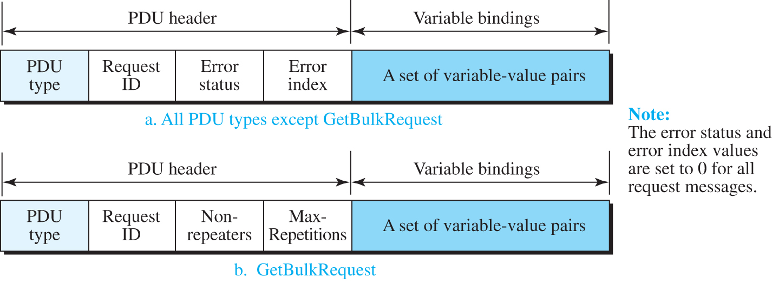
Figure 12.18 SNMP PDU format
Access the text alternative for slide images.

Slide 57
Table 12.3 PDU types
Data Type | Tag (Hex) | Type | Tag (Hex)
GetRequest | A0 | GetBulkRequest | A5
GetNextRequest | A1 | InformRequest | A6
Response | A2 | Trap (SNMPv2) | A7
SetRequest | A3 | Report | A8

Slide 58
Table 12.4 Types of errors
Status | Name | Meaning
0 | noError | No error.
1 | tooBig | Response too big to fit in one message.
2 | noSuchName | Variable does not exist.
3 | badValue | The value to be stored is invalid.
4 | readOnly | The value cannot be modified.
5 | genErr | Other errors.

Slide 59
Messages
SNMP does not send only PDUs, it embeds each PDU in a message. A message is made of a message header followed by the corresponding PDU as shown in Figure 12.19. The format of the message header, which depends on the version and the security provision, is not shown in the figure. We leave the details to some specific text.

Slide 60
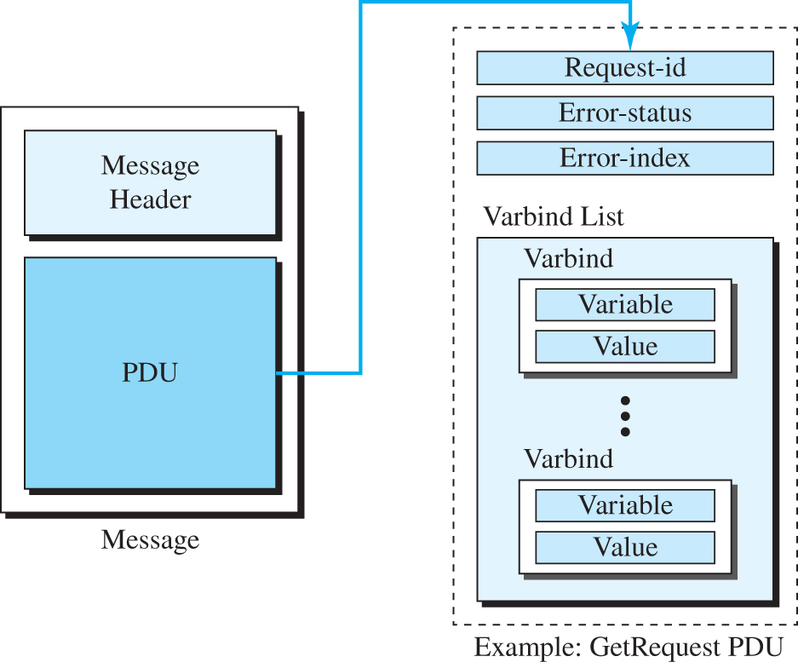
Figure 12.19 SNMP message
Access the text alternative for slide images.

Slide 61
Example 12.5
In this example, a manager station (SNMP client) uses a message with a GetRequest PDU to retrieve the number of UDP datagrams that a router has received (Figure 12.20).

Slide 62
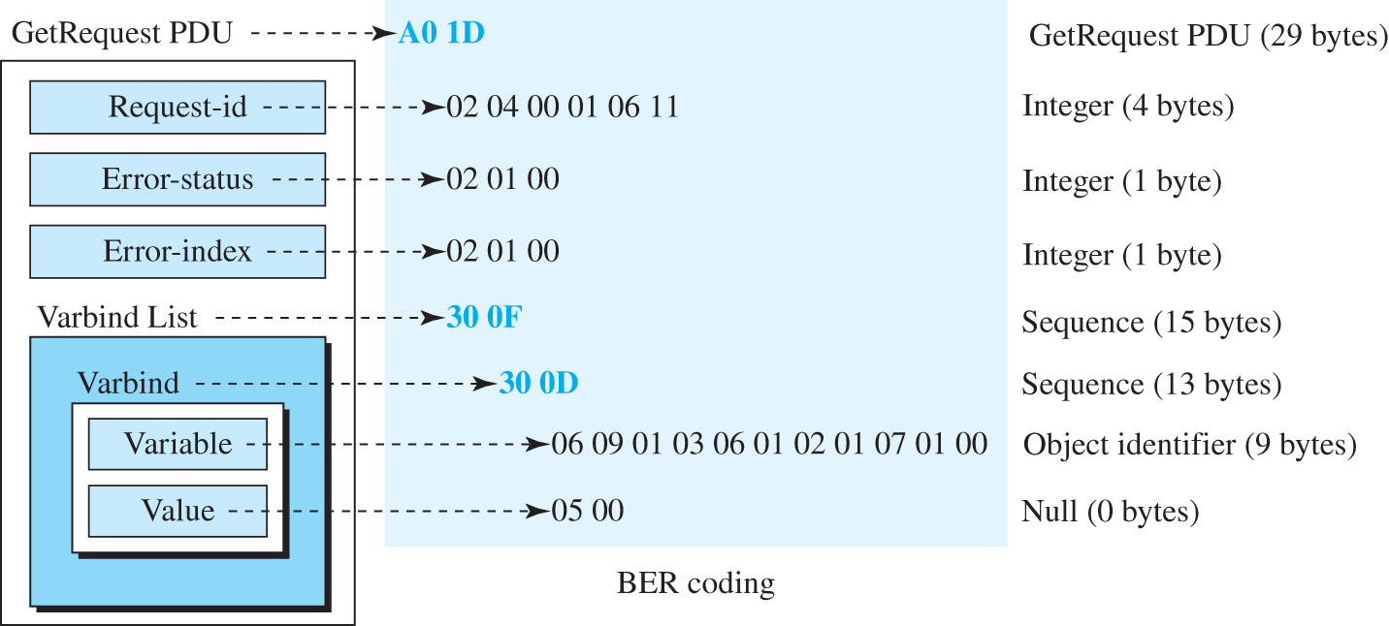
Figure 12.20 Example 12.5
Access the text alternative for slide images.

Slide 63
UDP Ports
SNMP uses the services of UDP on two well-known ports, 161 and 162. The well-known port 161 is used by the server (agent), and the well-known port 162 is used by the client (manager).

Slide 64
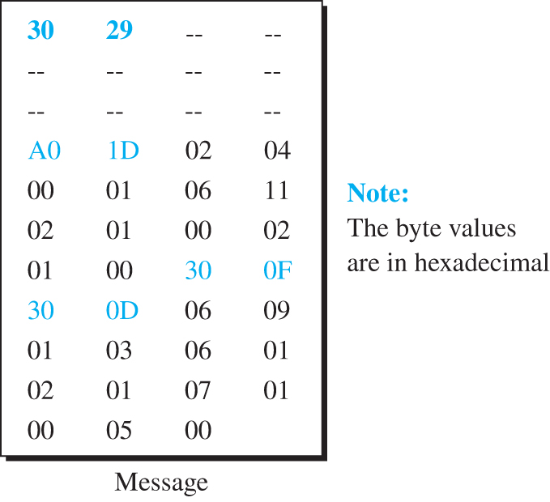
Figure 12.21 Actual message sent for Example 12.5
Access the text alternative for slide images.

Slide 65
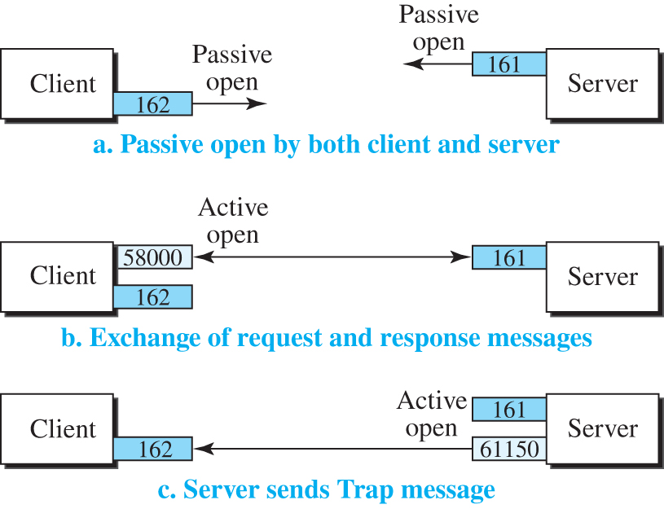
Figure 12.22 Port numbers for SNMP
Access the text alternative for slide images.

Slide 66
Security
SNMPv3 has added two new features to the previous version: security and remote administration. SNMPv3 allows a manager to choose one or more levels of security when accessing an agent. Different aspects of security can be configured by the manager to allow message authentication, confidentiality, and integrity.

Slide 67
12-3 ASN.1
In data communication, when we send a continuous stream of bits to a destination, we somehow need to define the format of the data. A solution is that we separate the definition of data types from the sequence of bits transmitted through the network. This is done through an abstract language called Abstract Syntax Notation One (ASN.1).

Slide 68
12.3.1 Language Basics
Before we show how we can define objects and associated values, let us talk about the language itself. The language uses some symbols and some key words and defines some primitive data types. As we said before, SMI uses a subset of these entities in its own language.

Slide 69
Symbols
The language uses a set of symbols, given in Table 12.5. Some of these symbols are single characters, but some are pairs of characters..

Slide 70
Table 12.5 Symbols used in ASN.1
Symbol | Meaning | Symbol | Meaning
⸬= | Defined as or assignment | .. | Range
| | Or, alternative, or option | {} | Start and end of a list
− | Negative sign | [] | Start and end of tag
−− | The following is a comment | () | Start and end of a subtype

Slide 71
Keywords
The language has a set of limited keywords that can be used. These words can be used in the language only for the purpose for which they have been defined. All words should be in uppercase (Table 12.6).

Slide 72
Table 12.6 Keywords in ASN.1
Key Word | Description
BEGIN | Start of a module
CHOICE | List of alternatives
DEFINITIONS | Definition of a data type or an object
END | End of a module
EXPORTS | Data type that can be exported to other modules
IDENTIFIER | A sequence of non-negative numbers that identifies an object
IMPORTS | Data type defined in an external module and imported
INTEGER | Any positive, zero, or negative integer
NULL | A null value
OBJECT | Used with IDENTIFIER to uniquely define an object
OCTET | Eight-bit binary data
OF | Used with SEQUENCE or SET
SEQUENCE | An ordered list
SEQUENCE OF | An ordered array of data of the same type
SET | An unordered list
SET OF | An array of unordered lists
STRING | A string of data

Slide 73
12.3.2 Data Types
After discussing the symbols and keywords used in the language, it is time to define its data types. The idea is similar to what we see in computer languages such as C, C++, or Java. In ASN.1, we have several simple data types such as integer, float, boolean, char, and so on. We can combine these data types to create a new simple data type (with a different name) or to define a structured data type such as array or struct. We first define simple data types in ASN.1 and then show how to make a new data type of these data types.

Slide 74
Simple Data Types
ASN.1 defines a set of simple (atomic) data types. Each data type is given a universal tag and has a set of values, as shown in Table 12.7. This is the same idea as used in a computer language when we have some basic data types with predefined ranges of values. For example, in C language, we have the data type int, which can take a range of values. Note that the tag in the table is actually the rightmost five bits of the tag we defined in Table 12.2.

Slide 75
Table 12.7 Some simple ASN.1 built-in types
Tag | Type | Set of values
Universal 1 | BOOLEAN | TRUE or FALSE
Universal 2 | INTEGER | Integers (positive, 0, or negative)
Universal 3 | BIT STRING | A string of binary digits (bits) or a null set
Universal 4 | OCTET STRING | A string of octets or a null set
Universal 5 | NULL | Null, single valued
Universal 6 | OBJECT IDENTIFIER | A set of values that defines an object
Universal 7 | ObjectDescriptor | Human readable text describing an object
Universal 8 | EXTERNAL | A type that is not in the standard
Universal 9 | REAL | Real numbers in scientific notation
Universal 10 | ENUMERATED | A list of integers
Universal 16 | SEQUENCE, SEQUENCE OF | Ordered list of types
Universal 17 | SET, SET OF | Unordered list of types
Universal 18 | NumericString | Digits 0–9 and space
Universal 19 | PrintableString | Printable characters
Universal 26 | VisibleString | ISO646String
Universal 27 | GeneralString | General character string
Universal 30 | CHARACTER STRING | Character set

Slide 76
New Data Types
ASN.1 uses Backus–Naur Form (BNF) syntax for defining a new data type from a built-in data type or a previously defined data type as shown below:
<new type> ::= <type>
where the new type must start with a capital letter.

Slide 77
Example 12.6
The following is an example of some new types using built-in types.
Married ::= BOOLEAN
Marital Status ::= ENUMERATED {single, married, widowed, divorced}
Day Of Week ::= ENUMERATED {sun, mon, tue, wed, thu, fri, sat}
Age ::= INTEGER

Slide 78
New Subtypes
ASN.1 uses Backus–Naur Form (BNF) syntax for defining a new data type from a built-in data type or a previously defined data type as shown below:
<new type> ::= <type>
where the new type must start with a capital letter.

Slide 79
Example 12.7
The following shows how we can make three new subtypes. The range of the first is the subset of INTEGER, the range of the second is the subset of REAL, and the range of the third is the subset of DayOfWeek, which we defined in before. Note that we use the symbol (..) to define the range and the symbol (|) to define the choice.
Number Of Students ::= INTEGER (15..40) | −− | An integer with the range 15 to 40
Grade ::= REAL (1.0..5.0) | −− | A real number with the range 1.0 to 5.0
Weekend ::= Day Of Week (sun | sat) | −− | A day that can be sun or sat

Slide 80
Simple Variables
In a programming language, we can create a variable of a particular type and assign (store) a value in it. In ASN.1, the term Value Name is used instead of variable, but we use the term variable, which is more familiar to programmers. We can create a variable of a particular type and assign a value belonging to the range defined for that type. The following shows the syntax:
<variable> <type> ::= <value>
The name of the variable should start with a lower-case letter to distinguish it from the type.

Slide 81
Example 12.8
The following are a few examples of defining some variables and assigning the appropriate value from the range of those types. Note that the first and the third variables are of the built-in type, the second is of the type defined before, and the last is of a subtype defined in Example 12.7.
Number Of Computers INTEGER ::= 2
married Married ::= FALSE
Her Age INTEGER ::= 35
Class Size Number Of Students ::= 22

Slide 82
Structured Type
ASN.1 uses a keyword SEQUENCE to define a structured data type similar to struct (record) in C language or C++. The SEQUENCE type is an ordered list of variable types. The following shows a new type StudentAccount which is a sequence of three variables: username, password, and accountNumber.
StudentAccount ::= SEQUENCE
{
userName VisibleString,
password VisibleString,
accountNumber INTEGER
}

Slide 83
Structure Variables
After defining the new type, we can create a variable out of it and assign values to variables as shown below:
johnNewton StudentAccount
{
userName "JohnN",
password "120007",
accountNumber 25579
}

Slide 84
Figure 12.23 Record representing the type definition and variable declaration
Access the text alternative for slide images.

Slide 85
12.3.3 Encoding
After the data has been defined and values are associated with variables, ASN.1 uses one of the encoding rules to encode the message to be sent. We already discussed the Basic Encoding Rule in the previous section.

Slide 86
End of Main Content
© 2022 McGraw Hill, LLC. All rights reserved. Authorized only for instructor use in the classroom.
No reproduction or further distribution permitted without the prior written consent of McGraw Hill, LLC.

Slide 87
Accessibility Content: Text Alternatives for Images

Slide 88
Figure 11.1 A version of run-length coding to compress binary patterns - Text Alternative
Return to parent-slide containing images.
The Network Management connects with Configuration Management, Fault Management, Performance Management, Security Management, and Accounting Management.
Return to parent-slide containing images.

Slide 89
Figure 12.2 SNMP concept - Text Alternative
Return to parent-slide containing images.
A Laptop represents manager connects with a cube-like structure then connects with agent contains agent variables. The agent connects with a cube-like structure sends the information into agents and the agent sends the information to the cube-like structure and finally sends it to the client.
Return to parent-slide containing images.

Slide 90
Figure 12.4 Comparing computer programming and network management - Text Alternative
Return to parent-slide containing images.
Computer Programming has Language Syntax, Declaration and definition, and Program coding. Network Management has S M I, M I B, and S N M P. Language syntax is interconnected with S M I. Declaration and definition is interconnected with M I B, and Program Coding is interconnected with S N M P.
Return to parent-slide containing images.

Slide 91
Figure 12.5 Management overview - Text Alternative
Return to parent-slide containing images.
The manager sends a question that reads, I want to know the number of U D P user diagrams received? to the network management protocols S M I, M I B, and S N M P. S M I shows the integer values are defined using three protocols, M I B shows the object has an integer value and is called udp in a datagram with id 1 dot 3 dot 6 dot 1 dot 2 dot 1 dot 7 dot 1 dot 0 and S N M P encapsulate the request in a GetRequest message .The network management protocols send the GetRequest through the S N M P packet and receive the response from the agent through the S N M P packet and provide an answer to the manager that six user datagram received on time.
Return to parent-slide containing images.

Slide 92
Figure 12.6 Object identifier in SMI - Text Alternative
Return to parent-slide containing images.
On top, the root colored red is connected with itu – t0, iso1, and iso-itu-u2 dot iso 1 connects with org3, org3 with dod6, dod6 with internet 1, internet 1 with management 2, and management 2 with mib-2 1. A red arrow pointing internet 1 reads 1 dot 3 dot 6 dot 1 (iso dot org dot dod dot internet). A red arrow pointing mib-2 1 reads 1 dot 3 dot 6 dot 1 dot 2 dot 1 (iso dot org dot dod dot internet dot management dot mib-2).
Return to parent-slide containing images.

Slide 93
Figure 12.7 Conceptual data types - Text Alternative
Return to parent-slide containing images.
A small rectangular box denotes a simple variable, sequence of the horizontal rectangular box which has three dark spots in the middle denotes sequence, sequence of the vertical rectangular box which has three dark spots in the middle denotes a sequence of, and an array of the vertical rectangular box which has three dark spots in the middle denotes a sequence of (sequence).
Return to parent-slide containing images.

Slide 94
Figure 12.8 Encoding format - Text Alternative
Return to parent-slide containing images.
On top, three rectangular boxes denote a tag with one byte, one or more bytes with length, and a value with variable length. A large rectangular box on the bottom shows an array that starts from o to n. The width of the array represents the size of the value, n, and the next n bytes defines the size of the value. A dome-like structure present in the middle.
Return to parent-slide containing images.

Slide 95
Figure 12.9 Example 12.1: INTEGER 14 - Text Alternative
Return to parent-slide containing images.
A sequence of horizontal rectangular box shows 0 times 02, 0 times 04, 0 times 00, 0 times 00, 0 times 00, and 0 times 0E. 0 times 02 denotes tag (integer), 0 times 04 denotes length (4 bytes), 0 times 00, 0 times 00, 0 times 00, and 0 times 0E denotes value (14).
Return to parent-slide containing images.

Slide 96
Figure 12.10 Encoding format - Text Alternative
Return to parent-slide containing images.
A sequence of the horizontal rectangular box shows 0 times 04, 0 times 02, 0 times 48, and 0 times 49. 0 times 04 denotes tag (string), 0 times 02 denotes length (2 bytes), 0 times 48 denotes value (H), and 0 times 49 denotes value (I).
Return to parent-slide containing images.

Slide 97
Figure 12.11 Encoding format - Text Alternative
Return to parent-slide containing images.
A sequence of the horizontal rectangular box shows 0 times 06, 0 times 04, 0 times 01, 0 times 03, 0 times 06, and 0 times 01. 0 times 06 denotes tag (object Id), 0 times 04 denotes length (4 bytes), 0 times 01 denotes value (1), 0 times 03 denotes value(2), 0 times 06 denotes value (6),and 0 times 01 denotes value (1). Values shows 1 dot 3 dot 6 dot 1 (iso dot org dot dod dot internet).
Return to parent-slide containing images.

Slide 98
Figure 12.12 Encoding format - Text Alternative
Return to parent-slide containing images.
A sequence of the horizontal rectangular box shows 0 times 40, 0 times 04, 0 times 83, 0 times 15, 0 times 0E, and 0 times 08. 0 times 40 denotes tag (I P address), 0 times 04 denotes length (4 bytes), 0 times 83 denotes value (131), 0 times 15 denotes value(21), 0 times 0E denotes value (14),and 0 times 08 denotes value (8). Values shows 131 dot 21 dot 14 dot 8.
Return to parent-slide containing images.

Slide 99
Figure 12.13 Some MIB-2 groups - Text Alternative
Return to parent-slide containing images.
On top, the root colored blue reads mib - 2 is connected with sys 1, I f 2, a t 3, I p 4, I c m p 5, t c p 6, u d p 7, e g p 8, t r a n s 10, and s n m p 10. An arrow pointing mib – 2 reads 1 dot 3 dot 6 dot 1 dot 2 dot 1.
Return to parent-slide containing images.

Slide 100
Figure 12.15 UDP variables and tables - Text Alternative
Return to parent-slide containing images.
The U D P variables read as follows: udpInDatagrams (1 dot 3 dot 6 dot 1 dot 2 dot 1 dot 7 dot 1), udpNoPorts (1 dot 3 dot 6 dot 1 dot 2 dot 1 dot 7 dot 1), udpInErrors (1 dot 3 dot 6 dot 1 dot 2 dot 1 dot 7 dot 3), and udpOutDatagrams (1 dot 3 dot 6 dot 1 dot 2 dot 1 dot 7 dot 4). The udp table lists the sequence of udpLocalAddress (1 dot 3 dot 6 dot 1 dot 2 dot 1 dot 7 dot 5 dot 1 dot 1), udpLocalPort (1 dot 3 dot 6 dot 1 dot 2 dot 1 dot 7 dot 5 dot 1 dot 2) and in the middle shows the sequence of udpEntry (1 dot 3 dot 6 dot 1 dot 2 dot 1 dot 7 dot 5 dot 1 dot 1), udpLocalPort (1 dot 3 dot 6 dot 1 dot 2 dot 1 dot 7 dot 5 dot 1 dot 2).
Return to parent-slide containing images.

Slide 101
Figure 12.16 Indexes for UDP table - Text Alternative
Return to parent-slide containing images.
The indexes reads as follows: 181 dot 23 dot 45 dot 1, 1 dot 3 dot 6 dot 1 dot 2 dot 1 dot 7 dot 5 dot 1 dot 1 dot 181 dot 23 dot 45 dot 14 dot 23; 23, 1 dot 3 dot 6 dot 1 dot 2 dot 1 dot 7 dot 5 dot 1 dot 2 dot 181 dot 23 dot 45 dot 14 dot 23; 192 dot 13 dot 5 dot 10, 1 dot 3 dot 6 dot 1 dot 2 dot 1 dot 7 dot 5 dot 1 dot 1 dot 192 dot 13 dot 5 dot 10 dot 16 dot 1; 161, 1 dot 3 dot 6 dot 1 dot 2 dot 1 dot 7 dot 5 dot 1 dot 2 dot 192 dot 13 dot 5 dot 10 dot 161; 227 dot 2 dot 45 dot 18, 1 dot 3 dot 6 dot 1 dot 2 dot 1 dot 7 dot 5 dot 1 dot 1 dot 227 dot 2 dot 45 dot 18 dot 180; 180, 1 dot 3 dot 6 dot 1 dot 2 dot 1 dot 7 dot 5 dot 1 dot 2 dot 227 dot 2 dot 45 dot 18 dot 180; 230 dot 20 dot 5 dot 24, 1 dot 3 dot 6 dot 1 dot 2 dot 1 dot 7 dot 1 dot 1 dot 230 dot 20 dot 5 dot 24 dot 212; 212, 1 dot 3 dot 6 dot 1 dot 2 dot 1 dot 7 dot 5 dot 1 dot 2 dot 230 dot 20 dot 5 dot 24 dot 212.
Return to parent-slide containing images.

Slide 102
Figure 12.17 SNMP PDUs - Text Alternative
Return to parent-slide containing images.
S N M P manager sends the request and receives the response from the S N M P agent through U D P connections. S N M P manager act as a client and S N M P agent as a server. The client sends the GetRequest, GetNextRequest, GetBulkRequest, and SetRequest to the server and the server sends a response and trap to the manager. S N M P manager informs the request and reports to another manager.
Return to parent-slide containing images.

Slide 103
Figure 12.18 SNMP PDU format - Text Alternative
Return to parent-slide containing images.
All P D U types except GetBulkRequest shows P D U type, Request I D, Error status, Error index as P D U header, and a set of variable value pair as variable bindings. GetBulkRequest shows P D U type, Request I D, Non-repeaters, M A X repetitions as P D U header, and a set of variable value pair as variable bindings.
Return to parent-slide containing images.

Slide 104
Figure 12.19 SNMP message - Text Alternative
Return to parent-slide containing images.
A message sends a request to the P D U. Message contains Message Header and P D U. GetRequest P D U shows Request id, Error status, Error index, and varbind list. The Varbind list has n number of variables and values.
Return to parent-slide containing images.

Slide 105
Figure 12.20 Example 12.5 - Text Alternative
Return to parent-slide containing images.
The P D U converts the command into B E R coding and byte values. The data reads as follows: GetRequest P D U, A0 1D (29 bytes); Request id, 02 04 00 01 06 11, Integer (4 bytes); Error-status, 02 01 00, Integer (1 byte); Error index, 02 01 00, Integer (1 byte); Varbind list, 30 0F, Sequence (15 bytes); Vabrind, 30 0D, Sequence (13 bytes); Variable, 06 09 01 03 06 01 02 01 07 01 00, Object identifier (9 bytes); and Value, 05 00, Null (0 bytes).
Return to parent-slide containing images.

Slide 106
Figure 12.21 Actual message sent for Example 12.5 - Text Alternative
Return to parent-slide containing images.
The P D U converts the command into B E R coding and byte values. The data reads as follows: GetRequest P D U, A0 1D (29 bytes); Request id, 02 04 00 01 06 11, Integer (4 bytes); Error-status, 02 01 00, Integer (1 byte); Error index, 02 01 00, Integer (1 byte); Varbind list, 30 0F, Sequence (15 bytes); Vabrind, 30 0D, Sequence (13 bytes); Variable, 06 09 01 03 06 01 02 01 07 01 00, Object identifier (9 bytes); and Value, 05 00, Null (0 bytes).
Return to parent-slide containing images.

Slide 107
Figure 12.22 Port numbers for SNMP - Text Alternative
Return to parent-slide containing images.
Client 162 and Server 161 shows the passive is open. Client 162 and Server 161 shows the active is open and sends a message 58000 to server. Client 162 and Server 161 shows the active is open and sends a message 61150 to client.
Return to parent-slide containing images.

Slide 108
Figure 12.23 Record representing the type definition and variable declaration - Text Alternative
Return to parent-slide containing images.
Client 162 and Server 161 shows the passive is open. Client 162 and Server 161 shows the active is open and sends a message 58000 to server. Client 162 and Server 161 shows the active is open and sends a message 61150 to client.
Return to parent-slide containing images.

