Slide 1

Chapter 02
Physical Layer
Data Communications and Networking, With TCP/IP protocol suite
Sixth Edition
Behrouz A. Forouzan
© 2022 McGraw Hill, LLC. All rights reserved. Authorized only for instructor use in the classroom.
No reproduction or further distribution permitted without the prior written consent of McGraw Hill, LLC.

Slide 2
Chapter 2: Outline
2.1 SIGNALS
2.2 SIGNAL IMPAIRMENT
2.3 DIGITAL TRANSMISSION
2.4 ANALOG TRANSMISSION
2.5 MULTIPLEXING
2.6 TRANSMISSION MEDIA

Slide 3
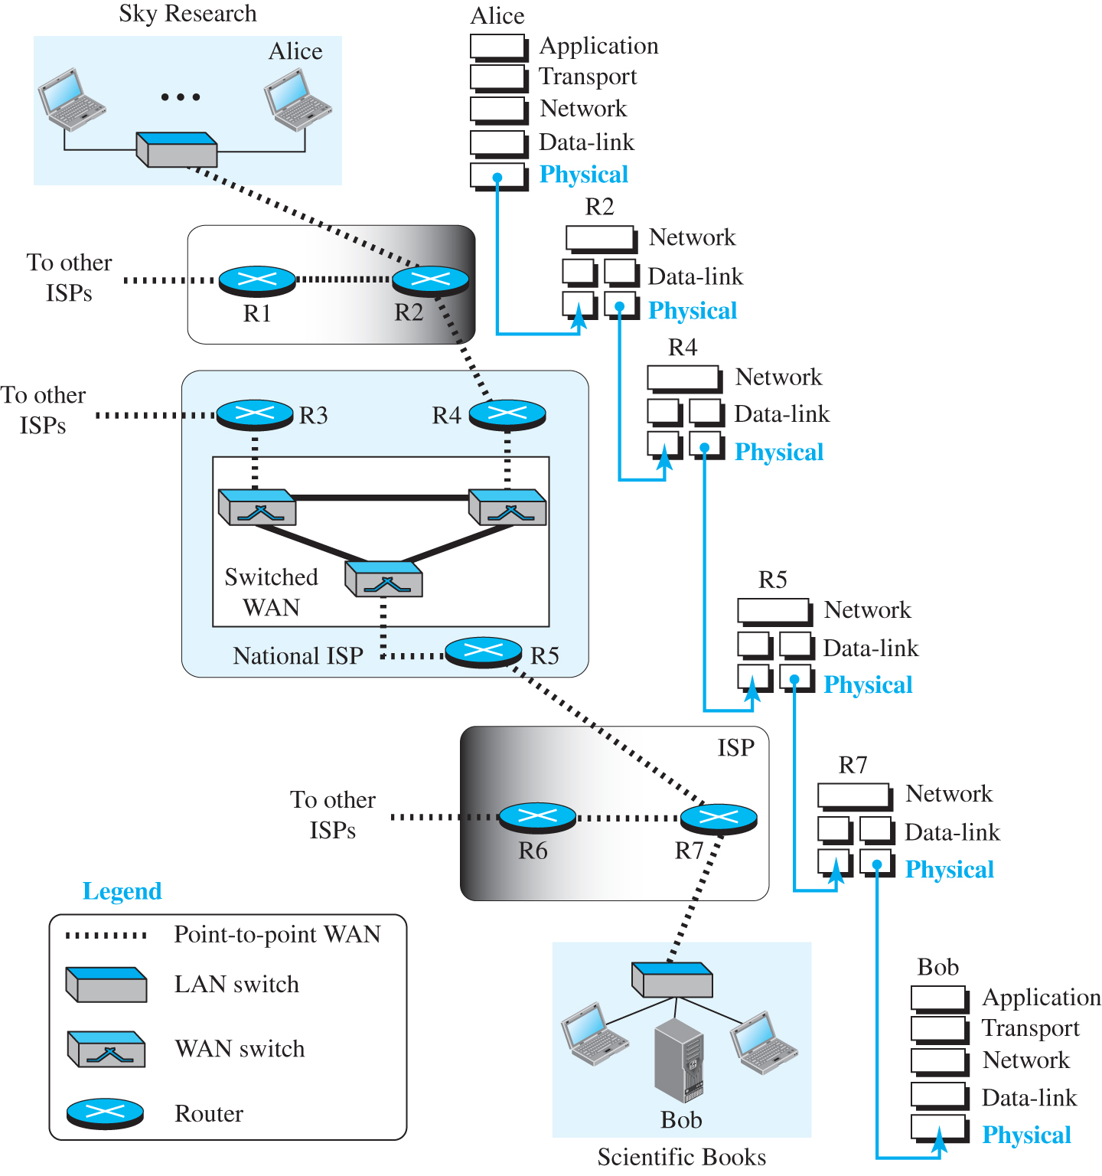
Figure 2.1 Communication at the physical layer
Access the text alternative for slide images.

Slide 4
2-1 SIGNALS
What is exchanged between Alice and Bob is data, but what goes through the network at the physical layer is signals.

Slide 5
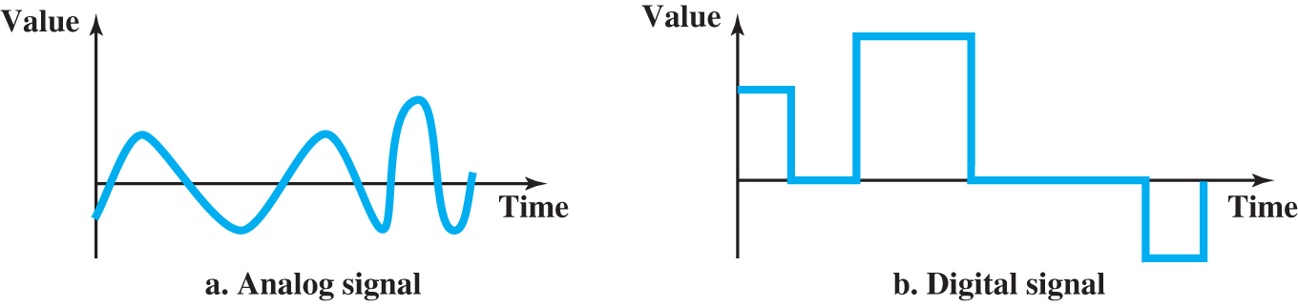
Figure 2.2 Comparison of analog and digital signals
Access the text alternative for slide images.

Slide 6
2.1.1 Analog Signal
An analog signal can take one of the two forms: periodic or aperiodic. In data communication, we normally use periodic signals. A simple periodic signal, a sine wave, cannot be decomposed into simpler signals.

Slide 7
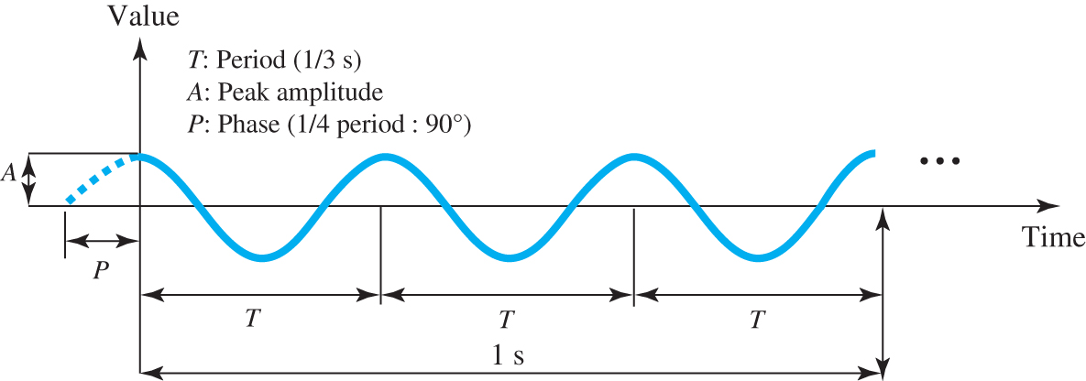
Figure 2.3 A sine wave
Access the text alternative for slide images.

Slide 8
Peak Amplitude
The peak amplitude of a signal is the absolute value of its highest intensity.

Slide 9
Period and Frequency
The period (T) refers to the amount of time, in seconds, that a signal needs to complete one cycle. The frequency (f), measured in Hertz (Hz), refers to the number of periods in one second. Note that period and frequency are just one characteristic defined in two ways. Period and frequency are inverse of each other, in other words (f = 1/ T).

Slide 10
Example 2.1
The voltage of a battery is constant. However, this can be considered as periodic with frequency of 0 and period of infinity.

Slide 11
Example 2.2
The electrical voltage in hour house in US is periodic with peak value of 120 to 120 volts. Its frequency is 60 Hz.

Slide 12
Phase
The term phase describes the position of the waveform relative to time 0. If we think of the wave as something that can be shifted backward or forward along the time axis, phase describes the amount of that shift.

Slide 13
Wavelength
The wavelength is the distance a simple signal can travel in one period. Wavelength binds the period or the frequency of a simple sine wave to the propagation speed in the medium. If we represent wavelength by l, propagation speed by c, and frequency by f, and period by T, we get

Slide 14
Time and Frequency Domain
A sine waves is comprehensively defined by its amplitude, frequency, and phase. This can be done in both time and frequency domain.

Slide 15
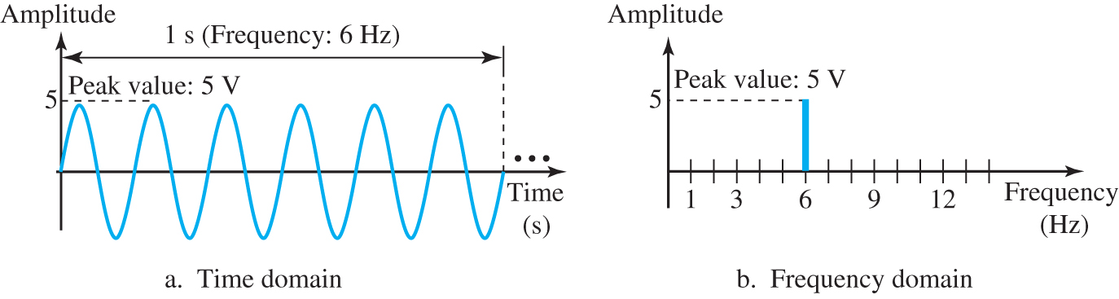
Figure 2.4 The time-domain and frequency-domain plots of a sine wave
Access the text alternative for slide images.

Slide 16
Composite Signal
So far, we have focused on simple sine waves. A composite signal is made of many simple sine waves.
The range of frequencies contained in a composite signal is its bandwidth. The bandwidth of a signal is the difference between the lowest and highest frequencies in the signal.

Slide 17
Bandwidth 1
The range of frequencies contained in a composite signal is its bandwidth. The bandwidth of a signal is the difference between the lowest and highest frequencies in the signal.
The bandwidth of a composite signal is the difference between the highest and the lowest frequencies contained in that signal.

Slide 18
2.1.2 Digital Signal
Information can also be represented by a digital signal. For example, a value 1 can be encoded as a positive voltage and a value 0 as zero voltage. A digital signal can have more than two levels. In this case, we can send more than 1 bit for each level. Figure 2.5 shows two signals, one with two levels and the other with four.

Slide 19
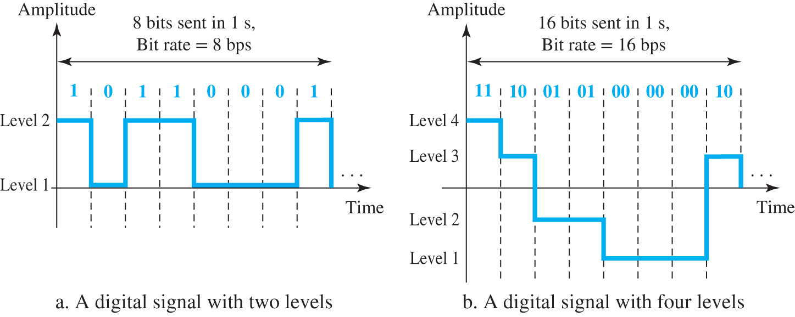
Figure 2.5 Two digital signals, one with two and one with four bit-levels
Access the text alternative for slide images.

Slide 20
Bit Rate
Most digital signal are nonperiodic, and thus period and frequency are not appropriate characteristics. Another term-bit rate (instead of frequency) is used. The bit rate is the number of bits sent in 1 second.

Slide 21
Example 2.3
Assume we have downloaded text documentation at the rate of 100 pages per minute. A page is an average of 24 lines with 80 characters per line. If we assume that one character requires 8 bits, the bit rate is:
100 * 24 * 80 * 8 = 1,536,000 bps = 1.536 Mbps

Slide 22
Bit Length
We discuss the concept of a wavelength for an analog signal. We can define something similar for a digital signal: the bit length. The bit length is the distance one bit occupy on the transmission medium.
bit length = 1 / bit rate

Slide 23
Example 2.4
The length of the bit in Example 2.3 is
1 / 1,536,000 = 0.651 microseconds

Slide 24
Transmission of Digital Signal
A digital signal is a composite analog signal with frequency between zero and infinity. We can have two types of transmission: baseband and broadband. The first means sending the digital signal without changing it to analog signal. The second means changing the digital signal to analog signal and send the analog signal.

Slide 25
2-2 SIGNAL IMPAIRMENT
Signals travel through transmission media, which are not perfect. The imperfection causes signal impairment. This means that the signal at the beginning of the medium is not the same as the signal at the end of the medium. What is sent is not what is received. Three causes of impairment are attenuation, distortion, and noise.

Slide 26
2.2.1 Attenuation and Amplification
Attenuation means a loss of energy. To compensate for this loss we need amplification. When a signal, simple or composite, travels through a medium, it loses some of its energy in overcoming the resistance of the medium. To compensate for this loss, we need amplification. Figure 2.6 shows the effect of attenuation and amplification.

Slide 27
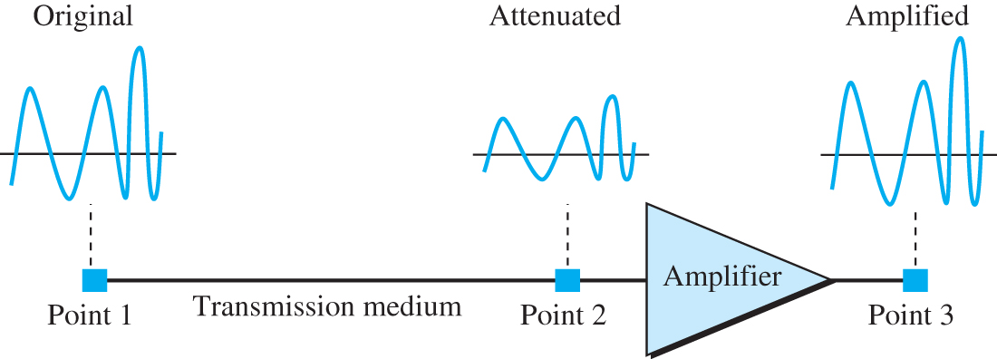
Figure 2.6 Attenuation and amplification
Access the text alternative for slide images.

Slide 28
Example 2.5
Suppose a signal travels through a transmission medium and its power is reduced to one half. This means that P2 = 0.5 P1. In this case, the attenuation (loss of power) can be calculated as
A loss of 3 dB (−3 dB) is equivalent to losing one-half the power.

Slide 29
2.2.2 Distortion
Distortion means that the signal changes its form or shape. Distortion can occur in a composite signal made up of different frequencies.

Slide 30
Noise
Noise is another cause of impairment. Several type of noise may occur during the signal transmission.
Signal-to-Noise Ratio (SNR) is defined as
SNR = (average signal power) / (average noise power)

Slide 31
2.2.3 Data Rate Limits
A very important consideration in data communications is how fast we can send data, in bits per second, over a channel. Data rate depends on three factors:
The bandwidth available
The level of the signals we use
The quality of the channel (the level of noise)
Two theoretical formulas were developed to calculate the data rate: one by Nyquist for a noiseless channel, another by Shannon for a noisy channel.

Slide 32
Noiseless Channel: Nyquist Bit Rate
For a noiseless channel, the Nyquist bit rate formula defines the theoretical maximum bit rate.

Slide 33
Example 2.6
We need to send 265 kbps over a noiseless (ideal) channel with a bandwidth of 20 kHz. How many signal levels do we need? We can use the Nyquist formula as shown:
Since this result is not a power of 2, we need to either increase the number of levels or reduce the bit rate. If we have 128 levels, the bit rate is 280 kbps. If we have 64 levels, the bit rate is 240 kbps.

Slide 34
Noisy Channel: Shannon Capacity
For a noisy channel, we have

Slide 35
Example 2.7
Consider an extremely noisy channel in which the value of the signal-to-noise ratio is almost zero. In other words, the noise is so strong that the signal is faint. For this channel the capacity C is calculated as shown below.
This means that the capacity of this channel is zero regardless of the bandwidth. In other words, the data is so corrupted in this channel that it is useless when received.

Slide 36
Example 2.8
We can calculate the theoretical highest bit rate of a regular telephone line. A telephone line normally has a bandwidth of 3000 Hz (300 to 3300 Hz) assigned for data communications. The signal-to-noise ratio is usually 3162. For this channel the capacity is calculated as shown below.
This means that the highest bit rate for a telephone line is 34.881 kbps. If we want to send data faster than this, we can either increase the bandwidth of the line or improve the signal-to noise ratio.

Slide 37
Using Both Limits
In practice, we need to use both limits.

Slide 38
Example 2.9
We have a channel with a 1-MHz bandwidth. The SNR for this channel is 63. What are the appropriate bit rate and signal level?
Solution
First, we use the Shannon formula to find the upper limit.
The Shannon formula gives us 6 Mbps, the upper limit. For better performance we choose something lower, 4 Mbps, for example. Then we use the Nyquist formula to find the number of signal levels.

Slide 39
2.2.4 Performance
Up to now, we have discussed the tools of transmitting data (signals) over a network and how the data behave. One important issue in networking is the performance of the network—how good is it?

Slide 40
Bandwidth 2
One characteristic that measure network performance is bandwidth.

Slide 41
Example 2.10
The bandwidth of a subscriber line is 4 kHz for voice or data. The bandwidth of this line for data transmission can be up to 56 kbps, using a sophisticated modem to change the digital signal to analog. If the telephone company improves the quality of the line and increases the bandwidth to 8 kHz, we can send 112 kbps.

Slide 42
Example 2.11
For example, one can say that the bandwidth of a fast Ethernet network is 100 Mbps. This means we can send 100 Mbps through this network.

Slide 43
Throughput
The throughput is the measure of how fast we can actually send data through a network.

Slide 44
Latency (Delay)
The latency or delay defines how long it takes for an entire message to completely arrive at the destination from the time the first bit is sent out from the source. We say that normally have four types of delay: propagation delay, transmission delay, queuing delay, and processing delay. The latency or total delay is
Latency = propagation delay + transmission delay + queuing delay + processing delay

Slide 45
Bandwidth-Delay Product
Bandwidth and delay are two performance metric of a link. However, what is very important in data communications is the product of the two, the bandwidth-delay product.

Slide 46
Example 2.12
We can think about the link between two points as a pipe. We can say that the volume of the pipe defines the bandwidth-delay product

Slide 47
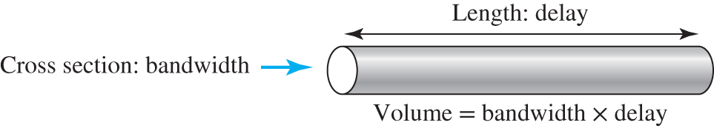
Figure 2.7 Bandwidth-delay product
Access the text alternative for slide images.

Slide 48
Jitter
Another performance issue that is related to delay is jitter. We can roughly say that jitter is a problem if different packets of data encounter different delays and the application using the data at the receiver site is time-sensitive (audio and video data, for example). If the delay for the first packet is 20 ms, for the second is 45 ms, and for the third is 40 ms, then the real-time application that uses the packets endures jitter.

Slide 49
2-3 DIGITAL TRANSMISSION
A computer network is designed to send information from one point to another. This information needs to be converted to either a digital signal or an analog signal for transmission. In this section, we discuss the first choice, conversion to digital signals; in the next section, we discuss the second choice, conversion to analog signals.

Slide 50
2.3.1 Digital-to-Digital Conversion
In this section, we see how we can represent digital data by using digital signals. The conversion involves three techniques: line coding, block coding, and scrambling. Line coding is always needed; block coding and scrambling may or may not be needed.

Slide 51
Line Coding
Line coding is the process of converting digital data to digital signals. We assume that data, in the form of text, numbers, graphical images, audio, or video, are stored in computer memory as sequences of bits.

Slide 52
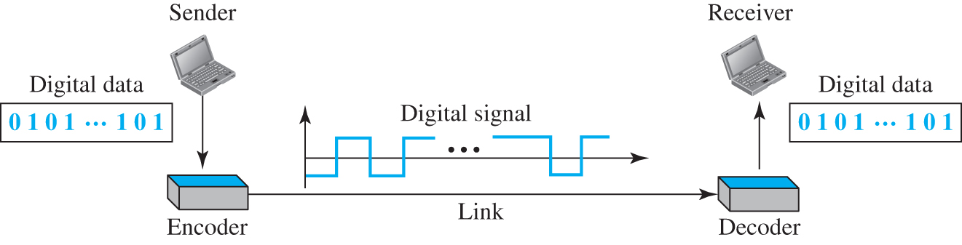
Figure 2.8 Line coding and decoding
Access the text alternative for slide images.

Slide 53
Block Coding
We need redundancy to ensure synchronization and to provide inherent error detecting. Block coding can give us this redundancy and improve the performance of line coding. In general, block coding changes a block of m bits into a block of n bits, where n is larger than m. Block coding is referred to as an mB/nB encoding technique.

Slide 54
2.3.2 Analog-to-Digital Conversion
Sometimes we have an analog signal such as one created by a microphone or camera. The tendency today is to change an analog signal to digital data because the digital signal is less susceptible to noise. In this section we describe two techniques, pulse code modulation and delta modulation.

Slide 55
Pulse-Code Modulation (PCM)
The most common technique to change to change an analog signal to a digital signal is called pulse code modulation (PCM) , as shown in Figure 2.9.

Slide 56
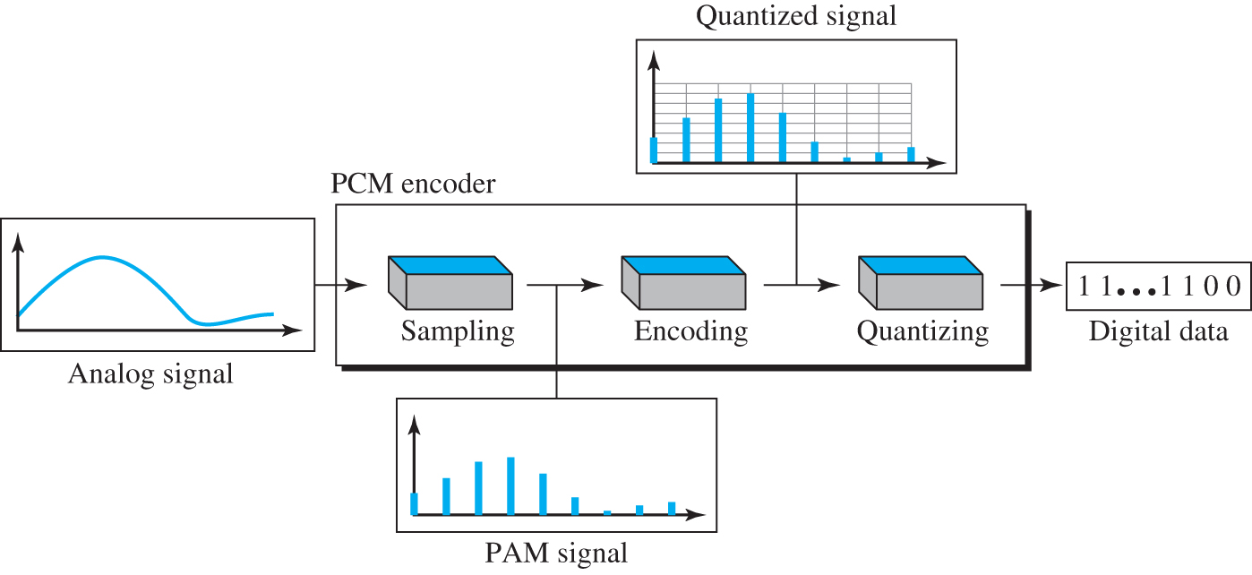
Figure 2.9 Components of PCM encoder
Access the text alternative for slide images.

Slide 57
Example 2.13
We want to digitize the human voice. What is the bit rate, assuming 8 bits per sample?
Solution
The human voice normally contains frequencies from 0 to 4000 Hz. So the sampling rate and bit rate are calculated as follows.

Slide 58
Delta Modulation (DM)
PCM is a very complex technique. Other techniques have been developed to reduce the complexity of PCM. The simplest is delta modulation. PCM finds the value of the signal amplitude for each sample; DM finds the change from the previous sample. Figure 2.10 shows the process.

Slide 59
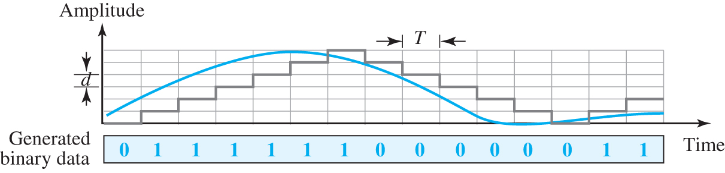
Figure 2.10 The process of delta modulation
Access the text alternative for slide images.

Slide 60
2-4 ANALOG TRANSMISSION
While digital transmission is desirable, it needs a low-pass channel; analog transmission is the only choice if we have a bandpass channel. Converting digital data to a bandpass analog signal is traditionally called digital-to-analog conversion. Converting a low-pass analog signal to a bandpass analog signal is traditionally called analog-to-analog conversion.

Slide 61
2.4.1 Digital-to-Analog Conversion
Digital-to-analog conversion is the process of changing one of the characteristics of an analog signal based on the information in digital data.

Slide 62
Amplitude Shift Keying (ASK)
In amplitude shift keying, the amplitude of the carrier signal is varied to create signal elements.

Slide 63
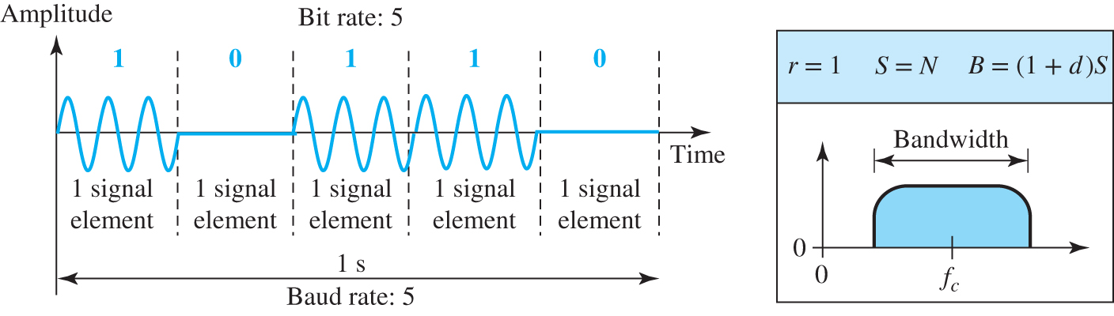
Figure 2.11 Binary amplitude shift keying
Access the text alternative for slide images.

Slide 64
Frequency Shift Keying
In frequency shift keying, the frequency of the carrier signal is varied to represent data.

Slide 65
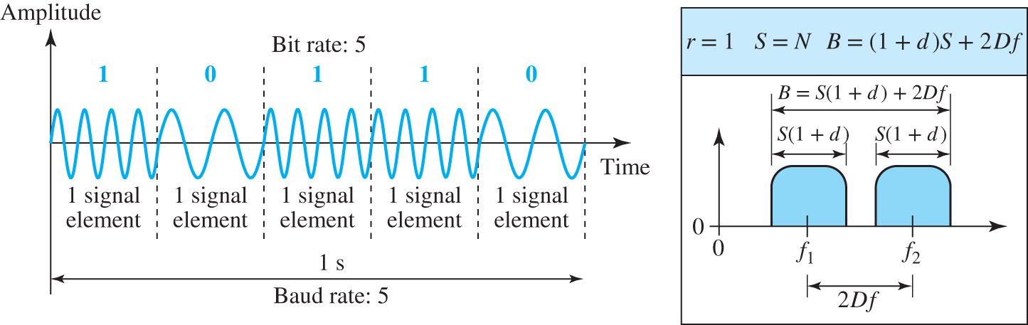
Figure 2.12 Binary frequency shift keying
Access the text alternative for slide images.

Slide 66
Phase Shift Keying
In phase shift keying, the phase of the carrier signal is varied to represent data.

Slide 67
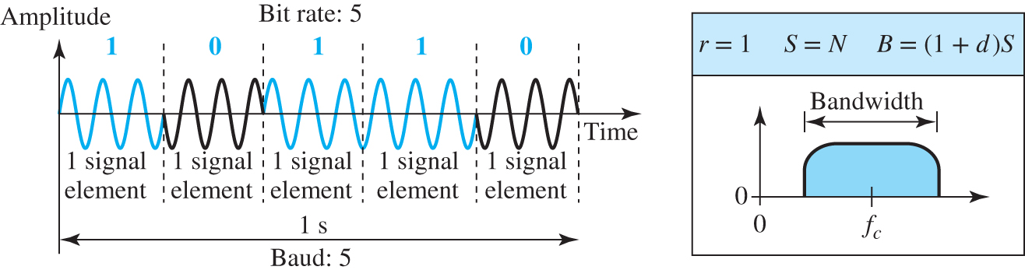
Figure 2.13 Binary phase shift keying
Access the text alternative for slide images.

Slide 68
2.4.2 Analog-to-Analog Conversion
Analog-to-analog conversion, or analog modulation, is the representation of analog information by an analog signal. One may ask why we need to modulate an analog signal; it is already analog. Modulation is needed if the medium is bandpass in nature or if only a bandpass channel is available to us.

Slide 69
Amplitude Modulation (AM)
In amplitude modulation, the amplitude of the carrier signal changes to follow the changes in modulating signal.

Slide 70
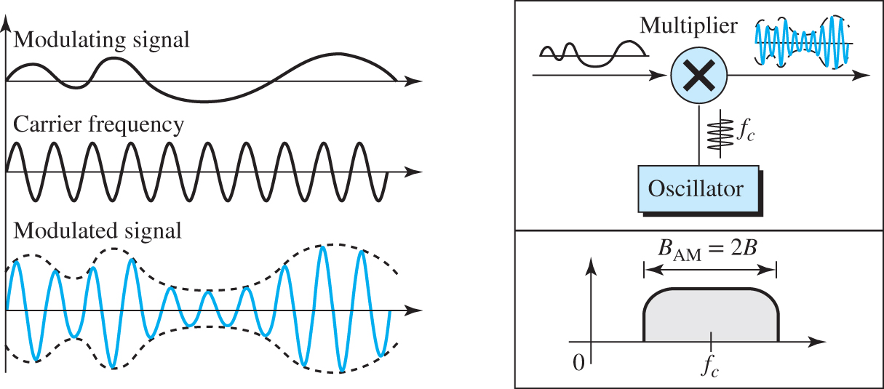
Figure 2.14 Amplitude modulation
Access the text alternative for slide images.

Slide 71
Frequency Modulation (FM)
In frequency modulation, the frequency of carrier signal changes to follow the changes in the modulating signal.

Slide 72
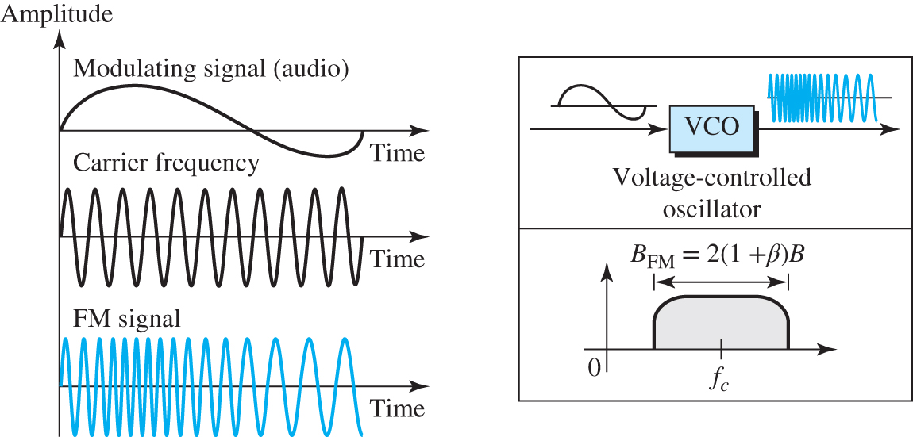
Figure 2.15 Frequency modulation
Access the text alternative for slide images.

Slide 73
Phase Modulation (PM)
In phase modulation, the phase of carrier signal changes to follow the changes in the modulating signal.

Slide 74
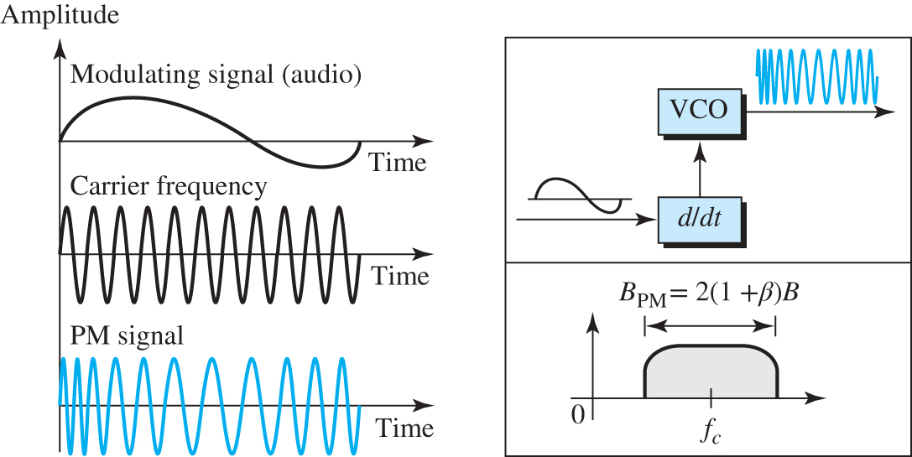
Figure 2.16 Phase modulation
Access the text alternative for slide images.

Slide 75
2-5 MULTIPLEXING
In real life, we have links with limited bandwidths. Sometimes we need to combine several low-bandwidth channels to make use of one channel with a larger bandwidth. Sometimes we need to expand the bandwidth of a channel to achieve goals such as privacy and anti-jamming.

Slide 76
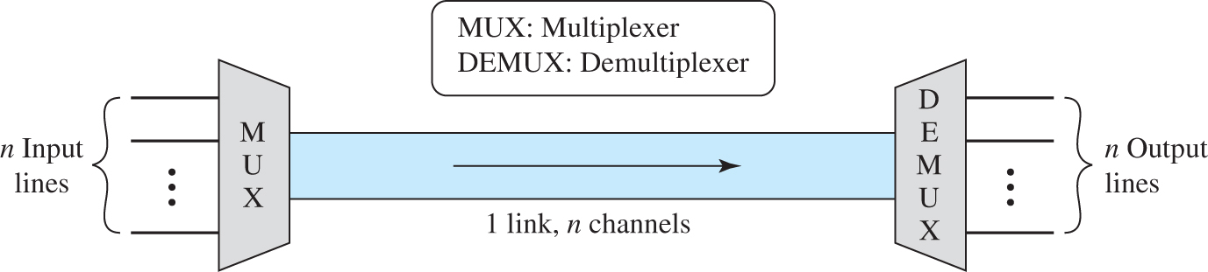
Figure 2.17 Dividing a link into channels
Access the text alternative for slide images.

Slide 77
2.5.1 Frequency-Division Multiplexing
Frequency-division multiplexing is an analog technique that can be applied when the bandwidth of a link is greater than the combined bandwidth of the signals to be transmitted together.

Slide 78
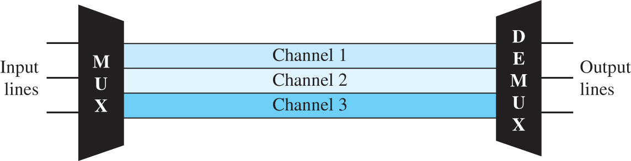
Figure 2.18 Frequency-division multiplexing
Access the text alternative for slide images.

Slide 79
2.5.2 Time-Division Multiplexing
Time-division multiplexing (TDM) is a digital technique that allows several connections to share the high bandwidth of a link.

Slide 80
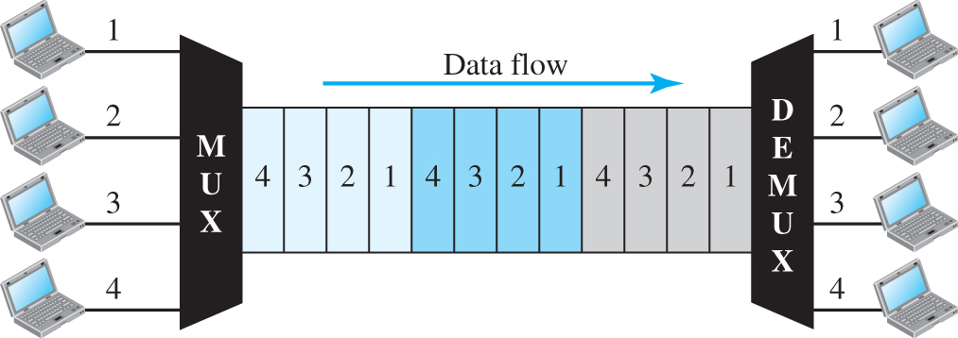
Figure 2.19 Time division multiplexing (TDM)
Access the text alternative for slide images.

Slide 81
2-6 TRANSMISSION MEDIA
We discussed many issues related to the physical layer in this chapter. In this section, we discuss transmission media. Transmission media are located below the physical layer and are directly controlled by the physical layer.

Slide 82
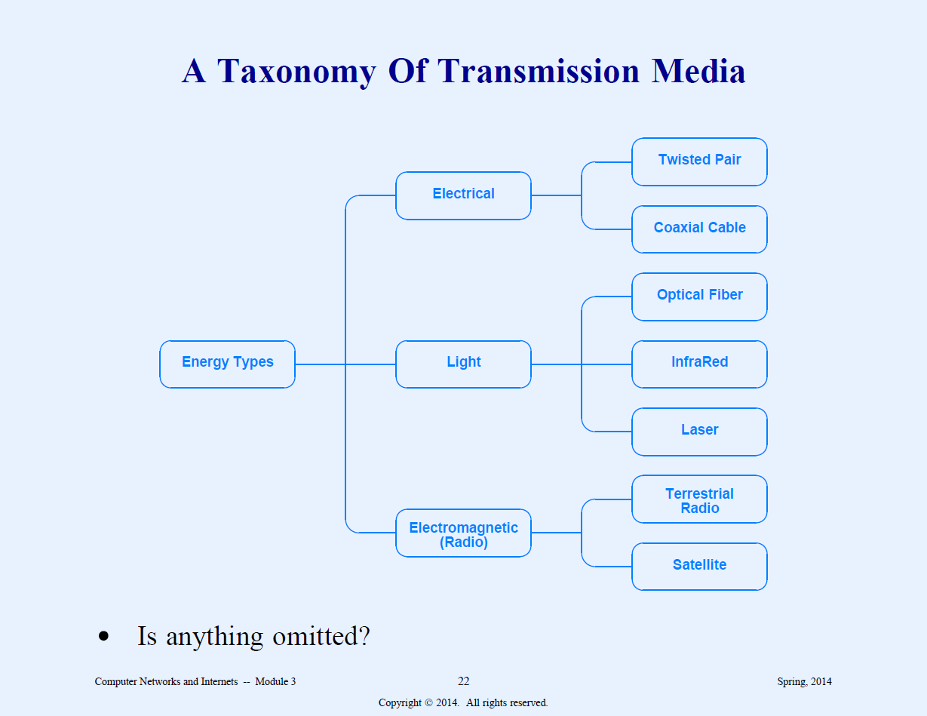
Taxonomy by forms of Energy
Electromagnetic, light, electrical

Slide 83
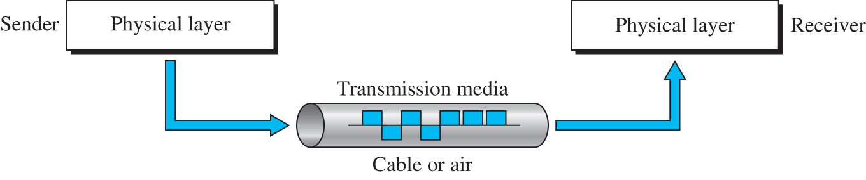
Figure 2.20 Transmission media and physical layer
Access the text alternative for slide images.

Slide 84
2.6.1 Guided Media
Guided media, which are those that provide a conduit from one device to another, include twisted-pair cable, coaxial cable, and fiber-optic cable.

Slide 85
Twisted-Pair Cable
A twisted-pair cable consists of two conductors, each with its own plastic insulation, twisted together as shown in Figure 2.21.

Slide 86
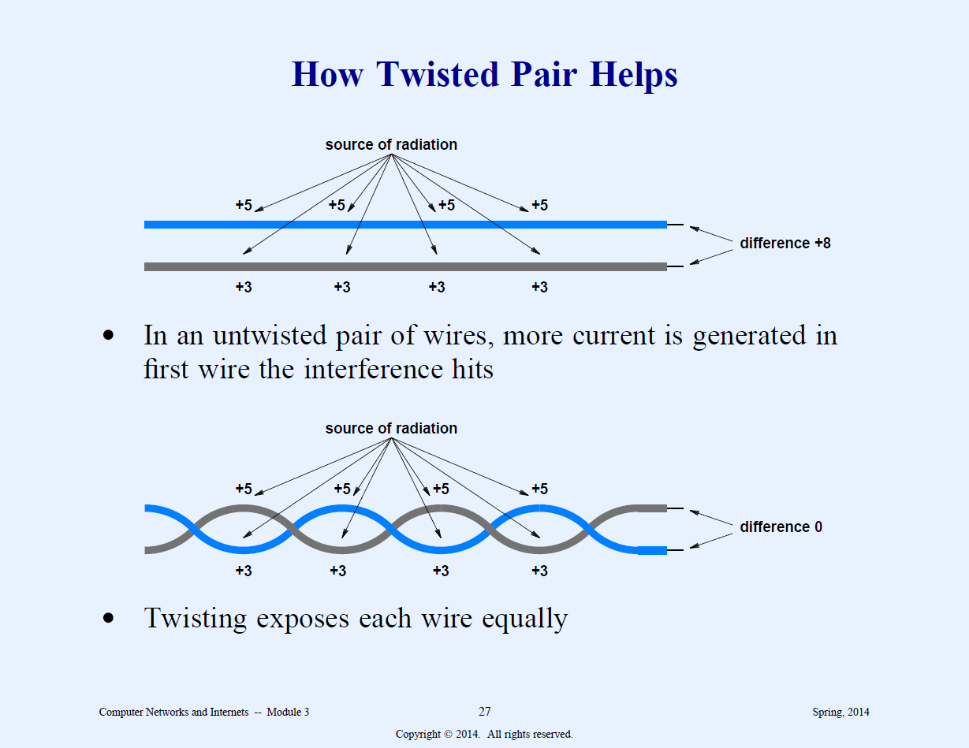

Slide 87
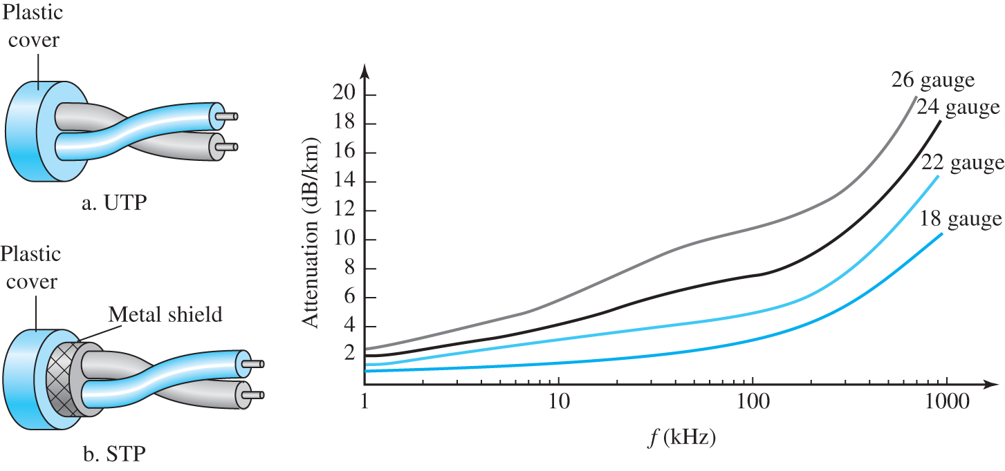
Figure 2.21 Twisted-pair cable
Access the text alternative for slide images.

Slide 88
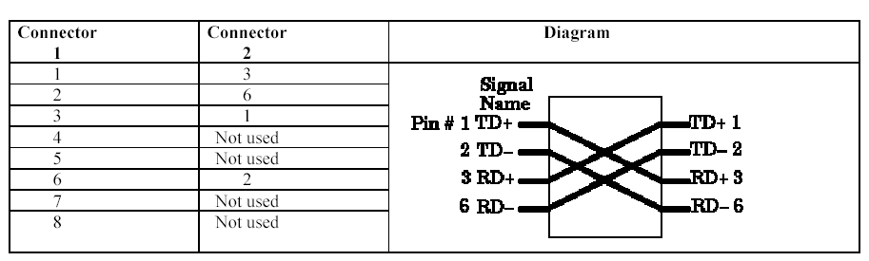
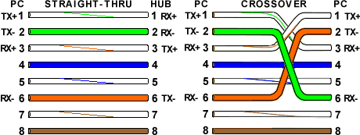
Crossover cable

Slide 89
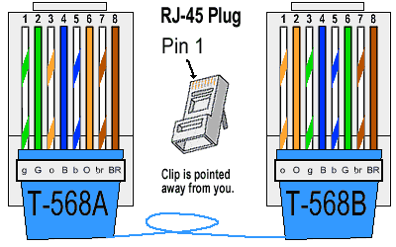
RJ-45 Crossover Ethernet Cable

Slide 90
Coaxial Cable
Coaxial cable carries signals of higher frequency ranges more than those in twisted-pair cable. Coaxial cable has a central core enclosed in an insulating sheath as shown in Figure 2.22.

Slide 91
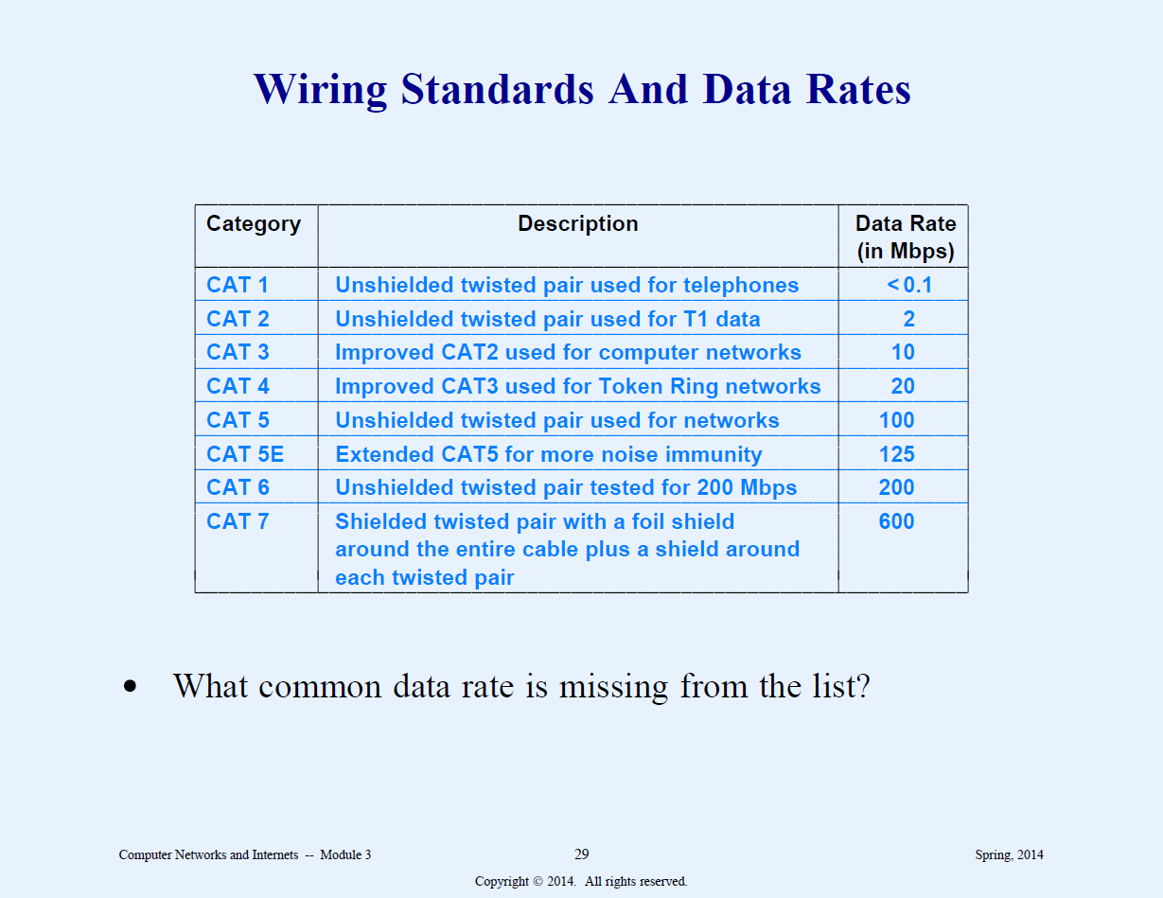

Slide 92
Crossover cable
1 | White/Orange | White/Green | 1
2 | Orange | Green | 2
3 | White/Green | White/Orange | 3
4 | Blue | White/Brown | 4
5 | White/Blue | Brown | 5
6 | Green | Orange | 6
7 | White/Brown | Blue | 7
8 | Brown | White/Blue | 8

Slide 93
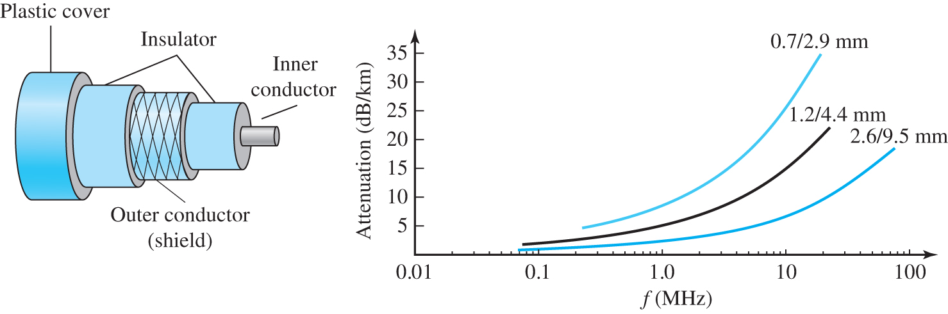
Figure 2.22 Coaxial cable
Access the text alternative for slide images.

Slide 94
Fiber-Optic Cable
A fiber-optic cable is made of glass or plastic and transmits signal in the form of light. If a light traveling in a substance enters another substance, the ray changes direction as shown in Figure 2.23. Figure 2.24 shows how a beam of light travels through an optical fiber.

Slide 95
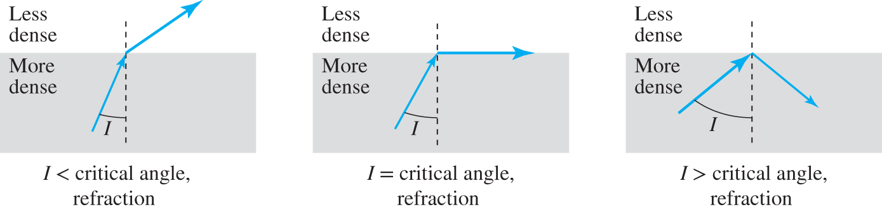
Figure 2.23 Bending of light ray
Access the text alternative for slide images.

Slide 96
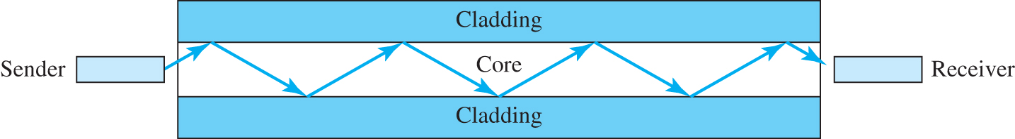
Figure 2.24 Optical fiber
Access the text alternative for slide images.

Slide 97
Fiber Optics
Greater capacity 2 Gbps over tens of kilometers
Repeaters needed only every 8 KM
Smaller size & weight
Materials used
  Plastic (short haul)
  Glass
  Fused Silica (best)

Slide 98
Fiber contd
http://www.datacottage.com/nch/fibre.htm
lower attenuation
electromagnetic isolation
Use LED or ILD
  light emitting diode, Injection Laser diode
Use Photodiode to detect
  PIN photodiode
  APD photodiode
One - short pulse of light, Zero-absence of light

Slide 99
Fiber contd
Core
Cladding
  optical properties differ between core and cladding. Cladding has lower refractive index
Jacket to protect against moisture, crushing, etc.

Slide 100
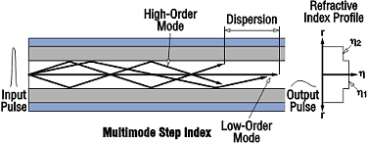
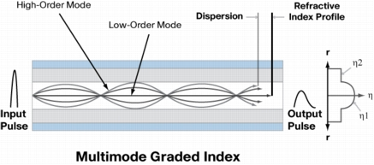
Fiber contd
Light propagates from one end to another in one of the following ways
  mono mode (straight line)
    the source is laser
    Most expensive
  Multimode stepped index
    the source is LED
    Bounces of cladding
  Multimode graded index
    The cladding refractive index increases as it moves away from the core

Slide 101
Fiber Optic Networks
Taps are difficult
Two types of interface
  Passive interface
    one end has an LED or laser diode
    The other end has photodiode
  Active interface
    incoming light is converted to electric signal
    Signal is generated to full strength
    Tap into the signal generator

Slide 102
2.6.2 Unguided Media: Wireless
Unguided media transport electromagnetic waves without using a physical conductor. This type of communication is often referred to as wireless communication. Signals are normally broadcast through free space and thus are available to anyone who has a device capable of receiving them. Figure 2.25 shows part of the electromagnetic spectrum from 3KHz to 800 THz used for wireless communication.

Slide 103
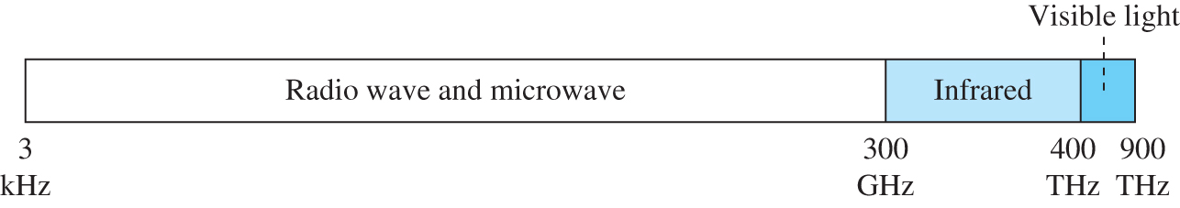
Figure 2.25 Electromagnetic spectrum for wireless communication
Access the text alternative for slide images.

Slide 104
Radio Waves
Although there is no clear-cut demarcation between radio waves and microwaves, electromagnetic waves ranging in frequencies between 3 kHz and 1 GHz are normally called radio waves; waves ranging in frequencies between 1 and 300 GHz are called microwaves. However, the behavior of the waves, rather than the frequencies, is a better criterion for classification. Radio waves, for the most part, are omnidirectional.

Slide 105
Microwaves
Electromagnetic waves having frequencies between 1 and 300 GHz are called microwaves. Microwaves are unidirectional. When an antenna transmits microwaves, they can be narrowly focused. This means that the sending and receiving antennas need to be aligned. The unidirectional property has an obvious advantage. A pair of antennas can be aligned without interfering with another pair of aligned antennas.

Slide 106
Infrared
Infrared waves, with frequencies from 300 GHz to 400 THz (wavelengths from 1 mm to 770 nm), can be used for short-range communication. Infrared waves, having high frequencies, cannot penetrate walls. This advantageous characteristic prevents interference between one system and another; a short-range communication system in one room cannot be affected by another system in the next room.

Slide 107
End of Main Content
© 2022 McGraw Hill, LLC. All rights reserved. Authorized only for instructor use in the classroom.
No reproduction or further distribution permitted without the prior written consent of McGraw Hill, LLC.

Slide 108
Accessibility Content: Text Alternatives for Images

Slide 109
Figure 2.1 Communication at the physical layer - Text Alternative
Return to parent-slide containing images.
The communication between Alice and Bob is depicted using a network topology and a data flow diagram. Two host devices (one belongs to Alice) are connected to a L A N switch. This network represents sky research. The L A N switch connects to a router R 2 by point-to-point W A N. The R 2 connects to a router R 1 which further connects to other I S P s through point-to-point W A N. The R 2 connects to a router R 4 through a by point-to-point W A N, that in turn connects to a W A N switch belonging to a switched W A N network of three W A N devices. The other W A N switch from the switched W A N network connects to a router R 3 through a point-to-point W A N, that further connects to other I S Ps. The third W A N switch from the switched network connects to a router R 5 by point-to-point W A N. This network represents a national I S P. The router R 5 connects to a router R 7 in an I S P network. The router R 7 connects to a L A N switch belonging to a network representing scientific books. The L A N switch connects to two host devices and a mainframe represents Bob. R 7 connects to a router R 6 that further connects to other I S Ps, by point-point W A N. The data flow diagram shows that the data flows from the physical layer of Alice host device to the physical layer of R 2 which has two physical and data-link layers and a network layer. From the other physical layer, the data flows to the physical layer of R4. From the other physical layer of R4, the data flows to the physical layer of R 5. Likewise, the data flows from R 5 to R 7 and reaches the physical layer of the Bob host device.
Return to parent-slide containing images.

Slide 110
Figure 2.2 Comparison of analog and digital signals - Text Alternative
Return to parent-slide containing images.
Two graphs of value versus time are shown. The first graph shows an analog signal that has wavy patterns with positive and negative peaks. The second graph shows a digital signal that shows square waveforms that lies at a positive value for a certain period, which then remains constant at the minimum value and then drops down to a negative value with increasing time.
Return to parent-slide containing images.

Slide 111
Figure 2.3 A sine wave - Text Alternative
Return to parent-slide containing images.
A graph shows a continuous sine waveform that originates from a positive value. The waveform with three crests and three troughs has a total period of 1 second. The period between any two crests is 'T ' that equals a period of 1 over 3 seconds. The amplitude is marked 'A. ' The half of the first crest lies on the negative x-axis. The distance between the origin and the point where the waveform meets the x-axis is marked 'P' that represents the phase, 1 over 4 period that equals 90 degrees.
Return to parent-slide containing images.

Slide 112
Figure 2.4 The time-domain and frequency-domain plots of a sine wave - Text Alternative
Return to parent-slide containing images.
The first graph represents the time-domain that shows six wavy peaks in positive and negative cycles in 1 second (frequency: 6 Hertz). The peak value is 5 Volts. The second graph represents the frequency domain. The x-axis represents the frequency that ranges as 1, 3, 6, 9, and 12. The graph shows a vertical line on the frequency of 6 Hertz with a peak value of 5 V.
Return to parent-slide containing images.

Slide 113
Figure 2.5 Two digital signals, one with two and one with four bit-levels - Text Alternative
Return to parent-slide containing images.
The first graph represents a digital signal with two levels that shows 8 bits sent in 1 second and the bit rate is equal to 8 bits per second. Level 2 represents 1 and level 1 represents 0. The patterns shown are 1 0 1 1 0 0 0 1. The second graph represents a digital signal with four levels that shows 16 bits sent in 1 second and the bit rate is equal to 16 bits per second. Level 4 represents 11, level 3 represents 10, level 2 represents 01, and level 1 represents 00. The patterns shown are 11 10 01 01 00 00 00 10.
Return to parent-slide containing images.

Slide 114
Figure 2.6 Attenuation and amplification - Text Alternative
Return to parent-slide containing images.
The original waveform at point 1 shows a steep increase and decrease in close intervals. The wave after passing through the transmission medium is attenuated on point 2, which shows shorter wave patterns, and after passing through an amplifier, the wave is amplified at point 3. The wave shows a steep increase and decreases in amplitude as similar to the original on point 1.
Return to parent-slide containing images.

Slide 115
Figure 2.7 Bandwidth-delay product - Text Alternative
Return to parent-slide containing images.
A cylindrical tube is shown. The length of the tube represents delay. The Cross-section of the tube represents bandwidth. Volume is given by the multiplication of bandwidth and delay.
Return to parent-slide containing images.

Slide 116
Figure 2.8 Line coding and decoding - Text Alternative
Return to parent-slide containing images.
A sender host device transforms digital data 0 1 0 1 continues to 1 0 1 to an encoder. The encoder sends to the decoder through a link. The data appears as a digital signal in between the encoder and decoder. The decoder sends the same digital data to the receiver host device that equals 0 1 0 1 continues to 1 0 1.
Return to parent-slide containing images.

Slide 117
Figure 2.9 Components of PCM encoder - Text Alternative
Return to parent-slide containing images.
A figure shows the conversion of an analog signal to digital data. An analog signal enters a P C M encoder. The signal passes through the Sampling block. A PAM signal is sent along with the sampling output to an encoder. A quantized signal and the output from the encoder block are sent to a quantizing block which produces digital data, 1 1 continues to 1 1 0 0.
Return to parent-slide containing images.

Slide 118
Figure 2.10 The process of delta modulation - Text Alternative
Return to parent-slide containing images.
A graph shows a sine wave and a stepped sine wave overlapping each other. The amplitude and period of each step is 'd' and 'T' respectively. The generated binary data is 0 1 1 1 1 1 1 0 0 0 0 0 0 1 1.
Return to parent-slide containing images.

Slide 119
Figure 2.11 Binary amplitude shift keying - Text Alternative
Return to parent-slide containing images.
The first graph exhibits a baud rate of 5 for 1 second and the bit rate is 5. The x-axis represents time and the y-axis represents amplitude. The graph shows a continuous waveform that is partitioned into five single elements representing the binary digits 10110. Every single element representing digit 1 has a waveform with three crests and troughs, and for the digit 0, the curve remains constant on the axis for the same time as required for digit 1. The bandwidth graph shows an open downward curve in the positive cycle. The length of the curve is the bandwidth. The midpoint is marked f subscript c. The values for r are equal to 1, S is equal to N, and b is equal to (1 plus d) times S.
Return to parent-slide containing images.

Slide 120
Figure 2.12 Binary frequency shift keying - Text Alternative
Return to parent-slide containing images.
The first graph exhibits a baud rate of 5 for 1 second and the bit rate is 5. The x-axis represents time and the y-axis represents amplitude. The graph shows a continuous waveform that is partitioned into five single elements representing the binary digits 10110. Every single element representing digit 1 has a waveform with three crests and troughs, and for the digit 0, the curve has two crests and troughs. The second graph shows two bands with f subscript 1 and f subscript 2 as midpoints. The distance between the two midpoints is 2 times Df. The bandwidths of the two bands are S times (1 plus d). The total bandwidth of the two bands is B equal to S times (1 plus d) plus 2 Df. The value for r is equal to 1, and S is equal to N.
Return to parent-slide containing images.

Slide 121
Figure 2.13 Binary phase shift keying - Text Alternative
Return to parent-slide containing images.
The first graph exhibits a baud rate of 5 for 1 second and the bit rate is 5. The x-axis represents time and the y-axis represents amplitude. The graph shows a continuous waveform that is partitioned into five single elements representing the binary digits 10110. Every single element representing digit 1 has a waveform originating from the positive cycle and ends in a negative cycle with three crests and troughs, and for the digit 0, the curve originates from the negative cycle and ends in a positive cycle with three crests and troughs. The bandwidth graph shows an open downward curve in the positive cycle. The length of the curve is the bandwidth. The midpoint is marked f subscript c. The value for r is equal to 1, S is equal to N, and b is equal to (1 plus d) times S.
Return to parent-slide containing images.

Slide 122
Figure 2.14 Amplitude modulation - Text Alternative
Return to parent-slide containing images.
A graph shows wave patterns of modulating signal, carrier frequency, and modulated signal. A modulating signal and a carrier frequency signal, f subscript c from an oscillator are given as inputs to a multiplier. The modifier gives a modulated signal output. The bandwidth graph shows an open downward curve in the positive cycle whose length is B subscript A M is equal to 2 B. The midpoint of the curve is f subscript c.
Return to parent-slide containing images.

Slide 123
Figure 2.15 Frequency modulation - Text Alternative
Return to parent-slide containing images.
A graph shows wave patterns for modulating signal (audio), carrier frequency, and F M signal. A modulating signal (audio) passes through a voltage-controlled oscillator to obtain an F M signal. A graph shows an open downward curve in the positive cycle, whose length is B subscript F M equals 2 times (1 plus beta) times B. The midpoint of the curve is f subscript c.
Return to parent-slide containing images.

Slide 124
Figure 2.16 Phase modulation - Text Alternative
Return to parent-slide containing images.
A graph shows wave patterns for modulating signal (audio), carrier frequency, and PM signal. The illustration shows the modulating signal entering a block, d over d t, from which the output passes through a voltage-controlled oscillator to obtain an P M signal. A graph shows an open downward curve in the positive cycle, whose length is B subscript PM equals 2 times (1 plus beta) times B. The midpoint of the curve is f subscript c.
Return to parent-slide containing images.

Slide 125
Figure 2.17 Dividing a link into channels - Text Alternative
Return to parent-slide containing images.
An illustration shows the 'n' number of input lines passing through a multiplexer (M U X). The multiplexer is connected to a demultiplexer through a link that has 'n' channels. The demultiplexer (D E M U X) provides 'n' output lines.
Return to parent-slide containing images.

Slide 126
Figure 2.18 Frequency-division multiplexing - Text Alternative
Return to parent-slide containing images.
A figure shows three input lines passes through a multiplexer (M U X). The input lines are sent to the demultiplexer through three different channels 1, 2, and 3. The demultiplexer (D E M U X) provides three output lines.
Return to parent-slide containing images.

Slide 127
Figure 2.19 Time division multiplexing (TDM) - Text Alternative
Return to parent-slide containing images.
A figure shows four host devices labeled as 1, 2, 3, and 4 connected to a multiplexer (M U X). The data, 4 3 2 1 4 3 2 1 4 3 2 1 flows from the multiplexer to the demultiplexer (D E M U), to which four host devices 1, 2, 3, and 4 are connected.
Return to parent-slide containing images.

Slide 128
Figure 2.20 Transmission media and physical layer - Text Alternative
Return to parent-slide containing images.
In the figure, the data from the physical layer of the sender passes through a transmission media, which is a cable or air, and enters the physical layer of the receiver.
Return to parent-slide containing images.

Slide 129
Figure 2.21 Twisted-pair cable - Text Alternative
Return to parent-slide containing images.
The unshielded twisted pair cable represents a pair of cable wires with a plastic cover. The shielded twisted pair cable represents a pair of cable wires with a metal shield present beneath the plastic cover. A graph is shown beside. The X-axis represents frequency in kiloHertz that ranges as follows: 1, 10, 100, and 1000. The Y-axis represents attenuation in decibels per kilometer that ranges from 0 to 20 in increments of 2. The graph shows four curves. The curve that represents 18 gauge increases from 1.6 to 10 decibels per kilometer with an increase in frequency from 1 to 1000 kiloHertz. The curve for 22 gauge increases from 1.8 to 14 decibels per kilometer with an increase in frequency from 1 to 1000 kiloHertz, the curve for 24 gauge increases from 2 to 16 decibels per kilometer in 1 to 1000 kiloHertz, and the curve for 26 gauge increases from 2.2 to 18 decibels per kilometer in 1 to 1000 kiloHertz.
Return to parent-slide containing images.

Slide 130
Figure 2.22 Coaxial cable - Text Alternative
Return to parent-slide containing images.
A coaxial cable has a plastic cover, two insulators, an outer conductor shielded in between the two insulators and an inner conductor. A graph is shown beside the cable. The X-axis of the graph represents frequency in megahertz that ranges as follows: 0.01, 0.1, 1.0, 10, and 100. The Y-axis represents attenuation in decibels per kilometer that ranges from 5 to 35 in increments of 5. The graph shows three curves. The curve representing 2.6 over 9.5 millimeters increases from 1 (approximately) to 18 decibels per kilometer with an increase in frequency from 0.07 to 80 megahertz. The curve for 1.2 over 4.4 millimeters increases from 1 (approximately) to 20 decibels per kilometer with the increase in frequency from 0.07 to 20 megahertz, and the curve for 0.7 over 2.9 millimeters increases from 5 (approximately) to 35 decibels per kilometer with the increase in frequency from 0.3 to 10 megahertz. Note: the above-mentioned values are approximate.
Return to parent-slide containing images.

Slide 131
Figure 2.23 Bending of light ray - Text Alternative
Return to parent-slide containing images.
Three figures depict the bending of light rays for different values of 'I. ' In the first figure, the value of I is less than the critical angle. As the light ray from a more dense medium enters the less dense medium, it slightly bends toward the right. The angle between the light ray and the vertical in the more dense medium is marked 'I. ' In the second figure, the value of I is equal to the critical angle. Here the light ray bends horizontally on the outer area of the more dense medium. In the third figure, the value of I is greater than the critical angle. Here the light ray, on reaching the less dense medium, bends downward back to the more dense medium.
Return to parent-slide containing images.

Slide 132
Figure 2.24 Optical fiber - Text Alternative
Return to parent-slide containing images.
The signal from the sender passes through the core layer of the optical fiber in zigzag patterns and reaches the receiver. The core layer is present between the two cladding layers.
Return to parent-slide containing images.

Slide 133
Figure 2.25 Electromagnetic spectrum for wireless communication - Text Alternative
Return to parent-slide containing images.
A spectrum shows that the radio waves and microwaves range from 3 kilohertz to 300 gigahertz, infrared region ranging between 300 gigahertz and 400 terahertz, and visible light ranges from 400 terahertz to 900 terahertz.
Return to parent-slide containing images.

