Slide 1
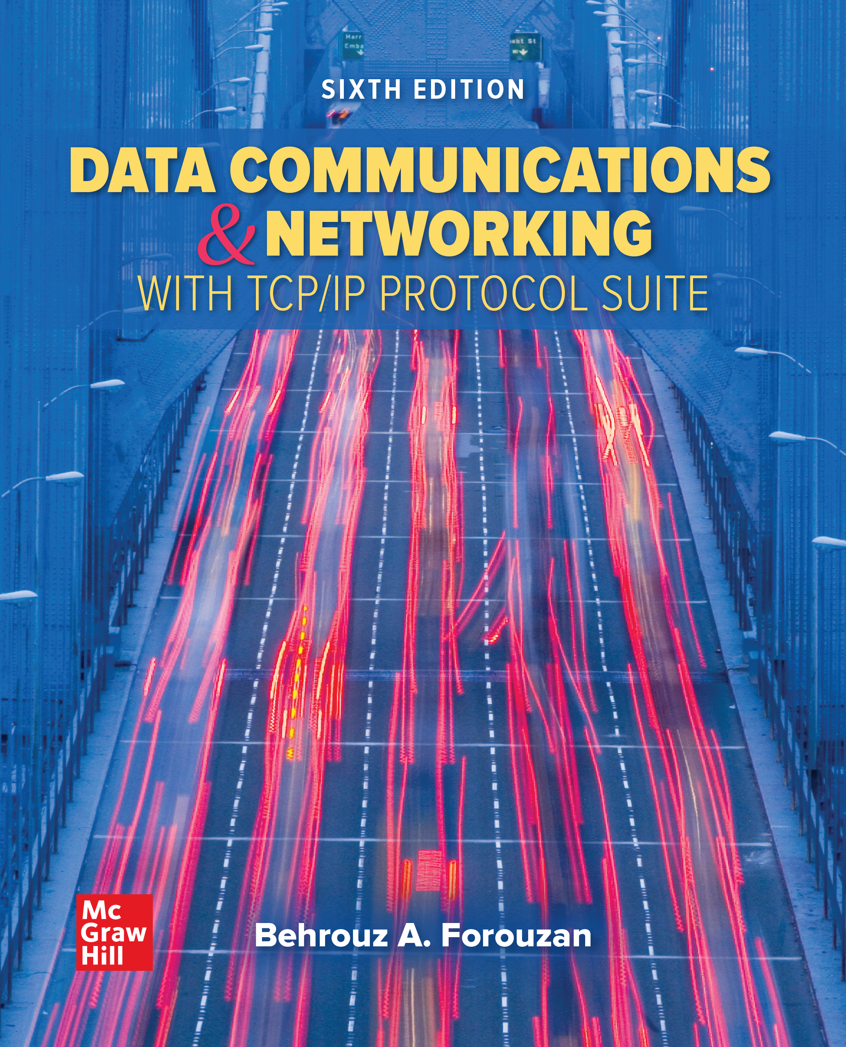
Chapter 01
Introduction
Data Communications and Networking, With TCP/IP protocol suite
Sixth Edition
Behrouz A. Forouzan
© 2022 McGraw Hill, LLC. All rights reserved. Authorized only for instructor use in the classroom.
No reproduction or further distribution permitted without the prior written consent of McGraw Hill, LLC.

Slide 2
Chapter 3: Outline
1.1 DATA COMMUNICATIONS
1.2 NETWORKS
1.3 NETWORK TYPES
1.4 PROTOCOL LAYERING
1.5 TCP/IP PROTOCOL SUITE
1.6 THE OSI MODEL

Slide 3
1.1 DATA COMMUNICATIONS
Data communication is the exchange of data between two devices via some form of transmission media. It depends on four characteristics:
Delivery
Accuracy
Timeliness
Jitter

Slide 4
1.1.1 Components
A data communications system has five components:
Message
Sender
Receiver
Transmission Medium
Protocol
(Figure 1.1)

Slide 5
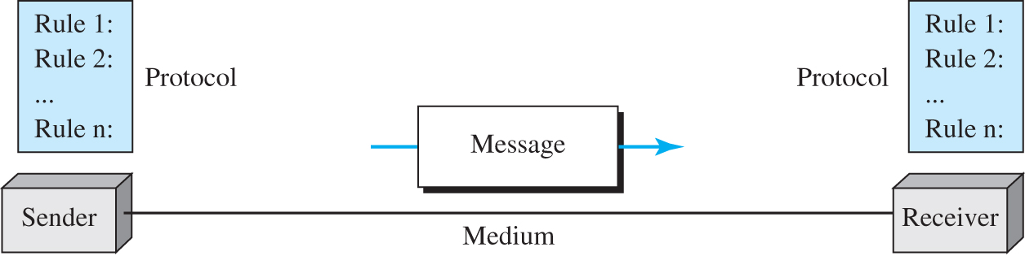
Figure 1.1 Five components of data communication
Access the text alternative for slide images.

Slide 6
1.1.2 Message
Information today comes in different forms such as text, numbers, images, audio, and video.

Slide 7
Text
Text is represented as a bit pattern using Unicode.

Slide 8
Numbers
Numbers are represented in binary.

Slide 9
Images
Images are represented as bit patterns using either RGB or YCM.

Slide 10
Audio
Audio refers to the recording or broadcasting of sound or music, represented as analog or digital signals.

Slide 11
Video
Videos can be a continues images or a combination of images.

Slide 12
1.1.3 Data Flow
Communication between two devices can be simplex, half-duplex, and duplex as shown in Figure 1.2.

Slide 13
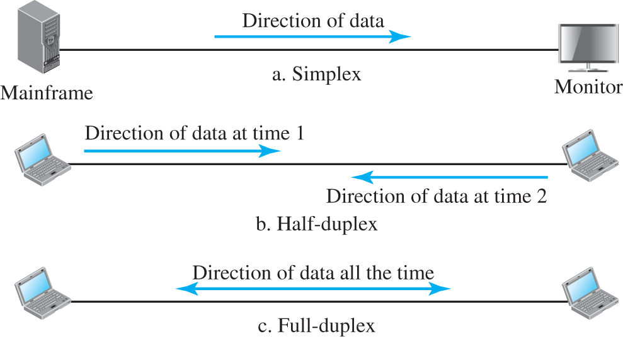
Figure 1.2 Data flow (simplex, half-duplex, full-duplex)
Access the text alternative for slide images.

Slide 14
Simplex
In simplex mode the communication is in one direction. Only one of the two connected devices can send or receive.

Slide 15
Half-Duplex
In half-duplex, each station can send or receive, but not at the same time.

Slide 16
Full-Duplex
In full-duplex, both stations can send or receive at the same time.

Slide 17
1-2 NETWORKS
A network is the interconnection of a set of devices capable of communication. In this definition, a device can be a host such as a large computer, desktop, laptop, workstation, cellular phone, or security system. A device in this definition can also be a connecting device such as a router a switch, a modem that changes the form of data, and so on.

Slide 18
1.2.1 Network Criteria
A network must be able to meet a certain number of criteria. The most important of these are: performance, reliability, and security.

Slide 19
Performance
Performance can be measured in many ways, including transit time and response time. Transit time is the amount of time required for a message to travel from one device to another. Response time is the elapsed time between an inquiry and a response.

Slide 20
Reliability
In addition to accuracy of delivery, network reliability is measured by the frequency of failure, the time it takes a link to recover from a failure, and the network’s robustness in a catastrophe.

Slide 21
Security
Network security issues include protecting data from unauthorized access, protecting data from damage and development, and implementing policies and procedures for recovery from breaches and data losses.

Slide 22
1.2.2 Physical Structures
Before discussing networks, we need to define some network structures.

Slide 23
Types of Connection
A network is two or more devices connected through links. A link is a communications pathway that transfers data from one device to another. There are two possible types of connections: point-to-point and multipoint (see Figure 1.3)

Slide 24
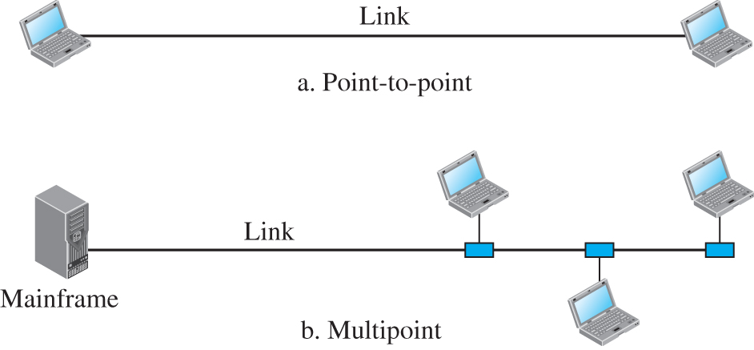
Figure 1.3 Types of connection
Access the text alternative for slide images.

Slide 25
Physical Topology
The term physical topology refers to the way in which a network is laid out physically. Two or more devices connect to a link; two or more links form a topology. The topology of a network is the geometric representation of the relationship of all the links and linking devices (usually called nodes) to one another. There are four basic topologies possible: mesh, star, bus, and ring.

Slide 26
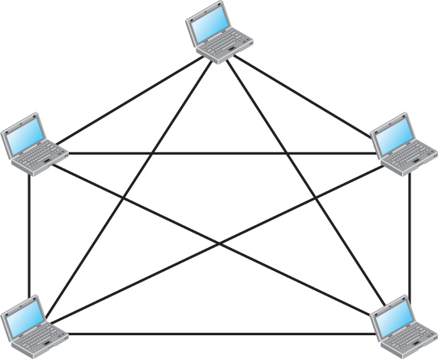
Figure 1.4 A fully connected mesh topology
n = 5
10 links
Access the text alternative for slide images.

Slide 27
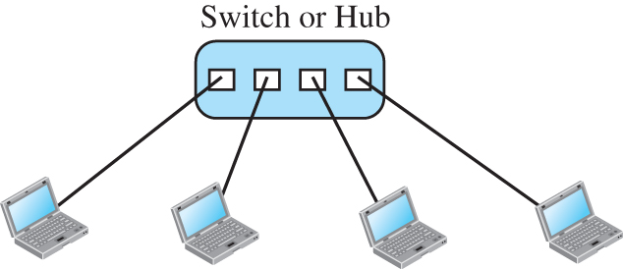
Figure 1.5 A star topology

Slide 28
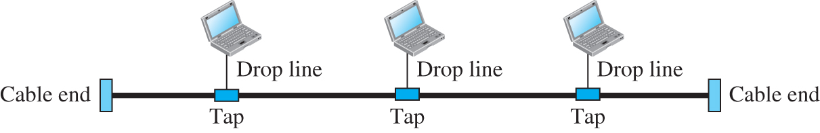
Figure 1.6 A bus topology
Access the text alternative for slide images.

Slide 29
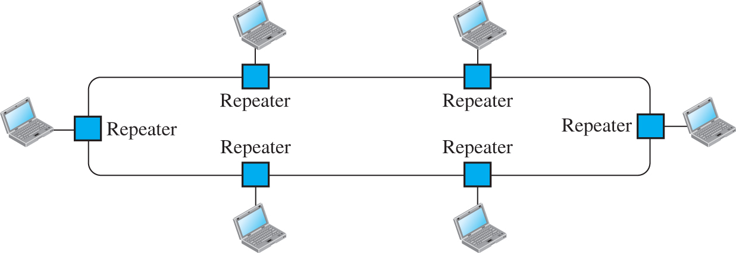
Figure 1.7 A ring topology
Access the text alternative for slide images.

Slide 30
    1-3 NETWORK TYPES
A network can be of two types: LANs and WANs

Slide 31
1.3.1 Local Area Network (LAN)
A local area network (LAN) is usually privately owned and connects some hosts in a single office, building, or campus.

Slide 32
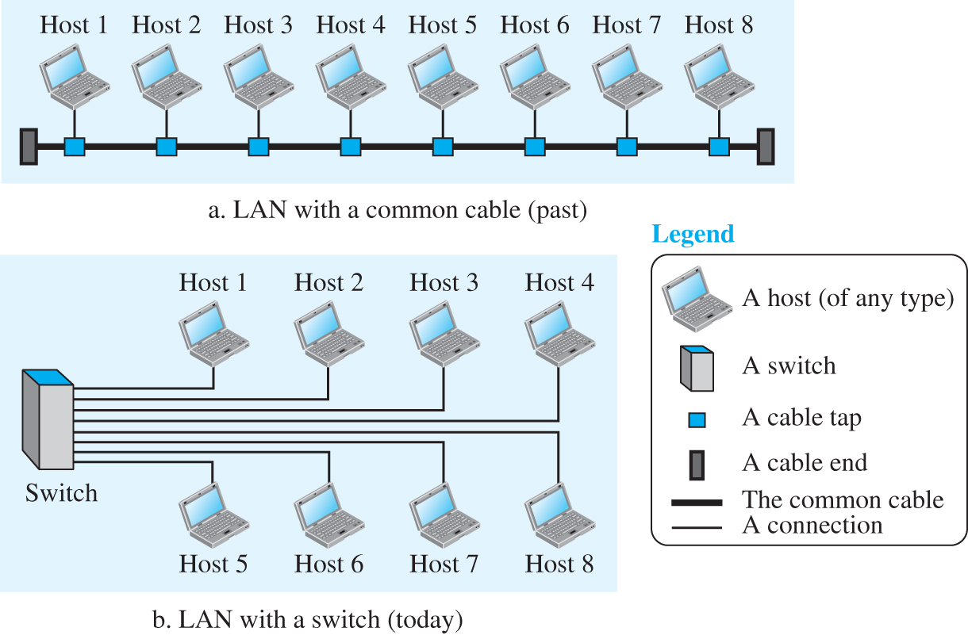
Figure 1.8 An isolated LAN in the past and today
Access the text alternative for slide images.

Slide 33
1.3.2 Wide Area Network (WAN)
A wide area network (WAN) is also a connection of devices capable of communication. a WAN has a wider geographical span, spanning a town, a state, a country, or even the world.

Slide 34
Point-to-Point WAN
A point-to-point WAN is a network that connects two communicating devices through a transmission media (cable or air). Figure 1.9 shows an example of a point-to-point WAN.

Slide 35
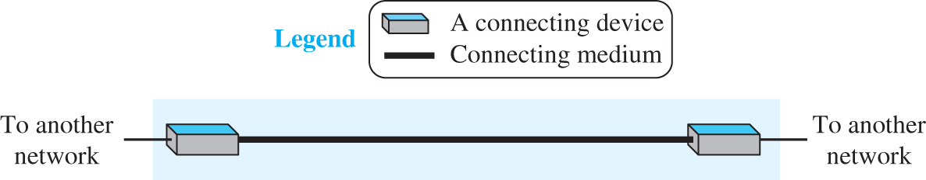
Figure 1.9 A point-to-point WAN
Access the text alternative for slide images.

Slide 36
Switched WAN
A switched WAN is a network with more than two ends. A switched WAN is used in the backbone of global communication today. Figure 1.10 shows an example of a switched WAN.

Slide 37
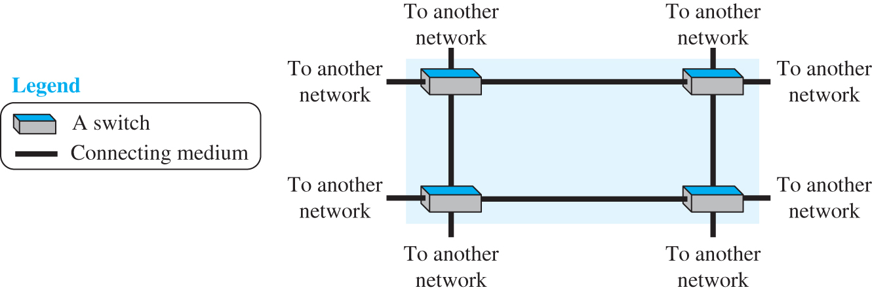
Figure 1.10 A switched WAN
Access the text alternative for slide images.

Slide 38
Internetwork
Today, it is very rare to see a LAN or a WAN in isolation; they are connected to one another. When two or more networks are connected, they make an internetwork, or internet.

Slide 39
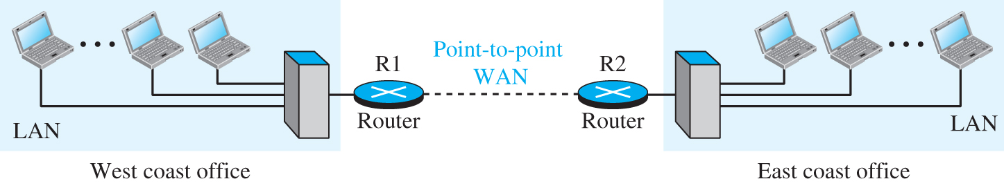
Figure 1.11 An internetwork made of two LANs and one WAN
Access the text alternative for slide images.

Slide 40
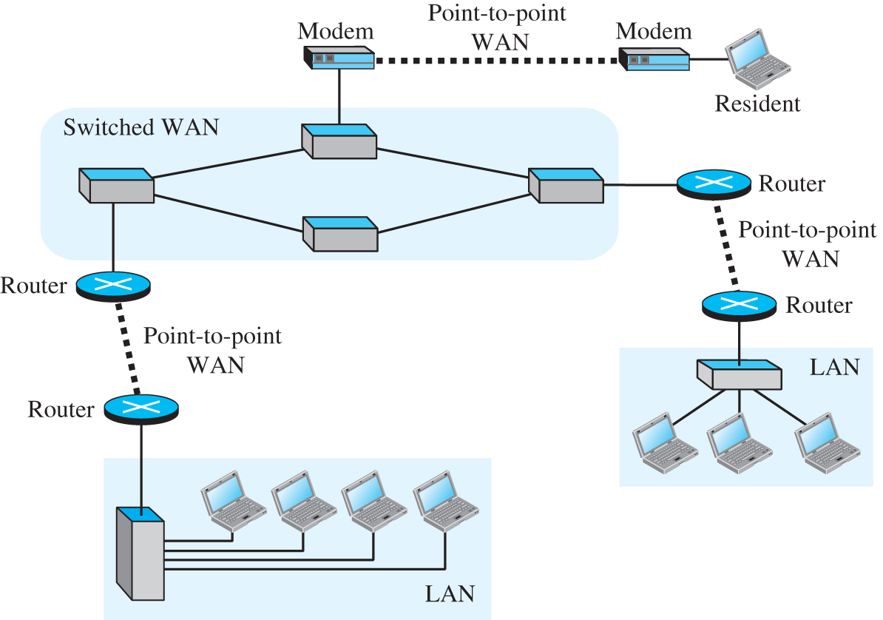
Figure 1.12 A heterogeneous network made of WANs and LANs
Access the text alternative for slide images.

Slide 41
1.3.3 The Internet
An internet (note the lowercase i) is two or more networks that can communicate with each other. The most notable internet is called the Internet (uppercase I) and is composed of millions of interconnected networks. Figure 1.13 shows a conceptual (not geographical) view of the Internet.

Slide 42
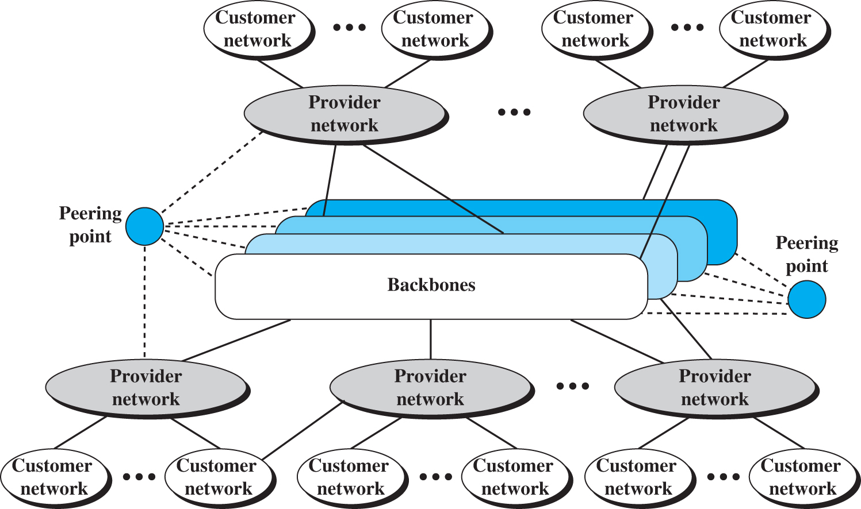
Figure 1.13 The Internet today
Access the text alternative for slide images.

Slide 43
1.3.4 Accessing the Internet
The Internet today is an internetwork that allows any user to become part of it. The user, however, needs to be physically connected to an ISP. The physical connection is normally done through a point-to-point WAN.

Slide 44
Using Telephone Networks
Today most residences and small businesses have telephone service, which means they are connected to a telephone network. Since most telephone networks have already connected themselves to the Internet, one option for residences and small businesses to connect to the Internet is to change the voice line between the residence or business and the telephone center to a point-to-point WAN.

Slide 45
Using Cable Networks
More and more residents over the last two decades have begun using cable TV services instead of antennas to receive TV broadcasting. The cable companies have been upgrading their cable networks and connecting to the Internet. A residence or a small business can be connected to the Internet by using this service.

Slide 46
Using Wireless Networks
Wireless connectivity has recently become increasingly popular. A household or a small business can use a combination of wireless and wired connections to access the Internet. With the growing wireless WAN access, a household or a small business can be connected to the Internet through a wireless WAN.

Slide 47
Direct Connection to the Internet
A large organization or a large corporation can itself become a local ISP and be connected to the Internet. This can be done if the organization or the corporation leases a high-speed WAN from a carrier provider and connects itself to a regional ISP. For example, a large university with several campuses can create an internetwork and then connect the internetwork to the Internet.

Slide 48
1-4 PROTOCOL LAYERING
We defined the term protocol before. In data communication and networking, a protocol defines the rules that both the sender and receiver and all intermediate devices need to follow to be able to communicate directly.

Slide 49
1.4.1 Scenarios
Let us develop two simple scenarios to better understand the need for protocol layering.

Slide 50
First Scenario
A large organization or a large corporation can itself become a local ISP and be connected to the Internet. This can be done if the organization or the corporation leases a high-speed WAN from a carrier provider and connects itself to a regional ISP.

Slide 51
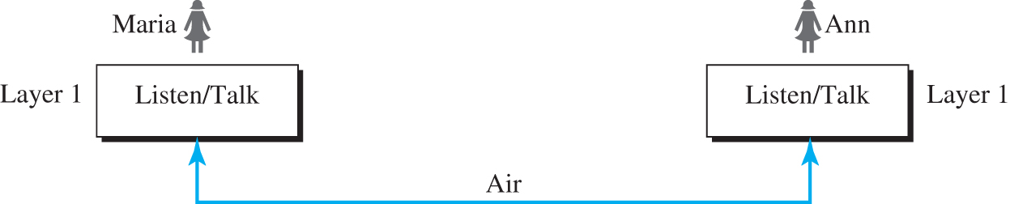
Figure 1.14 A single-layer protocol
Access the text alternative for slide images.

Slide 52
Second Scenario
In the second scenario, we assume that Ann is offered a higher-level position in her company, but needs to move to another branch located in a city very far from Maria. They decide to continue their conversion using regular mail through the post office. However, they do not want their ideas to be revealed by other people if the letters are intercepted. They use an encryption/decryption technique.

Slide 53
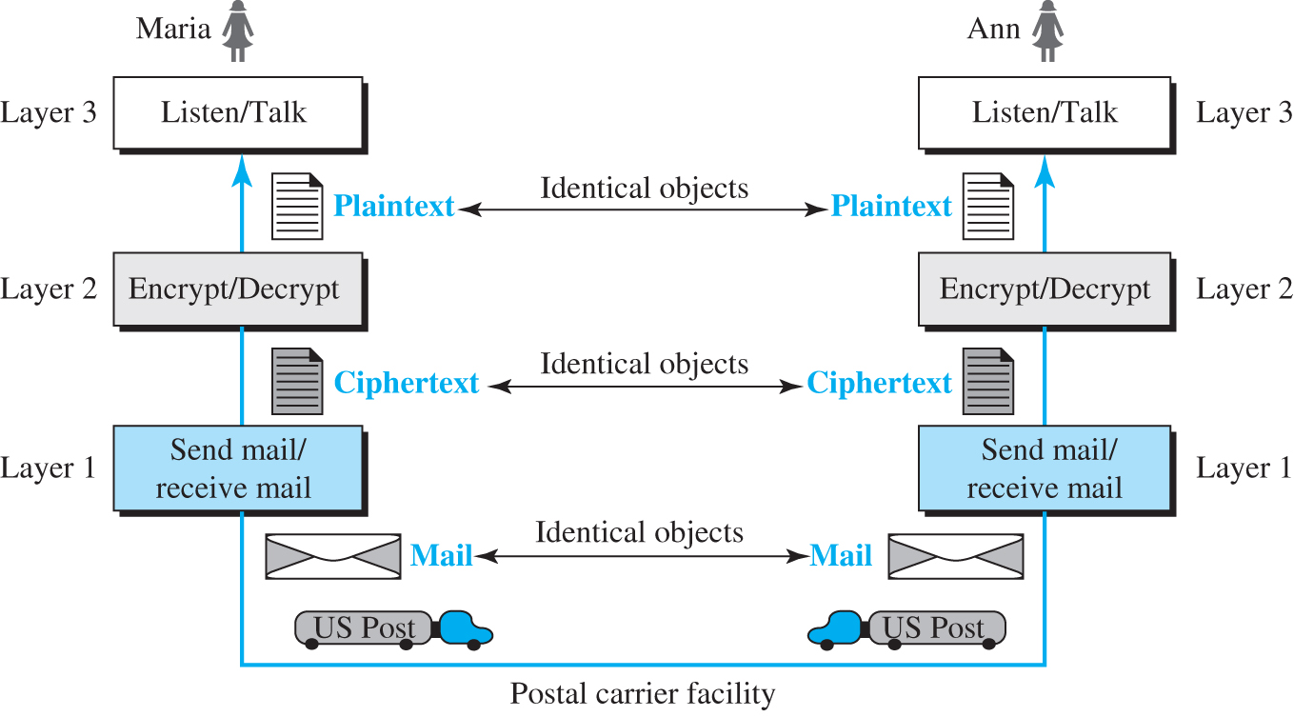
Figure 1.15 A three-layer protocol
Access the text alternative for slide images.

Slide 54
1.4.2 Principles of Protocol Layering
Let us discuss two principles of protocol layering.

Slide 55
First Principle
The first principle dictates that we need to make each layer to perform two opposite task in each direction.

Slide 56
Second Principle
The second principle dictates that two objects under each layer should be identical.

Slide 57
1.4.3 Logical Connections
After following the above two principles, we can think about logical connection between each layer as shown in Figure 1.16.

Slide 58
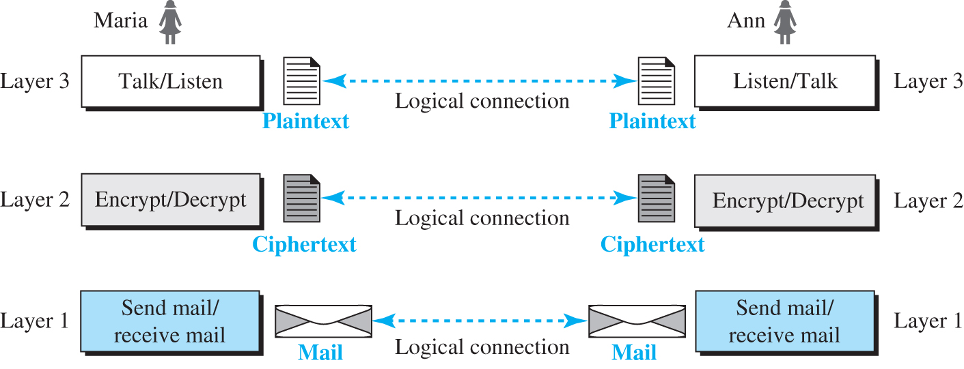
Figure 1.16 Logical connection between peer layers
Access the text alternative for slide images.

Slide 59
1-5 TCP/IP PROTOCOL SUITE
Now we can introduce the TCP/IP (Transmission Control Protocol / Internet Protocol). This is the protocol suite used in the Internet today.

Slide 60
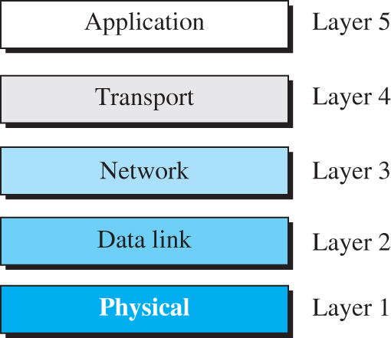
Figure 1.17 Layers in the TCP/IP protocol suite
Access the text alternative for slide images.

Slide 61
1.5.1 Layered Architecture
To show how the layers in the TCP/IP protocol suite are involved in communication between two hosts, we assume that we want to use the suite in a small internet made up of three LANs (links), each with a link-layer switch. We also assume that the links are connected by one router, as shown in Figure 1.18.

Slide 62
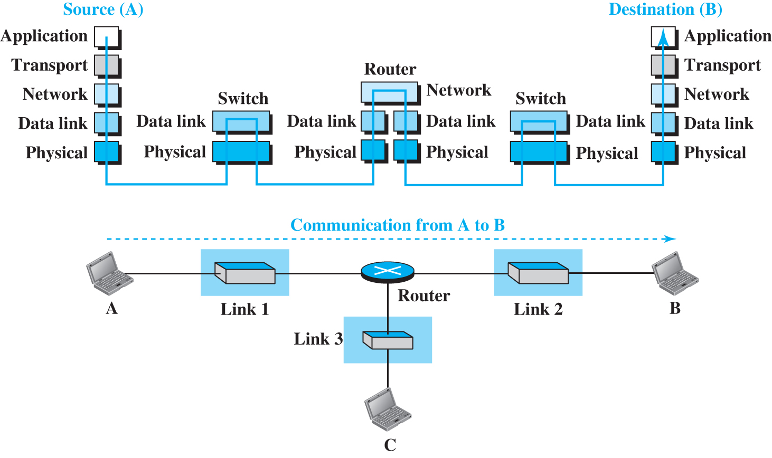
Figure 1.18 Communication through an internet
Access the text alternative for slide images.

Slide 63
1.5.2 Brief Description of Layers
After the above introduction, we briefly discuss the functions and duties of layers in the TCP/IP protocol suite. Each layer is discussed in detail in the next five parts of the book. To better understand the duties of each layer, we need to think about the logical connections between layers. Figure 1.19 shows logical connections in our simple internet.

Slide 64
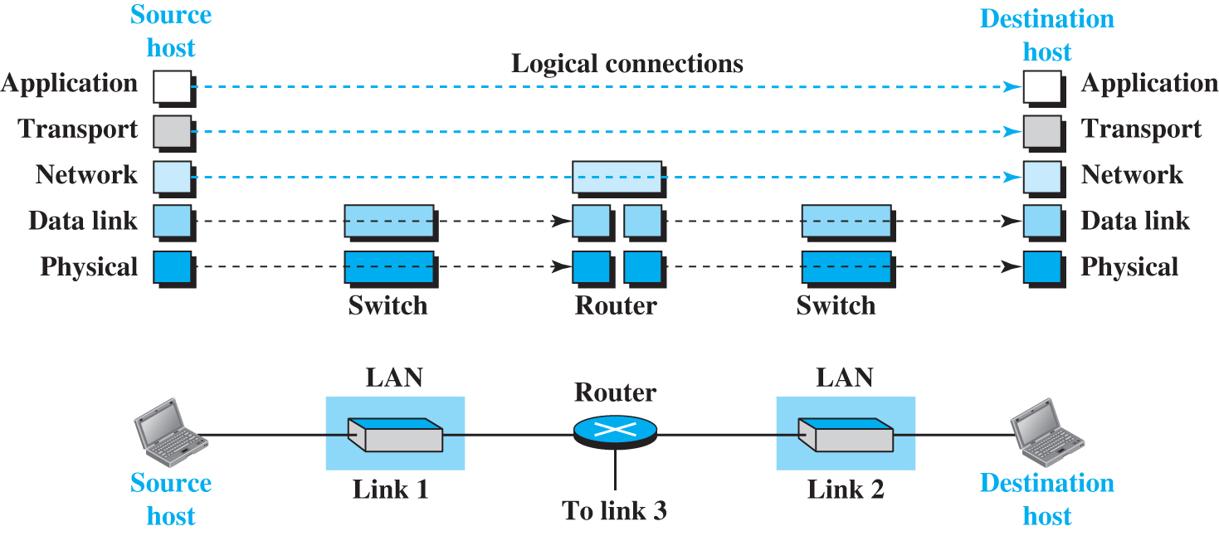
Figure 1.19 Logical connections between layers in TCP/IP
Access the text alternative for slide images.

Slide 65
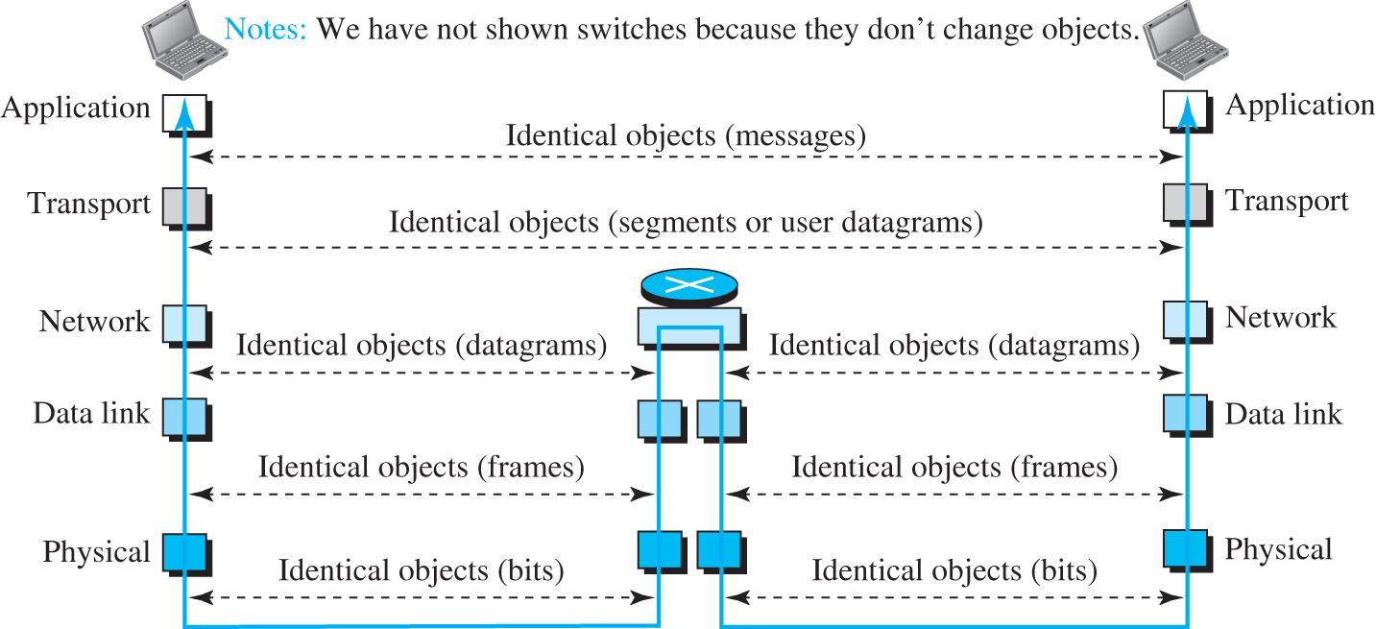
Figure 1.20 Identical objects in the TCP/IP protocol suite
Access the text alternative for slide images.

Slide 66
1.5.3 Description of Each Layer
After understanding the concept of logical communication, we are ready to briefly discuss the duty of each layer. Our discussion in this chapter will be very brief, but we come back to the duty of each layer in next five parts of the book.

Slide 67
Physical Layer
We can say that the physical layer is responsible for carrying individual bits in a frame across the link. The physical layer is the lowest level in the TCP/IP protocol suite, the communication between two devices at the physical layer is still a logical communication because there is another, hidden layer, the transmission media, under the physical layer. We discuss Physical Layer in Chapter 2.

Slide 68
Data Link Layer
We have seen that an internet is made up of several links (LANs and WANs) connected by routers. When the next link to travel is determined by the router, the data-link layer is responsible for taking the datagram and moving it across the link. We discuss Data-Link Layer in Chapter 3.

Slide 69
Network Layer
The network layer is responsible for creating a connection between the source computer and the destination computer. The communication at the network layer is host-to-host. However, since there can be several routers from the source to the destination, the routers in the path are responsible for choosing the best route for each packet. We discuss Network Layer in Chapter 4.

Slide 70
Transport Layer
The logical connection at the transport layer is also end-to-end. The transport layer at the source host gets the message from the application layer, encapsulates it in a transport-layer packet. In other words, the transport layer is responsible for giving services to the application layer: to get a message from an application program running on the source host and deliver it to the corresponding application program on the destination host. transmits user datagrams without first creating a logical connection. We discuss Transport Layer in Chapter 9.

Slide 71
Application Layer
The logical connection between the two application layers is end-to-end. The two application layers exchange messages between each other as though there were a bridge between the two layers. However, we should know that the communication is done through all the layers. Communication at the application layer is between two processes (two programs running at this layer). To communicate, a process sends a request to the other process and receives a response. Process-to-process communication is the duty of the application layer. We discuss Application Layer in Chapter 10.

Slide 72
1-6 OSI MODEL
Although, when speaking of the Internet, everyone talks about the TCP/IP protocol suite, this suite is not the only suite of protocols defined. Established in 1947, the International Organization for Standardization (ISO) is a multinational body dedicated to worldwide agreement on international standards. Almost three-fourths of the countries in the world are represented in the ISO. An ISO standard that covers all aspects of network communications is the Open Systems Interconnection (OSI) model. It was first introduced in the late 1970s.

Slide 73
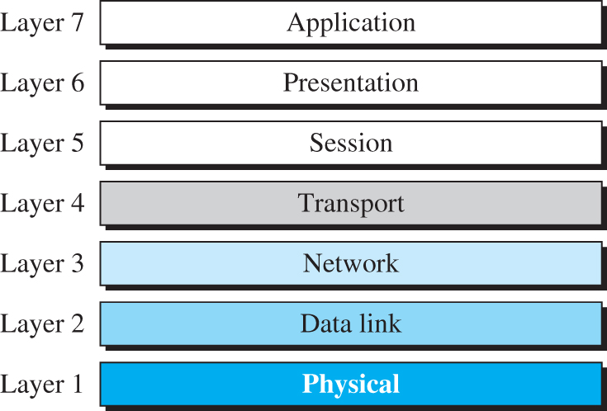
Figure 1.21 The OSI model
Access the text alternative for slide images.

Slide 74
1.6.1 OSI versus TCP/IP
When we compare the two models, we find that two layers, session and presentation, are missing from the TCP/IP protocol suite. These two layers were not added to the TCP/IP protocol suite after the publication of the OSI model. The application layer in the suite is usually considered to be the combination of three layers in the OSI model, as shown in Figure 1.22.

Slide 75
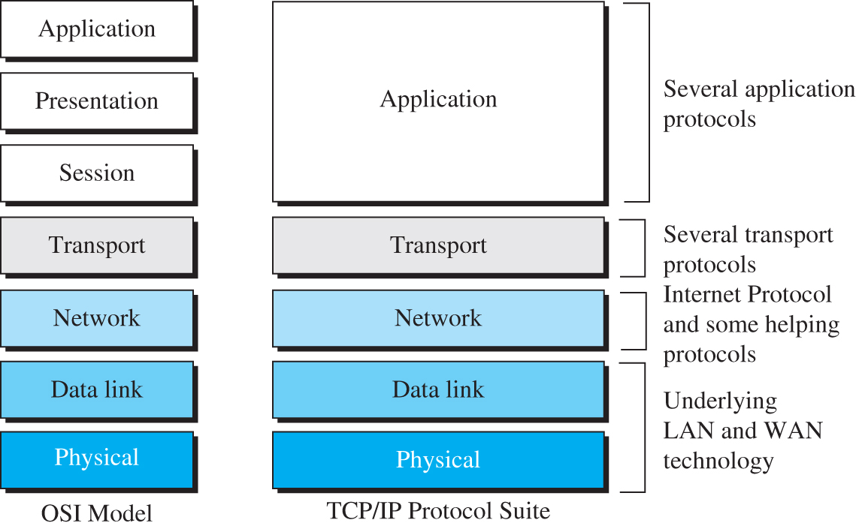
Figure 1.22 TCP/IP and OSI model
Access the text alternative for slide images.

Slide 76
Dr. Abraham’s Summary of OSI
Physical – Wiring, connectors, bits, modulation, hub, repeater
Data link – MAC address, Error detection (correction) media access, LAN connection (logical link), Switch, Bridge
Network – IP address, path finding-routing, host-to-host connection, Router
Transport – Process-to process connection, add reliability
Session – Establish/disable connection, restore session, user authentication,
Presentation – formatting data (ASCII, Unicode, etc), Encryption/Decryption
Application – write and run applications

Slide 77
1.6.2 Lack of OSI Model’s Success
The OSI model appeared after the TCP/IP protocol suite. Most experts were at first excited and thought that the TCP/IP protocol would be fully replaced by the OSI model. This did not happen for several reasons, but we describe only three, which are agreed upon by all experts in the field.

Slide 78
End of Main Content
© 2022 McGraw Hill, LLC. All rights reserved. Authorized only for instructor use in the classroom.
No reproduction or further distribution permitted without the prior written consent of McGraw Hill, LLC.

Slide 79
Accessibility Content: Text Alternatives for Images

Slide 80
Figure 1.1 Five components of data communication - Text Alternative
Return to parent-slide containing images.
The communication system includes five major components: sender, receiver, message to be communicated, medium of the communication, and protocol for both sender and receiver. The protocols of both sender and receiver consists of 'n' number of rules.
Return to parent-slide containing images.

Slide 81
Figure 1.2 Data flow (simplex, half-duplex, full-duplex) - Text Alternative
Return to parent-slide containing images.
The simplex, half-duplex, and full-duplex modes of data flow are demonstrated. The simplex mode (a) represents the transformation of data from a mainframe to a monitor in one direction. The half-duplex mode (b) represents the transformation of data from one laptop to another laptop in two-way directions in which the data is send from the first laptop to the second laptop at time 1 and the data is send from the second laptop to the first laptop at time 2. The full-duplex mode (c) represents the transformation of data between two laptops in two-way directions all the time.
Return to parent-slide containing images.

Slide 82
Figure 1.3 Types of connection - Text Alternative
Return to parent-slide containing images.
The point-to-point connections represents the direct link between two laptops. The multipoint connection represents a common link from a mainframe that is shared by three other laptops.
Return to parent-slide containing images.

Slide 83
Figure 1.4 A fully connected mesh topology - Text Alternative
Return to parent-slide containing images.
A schematic representation of a mesh topology shows five laptops connected in a pentagonal shape. Each laptop is connected to all the other four laptops.
Return to parent-slide containing images.

Slide 84
Figure 1.6 A bus topology - Text Alternative
Return to parent-slide containing images.
A linear cable with three taps, arranged in series is shown. The cable has a cable end on both sides. A laptop is connected to each tap with a drop line.
Return to parent-slide containing images.

Slide 85
Figure 1.7 A ring topology - Text Alternative
Return to parent-slide containing images.
A cyclic network with six repeaters is shown. A laptop is connected to each repeater.
Return to parent-slide containing images.

Slide 86
Figure 1.8 An isolated LAN in the past and today - Text Alternative
Return to parent-slide containing images.
Two L A N topologies are shown. The first one is a LAN with a common cable (past). It shows eight host devices labeled as host 1, host 2, host 3, host 4, host 5, host 6, host 7, and host 8, connected to eight taps on a common cable that has cable ends on both sides. The second one is a L A N with a switch (today). It shows each host devices labeled as host 1, host 2, host 3, host 4, host 5, host 6, host 7, and host 8, connected to a switch through eight different connections. A legend below lists the components and their names used in the topology. They are as follows: a host (of any type), switch, cable tap, cable end, common cable, and connection.
Return to parent-slide containing images.

Slide 87
Figure 1.9 A point-to-point WAN - Text Alternative
Return to parent-slide containing images.
A connecting device is connected to another connecting device through a connecting medium. The connecting medium extends to another network at both ends. A legend lists the components and their names: a connecting device and connecting medium.
Return to parent-slide containing images.

Slide 88
Figure 1.10 A switched WAN - Text Alternative
Return to parent-slide containing images.
A network topology with four switches, two on the top and top on the bottom is shown. All the four switches are connected via connecting medium. The network resembles a rectangle with switches on the four corners. Two connections are established on the free ends of the four switches and these connections lead to another network. A legend lists the components and their names: switch and connecting medium.
Return to parent-slide containing images.

Slide 89
Figure 1.11 An internetwork made of two LANs and one WAN - Text Alternative
Return to parent-slide containing images.
A network topology shows a local area network labeled as West coast office on the left and another local area network labeled as East coast office on the right. In each L A N, several host devices are connected to a switch through separate connections. The switch on the West coast office L A N is connected to a router labeled as R 1 and the switch on the East coast office L A N is connected to a router labeled as R 2. The R 1 and R 2 are connected and this represents a point-to-point wide area network.
Return to parent-slide containing images.

Slide 90
Figure 1.12 A heterogeneous network made of WANs and LANs - Text Alternative
Return to parent-slide containing images.
A heterogenous internetwork topology is shown, where a local area network with four host devices connected to a switch is connected to a point-to-point wide area network that has two routers connected each other. Similarly, another local area network with three host devices connected to a connecting device is connected to a point-to-point wide area network that has two routers connected each other. The routers from the two wide area networks are connected to the separate connecting devices in a switched wide area network. The switched wide area network has four switches connected in a diamond shape. One of the other two switches in the switched wide area network connects to a modem. This modem is connected to another modem, which in turn is connected to a resident host device. The connection between the two modems represent a point-to-point wide area network.
Return to parent-slide containing images.

Slide 91
Figure 1.13 The Internet today - Text Alternative
Return to parent-slide containing images.
A network topology representing the internet shows several backbones connected to several provider networks and peering points. The peering points connect to the provider networks. The provider networks connect to multiple customer networks. The provider networks establish connections between them. Similarly, the customer networks have connections between them.
Return to parent-slide containing images.

Slide 92
Figure 1.14 A single-layer protocol - Text Alternative
Return to parent-slide containing images.
In single layer protocol, the two persons named Maria on one side and Ann on another side communicates (listen or talk) through air medium. The listen or talk actions on both sides are represented as layer 1.
Return to parent-slide containing images.

Slide 93
Figure 1.15 A three-layer protocol - Text Alternative
Return to parent-slide containing images.
In three layer protocol, the communication between Maria and Ann is shown in three layers. The layer 1 is sending mail or receiving mail. The layer 2 is encrypting or decrypting the mail to a Ciphertext. The layer 3 is listening or talking where the ciphertext is converted to a plaintext. Each peer layers share identical objects that is the mail, ciphertext, and plaintext in both sides (Maria and Ann) are identical objects.
Return to parent-slide containing images.

Slide 94
Figure 1.16 Logical connection between peer layers - Text Alternative
Return to parent-slide containing images.
A three layer protocol communication between Maria and Ann is shown is demonstrated. The layer 1 is sending mail or receiving mail. The layer 2 is encrypting or decrypting the mail to a Ciphertext. The layer 3 is listening or talking where the ciphertext is converted to a plaintext. Each peer layer establishes a logical connection between the objects they share to the successive layers
Return to parent-slide containing images.

Slide 95
Figure 1.17 Layers in the TCP/IP protocol suite - Text Alternative
Return to parent-slide containing images.
The five layers in the TCP or IP protocol are shown from bottom to top and are as follows. Layer 1 - physical, layer 2 - data link, layer 3 - network, layer 4 - transport, and layer 5 - application.
Return to parent-slide containing images.

Slide 96
Figure 1.18 Communication through an internet - Text Alternative
Return to parent-slide containing images.
Two figures depict the communication through an internet. The first figure shows the data flow between the source A and destination B via the different protocol layers. From the application layer of source A, the data flows downward transport layer, network layer, data link layer, and physical layer. From the physical layer, the data flows through the physical and data link layer of a switch. From the data link layer of the switch, the data again flows back to the physical layer. From which, the data flows through the physical, data, and network layers of a router. From the network layer, the data flows through another data link and physical layer of the router and reaches another switch. Here it flows through the physical and data link layer and returns back in the same path and reaches the physical layer of the TCP or IP protocol. Then the data flows upward through the data link, network, transport, and reaches the application layer of destination B. The second figure shows a network topology depicting the communication between two host devices (A and B). A connects to a link 1 (a connecting device). Link 1 connects to a router. The router connects to link 2. Link 2 connects to B. The router also connects to link 3, which in turn connects to a host device (C).
Return to parent-slide containing images.

Slide 97
Figure 1.19 Logical connections between layers in TCP/IP - Text Alternative
Return to parent-slide containing images.
The first part shows source host has physical, data link, network, transport, and application. The destination has physical, data link, network, transport, and application. The physical source host connects to a switch to the router to switch to the physical destination host. The data link of the source host connects to switch to the router to switch to the data link of the destination host. The network of source hosts connects to the router to a network of the destination host. The transport of the source host connects to the transport of the destination host. The application of the source host connects to the application of the destination host. The second part shows a laptop labeled as source host connects to link 1 of L A N to the router to link 2 of L A N to a laptop labeled as destination host. The router connects to link 3.
Return to parent-slide containing images.

Slide 98
Figure 1.20 Identical objects in the TCP/IP protocol suite - Text Alternative
Return to parent-slide containing images.
An illustration shows that the first laptop and the second laptop have physical data link, networks, transport, and application. Reversible communication between the first and second laptops is shown. The application of first and second laptops shares identical objects (messages). The transport of first and second laptops shares identical objects (segments or user datagrams). The network of first and second laptops shares identical objects (datagrams) through the router. The data link of the first and second laptops shares identical objects (frames) through the router. The physical of first and second laptops share identical objects (bits) through the router. Notes: We have not shown switches because they don’t change objects.
Return to parent-slide containing images.

Slide 99
Figure 1.21 The OSI model - Text Alternative
Return to parent-slide containing images.
The seven layers of the OSI model are shown from bottom to top and are as follows. Layer 1 - physical, Layer 2 - data link, Layer 3 - network, Layer 4 - transport, Layer 5 - session, Layer 6 - presentation, and Layer 7 - application.
Return to parent-slide containing images.

Slide 100
Figure 1.22 TCP/IP and OSI model - Text Alternative
Return to parent-slide containing images.
The O S I model has seven layers: physical, data link, network, transport, session, presentation, and application layers (from bottom to top). The T C P/I P protocol suite has five layers (from bottom to top): physical, data link, network, transport, and application. The physical and data link layers represent underlying L A N and W A N technology, the network layer represents internet protocol and some helping protocols, transport layer represents several transport protocols, and application layer represents several application protocols.
Return to parent-slide containing images.

