Slide 1
Stack Architecture
Dr. John Abraham
Professor
UTRGV

Slide 2
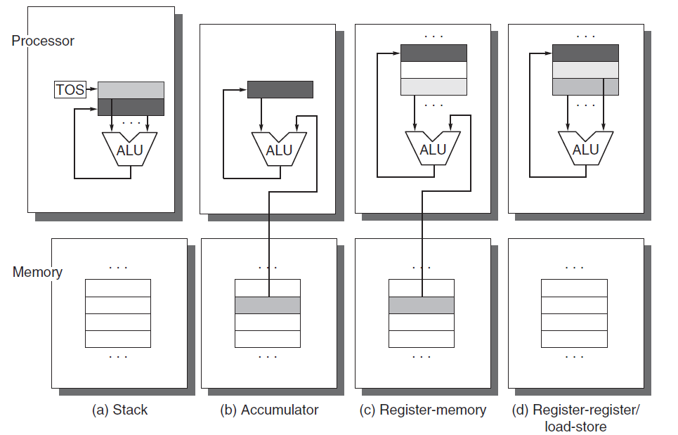
4 types of Architectures
stack, an accumulator, or a set of registers. Operands may be named explicitly or implicitly. C = A + B shown below. Lighter shades indicate inputs, and the dark shade indicates the result.
Notes:
Figure A.1 Operand locations for four instruction set architecture classes. The arrows indicate whether the operand
is an input or the result of the arithmetic-logical unit (ALU) operation, or both an input and result. Lighter shades
indicate inputs, and the dark shade indicates the result. In (a), a Top Of Stack register (TOS) points to the top input
operand, which is combined with the operand below. The first operand is removed from the stack, the result takes
the place of the second operand, and TOS is updated to point to the result. All operands are implicit. In (b), the Accumulator
is both an implicit input operand and a result. In (c), one input operand is a register, one is in memory, and
the result goes to a register. All operands are registers in (d) and, like the stack architecture, can be transferred to
memory only via separate instructions: push or pop for (a) and load or store for (d).
Stack Accumulator

Slide 3
Stack
Explain stack.
Stack architecture is simple. Locations of the operands is implicit. Location of the result is also implicit. All are top of the stack. We need to have a register to keep top of the stack.
We can use accumulator machine to implement stack, if we choose to. Accumulator architecture is now used for learning purpose only
Stack is still used for various activities in the CPU.
Example calling subroutines. I’ll explain on the board

Slide 4
Stack Architecture
Set of registers (perhaps 16 or 32) OR RAM are used as a stack to hold the LIFO structure. With all today’s CPUs stack uses RAM not registers; There are registers such as base pointer, stack segment register, stack-pointer, etc. in the register.
A register known as SP (stack pointer) will point to the top of the stack. Two other bits will be used to indicate Stack is Full (1 means full, 0 means not) and Stack is Empty (1 means empty, 0 means not).
Data from data register is pushed on to the stack and as popped off the stack to perform operations and result of operation is pushed into the stack itself.

Slide 5
Stack Full/Empty
4 bits are used for a stack 16 register file. 0000, first data is pushed after incrementing the SP by one, or 0001. When stack pointer reaches 1111, the next pointer is 0000. So, the last data is added to 0000. When you push If the SP is pointing to 0000 (which is 0) stack is full. When you are popping if the stack is pointing 0 then the stack is empty.

Slide 6
Stack Assignment
In order to understand stack we will implement a stack based postfix calculator.
I used array based stack. You are free to use array or pointer. You can use any language you feel comfortable.
For implementing visual stack you will be given 20 extra points.

Slide 7
Infix and postfix
If the operator (opcode) is between operands then it is an infix expression: a+b
If the operator is after the operands it is a postfix expression:a b c + -
Infix is human solvable as long as we know operator precedence and associativity.
Postfix is easily computer solvable
Infix can be converted to postfix by pushing and popping operators in a stack based on precedence and associativity.
For this assignment you don’t need to convert infix to postfix. Just write the expression in postfix.

Slide 8
Example Program
Suppose your math expression is 8 3 4 + *
The following will be carried out by the program you write.
Parse the expression.
For each number push it in the stack (make sure stack is not full when you push)
For each operator (opcode) pop two items from the stack (make sure stack is not empty when you pop) and perform the operation and place the result back in the stack.
Output result or appropriate error message.
Push 8, push 3, push 4. As + is encountered pop 4 and 3 and add. Result is pushed. Now the stack has 8 7. As * is encountered pop 7 and 8 and perform multiply and push the result 56. If end of the expression is reached pop and output the result.

Slide 9
Hennessy and Patterson– Fundamentals of Quantitative Design and Analysis
  70 years of computer technology
  25% performance improvement/year for first 25yrs
  Dramatic dominance of microcomputers since late 70s – 35% improvements/year. After 2003 less than 22% per year attributed to singe cpu.
  Renaissance computer design
    Architectural innovation
    Efficient use of technology improvements
    Vendor-independent operating system such as unix
    Paved way to RISC machines
Notes:
1988 cray y-mp, the fastest machine is very similar to a workstation of today for fraction of the cost.

Slide 10
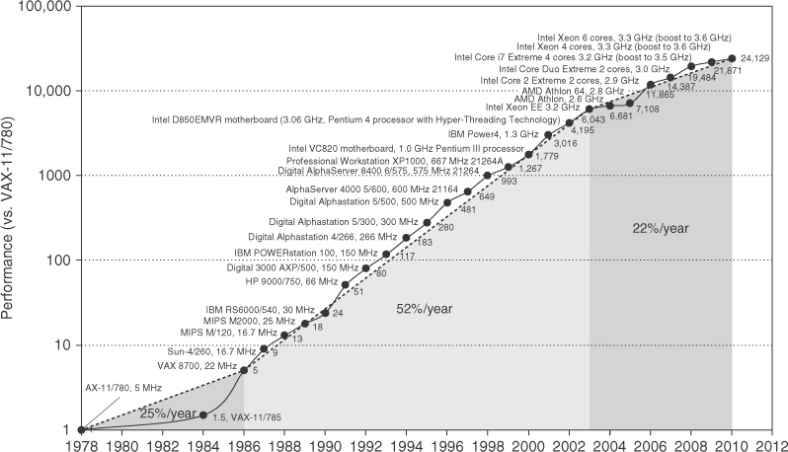
Growth in processor performance since late 70s

Slide 11
Growth in processor performance since the late 1970s. This chart plots performance relative to the VAX 11/780 as measured by the SPEC benchmarks (see Section 1.8). Prior to the mid-1980s, processor performance growth was largely technology driven and averaged about 25% per year. The increase in growth to about 52% since then is attributable to more advanced architectural and organizational ideas. By 2003, this growth led to a difference in performance of about a factor of 25 versus if we had continued at the 25% rate. Performance for floating-point-oriented calculations has increased even faster. Since 2003, the limits of power and available instruction-level parallelism have slowed uniprocessor performance, to no more than 22% per year, or about 5 times slower than had we continued at 52% per year. (The fastest SPEC performance since 2007 has had automatic parallelization turned on with increasing number of cores per chip each year, so uniprocessor speed is harder to gauge. These results are limited to single-socket systems to reduce the impact of automatic parallelization.) Figure 1.11 on page 24 shows the improvement in clock rates for these same three eras. Since SPEC has changed over the years, performance of newer machines is estimated by a scaling factor that relates the performance for two different versions of SPEC (e.g., SPEC89, SPEC92, SPEC95, SPEC2000, and SPEC2006).

Slide 12
Class of computers
Mobile device <$1000
Desktop <$2,500
Server <10,000,000
Cluster <200,000,000
Embedded <$100,000

Slide 13
Critical system design issues
Cost, energy, media performance, responsiveness – FOR MOBILE DEVICES
Price performance, energy,graphics performance – FOR DESKTOPS
Throughput, availability, scalability, energy – FOR SERVERS
Price-performance, throughput, energy, proportionality – FOR CLUSTERS
Price, energy, application-specific performance for EMBEDDED

Slide 14
hourly losses with downtime

Slide 15
Parallelism
1. Data-Level Parallelism (DLP) arises because there are many data items that can be operated on at the same time.
2. Task-Level Parallelism (TLP) arises because tasks of work are created that can operate independently and largely in parallel.
Flynn classification of implemation
SISD, SIMD, MISD, MIMD (multiple instruction streams, multiple data streams)
Notes:
Computer hardware in turn can exploit these two kinds of application parallelism
in four major ways:
1. Instruction-Level Parallelism exploits data-level parallelism at modest levels
with compiler help using ideas like pipelining and at medium levels using
ideas like speculative execution.
2. Vector Architectures and Graphic Processor Units (GPUs) exploit data-level
parallelism by applying a single instruction to a collection of data in parallel.
3. Thread-Level Parallelism exploits either data-level parallelism or task-level
parallelism in a tightly coupled hardware model that allows for interaction
among parallel threads.
4. Request-Level Parallelism exploits parallelism among largely decoupled
tasks specified by the programmer or the operating system.

Slide 16
Our task as computer architects
Determine what attributes are important
Maximize performance without increasing cost
In fact, the cost has decreased dramatically.
Different aspects of the task
  Instruction set design
  Functional organization
  Logic design
  Implementation

Slide 17
Instruction Set Architecture - ISA
Programmer visible instruction set
Boundary between software and hardware
  General-purpose register ISA (we saw accumulator)
  Operands are registers or memory locations
  32 GP & 32 FP registers today
  Memory-byte addressable, read as a word. Can use byte, half-word or full word (32bits)

Slide 18
Addressing modes
Register
Immediate for constants
Displacement – constant offset is added to register to form a memory address (or 2 registers base register and displacement)

Slide 19
Operations
Data transfer
Arithmetic logical
Control
Floating point single (32 bit) or double precision (64bit)
Summarized page 13, fig 1.5

Slide 20
Control flow explained
Conditional branches
Unconditional jumps
Procedure calls
and returns
PC relative addressing for branching (PC + addressfield)

Slide 21
Implementation
Three aspects: ISA, Organization, Hardware
Organization (microarchitecture)
  High level aspects of a computer’s design: memory system, interconnect and design of CPU (core)
  Example: Intel vs AMD same instruction set but different organization
Hardware
  Logic design, etc.

Slide 22
Architecture can be driven by market
Widely accepted application software
  Architects will attempt to deliver speed to such software.
Well accepted compilers
  Architects may keep the same ISA
Price, power, performance & availability

Slide 23
Choice between designs
Design complexity
  Complex design takes longer to complete
  This will prolong time to market
  Someone may come up with a better machine meantime.
Cost
  A balancing act.

Slide 24
Requirements and features

Slide 25
Trends in technology and usage -1
IC logic technology: transistor density increases about 35% per year, ICs on a chip doubles every 18-24 months. Moore’s law.
DRAM capacity doubles every 2 -3 years.
Capacity of Flash memory increases 50-60%/year.
Magnetic disk technology improved
  300 to 500 times cheaper per bit than DRAM.

Slide 26
Performance milestones

Slide 27

Trends in Cost
Time, volume and commoditization
  Cost of manufacture decreases over time.
  Cost of Integrated circuit=(cost of die+cost of testing+cost of packing)/final yield
  Cost of die=cost of wafer/(dies per wafer x die yield)
  Dies per wafer=area of wafer/area of the die minus unusable wafer area at the edges. See figure 1.15

Slide 28
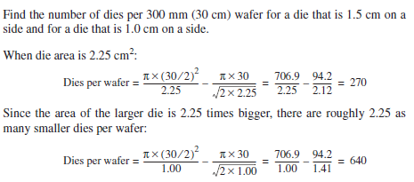
Example

Slide 29
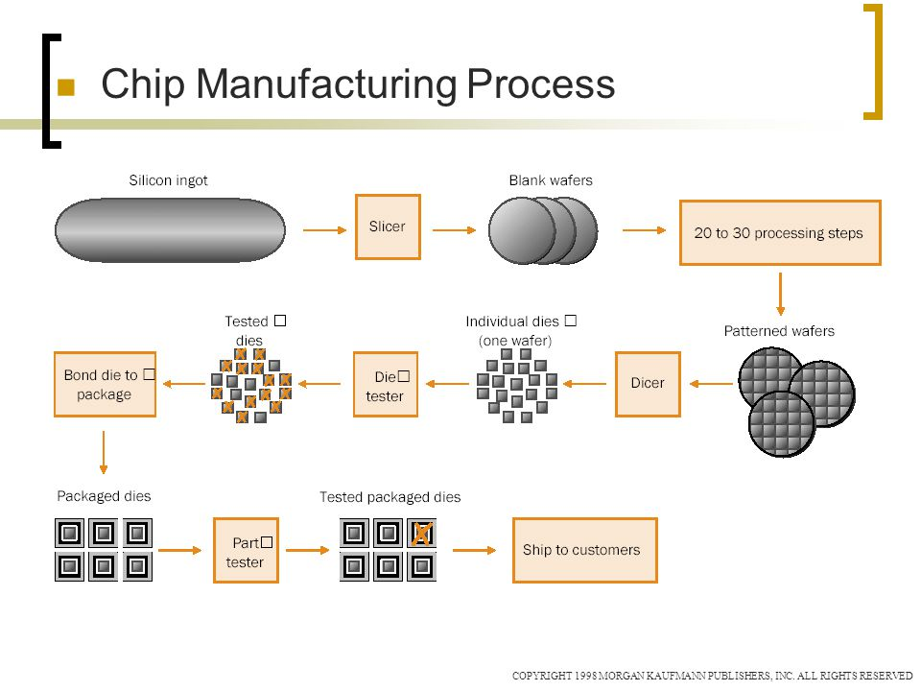

Slide 30
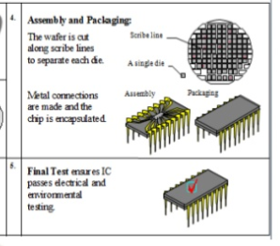
A manufacturing plant costs billions of dollars.

Slide 31
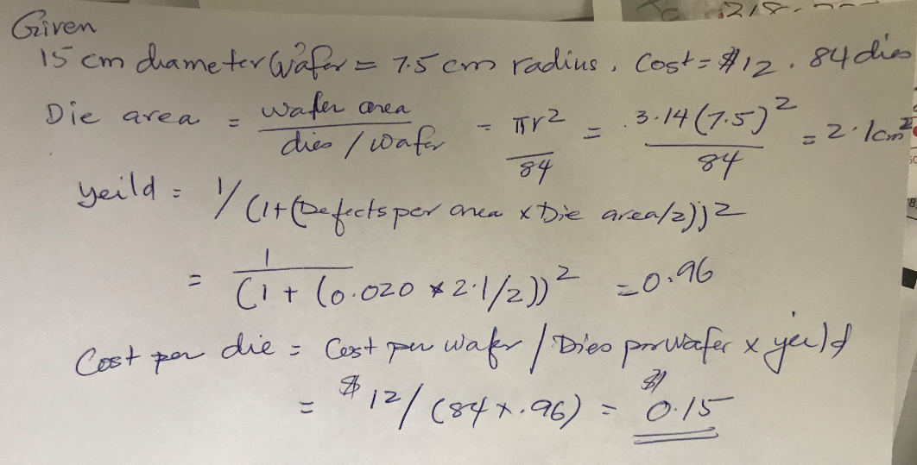
Assume a 15 cm diameter wafer has a cost of 12, contains 84 dies, and has 0.020 defects/cm2. Calculate yield and cost per die.

Slide 32
Measuring, Reporting & Summarizing Performance. 1.8
What criteria do we use to say one computer is faster than another?
We might use terms such as:
  execution time (also called response time)
  Throughput
    number of programs / unit time
  wall-clock time (or elapsed time)
  CPU time, user CPU time, system CPU time
    CPU time = user CPU time + system CPU time
  System performance (on an unloaded system)
  CPU performance

Slide 33
Performance Measures
To say X is n times faster than Y means that
  Execution time Y / Execution time X = n
  Performance X / Performance Y = n
The throughput of X is 1.3 times higher than Y means that the number of tasks that can be executed on X is 1.3 more than on Y in the same amount of time

Slide 34
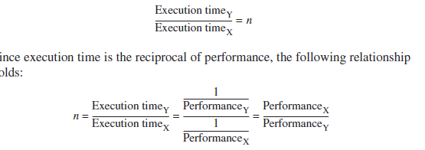
Execution time
Execution time depends upon performance of the machine
  Execution time = 1/performance.
    Better the performance smaller the time
  n= 1/performance of y
  1/performance of x

Slide 35
UNIX time
UNIX time command returns four measurements
  90.7u 12.9s 2:39 65%
cpu time = 90.7 sec
System cpu time = 12.9s
Elapsed time = 2min 39sec
%of cpu time (90.7+12.9) over total time=65%

Slide 36
Evaluating Peformance
There are four levels or programs that can be used to test performance
  Real programs - e.g., C compiler, TeX, CAD tool, programs that have input and output and options that the user can select
  Kernels - remove key pieces of programs and just test those
  Toy benchmarks - 10-100 lines of code such as quicksort whose performance is known in advance
  Synthetic benchmarks - try to match average frequency of operations to simulate those instructions in some large program

Slide 37
Benchmark Suite
A set of programs that test different performance metrics such as arrays, floating point operations, loops, etc…
  SPEC CPU2006is a commonly quoted benchmark suite
    12 integer and 17 floating point benchmarks
  Server Benchmarks – around OpenMP and MPI
    SPECrate
    SPECSFS

Slide 38
Reporting Performance Results
One important factor is that performance results be reproducible -
  However, reported results may omit such information as the input, compiler settings, version of compiler, version of OS, size and number of disks, etc…
  SPEC benchmark reports must include information like compiler flags, fairly complete description of the machine, and results running with normal and optimized compilers Comparing Performances

Slide 39
Quantitative Principles of Computer Design 1.9
Parallelism-pipelining
  most important methods for improving performance
Principle of locality
  –Temporal locality.. tendency to use same code used recently
  -Spatial locality..items whose addresses are near each other tend to be used close together
Focus on Common case – frequent case vs. infrequent case. Example, fetch/decode is more frequently than multiplier

Slide 40
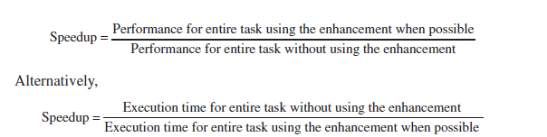
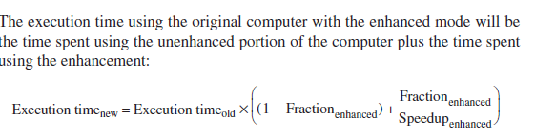
Amdahl’s Law
A fundamental law in describing performance gain created through some architectural improvement as speedup -- “make the common case fast”

Slide 41
Using Amdahl’s Law
We must consider two factors in using this:
  Fraction of the computation time in the original machine that can be converted to take advantage of the enhancement
  Improvement gained by the enhanced execution mode (how much faster will the task run if the enhanced mode is used for the entire program?)
Speedup = 1 / [ (1 - fraction enhanced) + Fraction enhanced / Speedup enhanced) ]

Slide 42
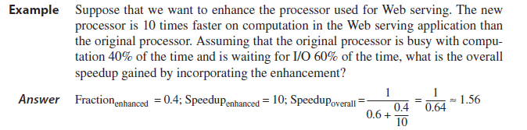
Examples
  An enhancement runs 10 times faster but is only usable 40% of the time.
    Speedup = 1 / [(1 - .4) * .4/10] = 1.56

Slide 43
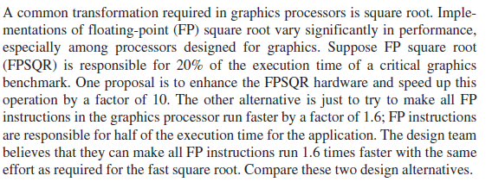
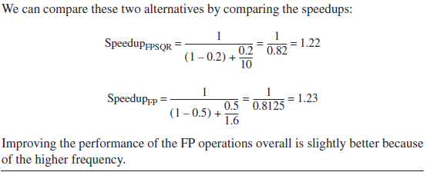
Suppose FP sqrt is responsible for 20% of instructions in a benchmark

Slide 44
The Processor Performance Equation
Essentially all computers are constructed using a clock running at a constant rate.
These discrete time events are called ticks, clock ticks, clock periods, clocks,

Slide 45
CPU Performance
  CPU time = CPU clock cycles * clock cycle time
  CPU time = CPU clock cycles for prog / Clock rate
  IC - instruction count
    This is the # of instructions in the program
  CPI - clock cycles per instruction
  CPI = CPU clock cycles for prog / IC
  CPU time = IC * CPI * Clock cycle time
  CPU time = (Sum CPI_{i} * IC_{i}) * clock cycle time
  Average CPI = Sum (CPI_{i} * IC_{i}/ Instruction Count)

Slide 46
Example
  Frequency of FP operations = 25%
  Average CPI of FP operations = 4.0
  Average CPI of other instructions = 1.33
  Frequency of FP sqrt = 2%
  CPI of FP sqrt = 20
  CPI = 4*25%+1.33*75% = 2.0
Two alternatives: reduce CPI of FP sqrt to 2 or reduce CPI of all FP ops to 2
  CPI new FP sqrt = CPI original - 2% * (20-2) = 1.64
  CPI new FP = 75%*1.33+25%*2.0=1.5
  Speedup new FP = CPI original/CPI new FP = 1.33
    refer back to previous example

Slide 47
CPU Components’ Performance
Large part of a Comp. Architect’s job is to design tools or means of measuring the CPU component performances
  Low level tools: timing estimators
We can also measure the instruction count for a program using compiler technology, using the program execution duration and the instruction mix
Execution-based monitoring by including in the program, code that saves the instruction mix during execution

Slide 48
Measuring CPI
Requires knowing the processor’s organization and the instruction stream
  Designers may use Average CPIs but this is influenced by cache and pipeline structures
  We might assume a perfect memory system that does not cause delays
  Pipeline CPI measures can be determined by simulating the pipeline
    This might be sufficient for simple pipes but not for advanced pipes

Slide 49
More Ex’s of CPU Performance
2 alternatives for a conditional branch instruction
  CPU A: condition code is set by a compare instruction and followed by a branch that tests the condition code
  CPU B: compare is included in the branch
Conditional branch takes 2 cycles, all other instructions take 1 clock cycle
For CPU A, 20% of all instructions are conditional branches
Assume CPU A has a clock cycle time 1.25 times faster than CPU B
  since CPUA does not have the compare included in the branch statement
Which CPU is faster?

Slide 50
Solution
CPI A = .2 * 2 + .8 * 1 = 1.2
CPU time A = IC A * 1.2 * Clock Cycle time A
  A’s clock rate is 1.25 times higher than B
  Compares are not executed in isolation on B, so there are instead 25% compares and 75% other
CPI B = .25 * 2 + .75 * 1 = 1.25
CPU time B = IC B * 1.25 * Clock Cycle time B = .8 * IC A * 1.25 * 1.25 * Clock Cycle time A
CPU time B = 1.25 * IC A * Clock Cycle time A
So, CPU time A is shorter than B and so A is faster

Slide 51
What if A’s clock cycle = 1.1 B?
We repeat the previous solution changing
  Clock Cycle time A = 1.1 * Clock Cycle time B
    instead of using 1.25
  CPU time A = 1.2 * IC A * Clock Cycle time A
  CPU time B = IC B * 1.25 * Clock Cycle time B = .8 * IC A * 1.25 * 1.1 Clock Cycle time A = 1.1 * IC A * Clock Cycle time A
  So, in this case, CPU B is faster

Slide 52
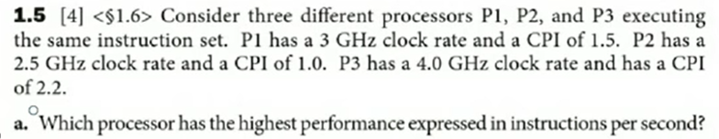
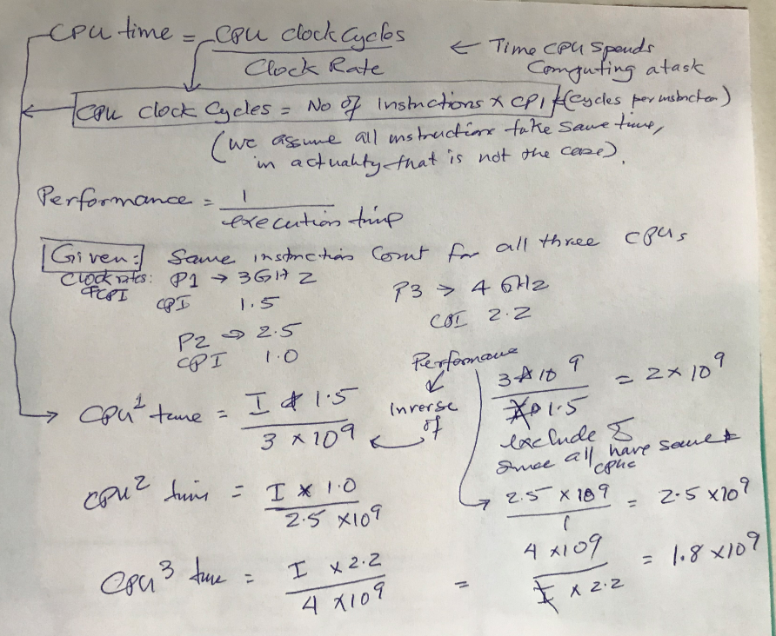

Slide 53
Memory Hierarchy
Register (CPU)
Cache
Main Memory
I/O Devices
  Hard Disk
  Optical disk, floppy disk
  Magnetic tape

Slide 54
Cache Performance
Assume: Cache is 10 times faster than memory and cache hit rate is 90%
How much speedup is gained using this cache?
  Use Amdahl’s law:
  Speedup = 1 / [(1-90%) + (90%/10)] = 1/[.1+.9/10] = 5.3
Over a 5 times speedup by using cache with these specifications!

Slide 55
Memory Impact on CPU
In a pipeline, a memory stall will occur if the memory fetch of an operand is not found in cache
  CPU execution time = (CPU clock cycles + Memory stall cycles) * Clock cycle
  Memory stall cycles = number of misses * miss penalty = IC * misses per instruction * miss penalty = IC * mem ref’s/instr * miss rate * miss penalty
  Miss rate is determined by cache efficiency
  Miss penalty is determined by main memory system speed (also bus load and bandwidth, etc…)

Slide 56
Example
Assume a machine with
  CPI = 2.0 when all memory accesses are hits
  Only data accesses are loads and stores (40% of all instructions are loads and stores)
  Miss penalty = 25 clock cycles
  Miss rate = 2%
  How much faster would the machine be if all accesses are hits?

Slide 57
Solution
For machine with no misses:
  CPU exec. Time = (CPU clock cycles + memory stall cycles) * clock cycle = (IC * CPI + 0) * clock cycle
For machine with 2% miss rate:
  Memory stall cycles = IC * memory references/instr * miss rate * miss penalty = IC * (1 + .4) * .02 * 25 = IC * .7
  CPU exec Time = (IC * 2.0 + IC * .7) * clock cycle = 2.7 * IC * clock cycle
So, the machine with no misses is 2.7/2.0 times faster or 1.35 times faster

