Slide 1
On
Temporal instability of Electrically forced jets with nonzero basic state velocity
Sayantan Das(SD) ☺
Masters Student @ UT Pan Am
Mentors :Dr . D.N. Riahi & Dr. D. Bhatta

Slide 2
In other words…
Modeling instabilities of the Electro spinning process

Slide 3
What is electro-spinning?
Process of producing nano-fibers
http://nano.mtu.edu/Electrospinning_start.html

Slide 4
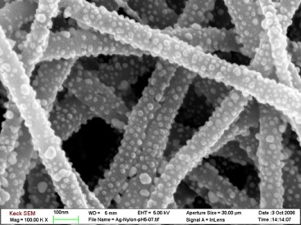
Quality Nanofibers
unparalleled in their porosity, high surface area
fineness and uniformity

Slide 5
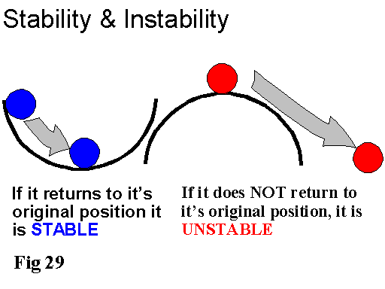
Stability?
. Here stability in terms of perturbation is considered

Slide 6
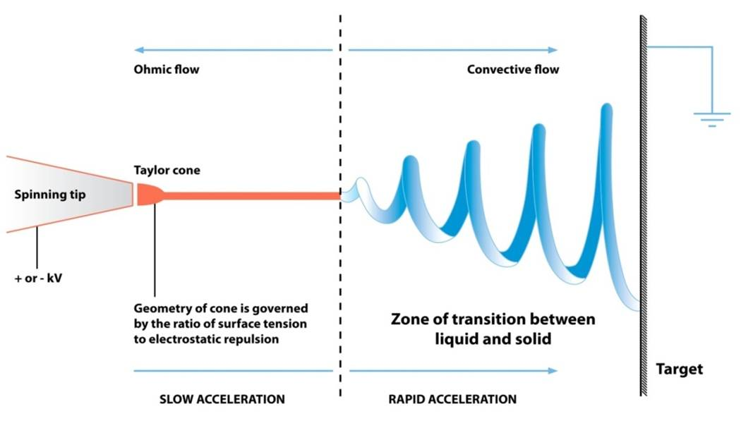
In Detail ☺
Schematic Representation

Slide 7

WHY ☺
To detect and understand temporal instabilities
Parameter regime under which Instabilities are strong
Subsequent ways to control and eliminate such instabilities

Slide 8
We use,
Electro-hydrodynamic Equation
mass conservation Dρ/Dt+ρ∇.u=0 (1a)
charge conservation Dq/Dt+∇.(KE)=0 (1c)
D/Dt =∂/∂t+ u.∇ - total derivative t-time variable
u-velocity vector
P-pressure E -electric field vector Φ -electric potential q- charge
ρ-fluid density μ-dynamic viscosity K-conductivity
electric potential E=−∇Φ (1d)
momentum ρDu/Dt =−∇P+∇.∇(μ u)+qE (1b)

Slide 9
How We Model?☺
We non- dimensionalize 1(a-d)
We get four non dimensional equation 2(a-d)
Using perturbation technique we linearize the PDE,s
Forming 4x4 determinant , we get the Dispersion relation

Slide 10
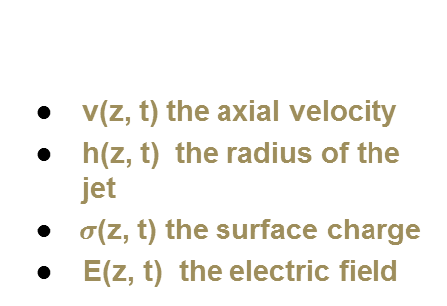
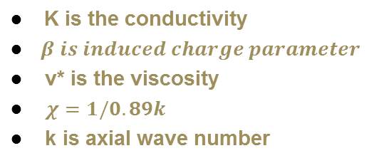
The Non Dimensional Eqn
All the constant
parameters are from
Hohman et al 2001

Slide 11
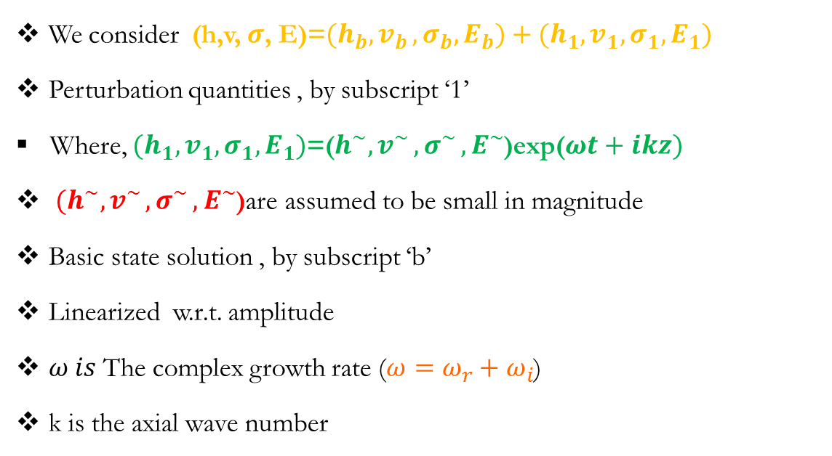
Perturbation technique
We consider (h,v, $σ$, E)=${(h}_{b}{,v}_{b},σ_{b},E_{b})+(h_{1},v_{1},σ_{1},E_{1})$
Perturbation quantities , by subscript ‘1’
Where, $(h_{1},v_{1},σ_{1},E_{1})$=($h^{\sim }{,v}^{\sim }{,σ}^{\sim },E^{\sim }$)exp($ωt+ikz)$
$(h^{\sim }{,v}^{\sim }{,σ}^{\sim },E^{\sim }$)are assumed to be small in magnitude
Basic state solution , by subscript ‘b’
Linearized w.r.t. amplitude
$ω is$The complex growth rate ($ω=ω_{r}+ω_{i}$)
k is the axial wave number

Slide 12
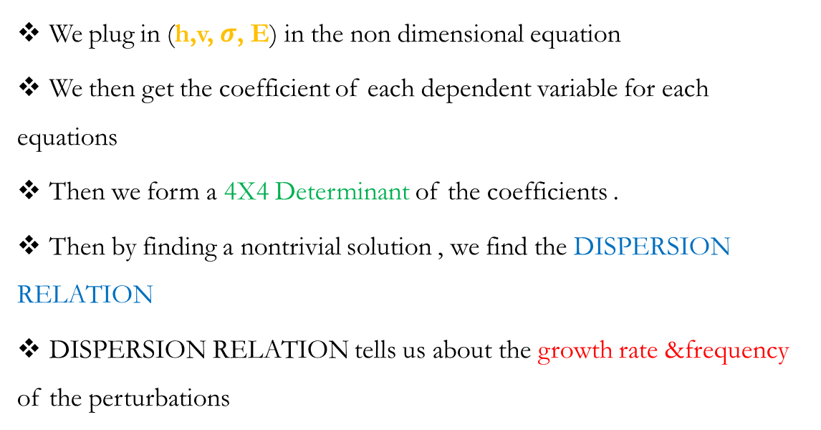
Mathematically
We plug in (h,v, $σ$, E) in the non dimensional equation
We then get the coefficient of each dependent variable for each equations
Then we form a 4X4 Determinant of the coefficients .
Then by finding a nontrivial solution , we find the DISPERSION RELATION
DISPERSION RELATION tells us about the growth rate &frequency of the perturbations

Slide 13
Our Work
Hohman et.al ,2001, considered the basic state velocity to be zero
We considered basic state velocity to be a non zero and a constant quantity
Considering this case we derived the DISPERSION RELATION

Slide 14
Dispersion Relation
We get ,
Where,
with;

Slide 15
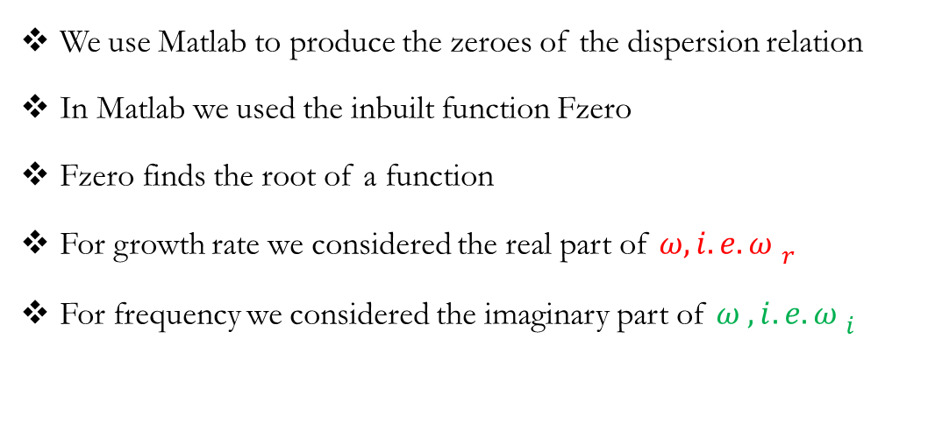
Computational
We use Matlab to produce the zeroes of the dispersion relation
In Matlab we used the inbuilt function Fzero
Fzero finds the root of a function
For growth rate we considered the real part of $ω{, i.e.ω }_{r}$
For frequency we considered the imaginary part of $ω{ ,i.e. ω }_{i}$

Slide 16
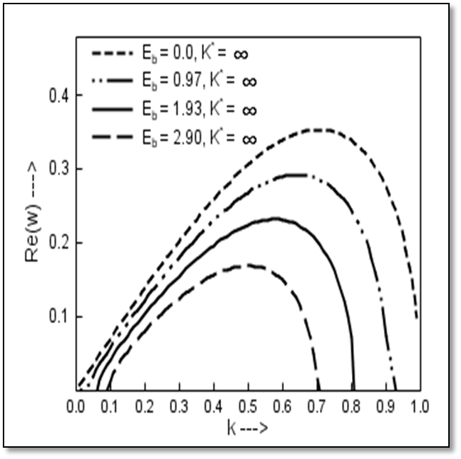
Results☺

Slide 17
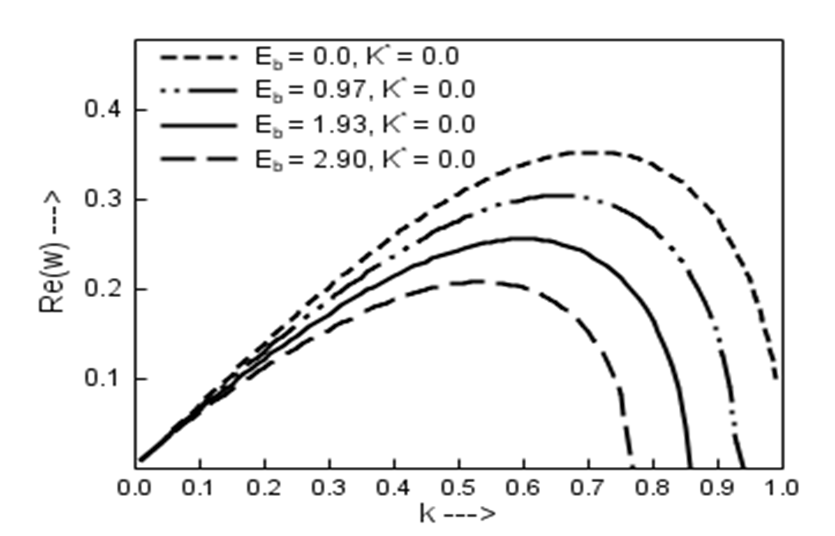

Slide 18
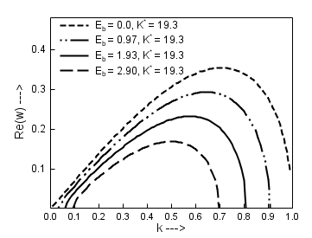
More…☺

Slide 19
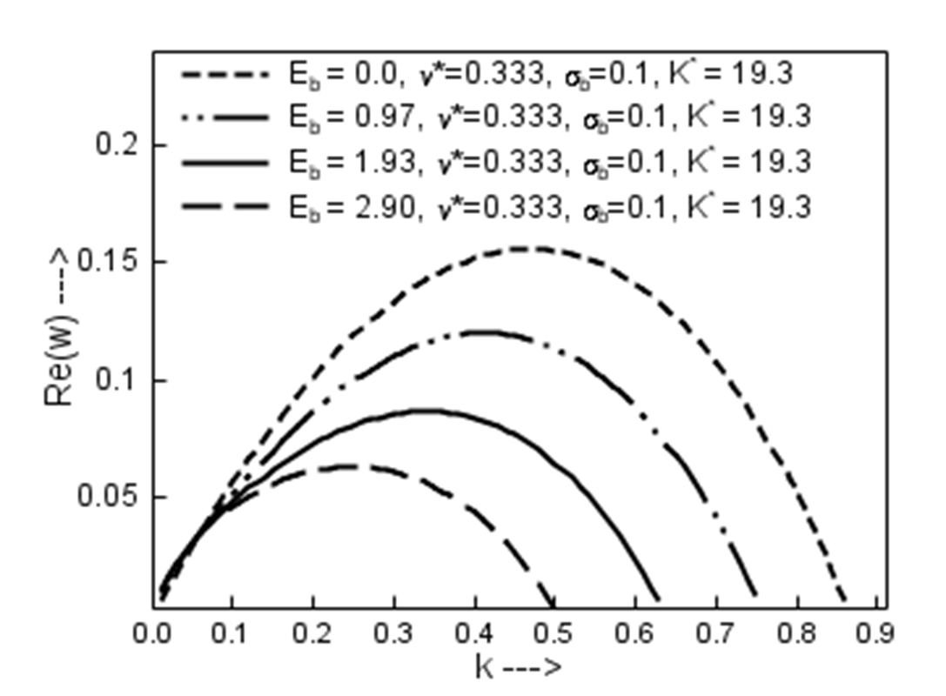

Slide 20
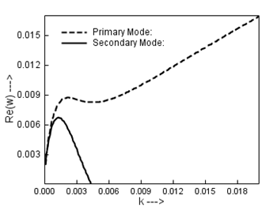
Contd….

Slide 21
So…
The variable applied field is stabilizing
The finite values of either viscosity or conductivity are stabilizing
There are two modes of instability for small values of the wavenumber
All above results comply with Hohman et al with zero basic state velocity
Hence,the growth rate in temporal instabilty is unaffected by the value of the basic state velocity, but significant changes are already seen in spatial instability cases.
So is our work is of no importance ? with vb being nonzero ☹

Slide 22
NO☺
The non zero basic state velocity significantly affects the frequency of the perturbed state
Hence also affects the period
Which is significant for producing quality fibers
LETS SEE HOW

Slide 23
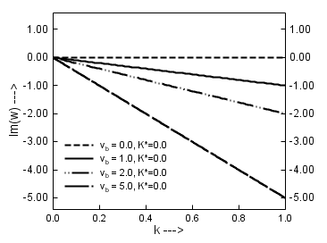
Figure ☺

Slide 24
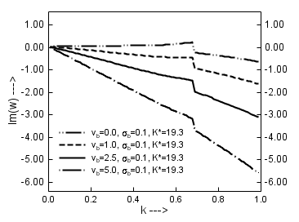

Slide 25
Hence
More the vb less is the frequency , hence more is the period
Presence of conductivity increases the period
As velocity of the wave is proportional to the negative frequency
As vb increases the velocity of the wave increases (Obvious)
Hence production of nanofibers will be affected

Slide 26
Future studies…☺
Investigate the case for spatial instability with non zero basic state velocity
Investigate combined spatial and temporal instability with non zero basic state velocity
Investigate non-linear model
Investigate non axisymmetric case

Slide 27
Thank You All…
My special thanks to Dr Bhatta, & Dr Riahi for the support and enthusiasm…..
Any questions or comments are gladly welcomed
☺

