Slide 1
Classfying meals using Machine Learning
By Edgar de la Torre

Slide 2
Objective
Use a machine learning model to classify different meals.

Slide 3
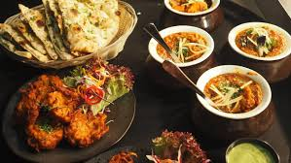
Why?
Food is important in everyday life
Identify foreign meals.
Tracking your diet

Slide 4
Current Uses of food Classification
Health Care
Production Lines.

Slide 5
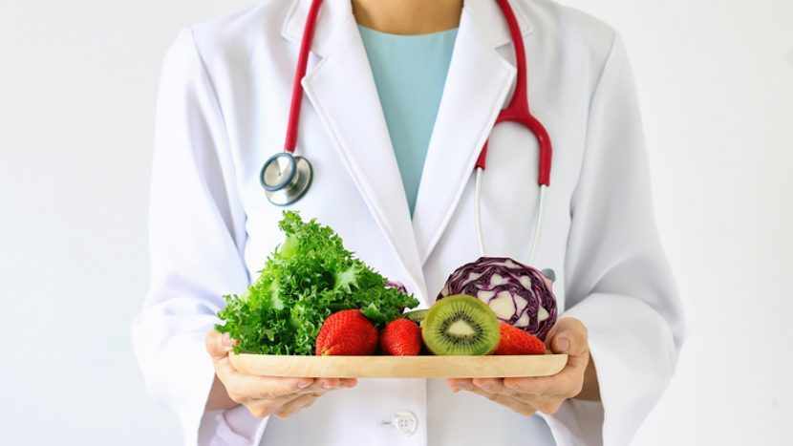
HealthCare Uses
Track Research patients eating habits
Measure Food and nutrient Intake.
Linking Diet and Desease

Slide 6
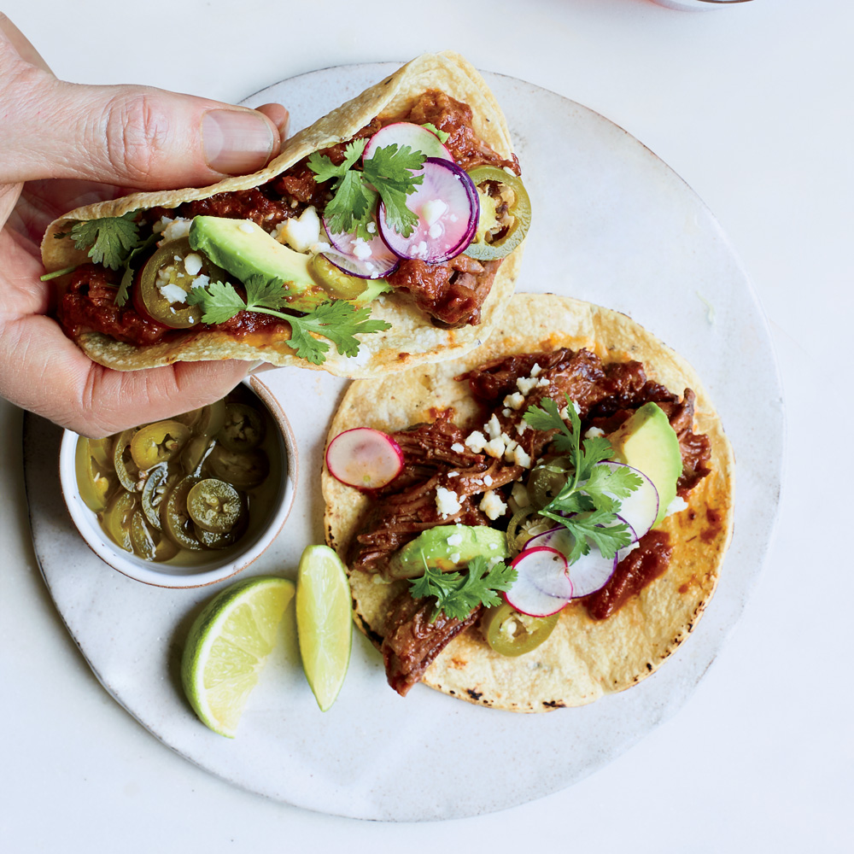
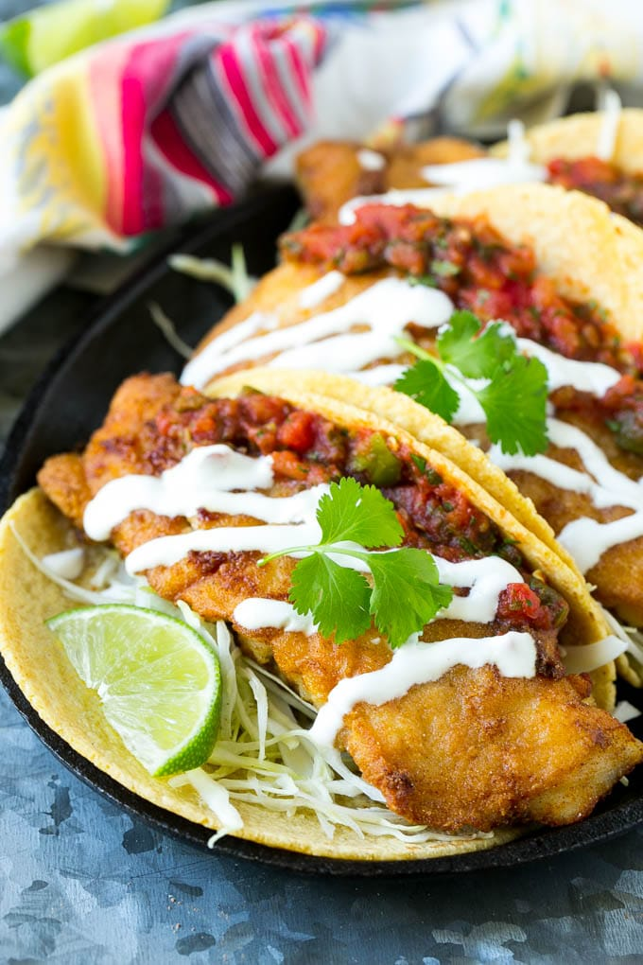
Challenges
Meal similarity between cultures.
Meals have many variations and its hard to discriminate between them.
Most pictures of meals other elements that are not part of the class

Slide 7
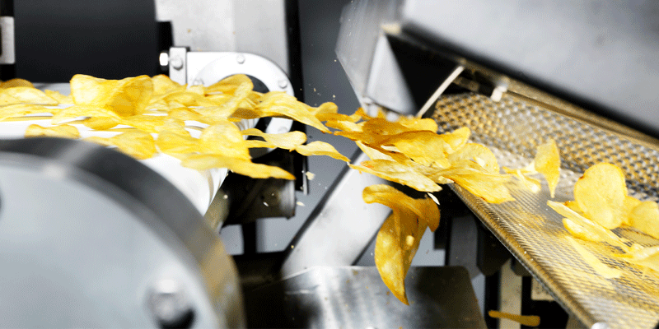
Production Uses
Sorting
Automatic food quality inspection

Slide 8
Data Set
Food-101 – Mining Discriminative Components with Random Forests
100 classes
750 images for training and 250 images for testing

Slide 9
Previous Work
Food-101 – Mining Discriminative Components with Random Forests
Collected from food spotting
A FOOD IMAGE RECOGNITION SYSTEM WITH MULTIPLE KERNEL LEARNING Taichi Joutou and Keiji Yanai
61% accuracy
Private dataset

Slide 10
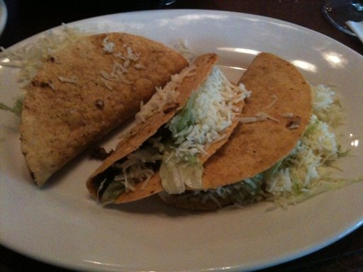
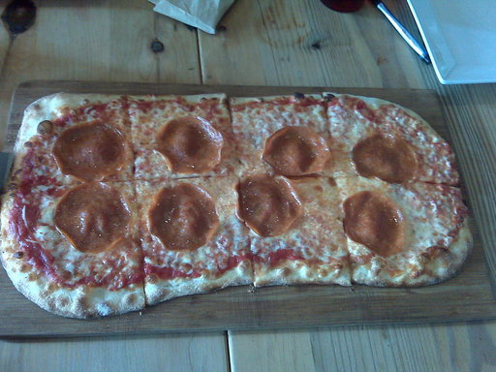
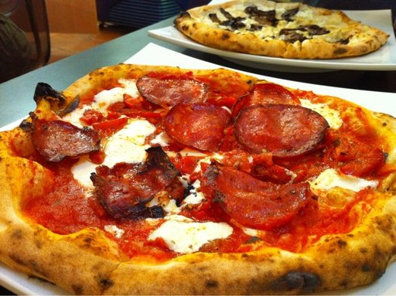
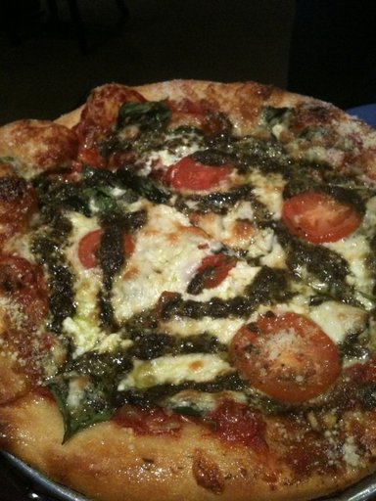
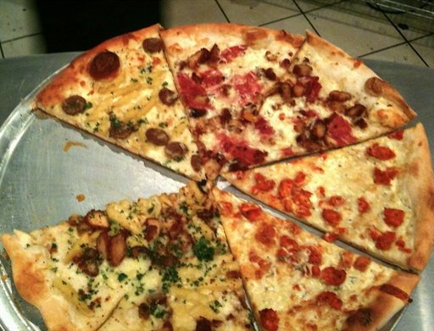
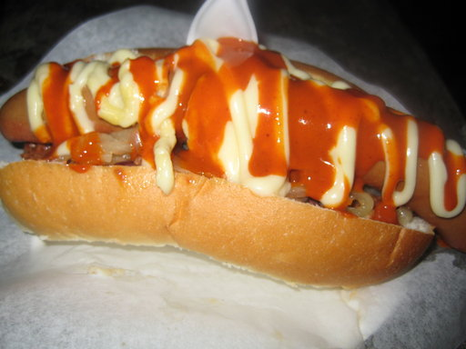
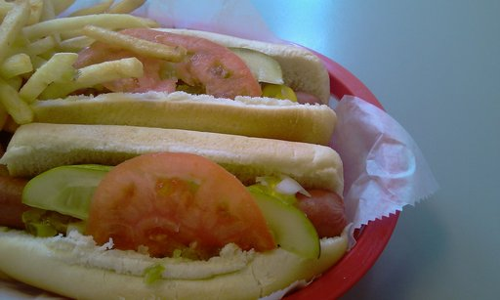
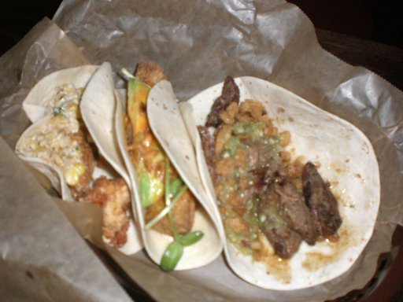
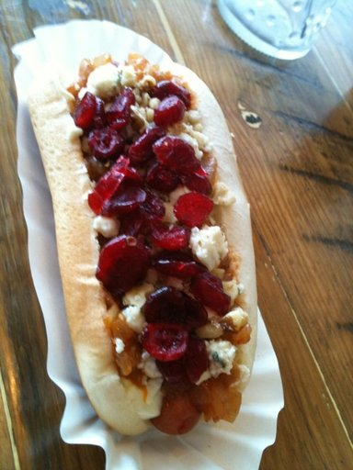

Slide 11
Model
3 class Classifier
CNN Neural Network using Keras
15 layers
Optimizer = adam
Categorical cross entroy

Slide 12



Frameworks
Keras
Flask
Tensorflow
Android

Slide 13
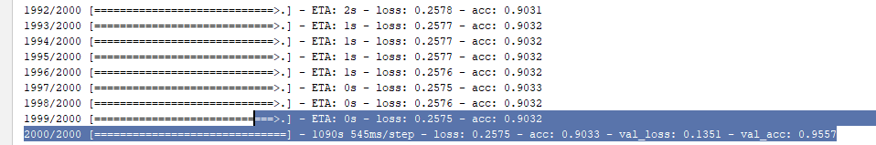
Results
10 epochs
2000 steps per epoch

Slide 14
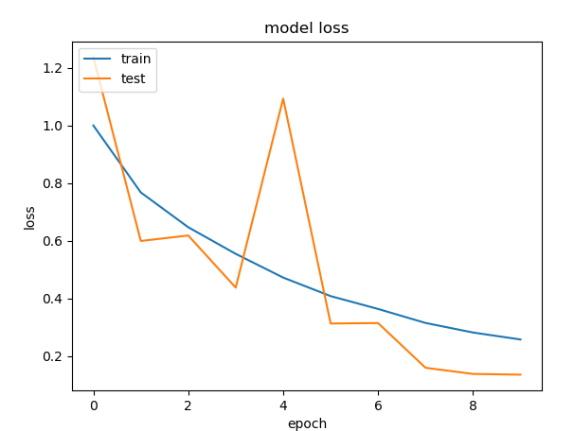
Loss

Slide 15
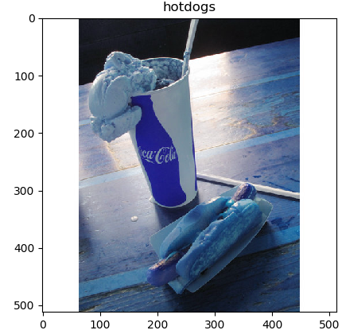
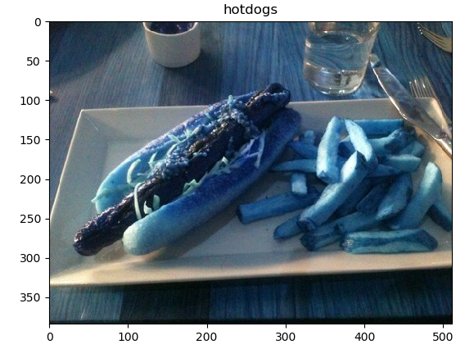
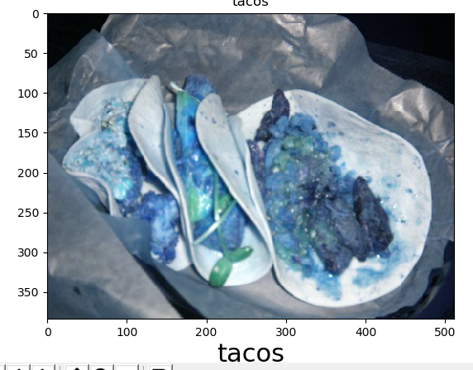
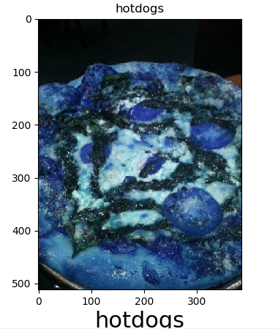

Slide 16
Future Work
Distinguish features within meal.
Finish Application
Add more
Calorie Estimation

Slide 17
Questions

