Slide 1
Reinforcement Learning with Project Malmo

Slide 2
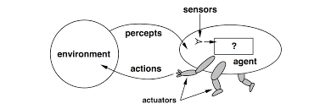
Introduction
We are utilizing Minecraft’s environment to train an intelligent agent using reinforcement learning.

Slide 3

Reinforcement Learning
It is about taking suitable action to maximize reward in a particular situation which has many approachable methods for each particular task.

Slide 4
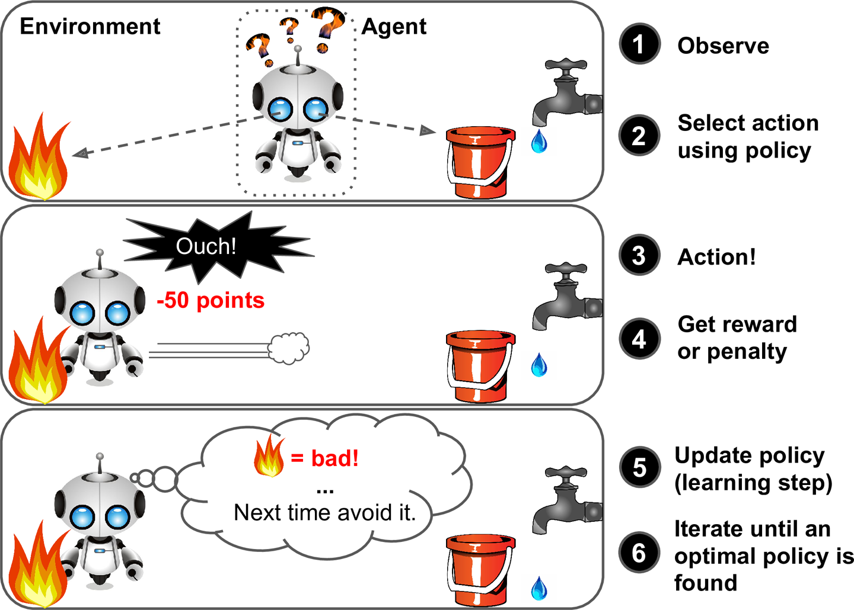
Policy Learning
A policy is a map from state to action
Finds the best action to take at a certain state

Slide 5
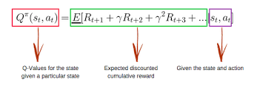
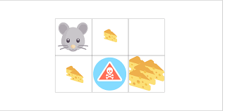
Q-Learning
The goal of Q-learning is to learn a policy, which tells an agent what action to take under what circumstances

Slide 6
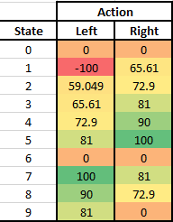
Q-Tables

Slide 7
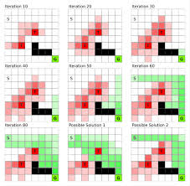
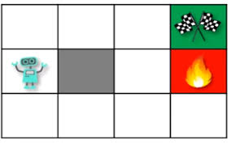
Q-learning and why we chose it
The method we chose was Q-learning due to the type of our experiments. The agent must be able to to reach a set goal with positive reward while avoiding negative rewards.
338 × 212

Slide 8
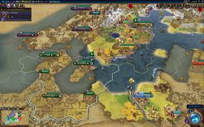
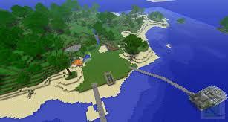
Motivation/Background
Implementing Artificial Intelligence within a realistic environment and have them grow
Minecraft environment

Slide 9
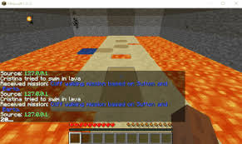
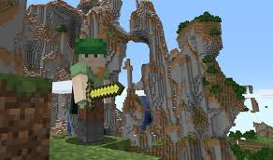
Problem/Goal
Problem: Minecraft is a massive open world environment
Goal: Have the Agent learn the properties within in this environment to be able to act on its own

Slide 10
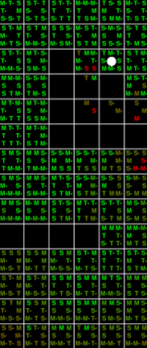
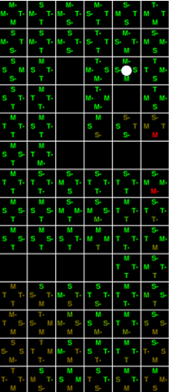
Related Works: Comparing Discretization Methods for Applying Q-learning in Continuous State-Action Space
They implemented diagonal movements and tested if this would be better than conventional horizontal/vertical movement.
https://www.cs.ru.nl/bachelors-theses/2017/Luuk_Arts___4396863___Comparing_Discretization_Methods_for_Applying_Q-learning_in_Continuous_State-Action_Space.pdf

Slide 11
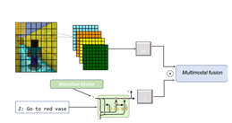
Related works: Language Grounding in Minecraft with Gated-Attention Networks
They used policy learning to predict the optimal action for the agent using a state representation module.
http://cs229.stanford.edu/proj2017/final-reports/5242630.pdf

Slide 12
Experiment Detail
We created 10x15 closed off environment
The goal in the center of the environment
The agent spawn in the center of the second row
With random hazards in the environment

Slide 13
Issues needing fixing
Agent would take simple random actions until goal was found
Agent would stay in a corner
Agent had a tendency to travel to previous states

Slide 14
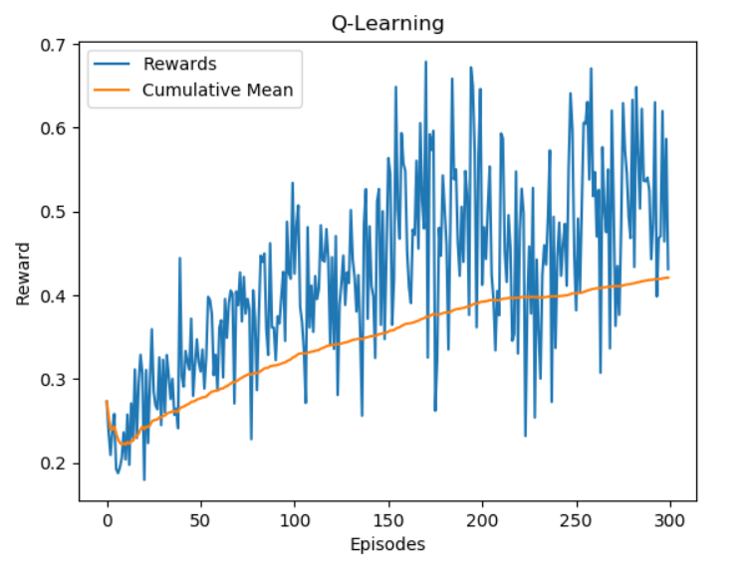

Original Results

Slide 15
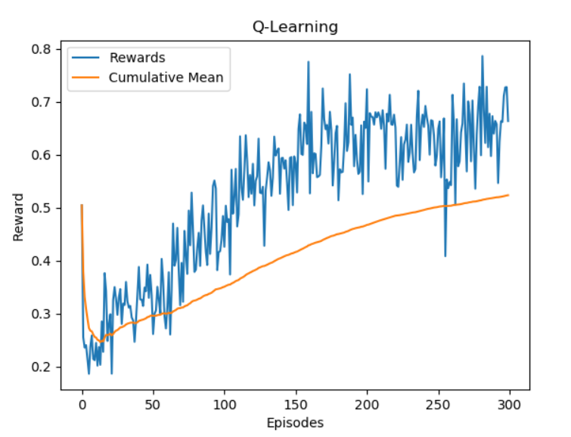
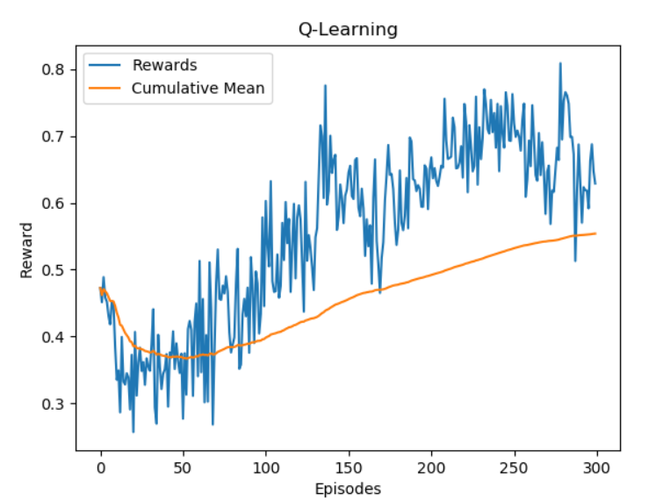
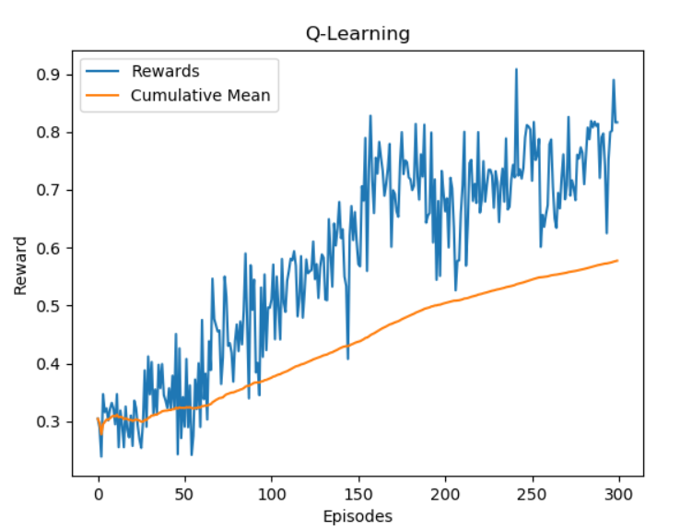
Modified Results

Slide 16
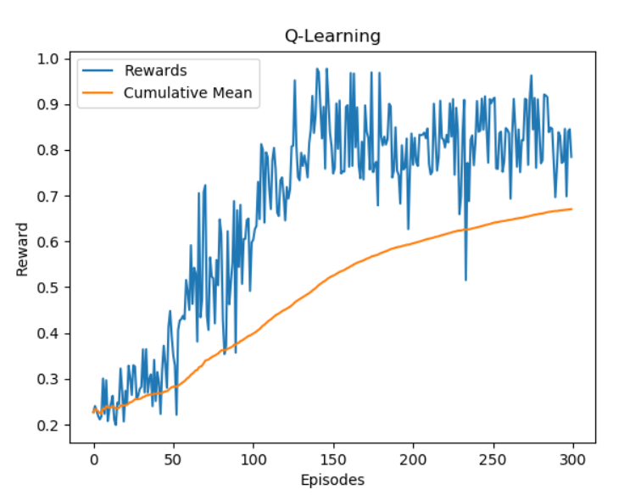
Modified Results

Slide 17
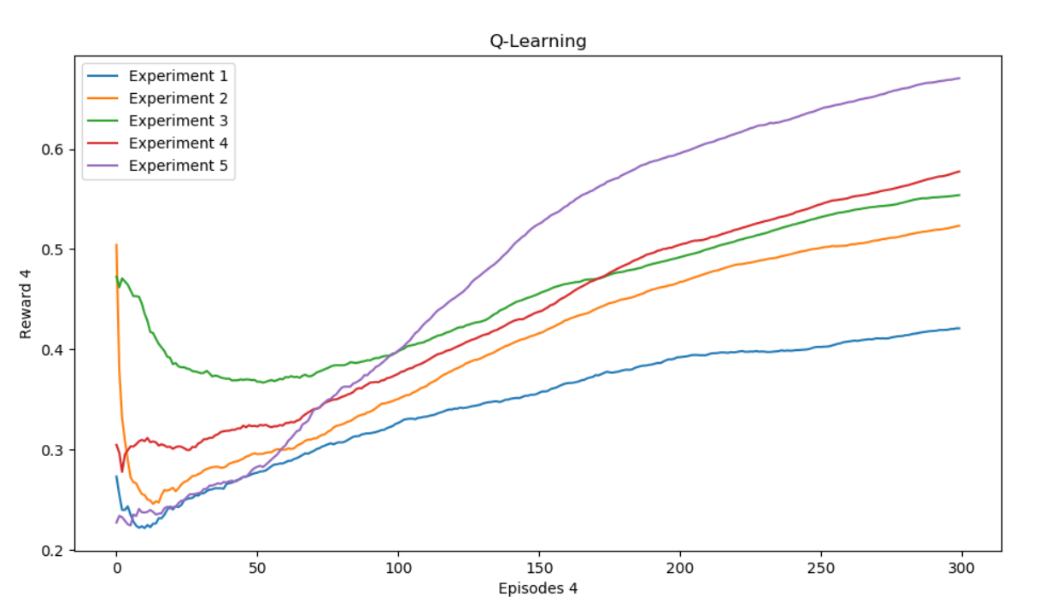
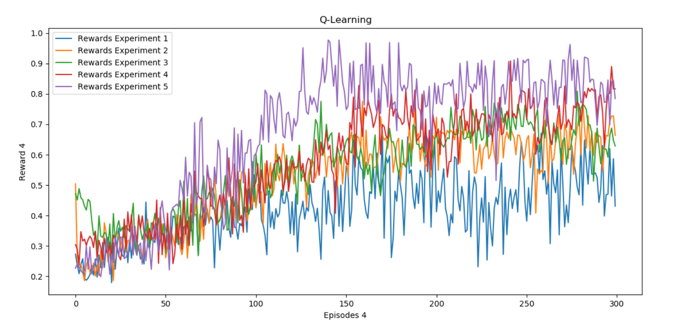
Improvements

Slide 18
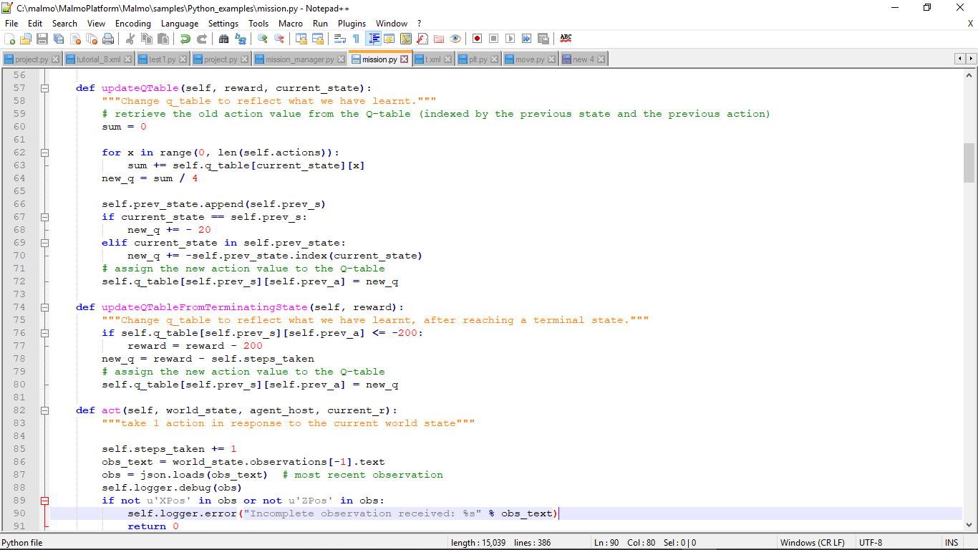
Code

Slide 19
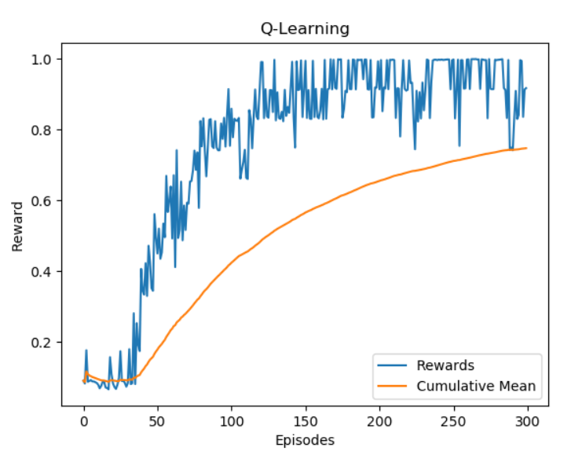
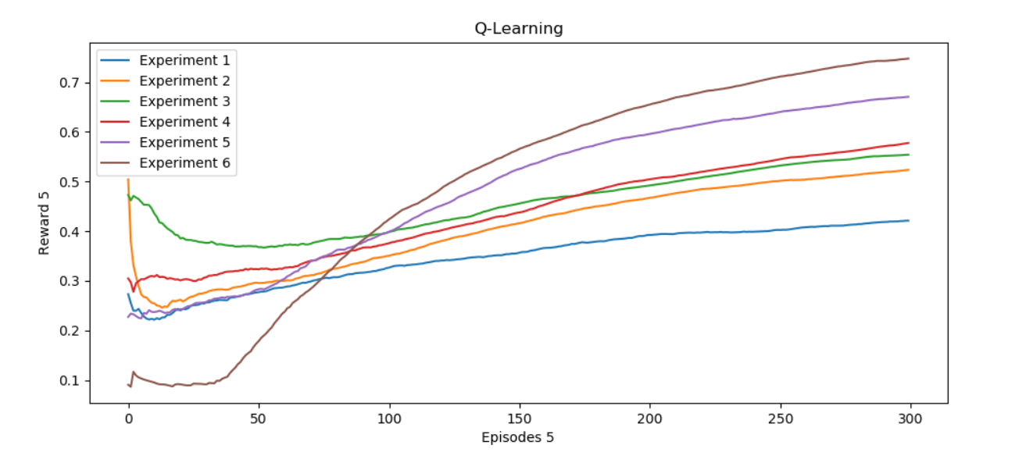
Current Results

Slide 20
Future plans
We plan to:
-introduce new obstacles
-introduce multiple agents
-implement computer vision

Slide 21
References
[1] Johnson M., Hofmann K., Hutton T., and Bignell D. The Malmo Platform for Articial Intelligence Experimentation. (2016). https://github.com/Microsoft/malmo.
[2] Arts L. Comparing Discretization Methods for Applying Q-learning in Continuous State-Action Space. (2017)
[3] Zaidi A. CS229 Final Project: Language Grounding in Minecraft with Gated-Attention Networks. (2017)

