Slide 1
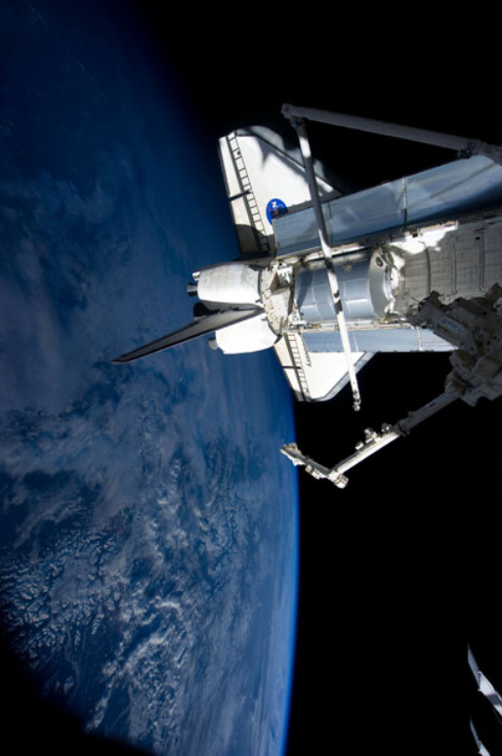
CNN Classifier for Astrophotography
Andrew Chen
Paulina Varela
Image courtesy of the Earth Science and Remote Sensing Unit, NASA Johnson Space Center

Slide 2
Introduction
Using a Convolutional Neural Network, we
identified geographical features within spatial images.
used pre-annotated data that was done manually to train our network.
images from the Gateway to Astronaut Photography of Earth website (GAPE).
Their database is inundated with images, especially raw, unlabeled images.

Slide 3
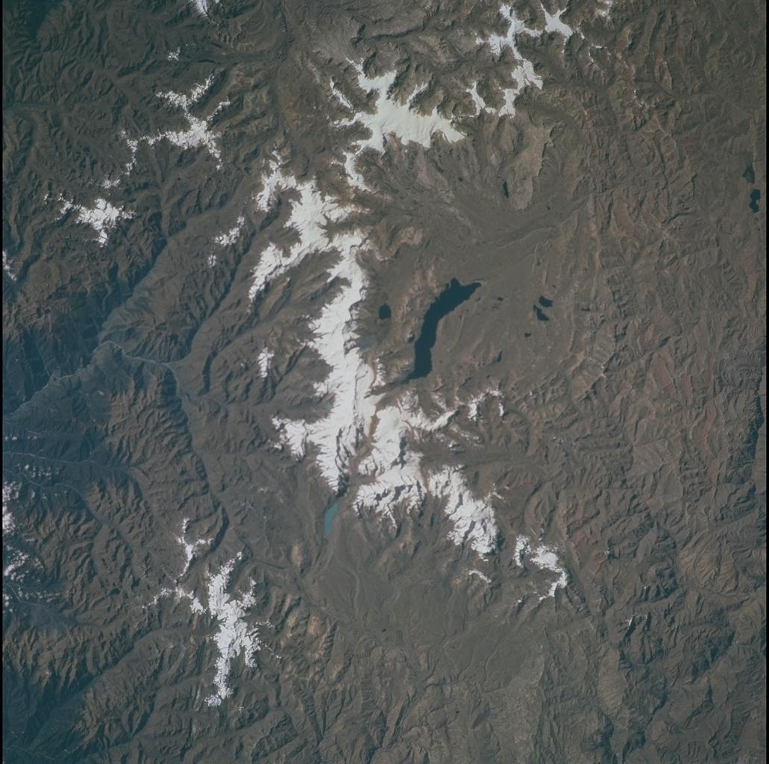
Objective
Classify geographical features in satellite images
Is there a mountain?

Slide 4
GAPE Background
Large database full of images that goes back six decades.
Taken by astronauts on the International Space Station.
When taking these images, no further information is stored other than the time it was taken and where the ISS is in relation to Earth.
Some images in the database have manually labeled and identified by their center location, many are just raw data waiting to be analyzed.

Slide 5
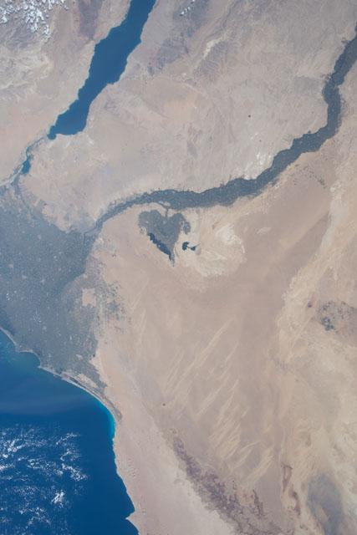
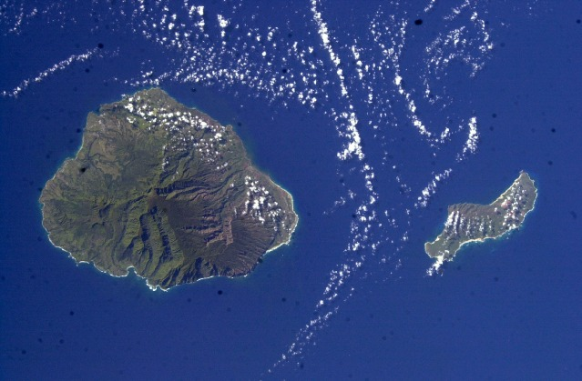
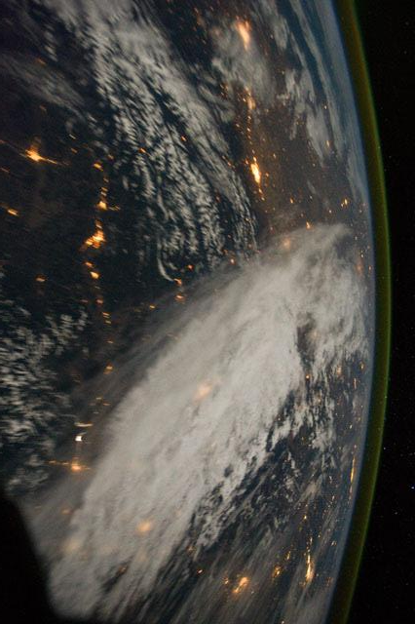
Examples
Images courtesy of the Earth Science and Remote Sensing Unit, NASA Johnson Space Center

Slide 6
Goals and Motivation
Our goal is to provide an accurate framework to annotate satellite images for the images taken and publicated on the GAPE website
Annotating images can be a tedious task, especially on a large scale. Implementing a successful training network would be useful in accelerating the process.

Slide 7
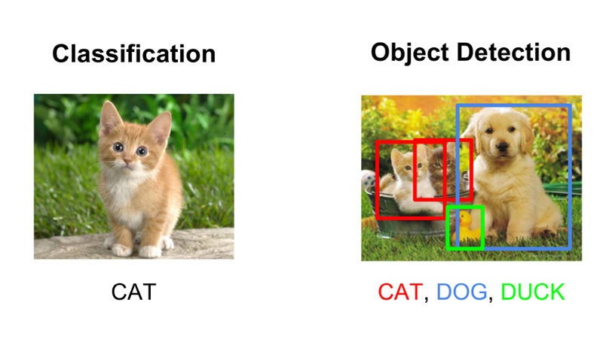
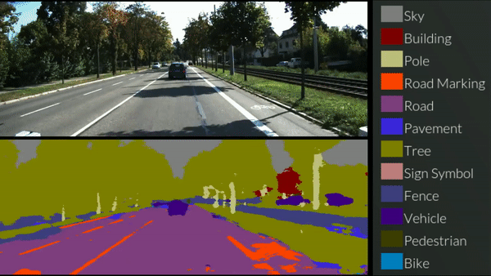
Background
Is it possible to use computers to see what humans see?
Computer Vision
Image recognition tasks:
Object detection
Localization
Classification
Semantic segmentation
etc

Slide 8
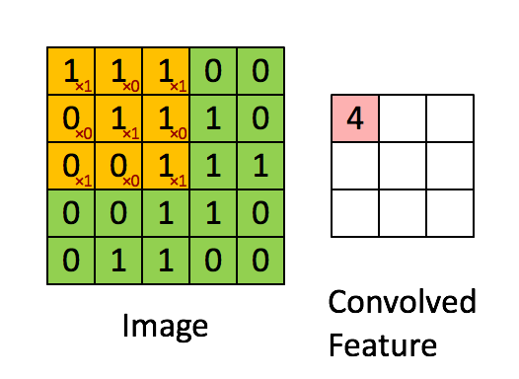
Convolutional Neural Networks
Specialized kind of neural network, employing a convolution which is a linear operation.

Slide 9
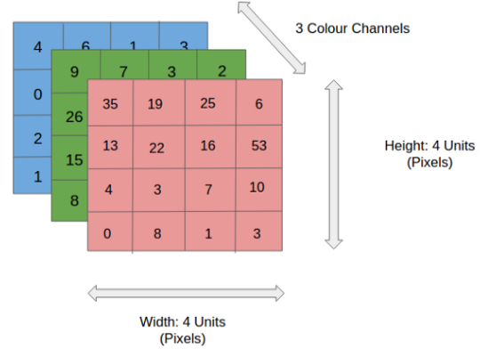
Why ConvNets?
Images can exist in a multitude of color spaces:
RGB
Grayscale
HSV
CMYK
Etc
Input of an image can be extremely large, especially at high resolutions
1920x1080 resolution = 2073600 pixels
An RGB 1920x1080 image is 2073600x3 pixels -> 6,220,800 input size
tl;dr version
ConvNets are great at reducing inputs to an easier form to process without losing features or details which are vital for making good predictions

Slide 10
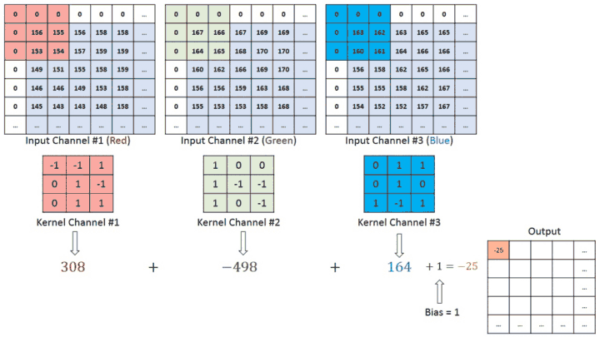
CNN Components
Convolutional Layer:
Extract the high and low level features:
Edges
Color
Gradient orientation
Etc.
Stride
Padding

Slide 11
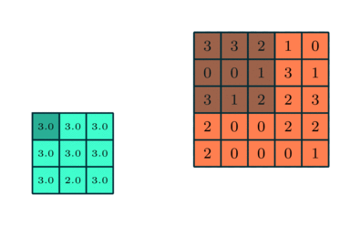
CNN Components
Pooling:
Reduces spatial size of the feature map
Reduce computation and maintain effective training
Discard noise

Slide 12
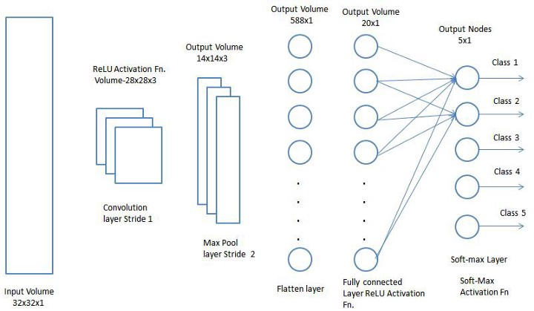
CNN Components
Fully Connected Layer
Learn non-linear combinations of high-level features
Similar to layers in a traditional neural network
Flattened into a single column vector and then feeds into a feed-forward neural network
Final classification layer classifies the features of the image

Slide 13
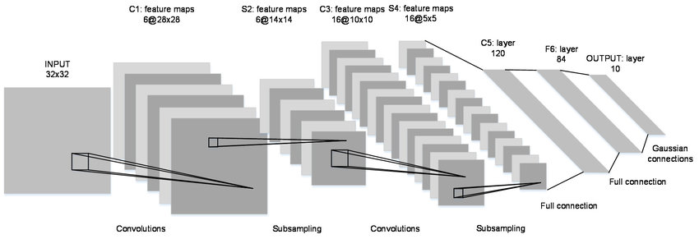
Deep Learning Using Convolutional Neural Networks
LeNet-5 (1998)
First successful CNN

Slide 14
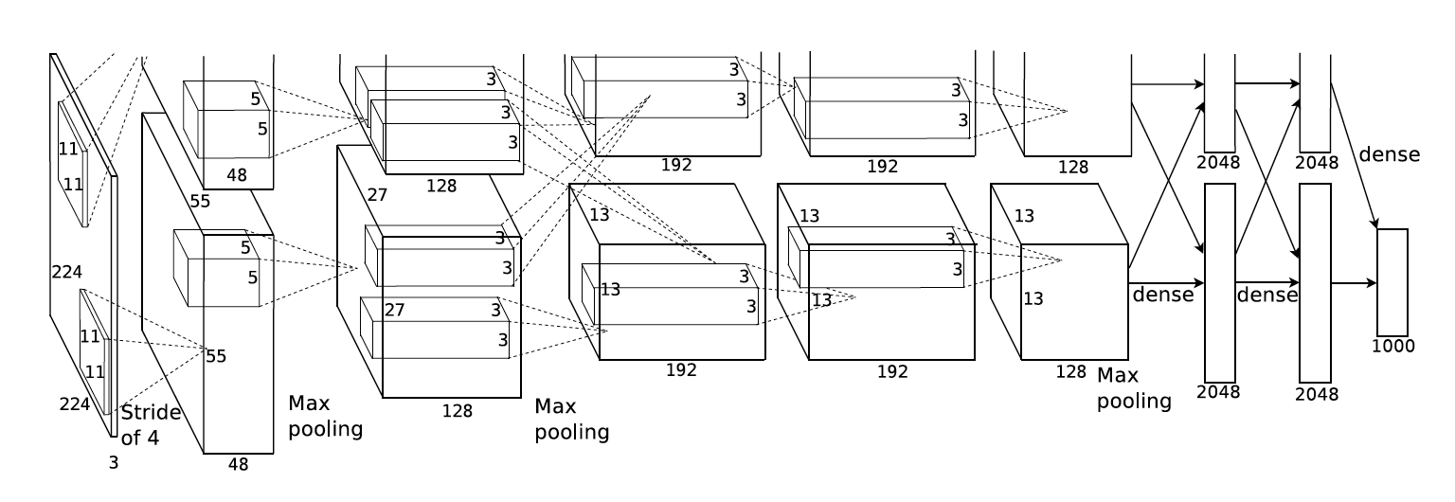
Deep Learning Using Convolutional Neural Networks
AlexNet (8 layers) 2012
popularized field of deep learning with its state-of-the-art results on ImageNet

Slide 15
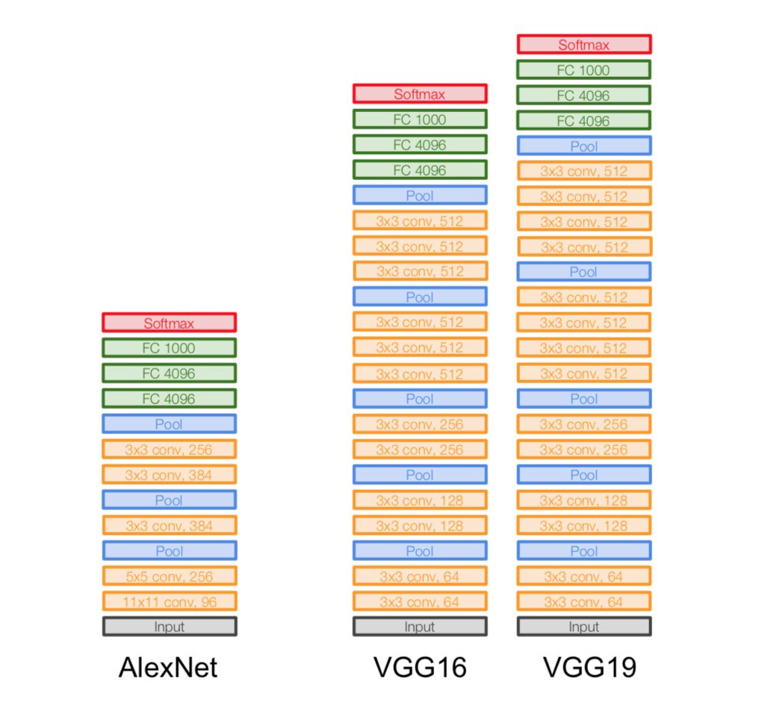
Deep Learning Using Convolutional Neural Networks
VGGNet (2014)
16 layers
Demonstrated importance of depth in CNNs

Slide 16
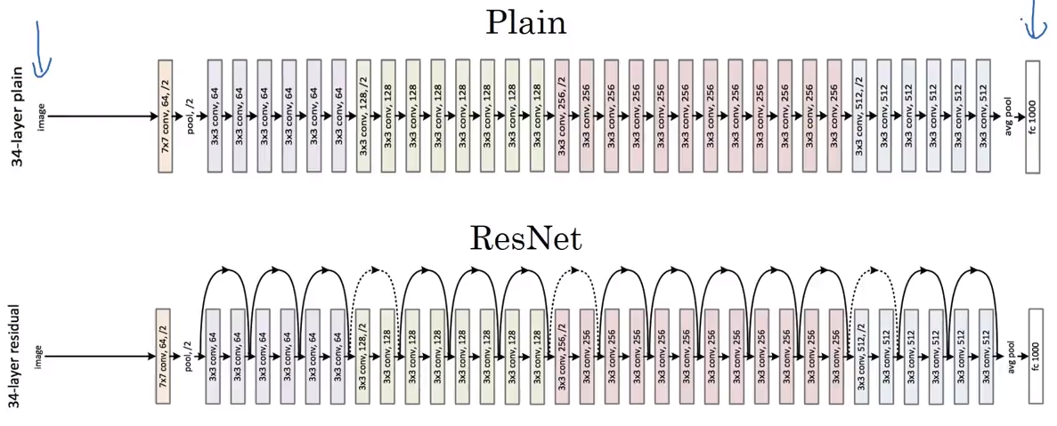
Deep Learning Using Convolutional Neural Networks
ResNet (2015)
101 layers
Significantly “deep” network surpassed human performance in image recognition tasks

Slide 17
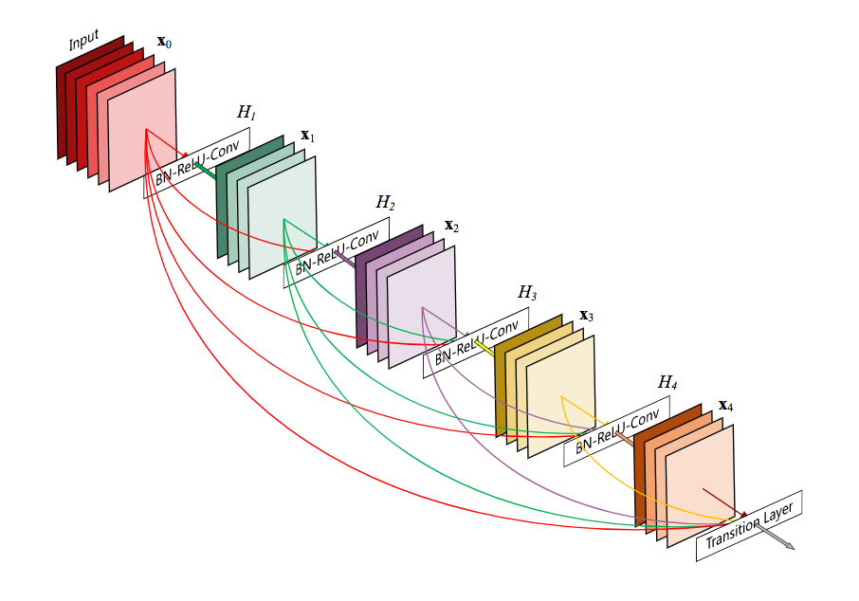
Deep Learning Using Convolutional Neural Networks
DenseNet (2016)
Explored new connectivity patterns

Slide 18
Problem Domain
Remote Sensing:
Generally refers to the use of satellite- or aircraft-based sensor technologies to detect and classify objects on Earth, including on the surface and in the atmosphere and oceans, based on propagated signals (e.g. electromagnetic radiation). -Wikipedia

Slide 19
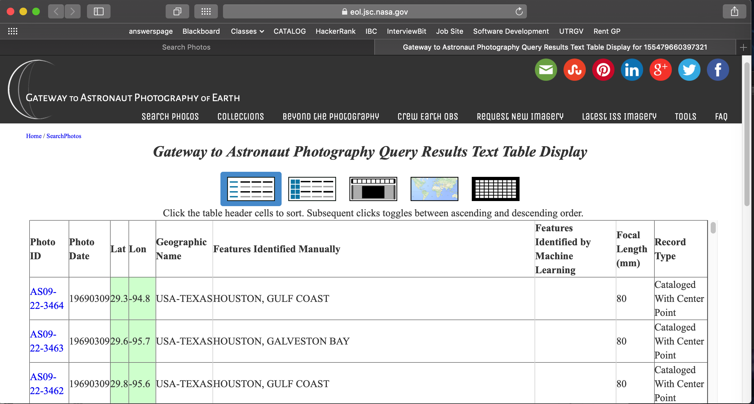
Data Extraction Method
Using a python script and given the website of the search query table, we were able to download thousands of images at a time.

Slide 20
Data Sample
Our main data sample was labeled mountain images extracted from the GAPE website. For our training set, we used positive images (pictures containing a mountain) and negative images (pictures not containing a mountain).

Slide 21
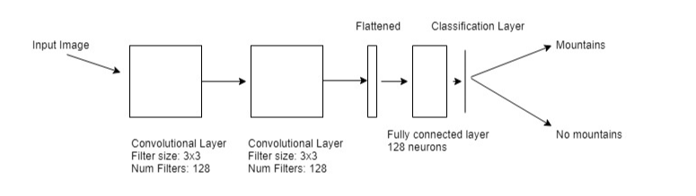
Architecture

Slide 22
Data
Datasets:
Binary:
Positive - images of mountains
Negative - images of cities
Training
500 positive
500 negative
Validation
Used the training set as the validation set
Testing
100 positive
100 negative
Images taken from GAPE
Specs:
256x256x3
JPEG format

Slide 23
Training
Data augmentation:
Horizontal flips
Parameters:
batch_size - 32
steps_per_epoch - 32
epochs - 6
Optimizer:
Stochastic gradient descent
Keras default parameters
Learning rate - 0.01

Slide 24




Tools & Frameworks Used
Model
Python
Keras with Tensorflow backend
Application
Python Flask web framework
Google MDL

Slide 25
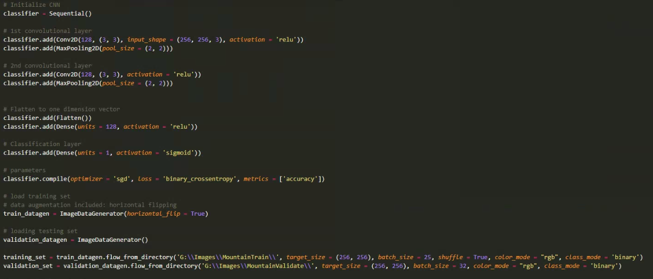
Code

Slide 26
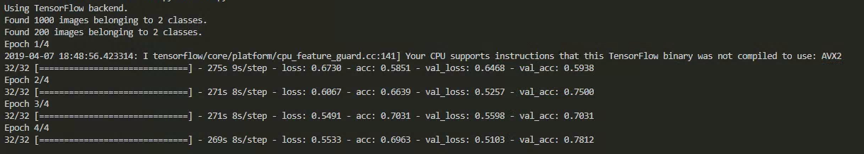
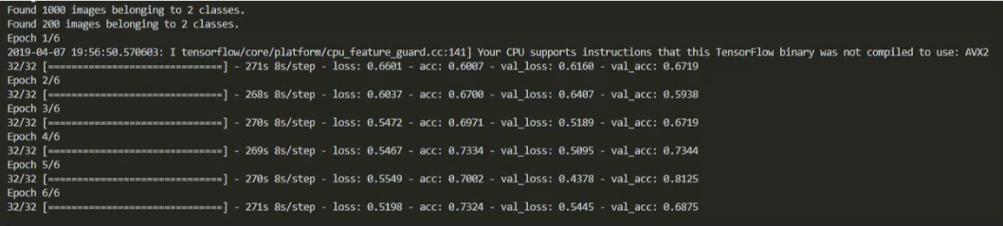
Training

Slide 27
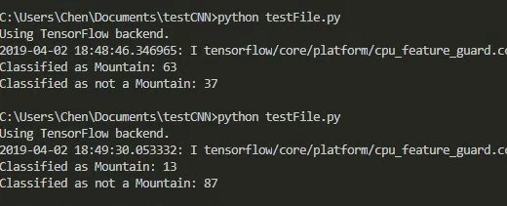
Testing
Positive:
63/100 correctly classified
63%
Negative:
87/100 correctly classified
87%
Combined performance:
75% accuracy

Slide 28
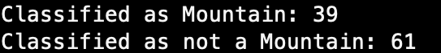



Multiple Attempts / Which Performed Best
Multiply Layers
Two Layer Performance (128, 64 # of filters, 3x3 filter size)
Three Layer Performance ( 128, 64, 32 #of filters, 5x5 filter size)

Slide 29
Discussion
Our model’s performance was decent, could definitely be better
Trained only on one feature
Potential problems with our training data:
Satellite images scan a large area
Too many classes to consider
Rivers, coastlines, islands, clouds, roads, trees, etc.
Negative data set were satellite images of cities
Possibility of mountains to be included
Try training with higher resolution images
Images from GAPE can be around 4000x3000 pixels in size
We reduced to 256x256 to reduce computation and allow for quicker training

Slide 30
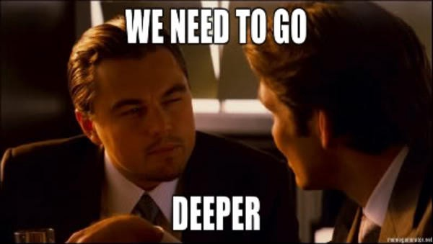
Future Work
We want to be able to consider all other classes in the image
Train a binary classifier for every class
Rivers
Roads
Forests
Clouds
Etc
Try training with a deeper network like ResNet
More data

Slide 31
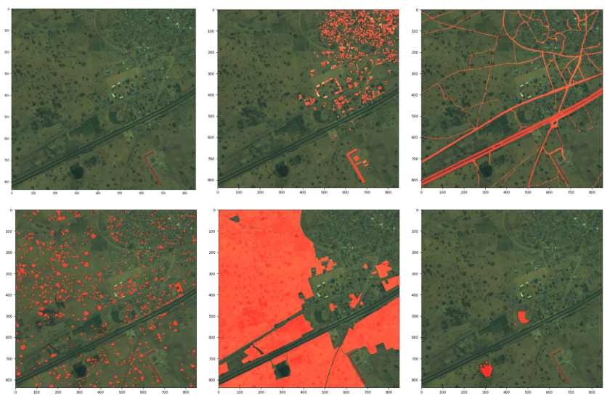
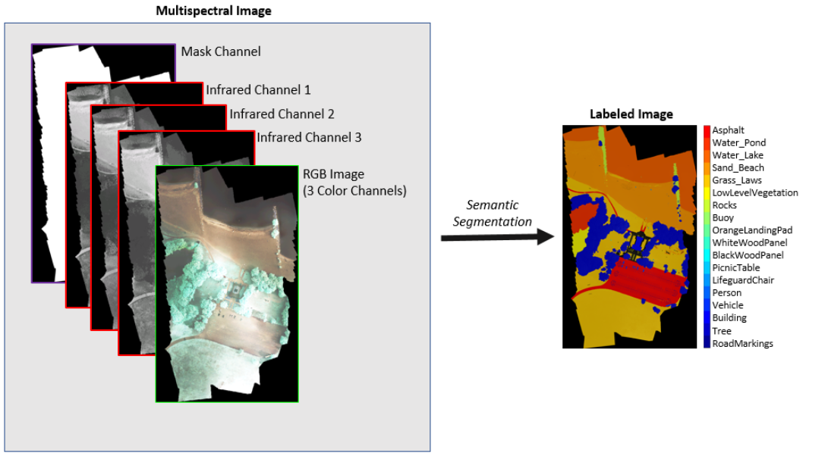
Future Work
We think the best approach for identifying geographical features in images is using UNet for semantic segmentation

Slide 32
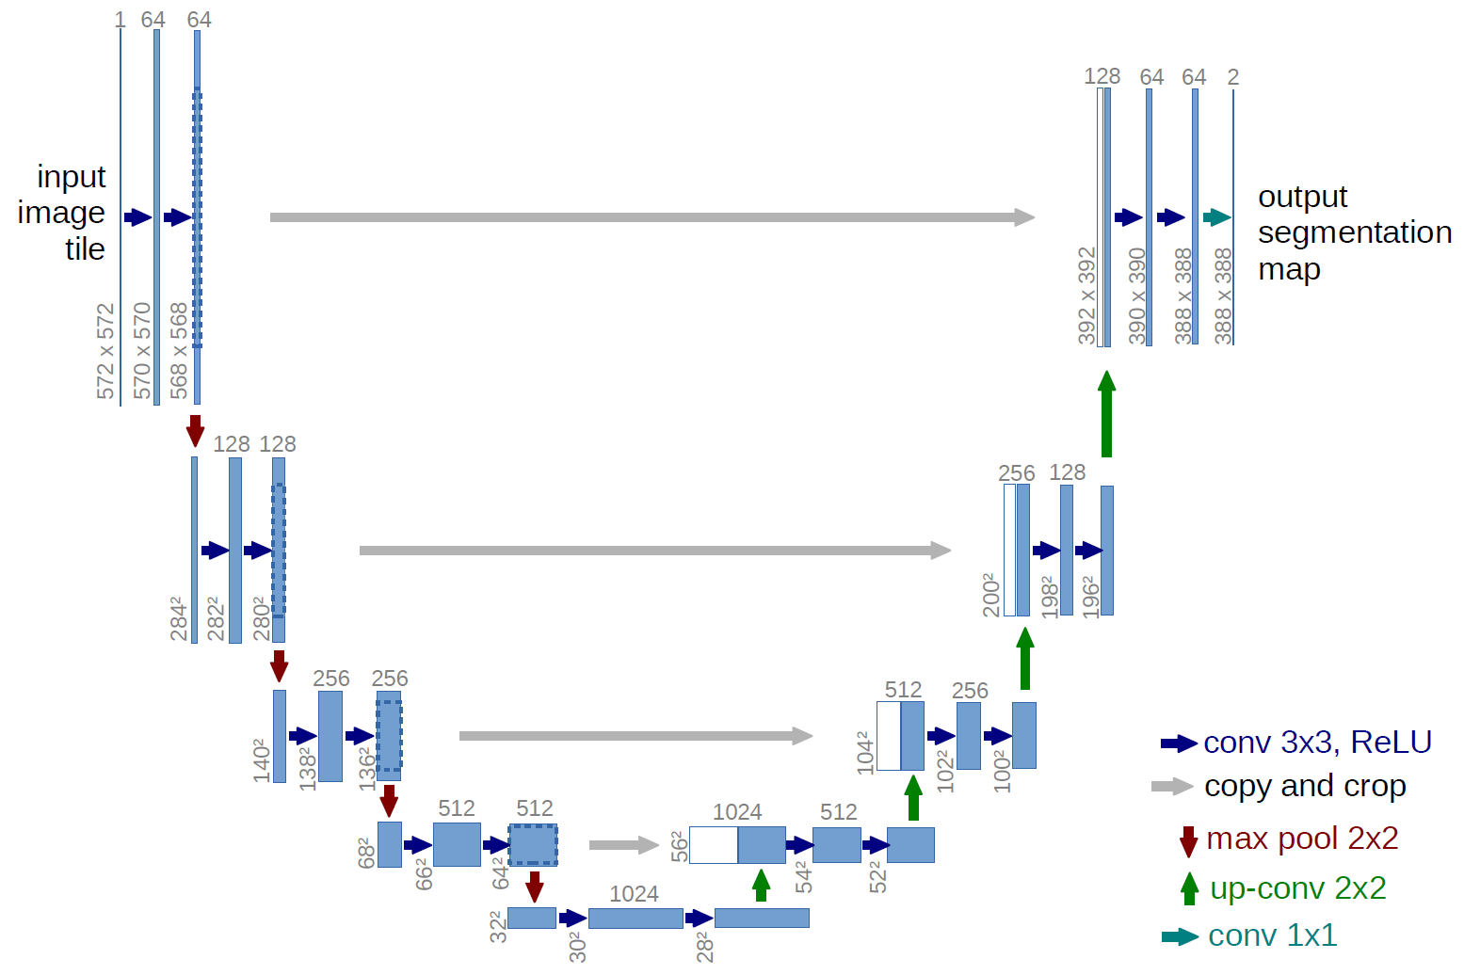
UNet
U-Net: Convolutional Networks for Biomedical Image Segmentation
Advantages:
Able to learn with limited training data
Proven to be effective for pixel-wise segmentation for satellite images

Slide 33
References
Deep Learning, Ian Goodfellow
Gateway to Astronaut Photography of Earth (GAPE)
AlexNet
VGGNet
ResNet
U-Net: Convolutional Networks for Biomedical Image Segmentation
Supervised Classification of Satellite Images
Semantic Annotation of High-Resolution Satellite Images via Weakly Supervised Learning

