Slide 1
Pysc2 Reinforcement Learning
Luis Romo
Marissa Jain

Slide 2
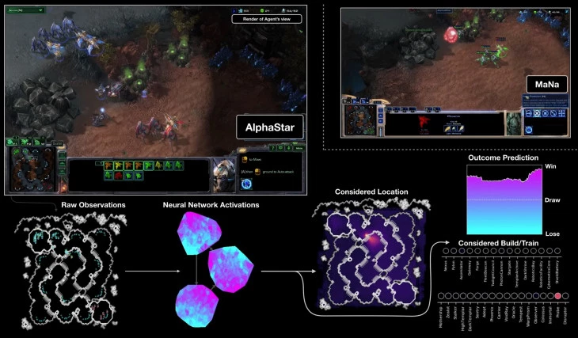
Introduction
Competitive computer games present a great opportunity for the application of Machine Learning, Artificial Intelligence, and Computer Vision
Real Time Strategy games provide an ideal testing environment for artificial intelligence and machine learning techniques

Slide 3
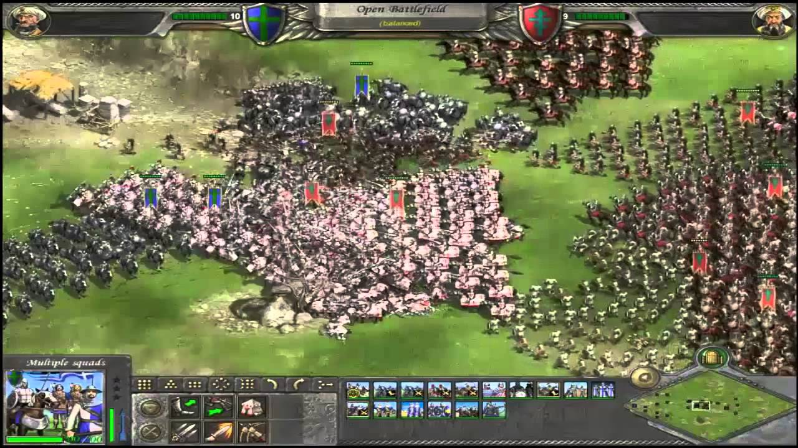
Machine Learning and RTS
The application of machine learning, artificial intelligence, and computer vision to real time strategy games is highly complex due to
  Being run in real-time
  Incomplete information
  Multiple strategies and elements

Slide 4
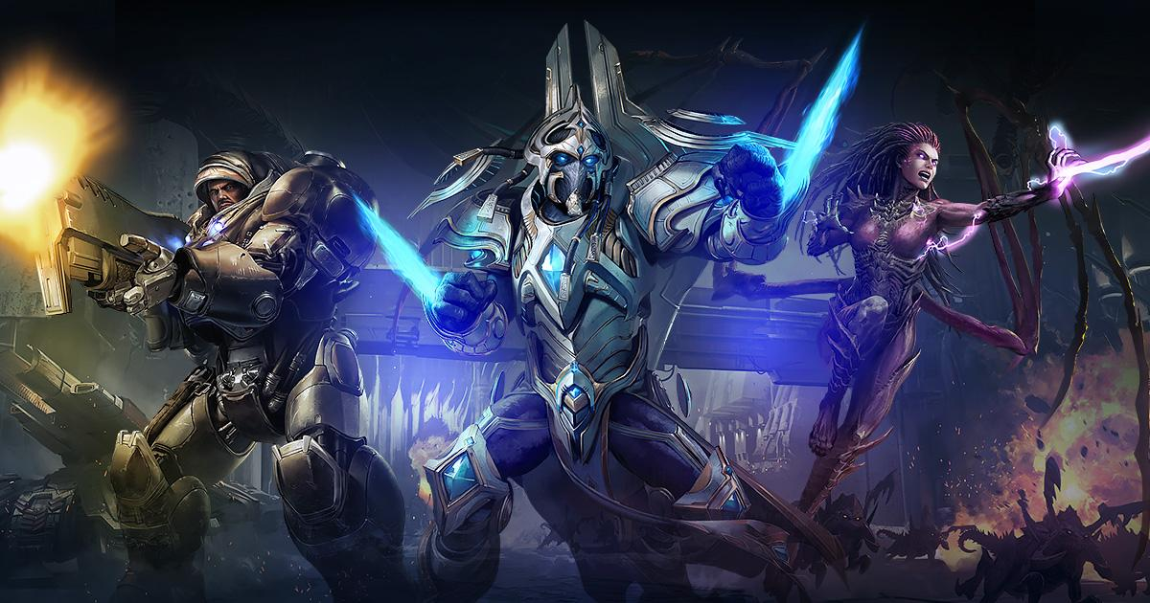
Starcraft II
Real Time Strategy Game developed by Blizzard
Goal of the game
  Collect resources
  Build a base
  Build units
  Defeat opponent
Suitable challenge for machine learning
  Deterministic
  Large state and action space
  Hidden information

Slide 5
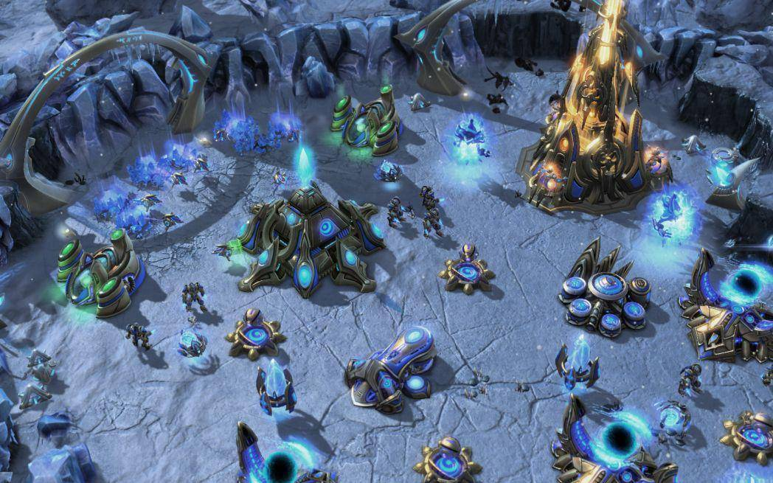
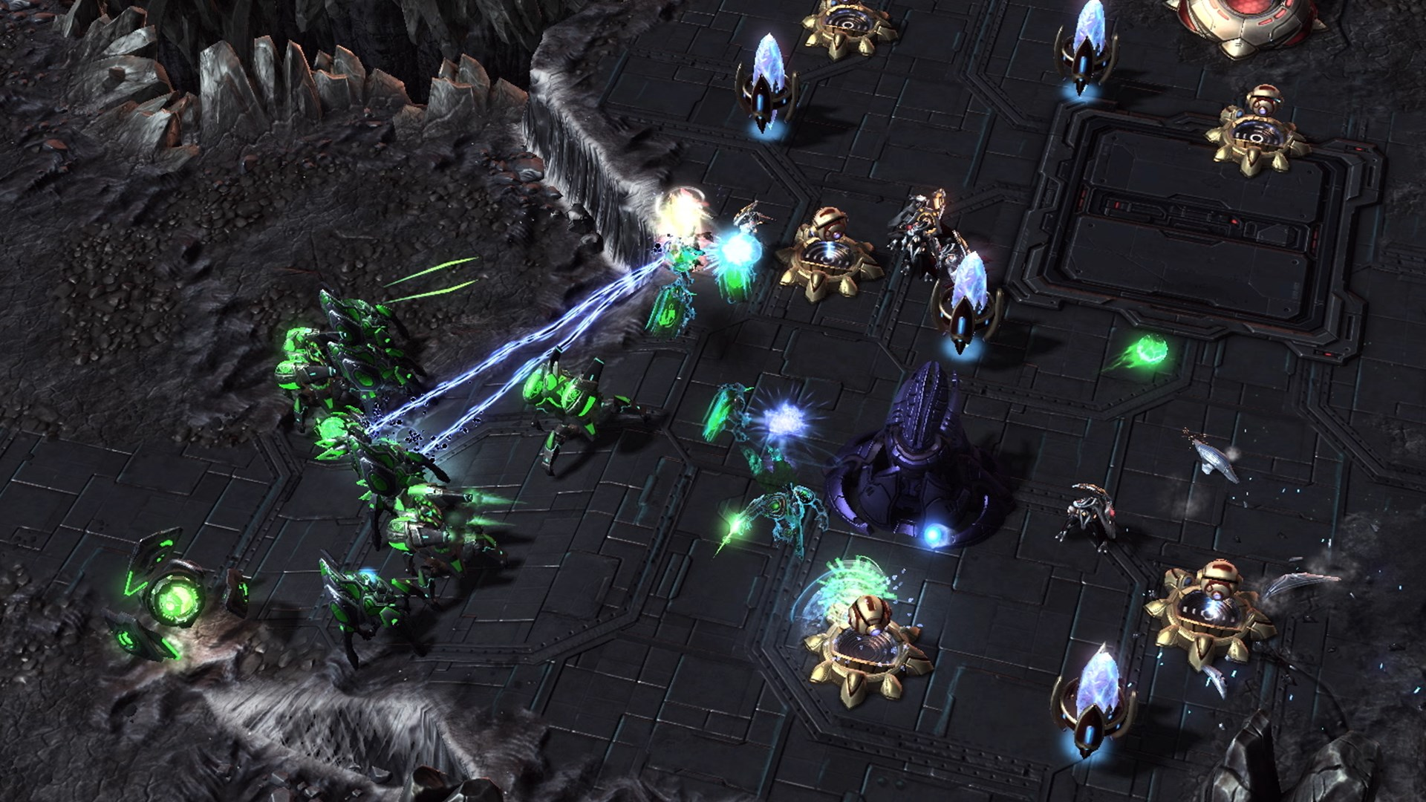
Starcraft 2

Slide 6
Previous Work
M. Samvelyan et al., "The StarCraft Multi-Agent Challenge", 2019. Available: https://arxiv.org/pdf/1902.04043.pdf. [Accessed 30 April 2019].
Z. Pang, R. Liu, Z. Meng, Y. Zhang, Y. Yu and T. Lu, "On Reinforcement Learning for Full-length Game of StarCraft", 2019. Available: https://arxiv.org/abs/1809.09095. [Accessed 30 April 2019].’
Vinyals, O. et al, StarCraft II: A New Challenge for ReinforcementLearning.arXiv:1708.04782 [cs], August 2017. URLhttp://arxiv.org/abs/1708.04782. arXiv: 1708.04782.
DeepMind. Alphastar: Mastering the real-time strategygame starcraft ii, 2019. URL https://deepmind.com/blog/alphastar-mastering-real-time-strategy-game-starcraft-ii/.
Hu, Y., Li, J., Li, X., Pan, G., and Xu, M. Knowledge-guided agent-tactic-aware learning for starcraft micro-management. InIJCAI, pp. 1471–1477, 2018

Slide 7
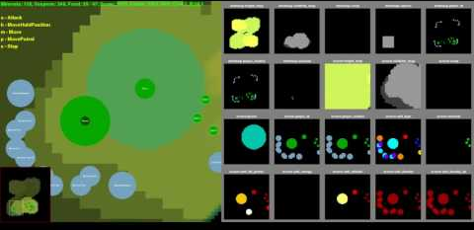
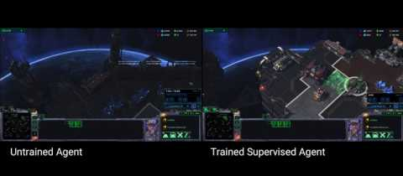
pysc2
Environment for Reinforcement Learning research
Developed by Deepmind - Blizzard collaboration
Provides an interface for RL agents to interact with StarCraft II
Designed to emulate human abilities

Slide 8
Difficulties with PySC2
Lack of Documentation
Difficult Debugging
Outdated Tutorials

Slide 9
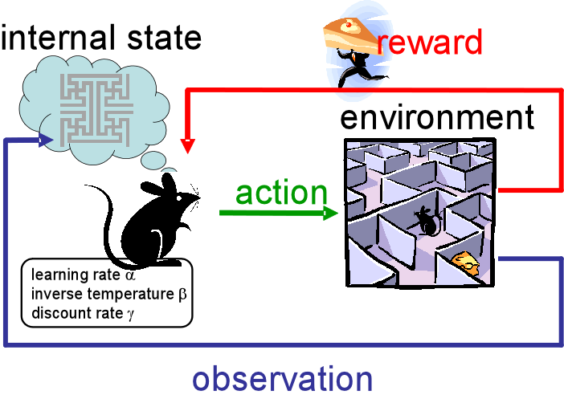
Goal
Our objective is to create an AI agent that is able to complete a StarCraft II mini-game and improve play through reinforcement learning

Slide 10
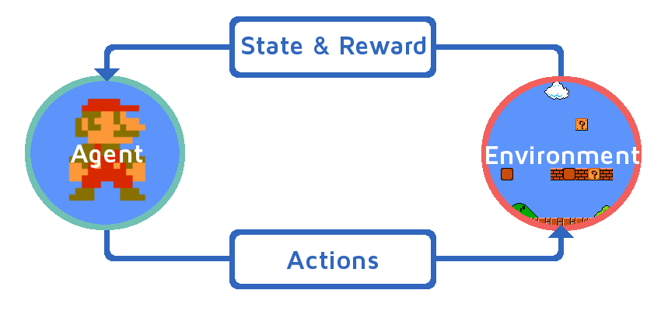
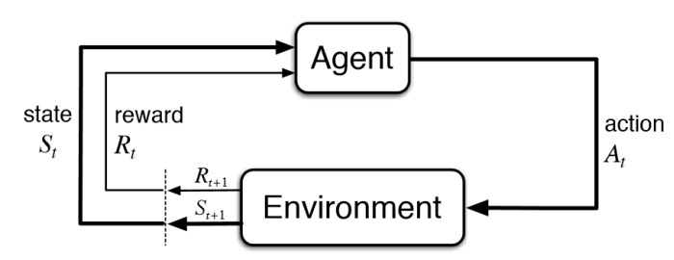
Reinforcement Learning

Slide 11
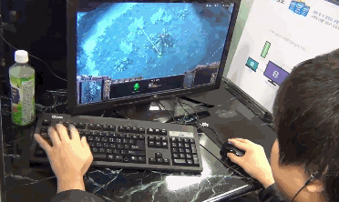
Starcraft 2 Minigames
Why use minigames?
Starcraft 2 is a very complex game
Minigames allow us to focus on individual aspects of the game

Slide 12
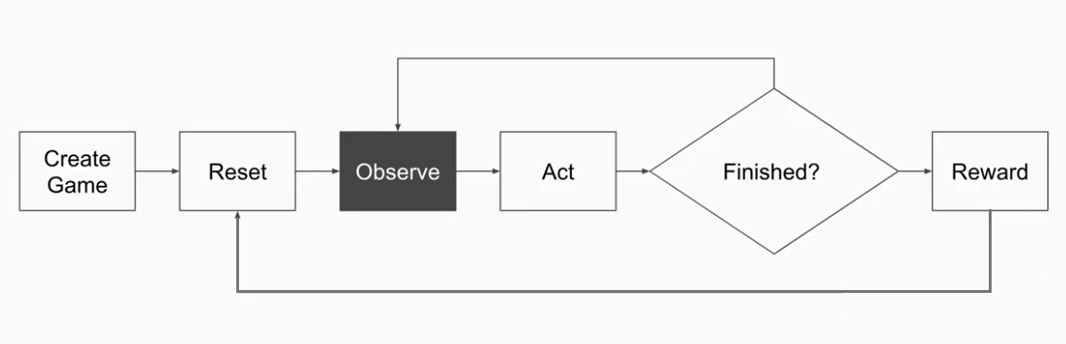
Game engine flow

Slide 13
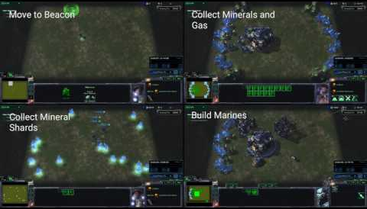
Maps - Mini Games already in Pysc2
BuildMarines
CollectMineralsAndGas
CollectMineralShards
DefeatRoaches
DefeatZerglingsAndBanelings
FindAndDefeatZerglings
MoveToBeacon

Slide 14
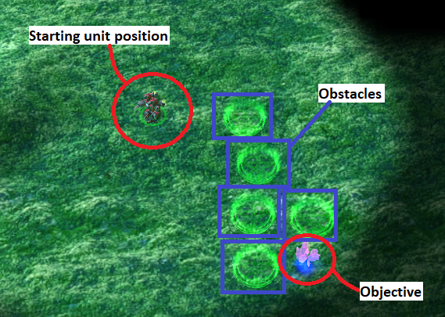
We created a minigame
None of the minigames that were included included a condition for rewarding an agent if it reached a certain location while avoiding obstacles
Our minigame’s win condition is for the unit to reach the mineral

Slide 15
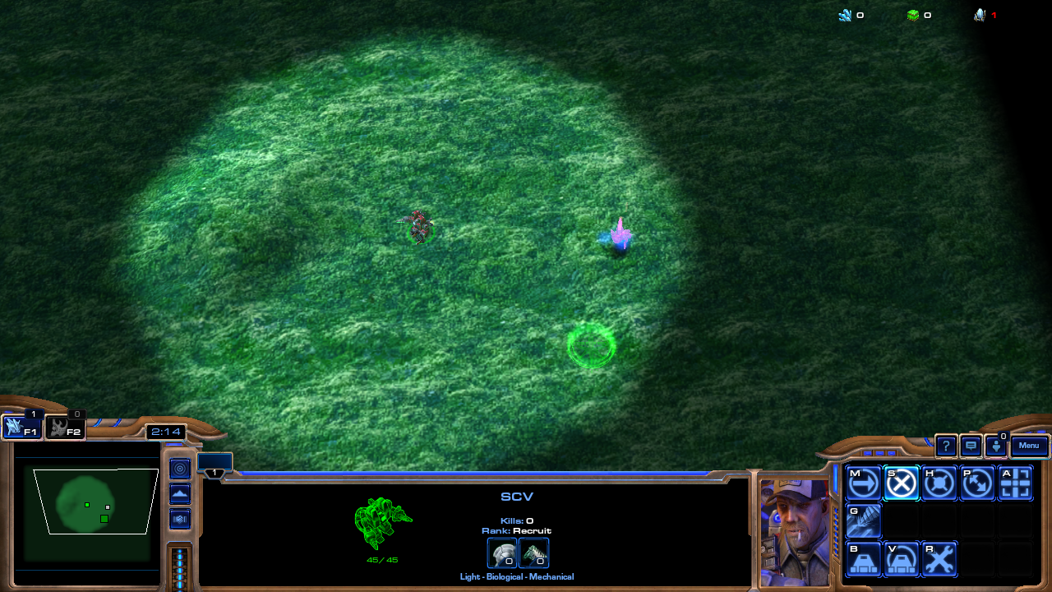
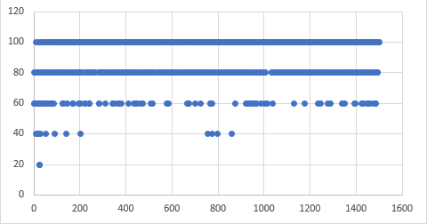
Challenges creating minigame
Too easy

Slide 16
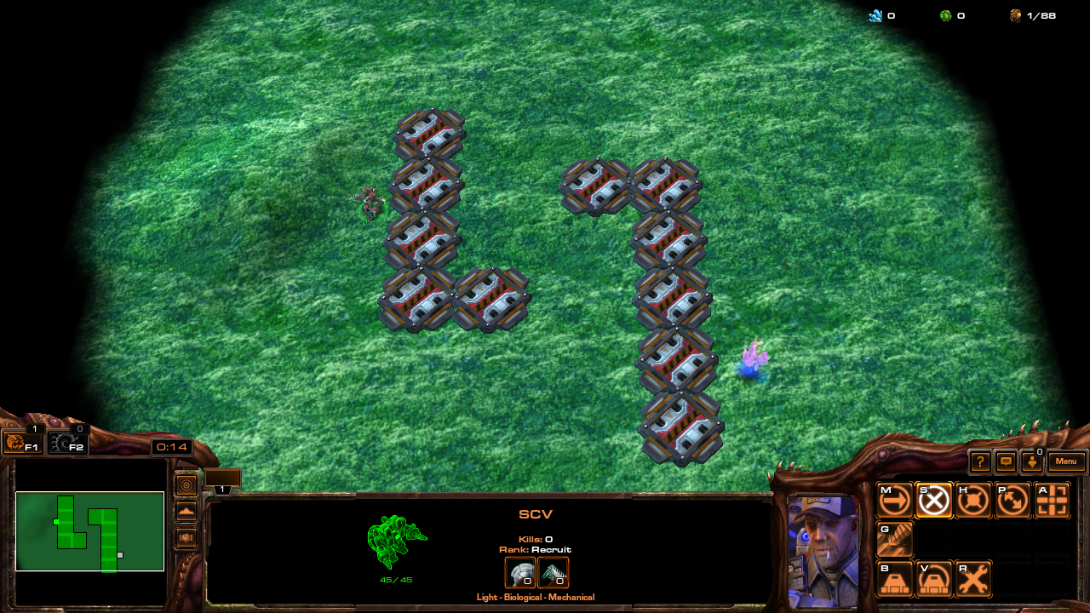
Challenges creating minigame
Too Hard

Slide 17
Challenges creating minigame
Just right

Slide 18

Starcraft 2 Editor

Slide 19
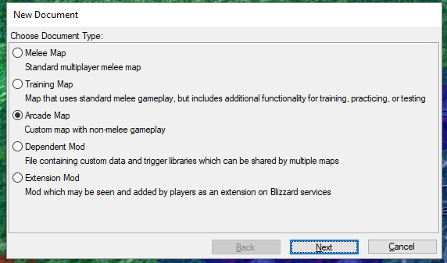
Using the map editor
Selecting what kind of map you will make

Slide 20
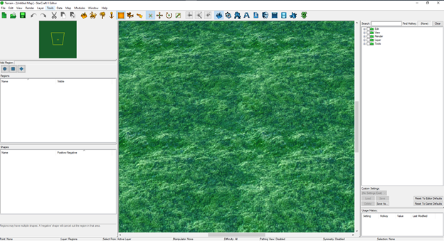
Map Editor

Slide 21
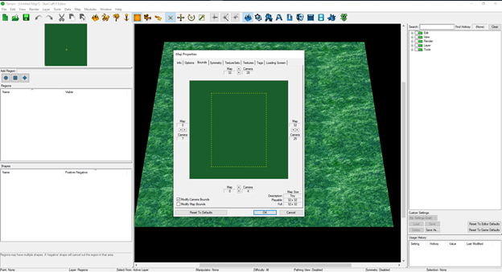
Map Editor - map boundaries

Slide 22
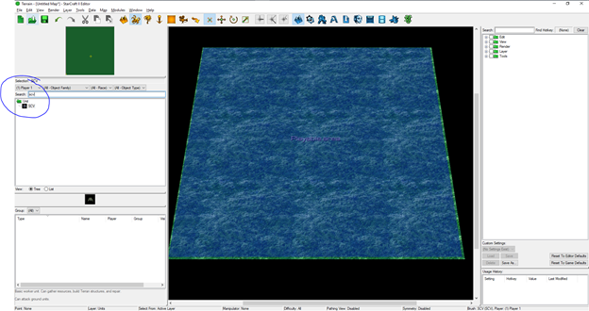
Map editor - making regions

Slide 23
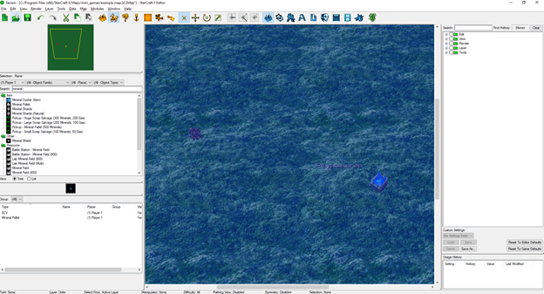
Map Editor - Creating units

Slide 24
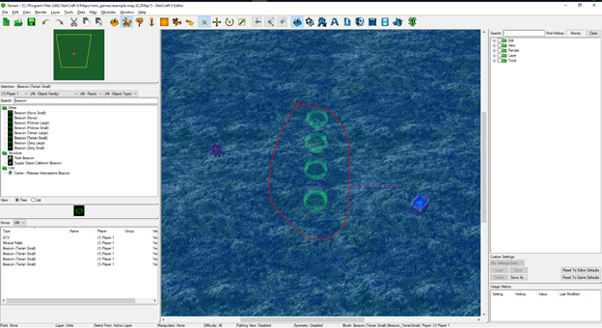
Add obstacles

Slide 25
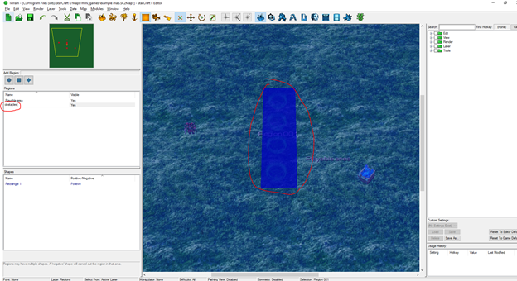
Create a region for the obstacles

Slide 26
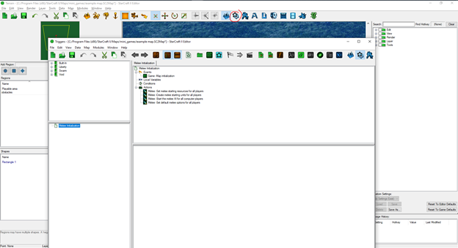
Triggers(code)

Slide 27
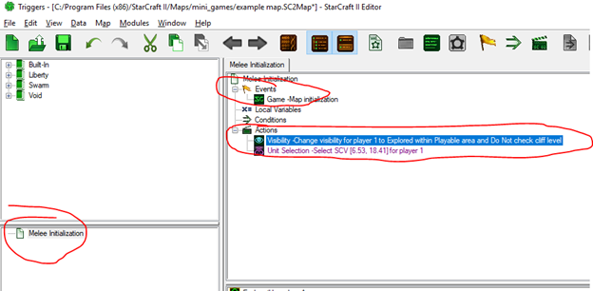
Events

Slide 28
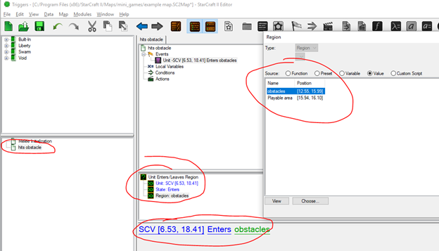

Slide 29
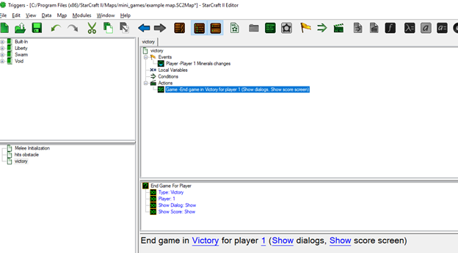
Victory condition

Slide 30
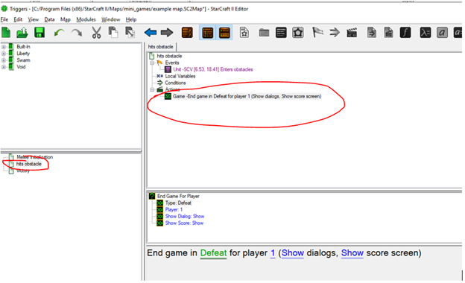
Defeat condition

Slide 31
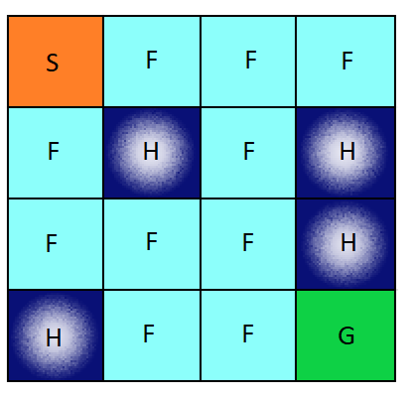
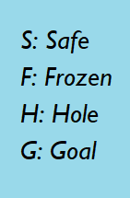
Frozen lake problem

Slide 32
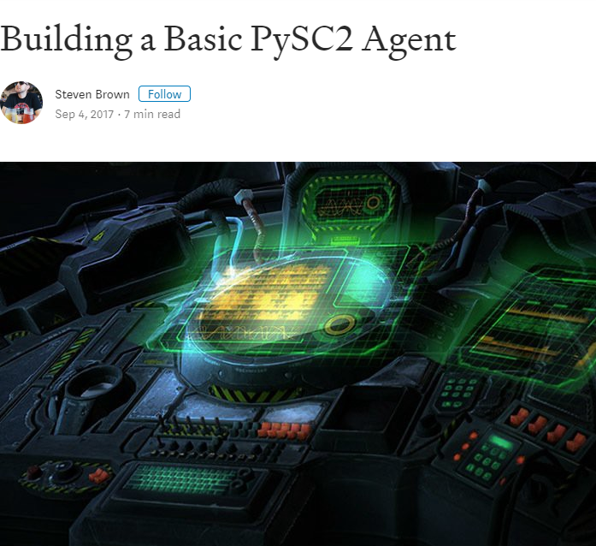
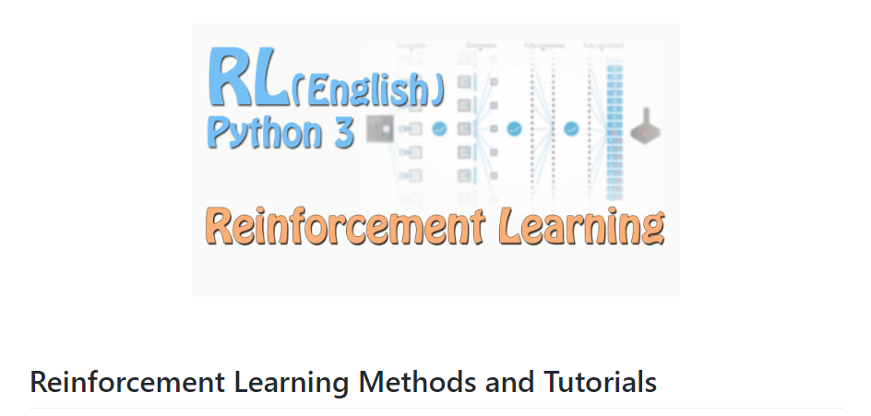
Base for our code

Slide 33
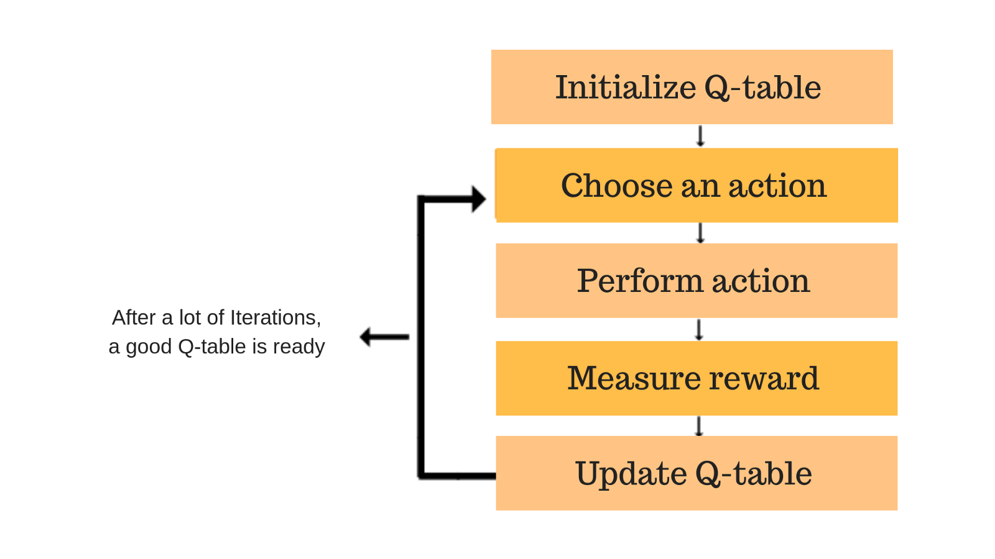
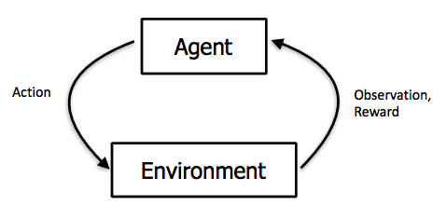

Q-tables
Reinforcement learning

Slide 34
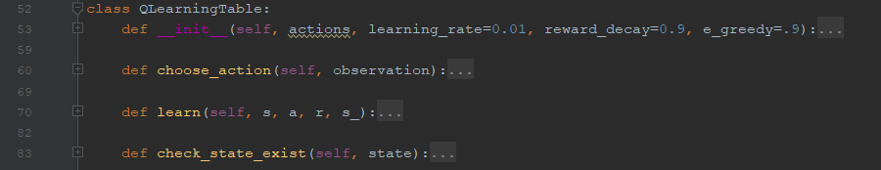

Slide 35
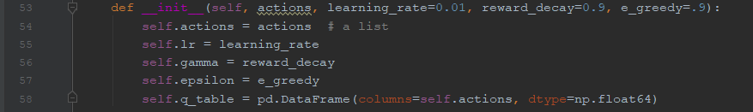

Slide 36
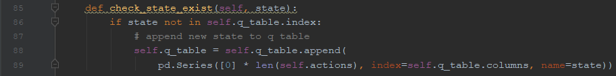

Slide 37
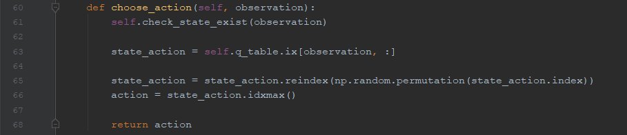

Slide 38
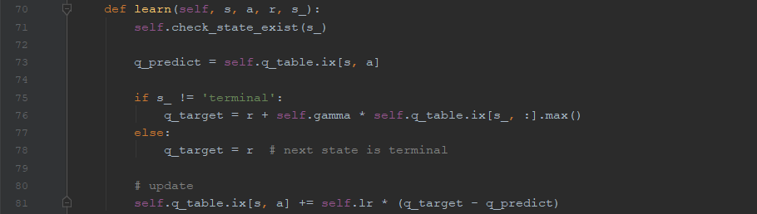
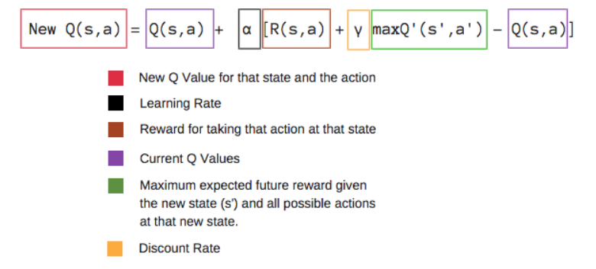

Slide 39
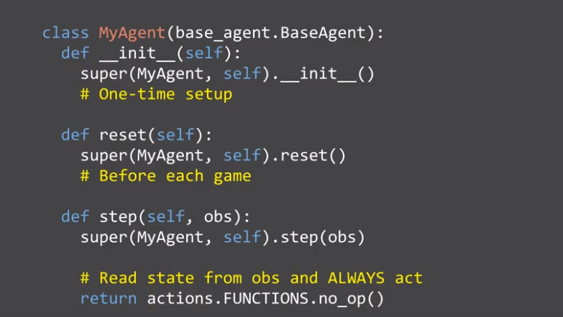
Example Agent

Slide 40
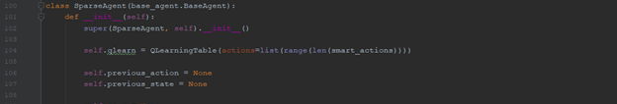
Agent constructor

Slide 41
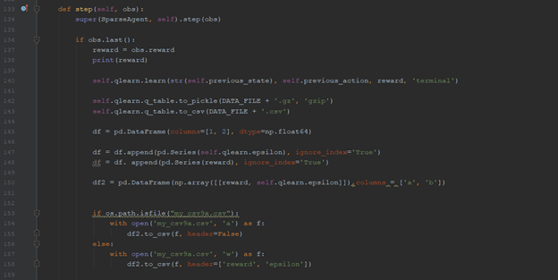
Step function

Slide 42
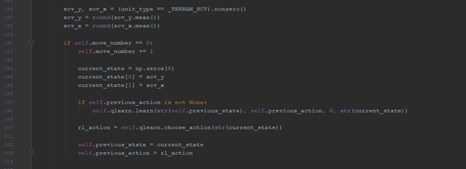
Step function

Slide 43
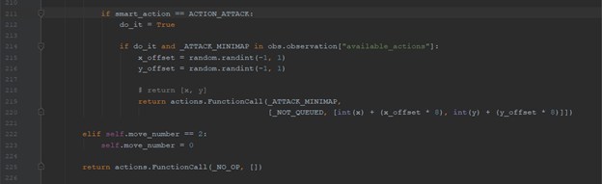
Step function

Slide 44

Untrained agent

Slide 45
Trained agent

Slide 46
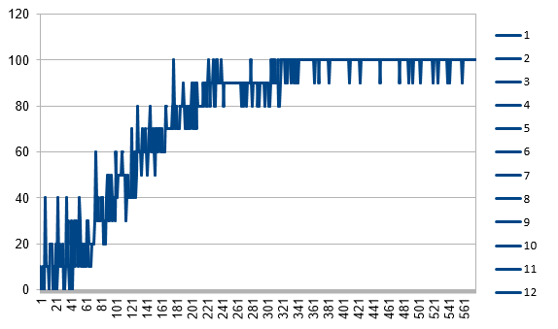
Results

Slide 47
Future works
Train an agent on an attacking
One agent controls multiple units
Use multiple agents where one agent controls one unit
Use DQN instead of Qtable

Slide 48
References
https://techcrunch.com/2019/01/24/starcraft-ii-playing-ai-alphastar-takes-out-pros-undefeated/
https://www.youtube.com/watch?v=EiUk4whH04M
https://medium.freecodecamp.org/a-brief-introduction-to-reinforcement-learning-7799af5840db?gi=4dde8722470e
https://www.elcorreogallego.es/tecnoloxia/ecg/starcraft-ii-pasa-ser-balde/idEdicion-2017-11-15/idNoticia-1084062/
https://www.polygon.com/2013/1/22/3900132/starcraft-2-heart-of-the-swarm-campaign-screenshots#20
https://www.gamecrate.com/blizzcon-2018-things-look-forward-starcraft-ii/21314
https://github.com/deepmind/pysc2
https://becominghuman.ai/the-very-basics-of-reinforcement-learning-154f28a79071?gi=b8c2eb8006c3
https://www.reddit.com/r/starcraft/comments/1ypg95/kanghogif_gaming_crosspost/

Slide 49
References
https://www.reddit.com/r/sc2ai/comments/9vgs5t/introduction_to_pysc2_part_3/
http://www.iconarchive.com/show/mega-games-pack-40-icons-by-3xhumed/Starcraft-2-Editor-2-icon.html
https://chatbotslife.com/building-a-basic-pysc2-agent-b109cde1477c
https://github.com/MorvanZhou/Reinforcement-learning-with-tensorflow
https://www.analyticsindiamag.com/openai-gym-frozen-lake-beginners-guide-reinforcement-learning/
https://itnext.io/reinforcement-learning-with-q-tables-5f11168862c8
https://medium.freecodecamp.org/an-introduction-to-q-learning-reinforcement-learning-14ac0b4493cc

