Slide 1
Object Detection: Reinforcement Learning and Generative Adversarial Network
Nami Akazawa, Angel A. Cantu

Slide 2
Objective
Object Detection: To implement a machine learning algorithm for the purpose of detecting an object in some image, without the need to pre-process any image (make object labels).
YOLO: Is a great object detection algorithm, but requires a human to manually pre-process their data using the Yolo Annotation Software.

Slide 3
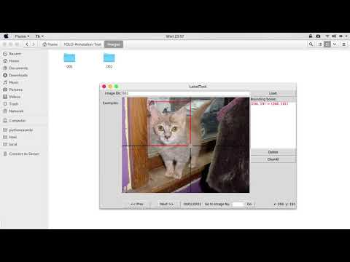

Slide 4
Our Approach
Using Generative Adversarial Networks, we replace the Generator part with an Agent. The agent’s objective is to select specific objects from the input image and send it to the Discriminator.
The Discriminator will evaluates the similarity between the Real (Class 1) and Fake data (Class 0). If the Agent finds the object and sends that cropped image to the Discriminator, then the Discriminator will classify it as Real (Class 1).

Slide 5
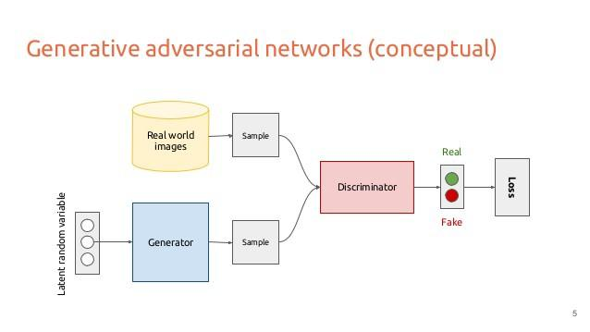
What’s GAN
Generator network: try to fool the discriminator by generating real-looking images
Discriminator network: try to distinguish between real and fake images

Slide 6
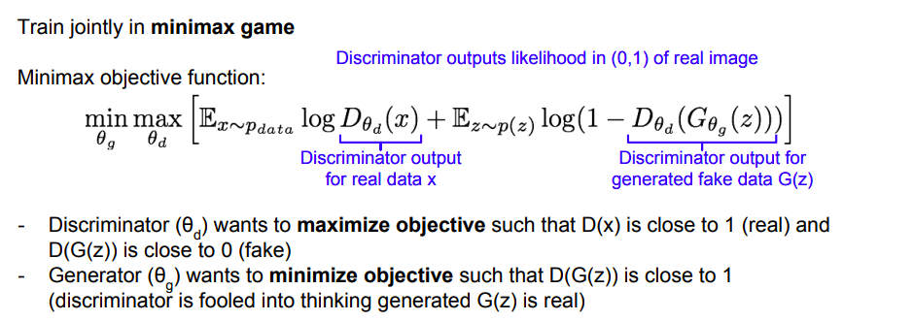
Details of GAN
http://cs231n.stanford.edu/slides/2017/cs231n_2017_lecture13.pdf

Slide 7
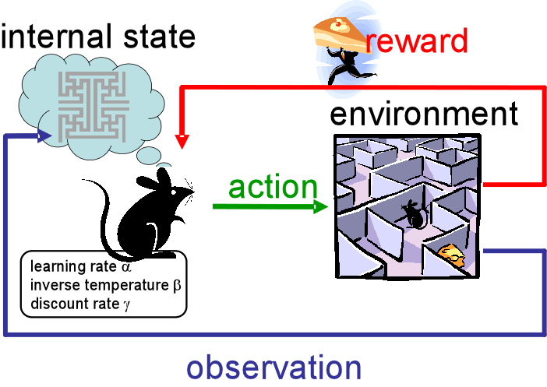
What’s RL

Slide 8

What does the agent see? - Environment
We feed the Agent an image where the particular object exists. This image is of fixed length.

Slide 9
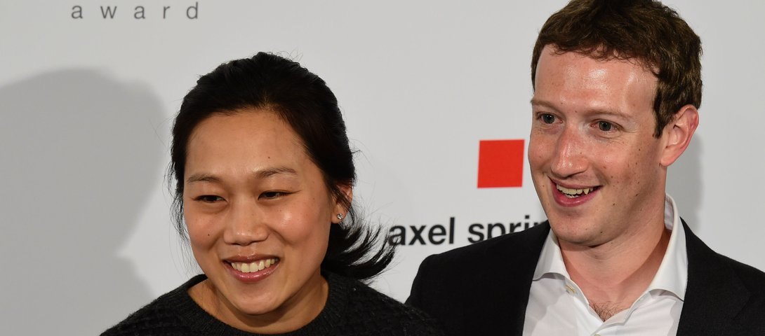
What does the agent see? - Environment
We feed the Agent an image where the particular object exists. This image is of fixed length.

Slide 10
What does the Agent do? - Actions
X
Y

Slide 11
What does the Agent do? - Actions

Slide 12
X
Y

Slide 14
Observation

Slide 15


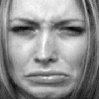


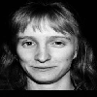
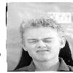

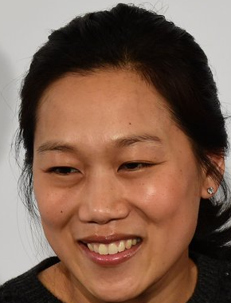

Slide 16
What is the reward?
The Agent needs to know how good of a cropped image it produced. This value is received from the Discriminator via the output layer of the Discriminator ‘s network. In other words, if the Discriminator predicted the cropped image as Real, then the Agent should get a bigger reward.

Slide 17
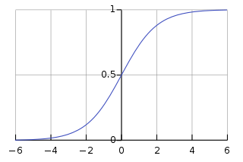
Reward
REAL
FAKE

Slide 18
REAL
REAL
.98
.97
REWARD

Slide 19
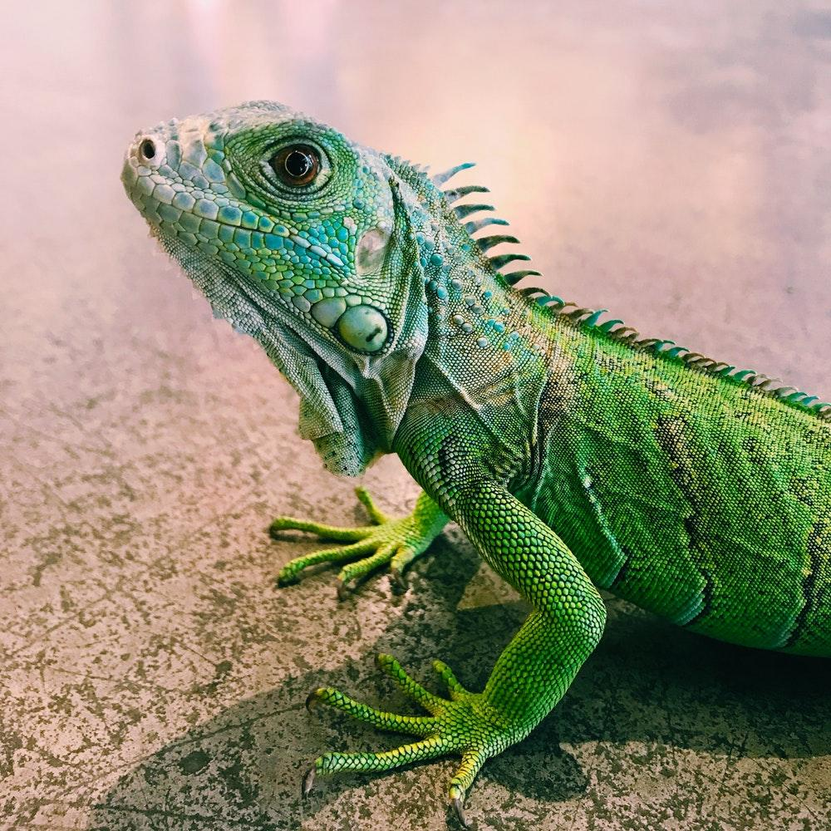
REAL
FAKE
.98
.07
REWARD

Slide 20

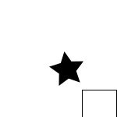
First Phase - Proof of Concept
To test out the model, we first test in a simple environment: A single star in a white background

Slide 21


Second Phase - Face Detection
For the second phase, we jumped right into a much harder problem: Face Detection
Our data was grabbed from various datasets available online.

Slide 22
Second Phase - Face Detection
For now, we still try a fixed bounding box square (80, 80)

Slide 23
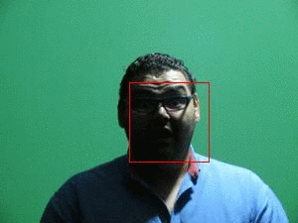
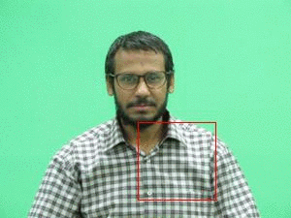
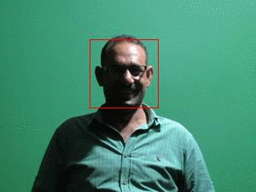
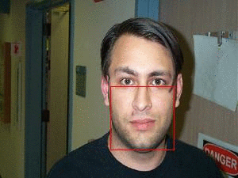
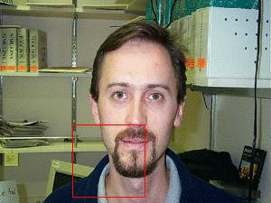
Second Phase - Face Detection
Good!!
Not Good
Meh

Slide 24
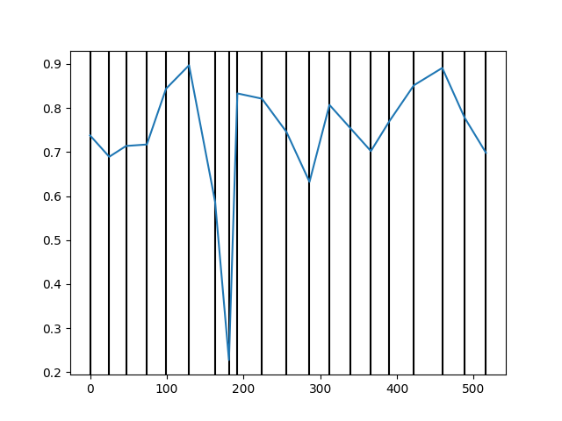
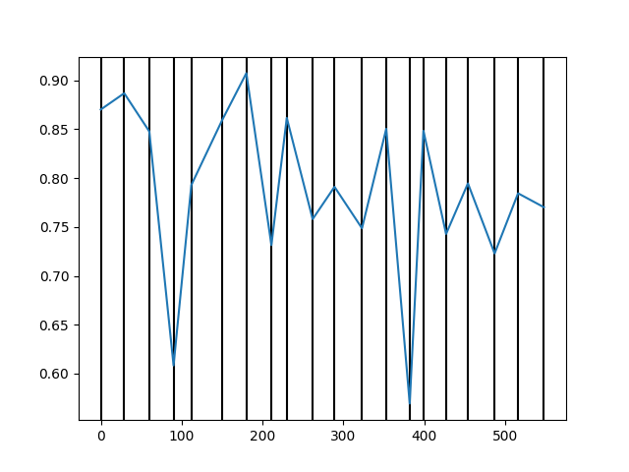
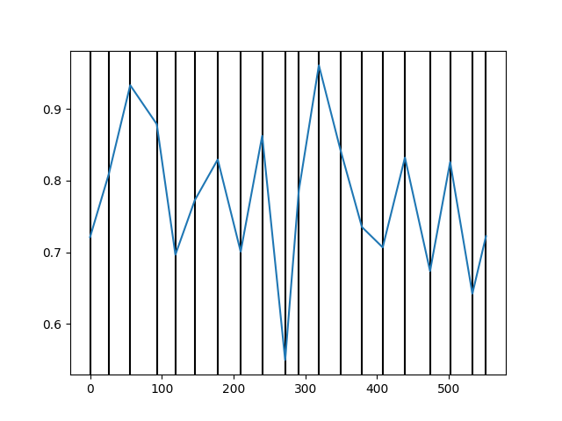
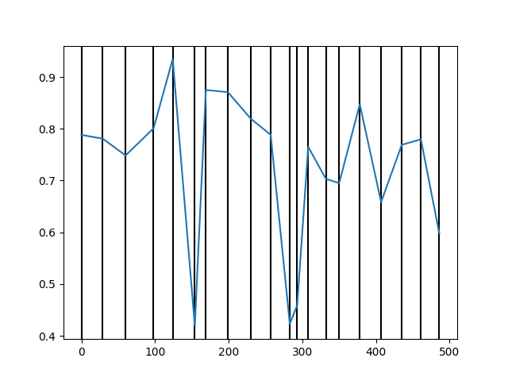
Y-axis: Reward
X-axis: Epochs
Vertical lines: Times where the discriminator begins training.
If the Agent crops an Image such that the reward is <0.5, we hypothesize that the image was probably not a face, and we therefore save that image (in some array). After the array has length x, we train the discriminator on that array, and another array of equal size of the real faces. This way, the discriminator is fed what the agent shouldn’t do, and can help the agent learn by giving it low reward. For example, if we feed into the discriminator everything that the Agent outputs, then whenever the Agent outputs the object (face), the Discriminator may learn the difference between the real faces and the fake faces.

Slide 25
Future improvements
Multiple Bounding Boxes Detection (multiple faces)
Multiple Objects
Try with different model architecture

