Slide 1
Beating the market -- forecasting the S&P 500 Index
Frank Saldivar
Mauricio Ortiz

Slide 2
“Life can only be understood backwards; but it must be lived forwards.” - Søren Kierkegaard

Slide 3
Background
Around 1970, an economist Eugene Fama launched the Efficient Market Hypothesis
  Weak Form: past information is priced into securities
  Semi-Strong Form: stock price is instantly adjusted in response to new information
  Strong Form: all information, public and private is reflected in a stock’s price
Random Walk Theory
  The stock market behaves randomly

Slide 4
Current non-ML Methods
Fundamental Analysis
Study surrounding economy, industry conditions, company data
Find intrinsic value of stock - see if undervalued or overvalued
  If overvalued, sell
  If undervalued, buy
Technical Analysis
Stock price & volume are only inputs
Assume all known fundamentals are baked into price
Identify patterns and trends to predict

Slide 5
Goal
Are we able to predict future stock prices given past prices and patterns?
  Which approaches of machine learning work best?
  Compare and contrast two models
    Linear Regression
    Long Short-Term Memory - Recurrent Neural Network

Slide 6
Data
SPDR S&P 500 ETF
  Fund based on the S&P 500 index, the 500 largest US publicly traded companies such as Exxon Mobil, Apple, Coca-Cola, etc
23 years of price data
  3/15/1996 - 3/14/2019
  5789 entries total
80/20 split for training/testing
  4631 training entries
  1158 testing entries

Slide 7
Tools & Libraries used
NumPy
Pandas DataFrames
Scikit-Learn (sklearn)
Keras
Matplotlib
Yahoo Finance

Slide 8
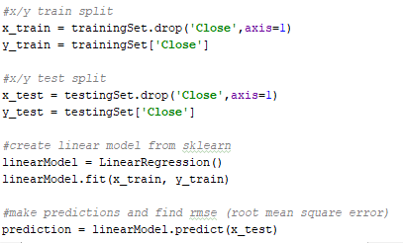
Linear Regression
Simple regression from sklearn
Very straightforward, load in data,
call sklearn’s LinearRegression and fit

Slide 9
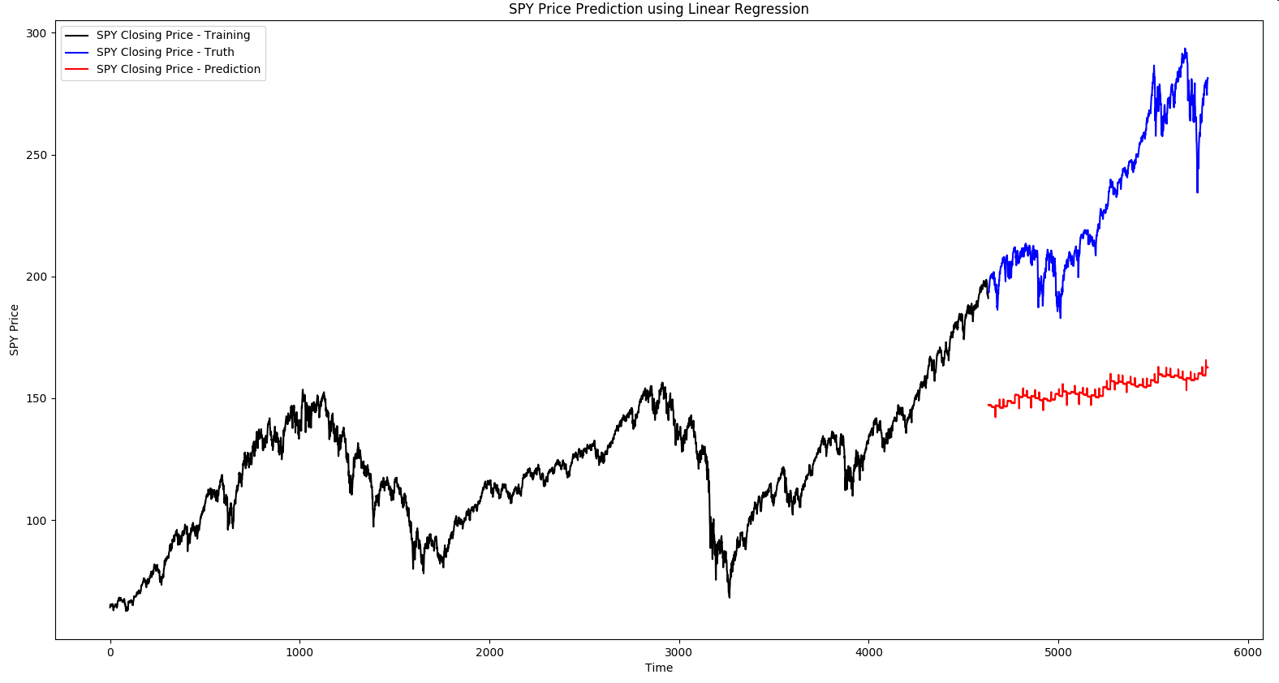
Linear Regression Results

Slide 10
Linear Regression Results
As expected, linear regression performed poorly
Having a complex problem like stock price prediction may be beyond the scope of simple linear regression
Can we do better??

Slide 11
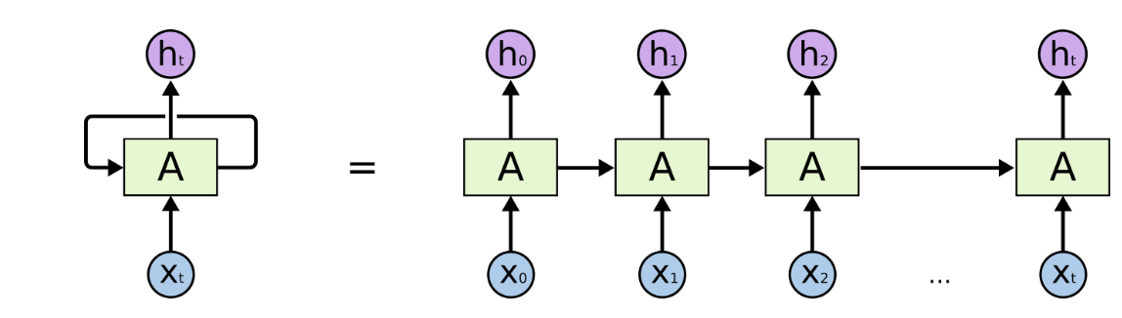
RNN
Information persists throughout network
Long Term Dependencies
“the clouds are in the sky”
“I grew up in France… I speak fluent French.”

Slide 12
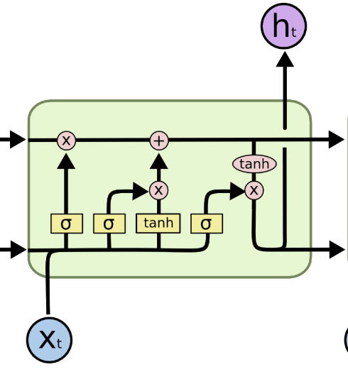
LSTM
Variation of RNN
Multi-layer repeating module
Steps:
  What to forget
  What to store
    What values to update
    What new values to store
  Update state
  Decide Output
Multiple variations exist

Slide 13
LSTM
Load and Scale Data
Build LSTM
  Sequential
  Dense
  LSTM
  Dropout

Slide 14
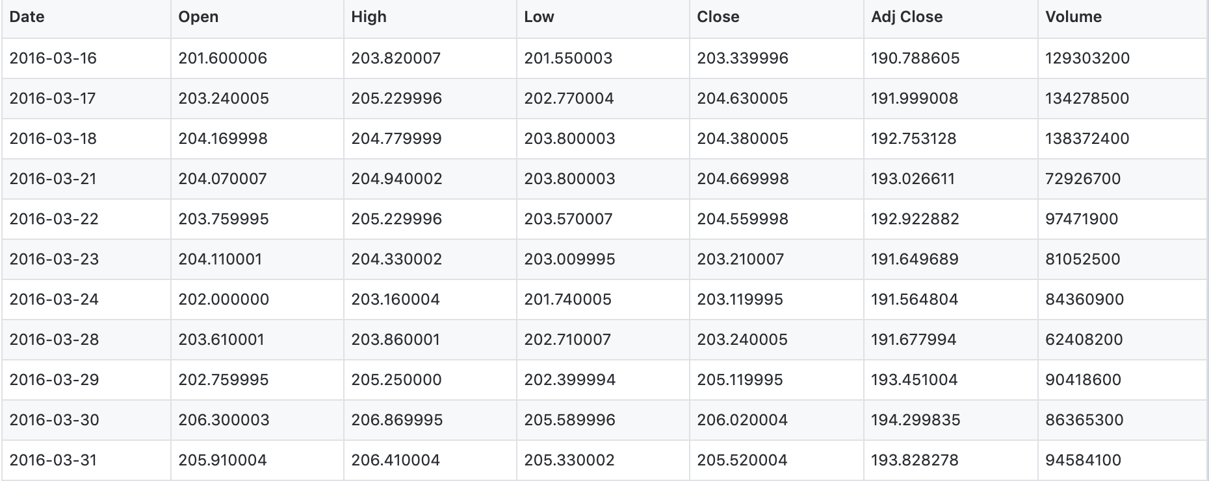
LSTM
Training Data (1996 - 2016)
Test Data (2016 - 2019)
Normal and Reversed Data
1, 5, 25, 40, 100, 1000 epochs

Slide 15
LSTM Results - 1 epoch
Normal sorted data
Reverse sorted data

Slide 16
LSTM Results - 5 epochs
Normal sorted data
Reverse sorted data

Slide 17
LSTM Results - 25 epochs
Normal sorted data
Reverse sorted data

Slide 18
LSTM Results - 40 epochs
Reverse sorted data
Normal sorted data

Slide 19
LSTM Results - 100 epochs
Normal sorted data
Reverse sorted data

Slide 20
Results - Normal Sorted Data
1 epoch
10 epochs
10 epochs
5 epochs
40 epochs
1000 epochs

Slide 21
Results - Reverse Sorted Data
1 epoch
10 epochs
100 epochs
5 epochs
40 epochs
1000 epochs

Slide 22
Discussion
More epochs != better results
Why does normal sorted data tend towards worse predictions over more epochs?
  Why does reverse sorted data lead to diminishing returns in accuracy?
We posit that there exists a sweet spot in iterations that results in highest accuracy/epoch

Slide 23
Future Improvements & Conclusion
Focus on singular stock, however may result in higher volatility
Historical price is not the only factor in future price. Inspired by fundamental analysis, solve for significant factors
Account for:
  Investor sentiment -- via Twitter or news
  Company qualitative data
  Miscellaneous factors

Slide 24
References
A simple deep learning model for stock price prediction using TensorFlow
  https://medium.com/mlreview/a-simple-deep-learning-model-for-stock-price-prediction-using-tensorflow-30505541d877
Predicting the Stock Market Using Machine Learning and Deep Learning
  https://www.analyticsvidhya.com/blog/2018/10/predicting-stock-price-machine-learningnd-deep-learning-techniques-python/
Using a Keras Long Short-Term Memory (LSTM) Model to Predict Stock Prices
  https://www.kdnuggets.com/2018/11/keras-long-short-term-memory-lstm-model-predict-stock-prices.html
Understanding LSTM Networks
  https://colah.github.io/posts/2015-08-Understanding-LSTMs/

