Slide 1
A Deep Reinforcement Learning Approach to Traffic Management
By Osvaldo Castellanos

Slide 2
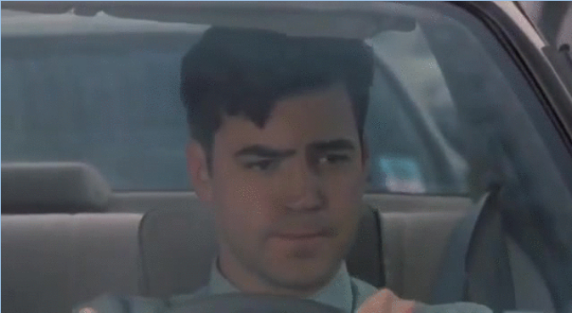
Motivation

Slide 3
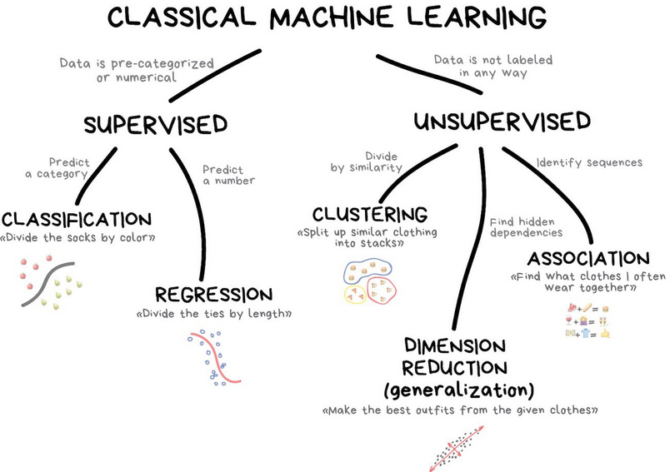
Ref: Machine Learning for Everyone

Slide 4
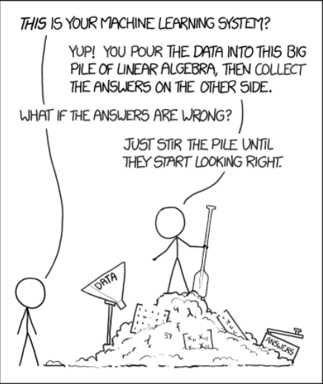
Ref: https://xkcd.com/1838/

Slide 5
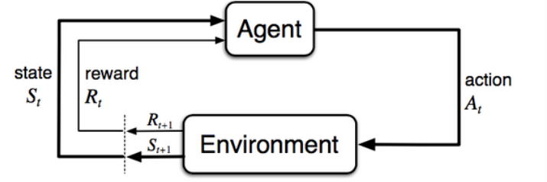
RL Model
Ref: https://lilianweng.github.io/lil-log/2018/02/19/a-long-peek-into-reinforcement-learning.html#what-is-reinforcement-learning

Slide 6
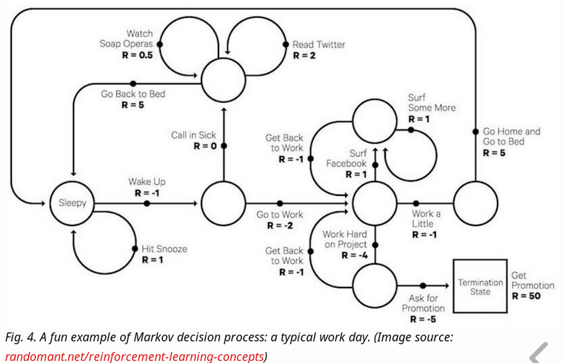
Markov Decision Processes
Ref: https://lilianweng.github.io/lil-log/2018/02/19/a-long-peek-into-reinforcement-learning.html#what-is-reinforcement-learning

Slide 7
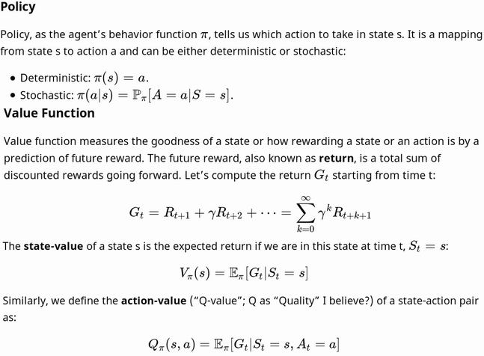
Important Concepts:
Ref: https://lilianweng.github.io/lil-log/2018/02/19/a-long-peek-into-reinforcement-learning.html#what-is-reinforcement-learning

Slide 8
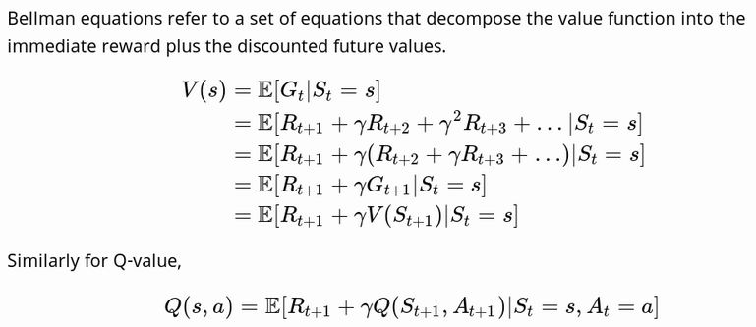
Ref: https://lilianweng.github.io/lil-log/2018/02/19/a-long-peek-into-reinforcement-learning.html#what-is-reinforcement-learning

Slide 9
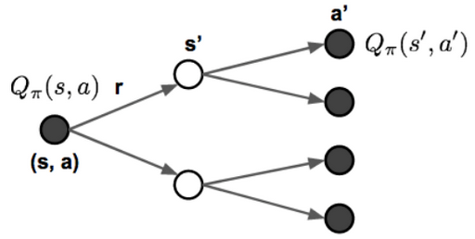

Backup Diagram
Ref: https://lilianweng.github.io/lil-log/2018/02/19/a-long-peek-into-reinforcement-learning.html#what-is-reinforcement-learning

Slide 10
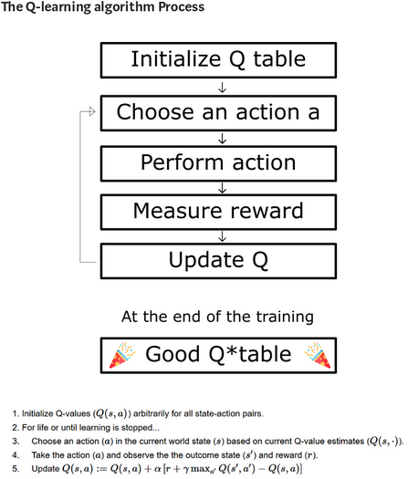
Ref: https://medium.freecodecamp.org/diving-deeper-into-reinforcement-learning-with-q-learning-c18d0db58efe

Slide 11
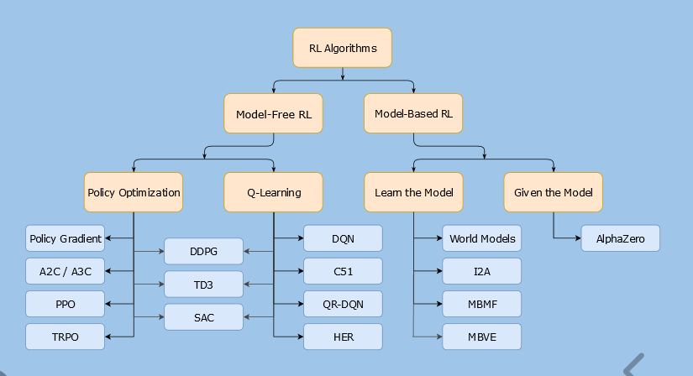
A Taxonomy of RL Algorithms
Ref: Spinning up RL

Slide 12
Approaches
Dynamic Programming
Policy Evaluation
Policy Improvement
Policy Iteration
Monte-Carlo Methods
Temporal-Difference Learning
SARSA: On-Policy TD
Q-Learning: Off-Policy TD
Deep Q-Network

Slide 13
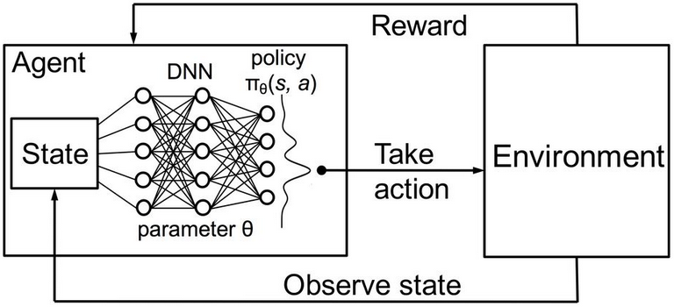
Deep Q-Network
Ref: URL: https://2.bp.blogspot.com/-bZERYUNyjao/Wa98yt7GjhI/AAAAAAAACt8/SYQjUNrbe1YDtKTMKR6LPt68C0pPqkoowCLcBGAs/s1600/DRL.JPG

Slide 14
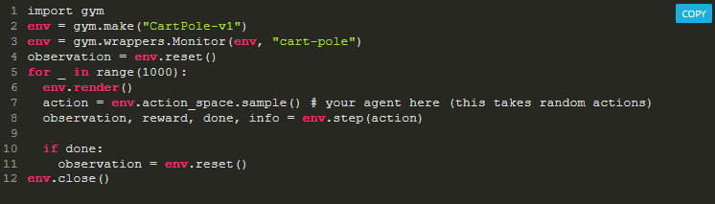
OpenAI Gym
Step returns:
next state
reward
done
info
Main Functions Needed in a Custom Environment to Interface with Gym:
Reset
Step
Render

Slide 15
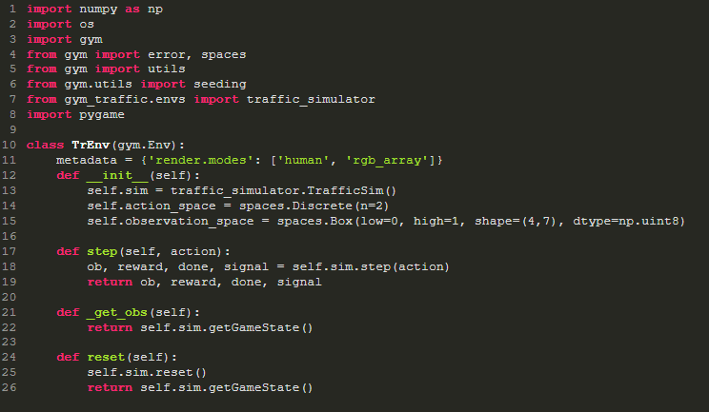
https://github.com/oscastellanos/gym-traffic/blob/master/gym_traffic/envs/TrEnv.py

Slide 16

pygame (the library) is a Free and Open Source python programming language library for making multimedia applications like games built on top of the excellent SDL library. Like SDL, pygame is highly portable and runs on nearly every platform and operating system.
Does not require OpenGL
Multi core CPUs can be used easily
Uses optimized C, and Assembly code for core functions.
Ref: https://www.pygame.org/wiki/about

Slide 17
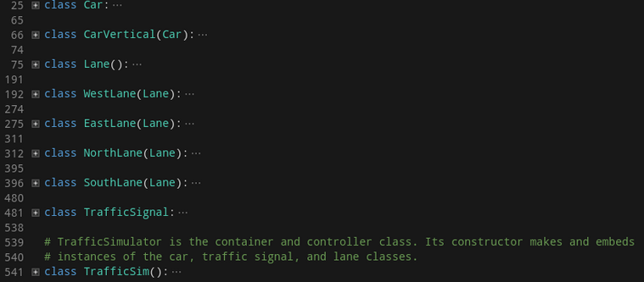
traffic_simulator.py
https://github.com/oscastellanos/gym-traffic/blob/master/gym_traffic/envs/traffic_simulator.py

Slide 18
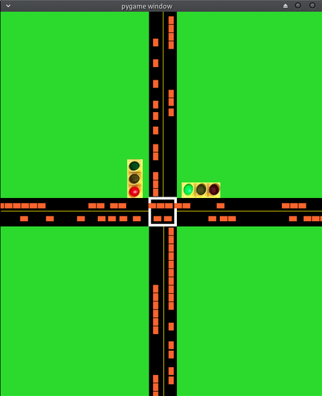

Slide 19
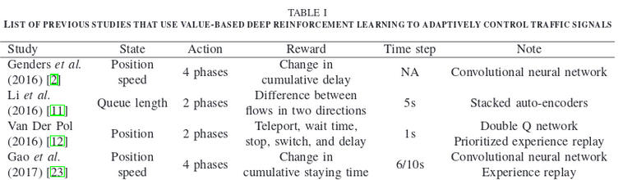
"Deep Reinforcement Learning for Traffic Light Control in Vehicular Networks," Liang et al., (2018), arxiv.org/abs/1803.11115

Slide 20
Faulty Reward Example
https://youtu.be/tlOIHko8ySg
From https://openai.com/blog/faulty-reward-functions/

Slide 21
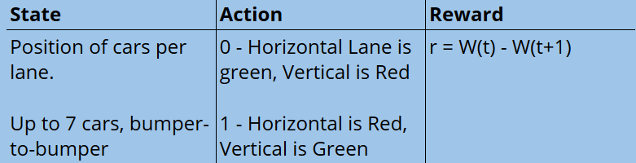
Intersections consist of different statuses.
Complex behavior such as "Left turn on green," etc. require their own status
The time duration at one status is called a phase. The number of phases is decided by the number of legal statuses.
In the Liang et al. paper, a cycle consists of phases with fixed sequences, but the duration of every phase is adaptive.
"Deep Reinforcement Learning for Traffic Light Control in Vehicular Networks," Liang et al., (2018), arxiv.org/abs/1803.11115

Slide 22
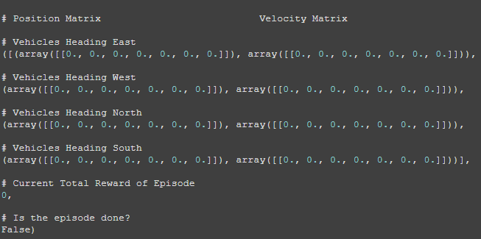

Slide 23
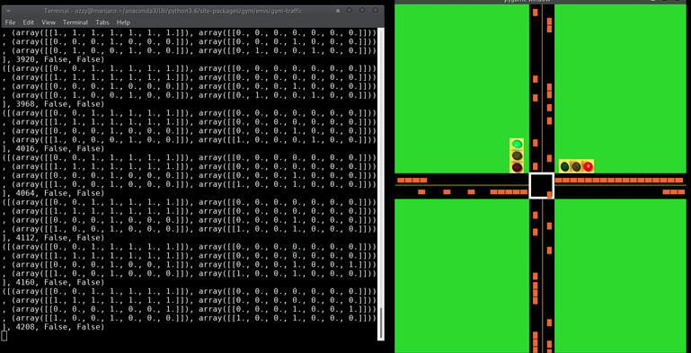

Slide 24
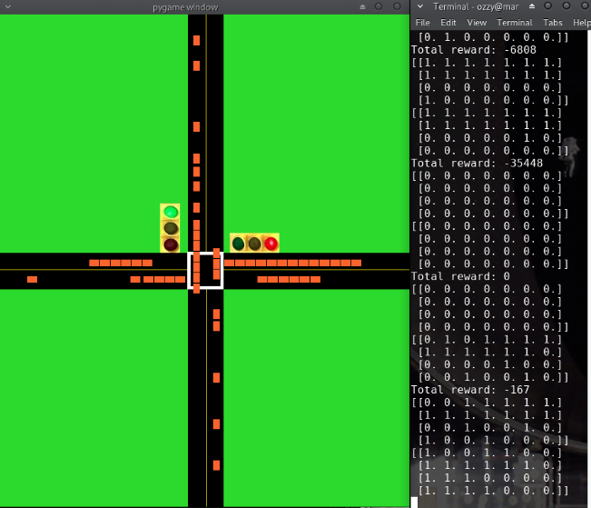

Slide 25
Example of my gym-traffic
https://www.youtube.com/watch?v=sVswDx8WfPU

Slide 26
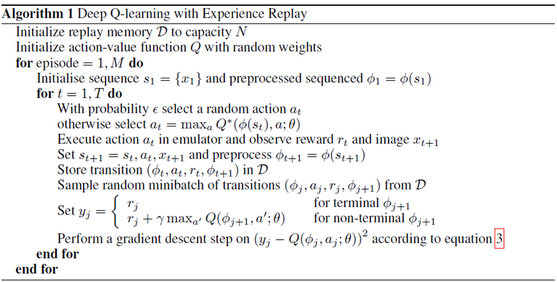
Ref: https://github.com/sarcturus00/Tidy-Reinforcement-learning/blob/master/Pseudo_code/DQN.png

Slide 27
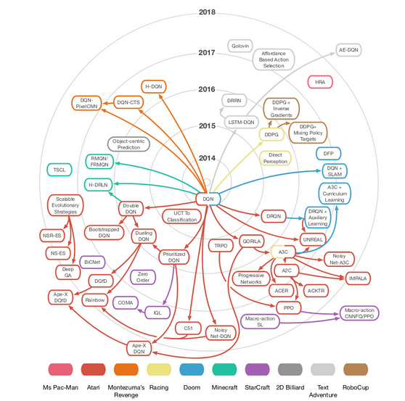

Slide 28
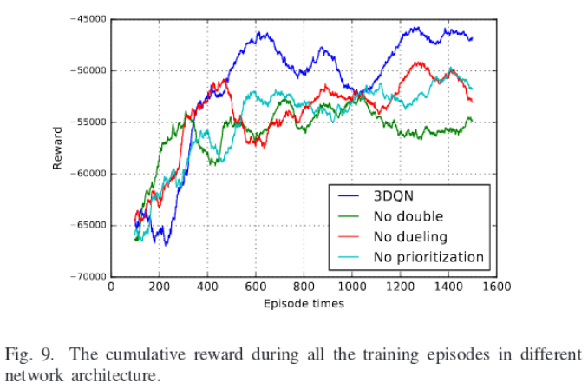
"Deep Reinforcement Learning for Traffic Light Control in Vehicular Networks," Liang et al., (2018), arxiv.org/abs/1803.11115

Slide 29
A To-Do list of upcoming changes to simulator/environment:
Refactor traffic-simulator.py
Add docstrings to methods
Include more statuses at an intersection
Extend to multiple lanes
Implement render in environment, add compatibility to monitor class of gym
Add tensorboard summaries for variables

Slide 30
For the Poster:
Finish implementing DQN
Adaptive phase duration
Implement DDQN
Add more graphs/results comparing random, fixed-timer, DQN, and DDQN

Slide 31
Final report:
Implement multi-agent reinforcement learning for multiple intersections
Add randomness to the environment by closing lanes for a period of time.

Slide 32
References:
"Deep Reinforcement Learning for Traffic Light Control in Vehicular Networks," Liang et al., (2018), arxiv.org/abs/1803.11115
Machine Learning for Everyone : https://vas3k.com/blog/machine_learning/
A (Long) Peek into Reinforcement Learning by Lilian Weng : https://lilianweng.github.io/lil-log/2018/02/19/a-long-peek-into-reinforcement-learning.html#what-is-reinforcement-learning
OpenAI Spinning Up : https://spinningup.openai.com/en/latest/spinningup/rl_intro.html
Understanding RL: The Bellman Equations by Josh Greaves : https://joshgreaves.com/reinforcement-learning/understanding-rl-the-bellman-equations/
OpenAI Gym basics: https://katefvision.github.io/10703_openai_gym_recitation.pdf
Diving Deeper into Reinforcement Learning with Q-Learning : https://medium.freecodecamp.org/diving-deeper-into-reinforcement-learning-with-q-learning-c18d0db58efe

Slide 33
THANK YOU!

