Slide 1
USING DEEP LEARNING TO ANALYZE SERIAL KILLER PATTERNS
Group 12
Mason Garza
Fernando Martinez

Slide 2
INTRODUCTION

Slide 3
ABSTRACT
Use Machine Learning on serial killer data to predict
Motivation
Number of Victims
Sex

Slide 4
MOTIVATION
Ted Bundy Tapes
How often serial killers get away with murder in comparison to other crimes.
Little research done on serial killers using computer science.
→ Help law enforcement better construct the profiles of targeted serial killers.

Slide 5
RELATED WORKS
Using machine learning algorithms to analyze crime data
Crime Analysis Through Machine Learning
Modeling the violent crime patterns in the states of Mississippi, and the city of Vancouver using machine learning.
Regression analysis
Very limited work found on serial killers using machine learning.

Slide 6
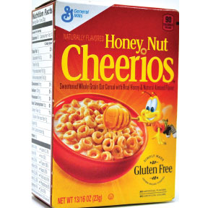
BACKGROUND
A serial killer is someone who kills at least two people in separate events occurring at different times.
This differs from mass murder, and organized crime (in service of an illegal organization).
Jack the Ripper sparked public interest in serial killers in the late 1880’s although they have existed since ancient times.
Myths
Dysfunctional loners
All white males
Motivated by sex
Insane/Evil

Slide 7
DATA

Slide 8
DATA
Florida Gulf Coast University Radford/FGCU Serial Killer Database
Serial Killers
Mass Killers
Spree Killers
Organized Killers
War Criminals
Accomplices
2870/2580 serial killer samples
179 features including:
Victim Profiles
IQ
Serial Killer Personal Life

Slide 9
DATA
Python script using cookies to bypass login page, and scrape multiple csv files containing data from separate pages.
Killers with less than 2 kills removed, and/or not fitting the definition of a serial killer (war criminals, mass murder, organized crime).
Killers born before the 1800’s removed.
Label data formatted.
Delete features that are missing more than 20% of data.
Delete instances missing data from remaining features.
Non numerical data, and lists removed.

Slide 10
MOTIVE
Motive
1125 instances
60 features
Label: Motive (11 categories)
Enjoyment (Avg.)
Other

Slide 11
SEX
Motive
1125 instances
59 features
Label: Sex
Female
Male

Slide 12
NUMBER OF VICTIMS
Motive
1125 instances
56 features
Label: # of confirmed victims
2 - 49
Average: 5

Slide 13
MACHINE LEARNING

Slide 14
METHODOLOGY
For each target feature, we used a different algorithm
Motive ← Classification Random Forests
Victim ← Regression Random Forests
Sex ← Decision Tree
10-fold Cross Validation was used in all 3 of these

Slide 15
MOTIVE RESULTS

Slide 16
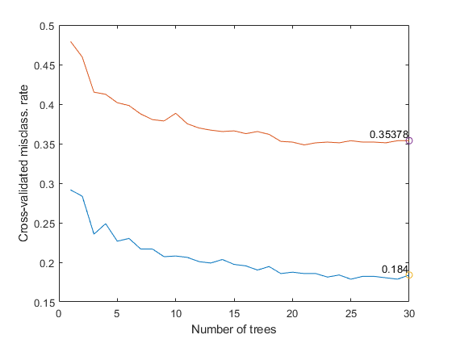
CV Avg. Error Plot of the Motive Models

Slide 17
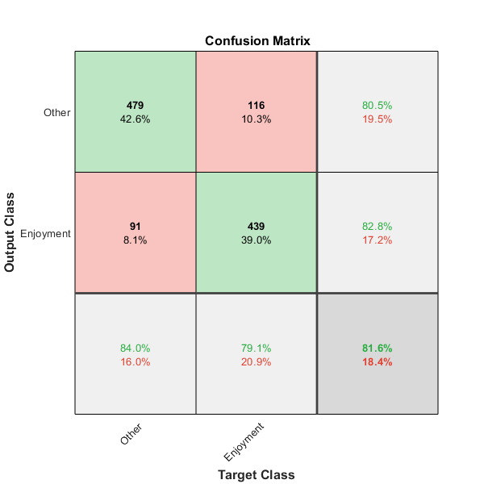
Binary Motive Confusion Matrix

Slide 18
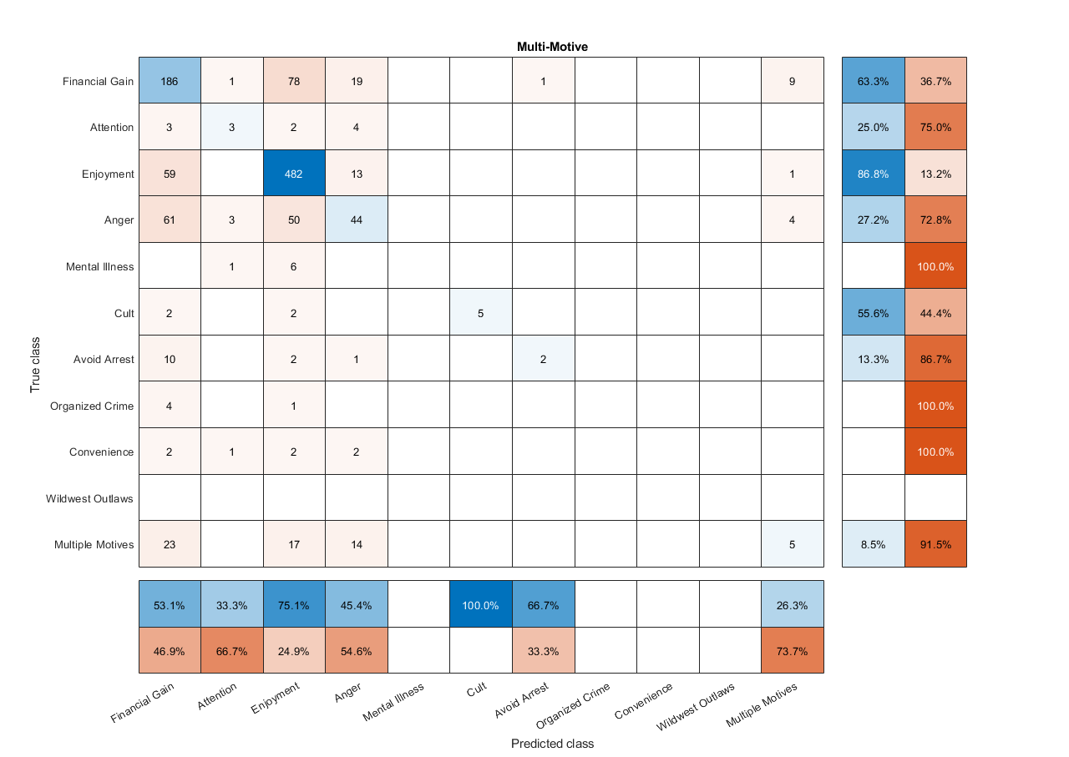

Slide 19
VICTIM RESULTS

Slide 20
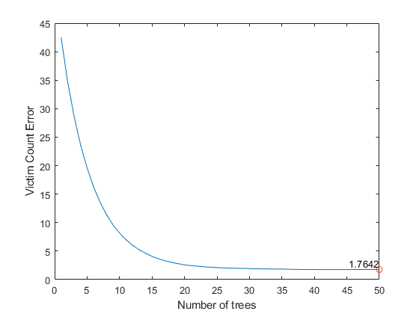
CV Error Plot of the Victims

Slide 21
SEX RESULTS

Slide 22
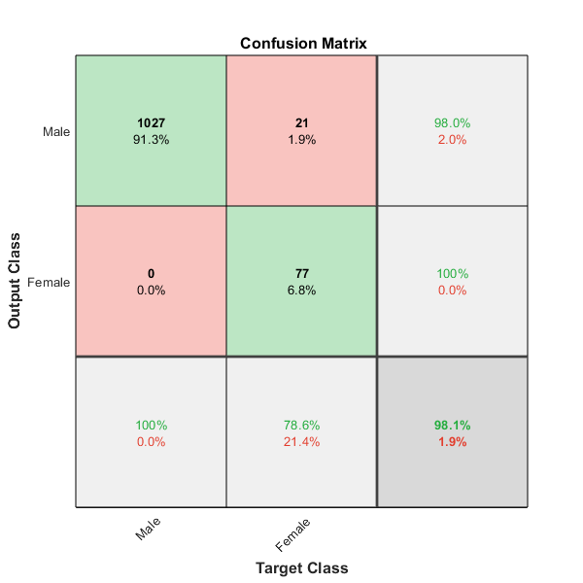
Sex Confusion Matrix

Slide 23
CONCLUSION
We can predict whether a serial killer will kill for enjoyment or for another motive with an 81.6% accuracy.
We can predict any motive with 64.6% accuracy
We were able predict the number of victims with an error of <2 victims
We were able predict the sex of the killers with 98.1% accuracy

Slide 24
FUTURE WORK
Interpret our current models for insights
Fill in missing data to increase model accuracy
Incorporate more features such as Country or Sentence (Lists, and specific dates).

Slide 25
REFERENCES
McClendon, Lawrence, and Natarajan Meghanathan. "Using machine learning algorithms to
analyze crime data." Machine Learning and Applications: An International Journal (MLAIJ)
2.1 (2015): 1-12.
Radford FGCU Database
Kim, Suhong, et al. "Crime Analysis Through Machine Learning." 2018 IEEE 9th Annual
Information Technology, Electronics and Mobile Communication Conference (IEMCON). IEEE,
2018.

