Slide 1
Car Damage Classification
By: David Parra
Adrian E. Gonzalez

Slide 2
Motivation
Wanted to work on a project that involved being able to identify and determine the damage in a car of a given an image .

Slide 3
Background
Current visual inspection and validation is done by somebody and because of this, it tends to delay the claim process.
Car insurances tend to waste resources due to claim leakage
claim leakage: lost dollars through claims management inefficiencies
This Claim leakage can be the difference between the actual claim payment made and the amount that should have been paid

Slide 4
Problem
Attempting to obtain a higher accuracy using CNN in Car Damage Classifications, while using a limited set of Data.

Slide 5
Goals
Being able to Compare 2 types of Cars
Such as Damage vs Whole
Being able to Compare at least 3 levels of damages
Such as Minor vs Moderate vs Severe
Being able to determine the side of the car that is damaged
Such as Front vs Rear vs Side

Slide 6
Related Works
Previous works used different methods based off of CNN in attempting to solve the problem, ultimately achieving between 80%-90% accuracy using CNN.
https://www.researchgate.net/publication/322671990_Deep_Learning_Based_Car_Damage_Classification

Slide 7
Data
Data Set in total is more than a thousand images
Dimensions are (160, 160, 3)
8 classes
Data is separated into this cases for the demo
Data Set 1: Damage, Whole
Data Set 2: Front, Rear, Side
Data Set 3: Minor, Moderate, Severe
Each Data Set has its own Training and Validation Data
in which it was split into 80%-20%, where 80% was used for training and 20% was used for testing.

Slide 8
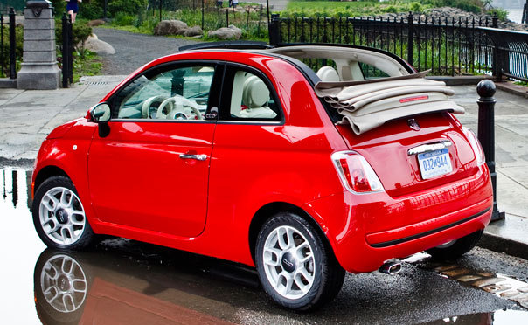
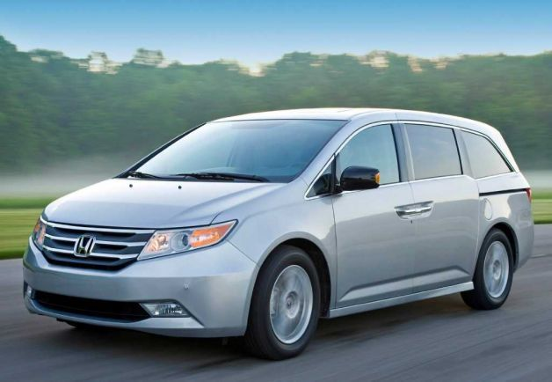

Whole

Slide 9
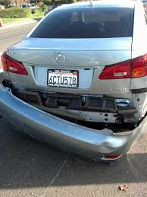
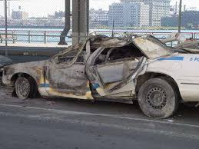
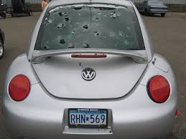
Damaged

Slide 10
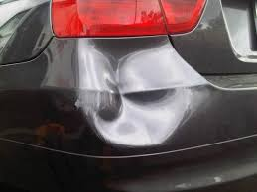
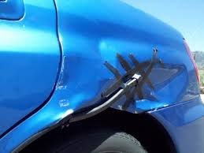
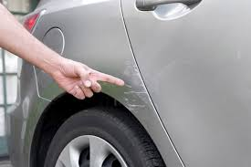
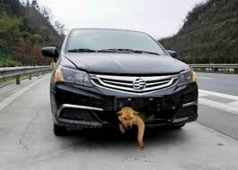
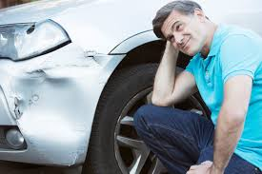
Minor Damage

Slide 11
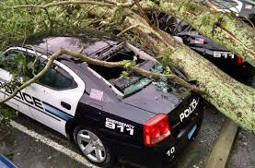
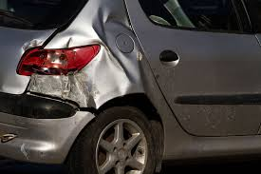
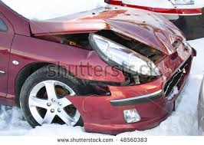
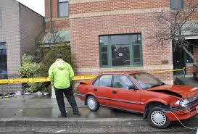
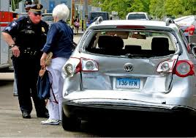
Moderate Damage

Slide 12
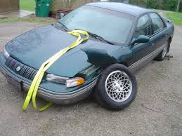
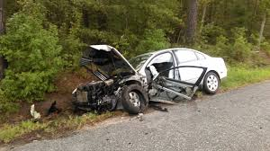
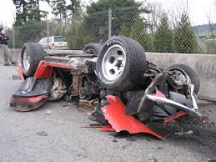
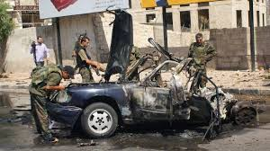
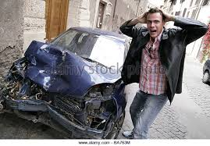
Severe Damage

Slide 13
Method (intro)
Training a neural network from scratch requires:
A lot of data
A lot of time
A lot of processing power
We use Transfer learning from pretrained models

Slide 14
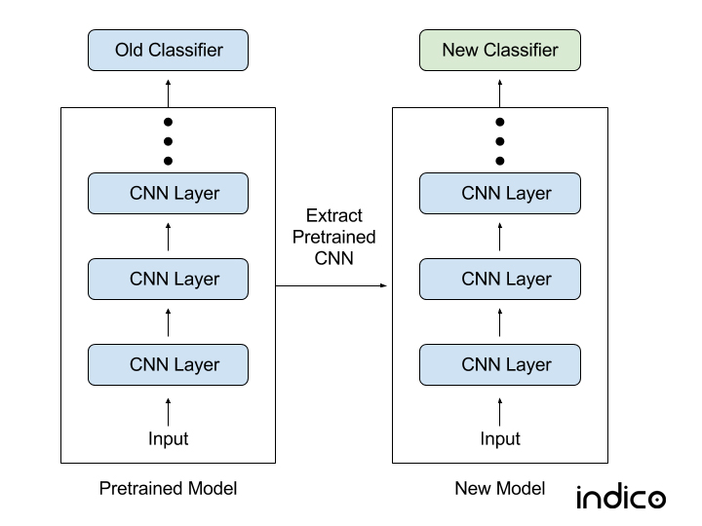
Method (cont.)

Slide 15
PRETRAINED CNN’s (keras)
Xception
VGG16
VGG19
ResNet, ResNetV2, ResNeXt
InceptionV3
InceptionResNetV2
MobileNet
MobileNetV2
DenseNet
NASNet

Slide 16
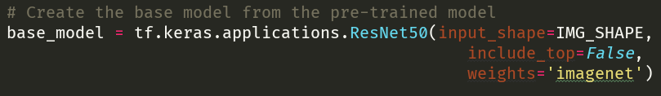
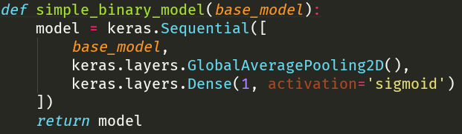
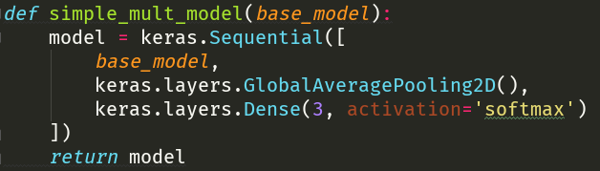
MODEL

Slide 17
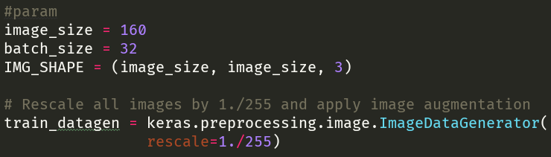
Training Parameters(1)
images

Slide 18
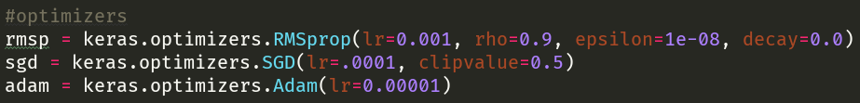

Training Parameters(2)
Optimizers
fine tuning

Slide 19
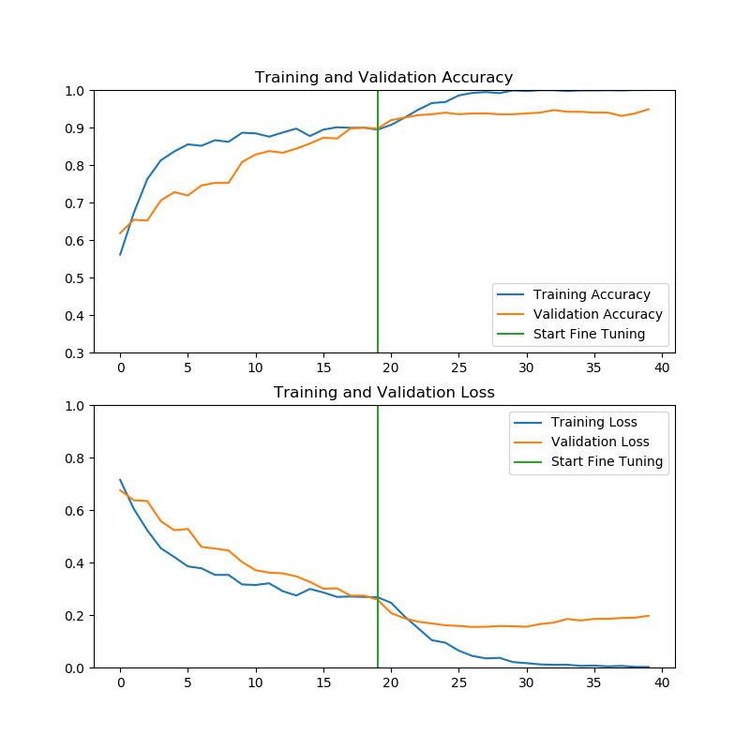
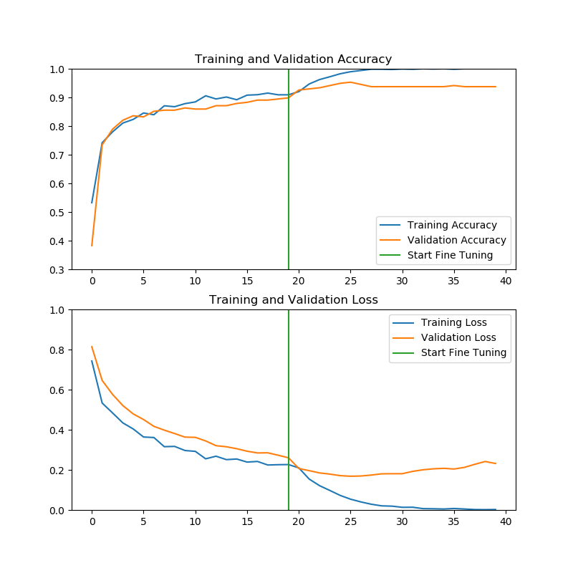
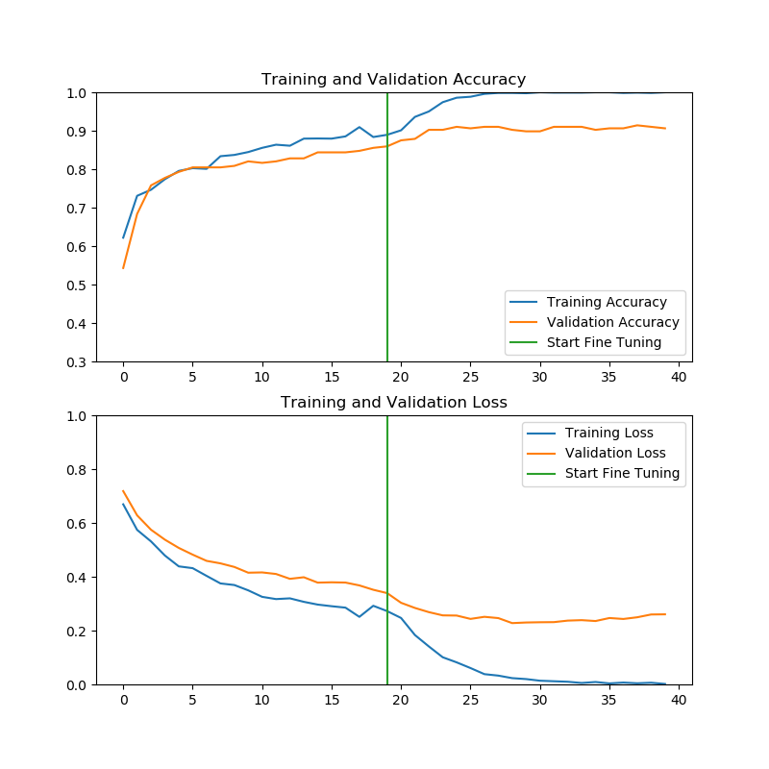
Experimental Results(1)
3 cases where the architecture worked ok
Damage vs Whole
Minor vs Whole
Moderate vs Whole

Slide 20
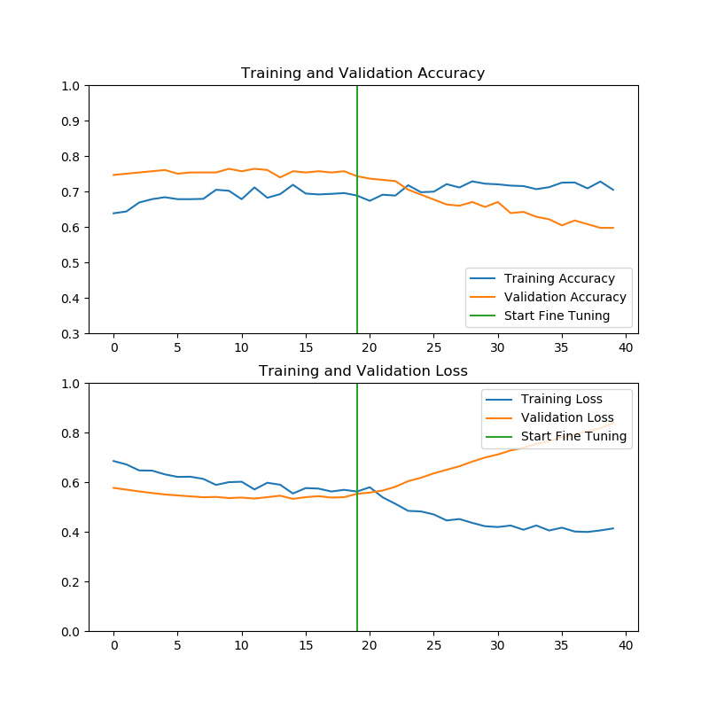
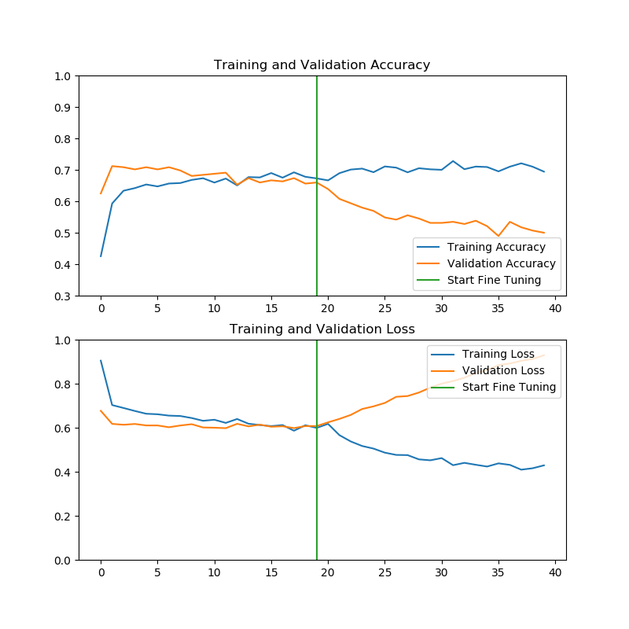
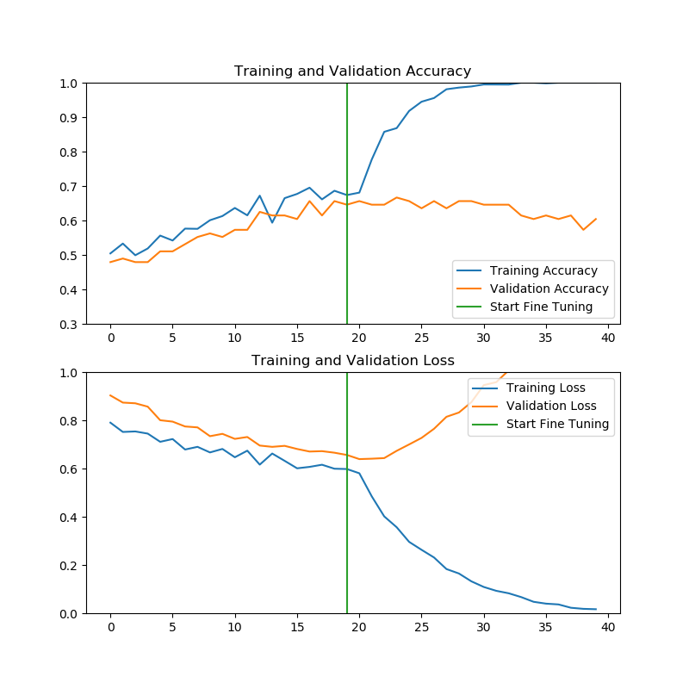
Experimental Results(2)
3 cases where the architecture didn’t work as expected
Severe vs Damage
Damage vs Front
Moderate vs Minor

Slide 21
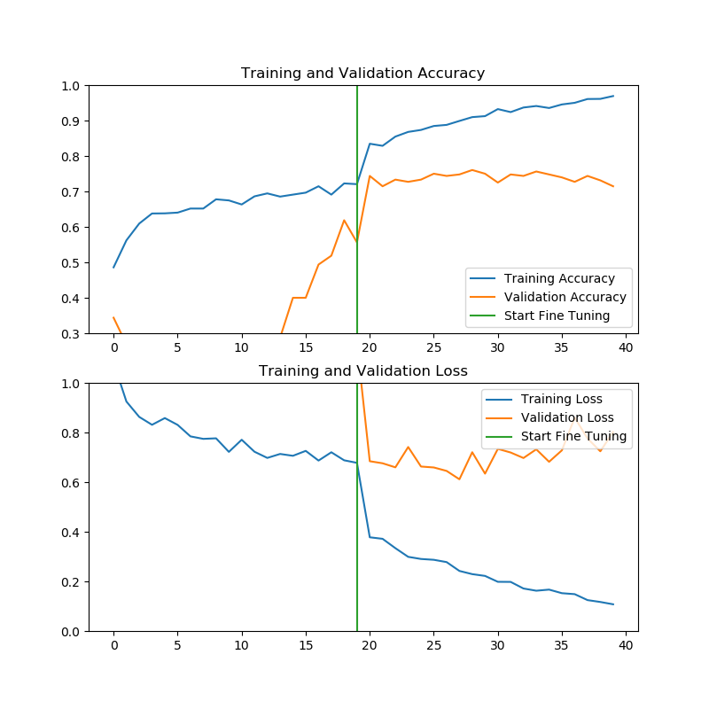
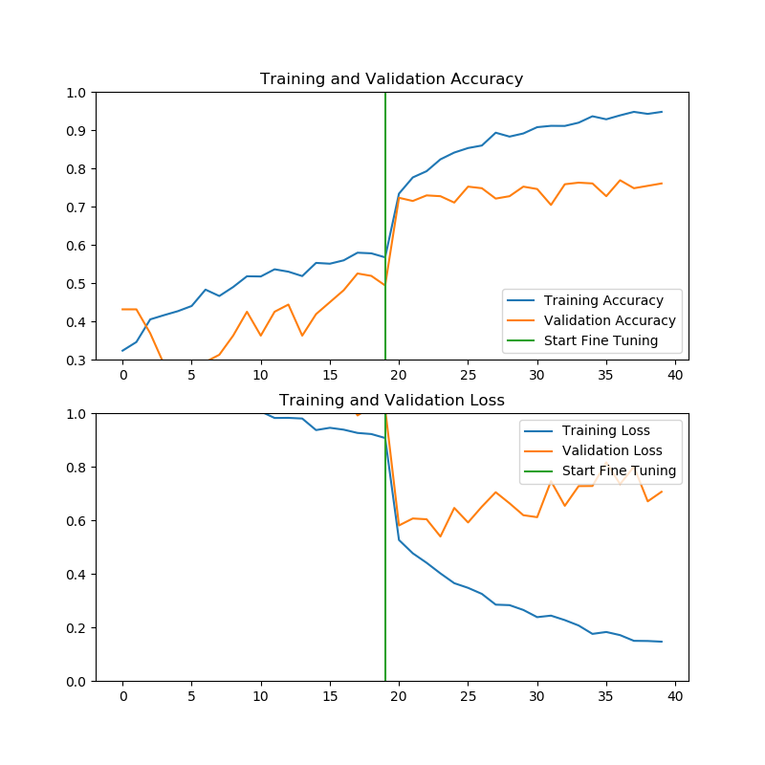
Experimental Results(3)
Front vs Rear vs Side
Minor vs Moderate vs Severe

Slide 22
Discussion about Results and Performance
-Overall accuracy is between .6 and .8
-Accuracy remains low unless classes are very different
-Fine tuning helped in most cases to gain some accuracy

Slide 23
Future Works and Plans
Test with more pretrained models
Extend the dataset
Try different classifiers
Try other classes

Slide 24
References
K. Patil, M. Kulkarni, S. Karande, "Deep learning based damage classification", 2017 16th IEEE International Conference on Machine Learning and Applications (ICMLA), pp. 50-54, 2017.

