Slide 1
Machine Learning’s Impact on Encryption
By
Anthony Meza

Slide 2
Motivation
To utilize the capabilities of machine learning for the sake of encrypting systems
Streamlining the process of encryption itself and leave the handling of security to machine learning with minimal user interaction
To better how machine learning’s previous application towards medical computation, genomics prediction, spam detection can work for encryption

Slide 3
Background
During the initial years of encryption there were only small character limits and simplistic requirements. As recent years indicated, password requirements are much more strict (a combination of case-sensitive letters, numbers, and symbols are required for a password nowadays)
As time progressed machine learning has become more useful. Classifiers were recently created with machine learning in mind.

Slide 4
Problem
With preexisting cryptographic practice, there does not exist any secure algorithm that doesn’t contain any secret unknown to the attacker
Applying machine learning to big data is generally very expensive
Simple ciphers will not be enough because they can easily be cracked by hackers

Slide 5
Goal
To successfully encrypt computers with machine learning and to attempt successful implementations of encryption with newer methods
To train encryption systems with machine learning so that attackers will think twice before attempting to hack them

Slide 6
Fully Homomorphic Encryption
Computes any function of encrypted bits without knowledge of the secret key
A homomorphic encryption scheme is called fully homomorphic encryption (FHE) scheme if it is 𝐿-homomorphic for any polynomial function L = poly(n).

Slide 7
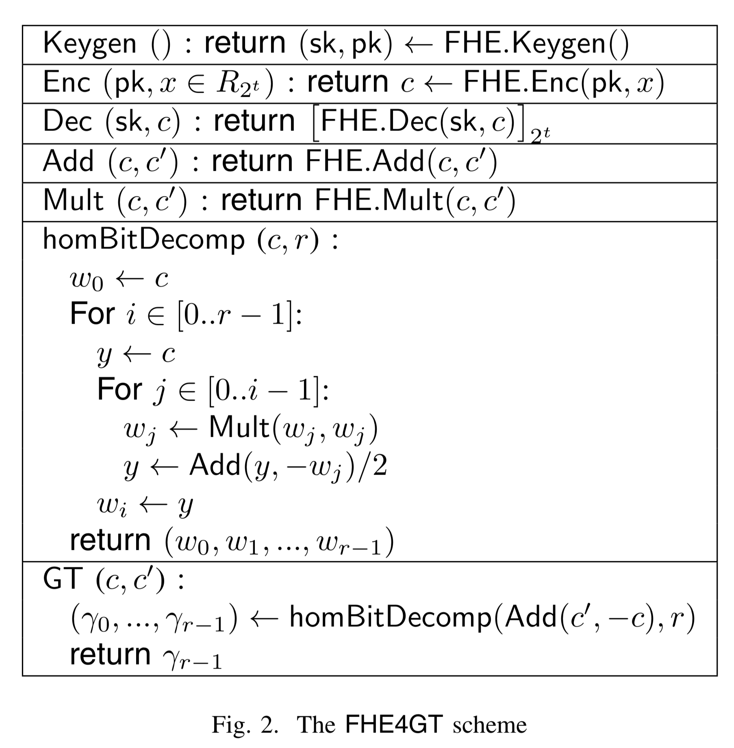
FHEG4T
fully homomorphic encryption for greater than
Semantically secure and fully homomorphic with suitable choice of parameters that makes the underlying FHE scheme as such
Paramaters: q, r, t
q -> ciphertext modulus
r -> part of 2^r where it denotes plaintext modulus of FHE
t -> bit-length of plaintext

Slide 8
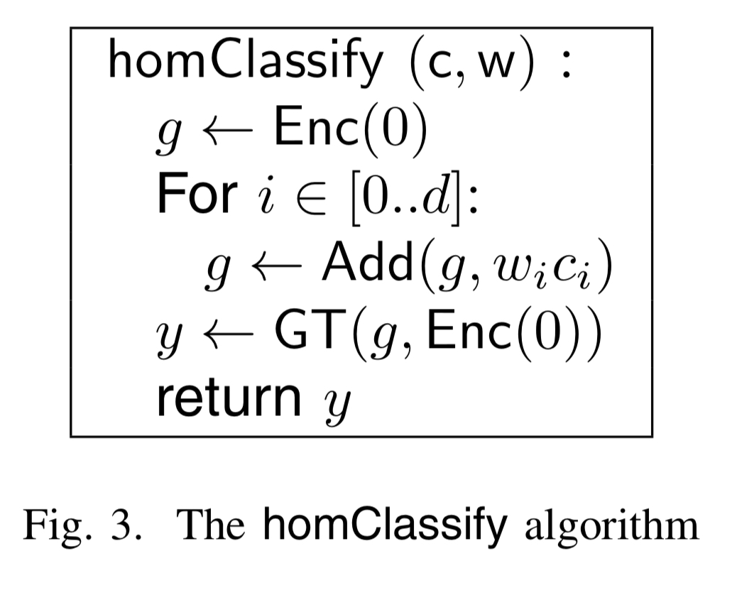
homClassify
Based on the FHE4GT scheme, this is the machine learning based classifier
Has comparable results to greater than (GT)
Homomorphically classifies a given encrypted data without decrypting it via machine learned parameters.

Slide 9
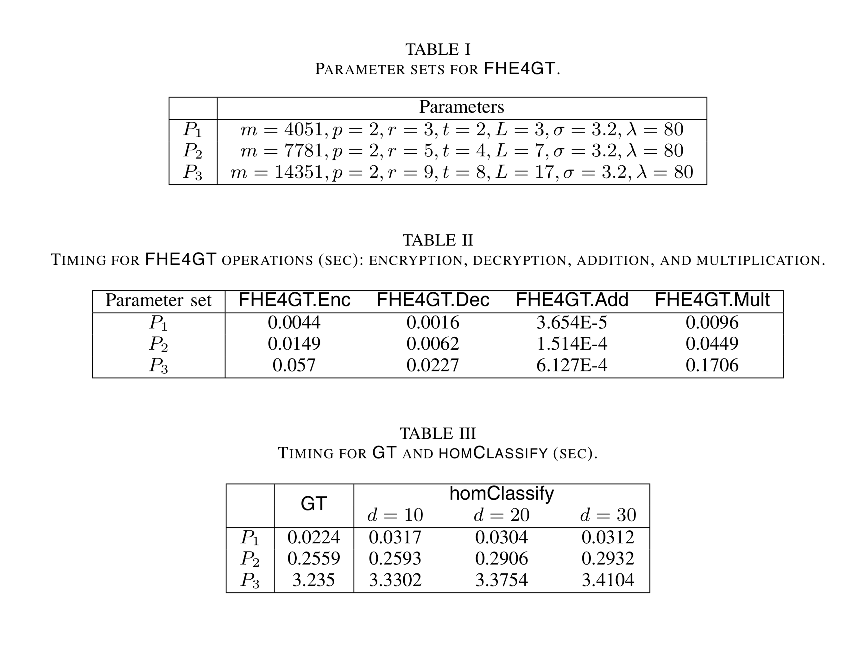

Slide 10
Side Channel Analysis
Side Channel Analysis (SCA) reveals the keys of cipher devices by collecting number of power traces and applying statistical analysis
Hardware countermeasures are sought out to protect systems from SCA processes. It must also protect against correlation power analysis (a process to find a secret encryption key stored on a victim device)
Machine learning can build a SCA-resistant program with experimental verification. An algorithm typically finds out the best hamming distance (HD) redistribution mapping by using neural dynamic programming.

Slide 11
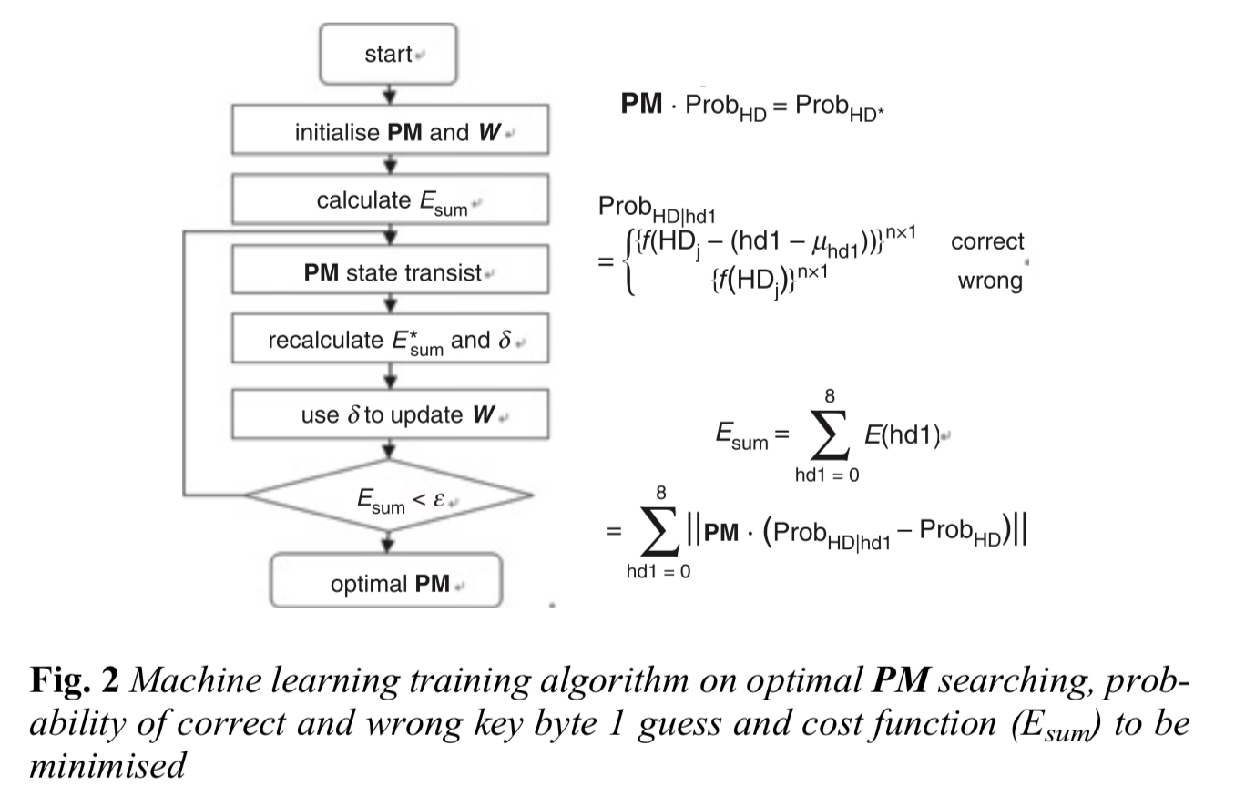
Machine learning against SCA and CPA
A method is proposed to compensate the power consumption based HD distribution (as it is typically expensive and time consuming) directly to make it unable to be distinguished from correct and incorrect sub-key.
This is where offline machine learning training is executed
The power mapping matrix (PM) plays a crucial role for this algorithm
An offline program is implemented inside the circuit architecture

Slide 12
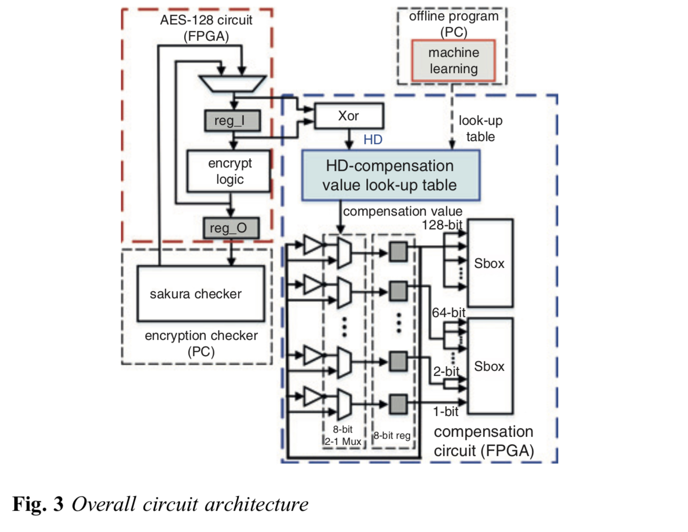

Slide 13
Privacy Preserving with machine learning
A classifier model would help preserve privacy with data
With a neural network model, a client can classify encrypted data with a neural network on a cloud server (however it doesn’t provide a learning algorithm for encrypted data).

Slide 14
Privacy Preserving Extreme Learning Machine
A remedy for the trade-off between privacy preserving nature and classification accuracy is Privacy Preserving Extreme Learning Machine (PP-ELM)
A feedforward neural network that has fast learning property whose connection weights are analytically obtained
Extreme learning machine (ELM) requires data contributors, an outsourced server, and data analysts.

Slide 15
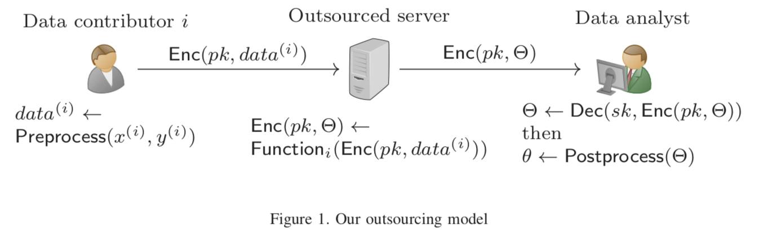
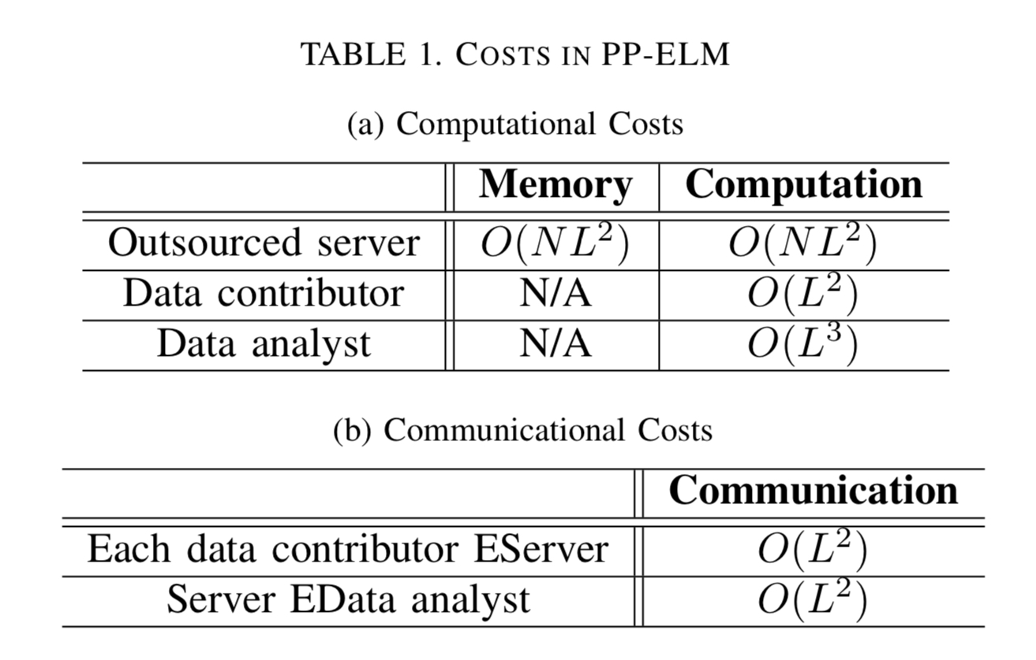
Data contributors calculate polynomial terms of input variables as preprocessing and encrypts them
The outsourced server calculates encrypted outputs of hidden units (of which obtain the connection weights of ELM
Data analysts receive encrypted hidden outputs from the server and then decrypts to obtain the connection weights of ELM.
On practical user this scheme is questionable considering the huge computational resources required for encryption, decryption, and homomorphic operations

Slide 16
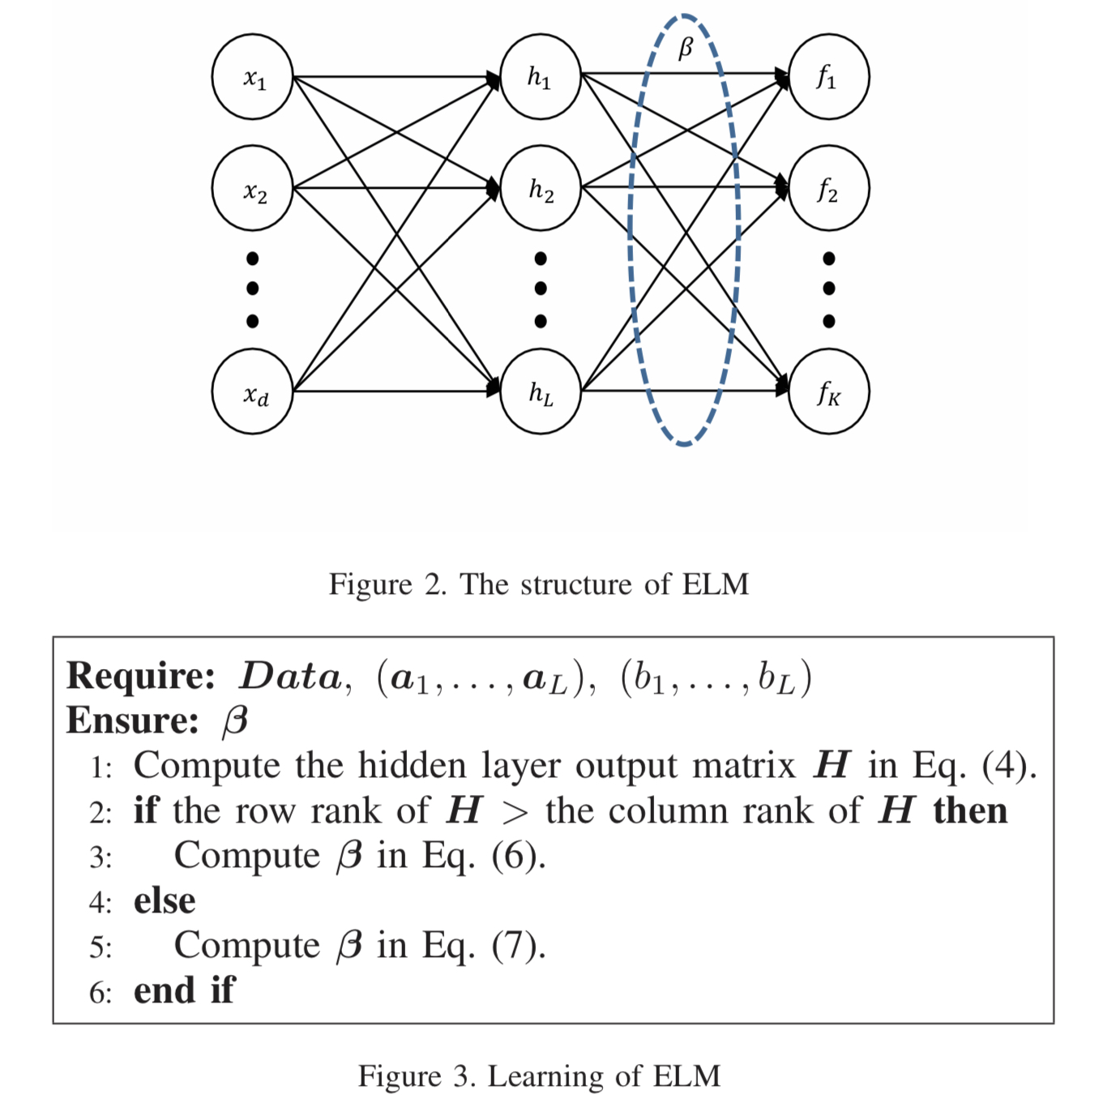
Extreme Learning Machine
ELM consists of a type of single hidden layer feedforward neural networks
Aim of the model is to prevent leaking information of data records

Slide 17
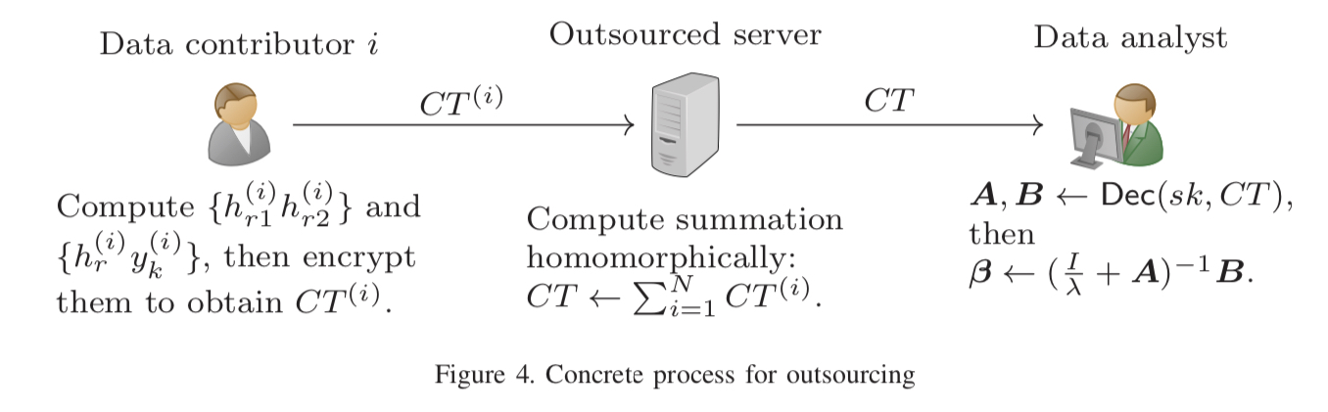
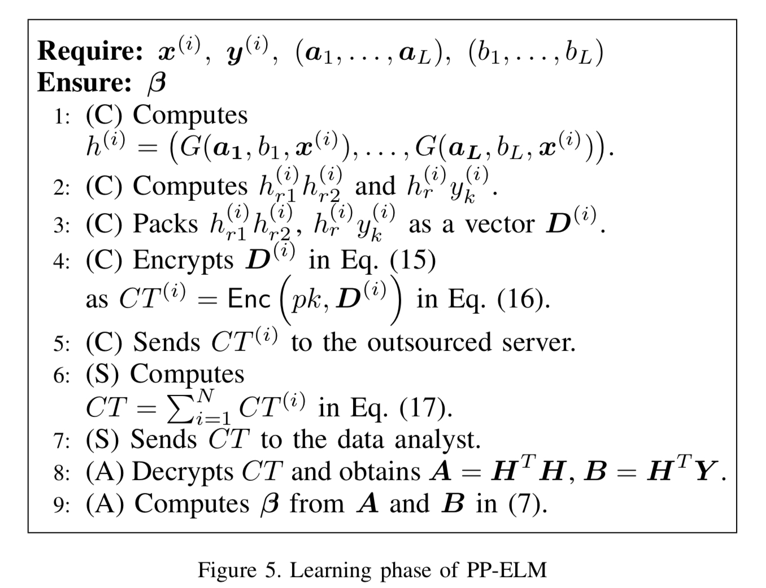
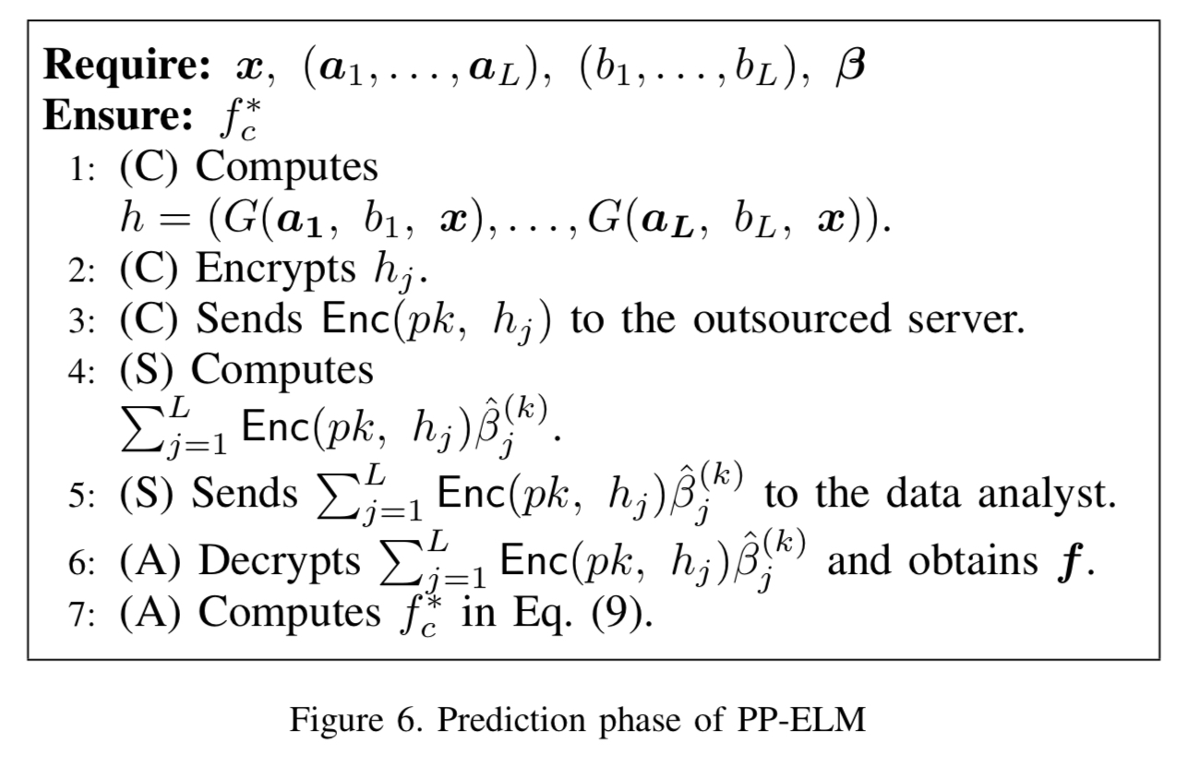

Slide 18
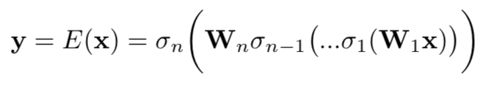
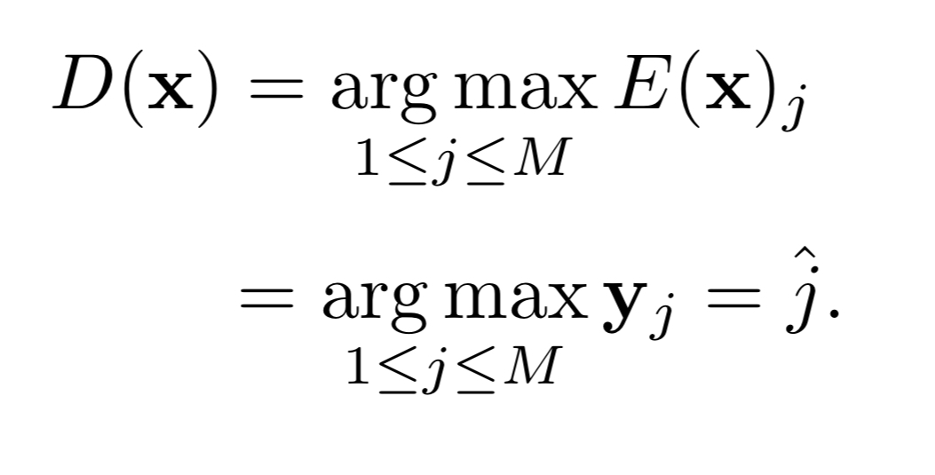
Deep Neural Network
A DNN classifier consists of two parts: encoder (training part) and decoder (classifier)
Encoder:
Several nested layers
Decoder
Assigns class labels based on encoder results

Slide 19
State of the art attacks against DNN classifiers
Gradient based attacks
Consists in the end-to-end differentiability of many neural network classification systems
Limited-memory Broyden-Fletcher-Goldfarb-Shanno (L-(BFGS): Attacks of which are time consuming due to expensive linear search and impractical for real-time applications
Fast gradient sign method (FGSM): fast but not enough time for minimal adversarial perturbation between original and targeted samples.

Slide 20
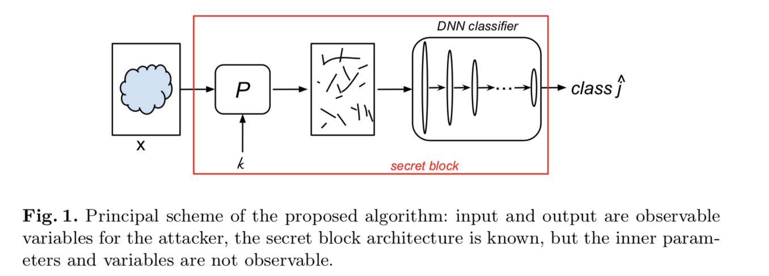

Slide 21
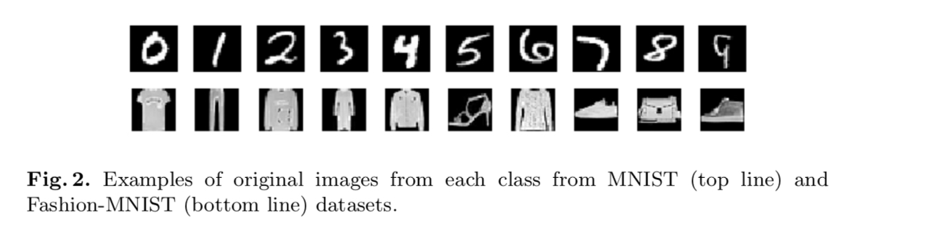
MNIST dataset
MNIST: A sample data of 10 classes, 60000 training images, and 10000 test grayscale images of size 28 x 28 were used. Images are hand-written digits
Fashion-MNIST: 10 classes, 60000 training images, and 10000 test grayscale images of size 28 x 28 were used. Images consist of clothes.

Slide 22
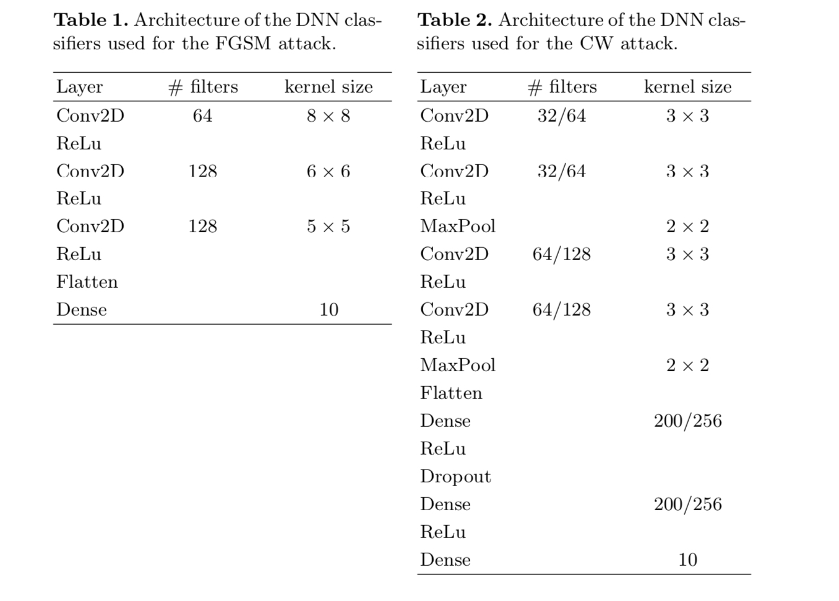

Slide 23
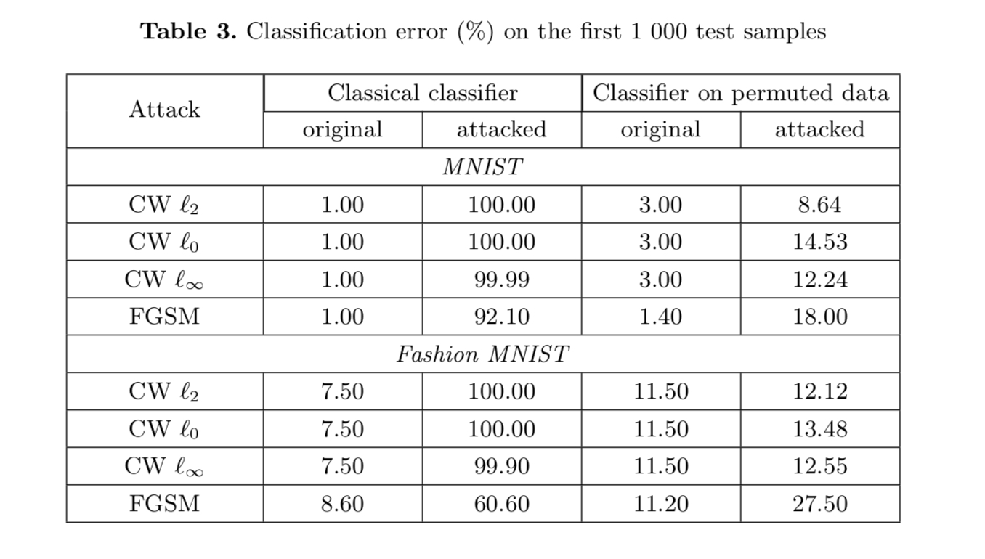

Slide 24
Future plans
To better explore how machine learning can enhance security beyond the foundations of encryption (such as quick processing of 128-bit public/private keys)
To self-train systems with daily use so that the security easily adapts.

Slide 25
References
Fully Homomorphic Encryption for Classification in Machine Learning. Seiko Arita, Shota Nakasato. 2017
Machine learning based side-channel-attack countermeasure with hamming-distance redistribution and it’s application on advanced encryption standard. Weiwei Shan, Shaui Zhange, Yukun He. 2017.
Private machine learning classification based on fully homomorphic encryption. Xiaoqiang Sun, Peng Zhang, Joseph Liu, Jianping Yu, Weixin Xie. 2017.
Privacy Preserving Extreme Learning Machine Using Additively Homomorphic Encryption. Shohei Kuri, Takuya Hayashi, Toshiaki Omori, Seiichi Ozawa, Yoshinori Aono, Le Trieu Phong, Lihua Wang, Shiho Morai. 2017.
Bridging machine learning and cryptography in defence against adversarial attacks. Ogla Taran, Shideh Rezaeifar, and Slava Voloshynovskiy. 2018
Unsupervised Chiper Cracking Using Discrere GANs. Adian Gomez, Sicong Huang, Ivan Zhang, Bryan Li, Muhammad Osama, and Lukasz Kaiser. 2018

Slide 26
ChiperGAN
Generative Adversarial Networks (GAN)
class of neural network architecture serving as an alternative to optimizing likelihood under a true data distribution
Great with image generation but weak with discrete data
Requires little or no modification to be applied to plaintext and chipertext banks generated by the user's chiper of choice
Consistent in training and notably insensitive to the random initialization of weights compared to other GANs

