Slide 1
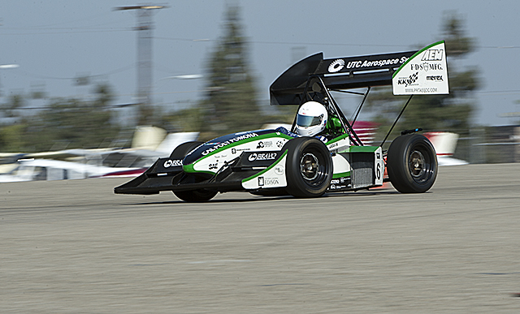
Towards Formula SAE Driver/Vehicle Optimization
Salvador Jimenez, Austin Luchsinger

Slide 2
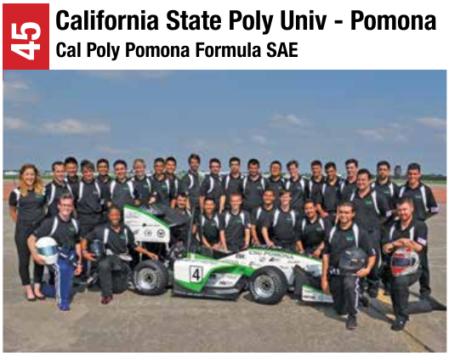
Formula SAE
Formula SAE is an international automotive competition where students design, build, and compete in a Formula-style race car.
Notes:
SAE = Society of Automotive Engineers

Slide 3
Formula SAE
Formula SAE is an international automotive competition where students design, build, and compete in a Formula-style race car.
California State Polytechnic University, Pomona competes in Formula SAE competitions every year.
Notes:
SAE = Society of Automotive Engineers

Slide 4
Formula SAE
Formula SAE is an international automotive competition where students design, build, and compete in a Formula-style race car.
California State Polytechnic University, Pomona competes in Formula SAE competitions every year. They have recently started collecting vehicle performance data from their competitions.
Notes:
SAE = Society of Automotive Engineers

Slide 5
Formula SAE
Formula SAE is an international automotive competition where students design, build, and compete in a Formula-style race car.
California State Polytechnic University, Pomona competes in Formula SAE competitions every year. They have recently started collecting vehicle performance data from their competitions.
One of their members reached out to us, asking if we can extract some useful information from this data.
Notes:
SAE = Society of Automotive Engineers

Slide 6
Formula SAE
Formula SAE is an international automotive competition where students design, build, and compete in a Formula-style race car.
California State Polytechnic University, Pomona competes in Formula SAE competitions every year. They have recently started collecting vehicle performance data from their competitions.
One of their members reached out to us, asking if we can extract some useful information from this data.
Notes:
SAE = Society of Automotive Engineers

Slide 7
Current ML Applications in F1
Formula 1 has always been a very data-driven sport.
As of July 2018, Formula 1 began integrating its infrastructure with Amazon Web Services.
https://aws.amazon.com/solutions/case-studies/formula-one/ After this shift, ML applications have piqued the interest of the Formula 1 franchise.
Nothing like this is present in collegiate Formula SAE.

Slide 8
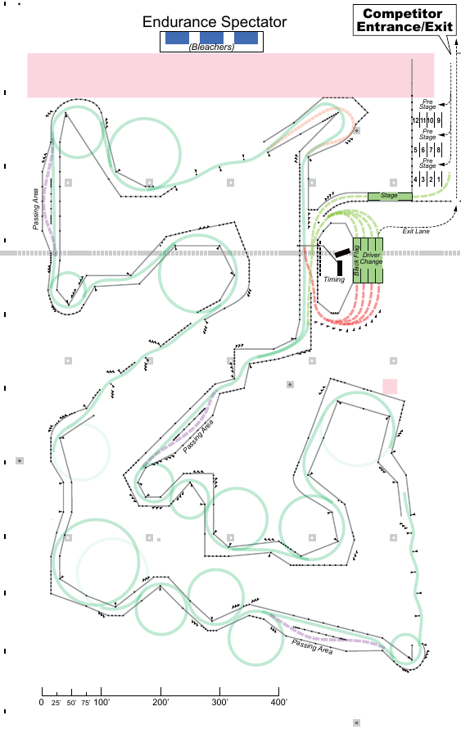
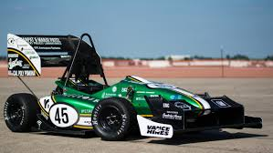
Formula SAE Lincoln 2016 Endurance Event
Endurance Event
Teams must complete 15 laps for a total of ~37500m.
They get 1 pit stop and driver change.
Sensors
engine
exhaust
throttle
Cal Poly Performance
Out of 29 competitors, Cal Poly placed 3rd overall.
Of the teams who completed the Endurance event, Cal Poly had the 3nd fastest completion time.
tires
brakes
accelerometer

Slide 9
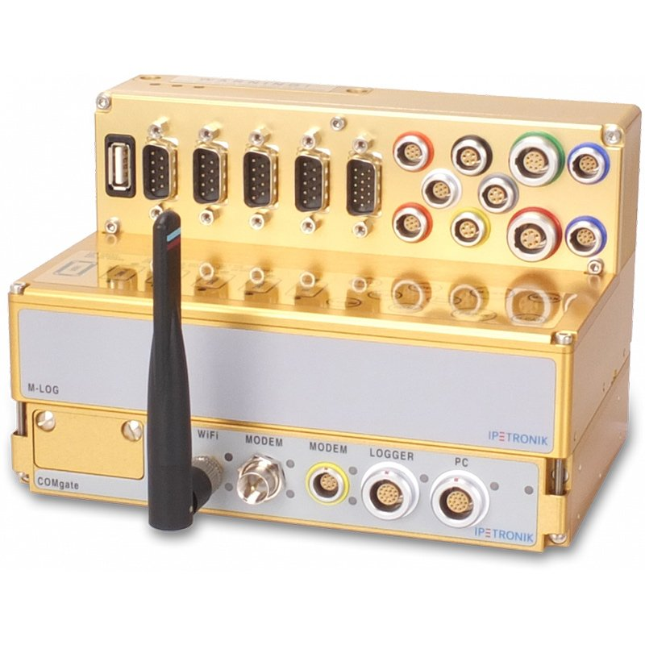
Endurance Data
Sensors
engine
exhaust
throttle
tires
brakes
https://www.ipetronik.com/ipemotion-rt-481.html
accelerometer

Slide 10
Endurance Data
throttle
Cal Poly’s Request
Cal Poly Pomona asked if we could determine the impact of throttle, brake, and lateral acceleration on lap time.
brakes
accelerometer

Slide 11
Endurance Data
Throttle
Brake
Lateral Acceleration

Slide 12
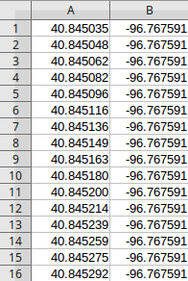
Endurance Data
GPS Coordinates
Track Positions
p₁
p₂ p₃
p₄ .
.
.
p_{i}
.
.
.
p_{n}

Slide 13
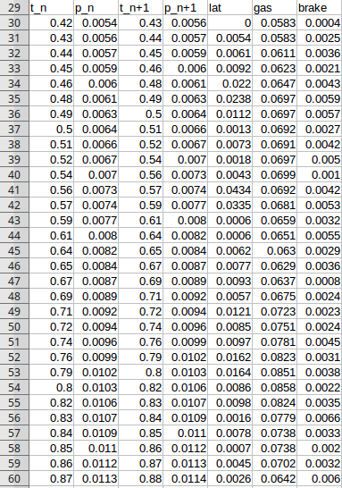
Objective
We want to learn the relationship between track segments and throttle, brake, and lateral acceleration.
t_{n}
t_{n+1}
p_{n}
p_{n+1}
g_{n}?
b_{n}?
l_{n}?

Slide 14
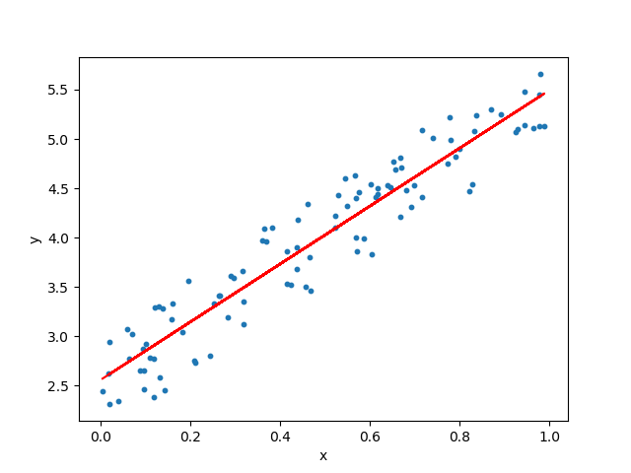
Machine Learning Algorithms
Linear Regression

Slide 15
Machine Learning Algorithms
Linear Regression
Notes:
Linear Regression doesn’t work because there is a non-linear relation between the independent variables and the dependent variable.

Slide 16
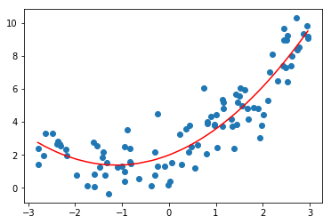
Machine Learning Algorithms
Linear Regression
Polynomial Regression

Slide 17
Machine Learning Algorithms
Linear Regression
Polynomial Regression
Notes:
Polynomial Regression requires knowledge of the relation between feature variables.

Slide 18
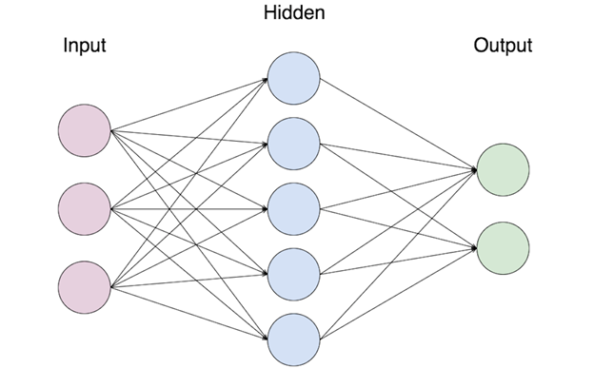
Machine Learning Algorithms
Neural Network
Linear Regression
Polynomial Regression
Notes:
We chose to use a Neural Network because, with hidden layers, they are ale to learn non-linear relations without prior knowledge.

Slide 19
Machine Learning Algorithms
Neural Network
Feed-Forward
Multi-layer perceptron
Notes:
We chose to use a Neural Network because, with hidden layers, they are ale to learn non-linear relations without prior knowledge.

Slide 20
Our Neural Network Architecture
Inputs
Outputs
p_{n}
g_{n}
t_{n}
b_{n}
p_{n+1}
l_{n}
t_{n+1}

Slide 21
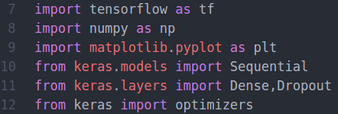
Software Implementation

Slide 22
Software Implementation

Slide 23
Software Implementation

Slide 24
Results
Loss = .0582
Accuracy = .6921

Slide 25
Results
Loss = .0582
Accuracy = .6921
Not too great.

Slide 26
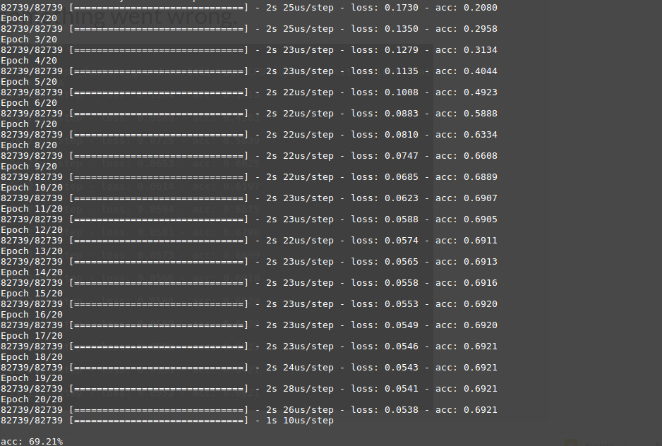
Results
Could not get higher than 69%

Slide 27
Another Approach
Inputs
p_{n}
Outputs
p_{n+1}
g_{n}
t_{n+1}
b_{n}
l_{n}
t_{n}

Slide 28
Results
Loss = .2727
Accuracy = 0
This was worse...

Slide 29
Future Work
Time-Series Analysis/Prediction
At first, this seemed like it wouldn’t work because the time intervals are not fixed. However, since we created fixed points on the track, we may be able to use those in a modified time-series analysis.
Possibly use an LSTM?

Slide 30
Thank you!

