Slide 1

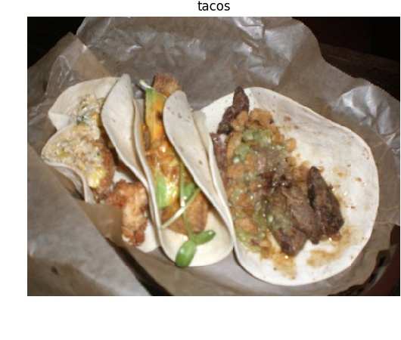
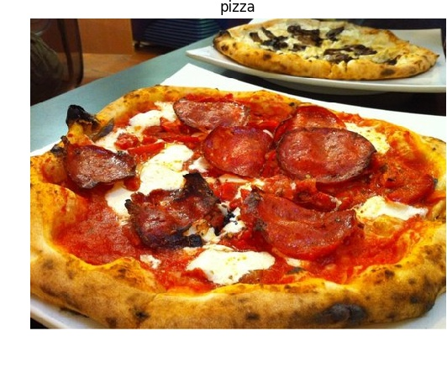
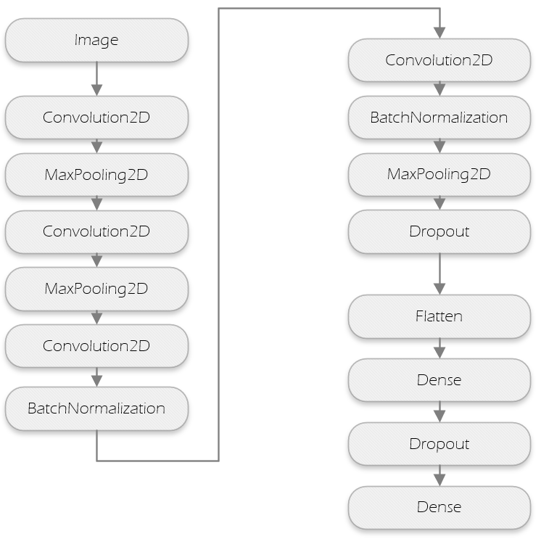
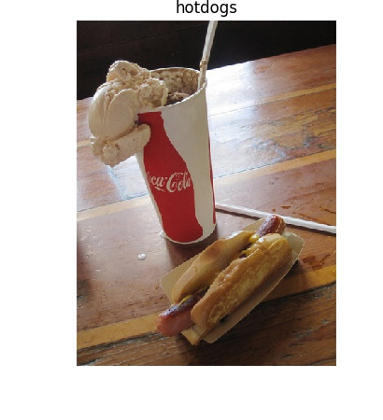
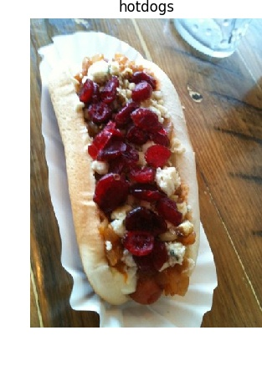
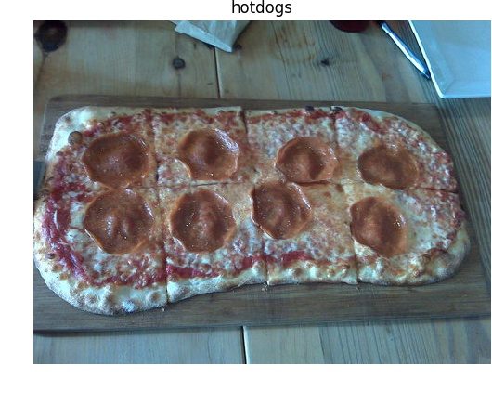

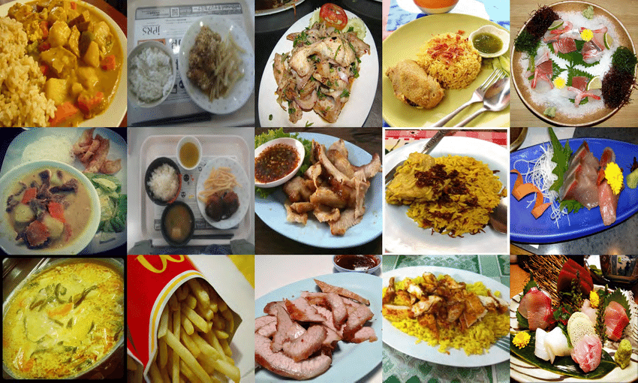


Food Dish Classification using Convolutional Neural Networks
Edgar de la Torre Bazan
Professor: Dr. Dong-Chul Kim
Department of of Engineering and Computer Science
The University of Texas Rio Grande Valley
Introduction
One of the most fundamental aspects of life is food consumption. Everyday we eat and consume many different types of foods. The food that we eat is sometimes not the healthiest available. More people are becoming aware of this need keeping a healthy diet and working to improve their diet by documenting their intake. The popularity of mobile imagery hardware has made this documenting easier by allowing individuals to take images of the food they consume.
Methodology
To solve the problem of classifying dishes, we trained a machine learning model to identify different classes of food dishes. Currently it identifies 3 different types of dishes. They are pizza, tacos, and hotdogs.
The model is a convolutional neural network(CNN) that consists of 14 layers and it is fed images of size 150 by 150
Results
In our original model (4 layer) we were able to achieve 64% accuracy using a binary model. We abandoned that model and created a multi class model with 14 layers. These change successfully increased our classification accuracy to 90%.
.
Motivation
The main motivation for this project is to help individuals automatically identify the dishes they have documented on their social media. This is a complex task due to many variations of the same food dishes in the world. We believe that I applying machine learning technology will simplify this task and help individuals improve their health by monitoring their food intake.
Examples of successful results
CNN layers
Data
The data we use to train this model is a curated version of the dataset Food 101. It consists of 100 different classes of dishes. For each dish are 750 images for training and 250 for testing.
We extracted 3 classes from the dataset and curated the images. We manually curated the images by removing any low quality images.
Challenges
Meals classification is very complex due to the different variations of the same meals. The same dish con look very different depending on the conditions For example, there are a lot of variations of tacos. There are fish tacos, meat, and chicken to mention a few. The dishes are never the main entry on its own. It regularly contains side dishes that affect the classification process
Another problem we encountered was the low quality of social media images. Different lighting and camera quality affects the result
Example of failure
Conclusions and Future Work
Food classification using machine learning is complicated due to the variety of dishes and their similarity. With more training and data, we are capable of achieving respectable results.
In the future we would like to expand the classifier to predict many more classes. We would also like to expand it to classify side meals with the dishes.
Samples of Dataset. Food 101
References
Frameworks used in this project
1. Food-101 – Mining Discriminative Components with Random Forests. Lukas Bossard, Matthieu Guillaumin, Luc Van Gool

