Slide 1


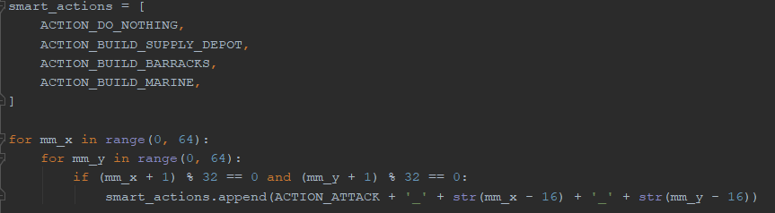
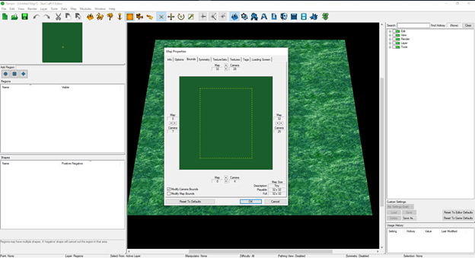
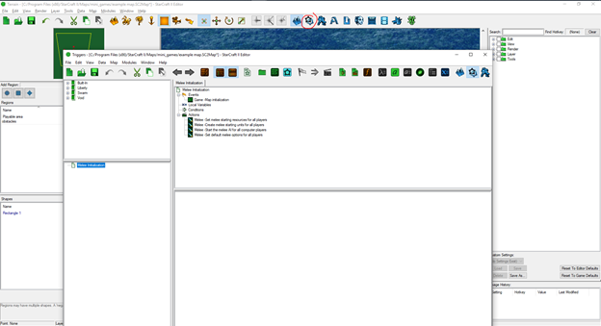
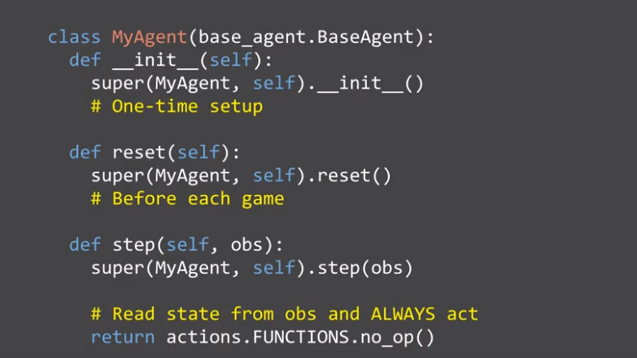
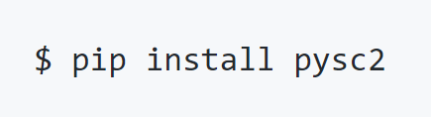
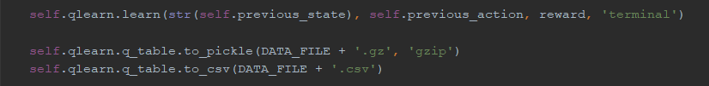
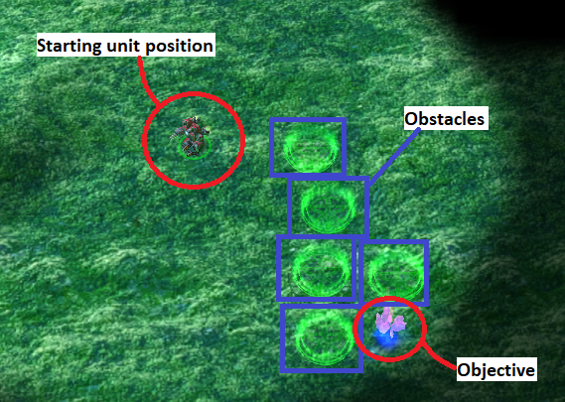
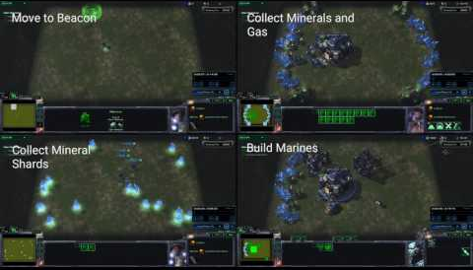
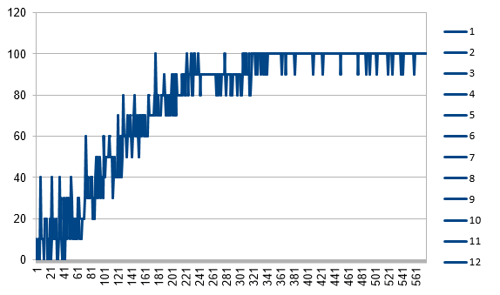
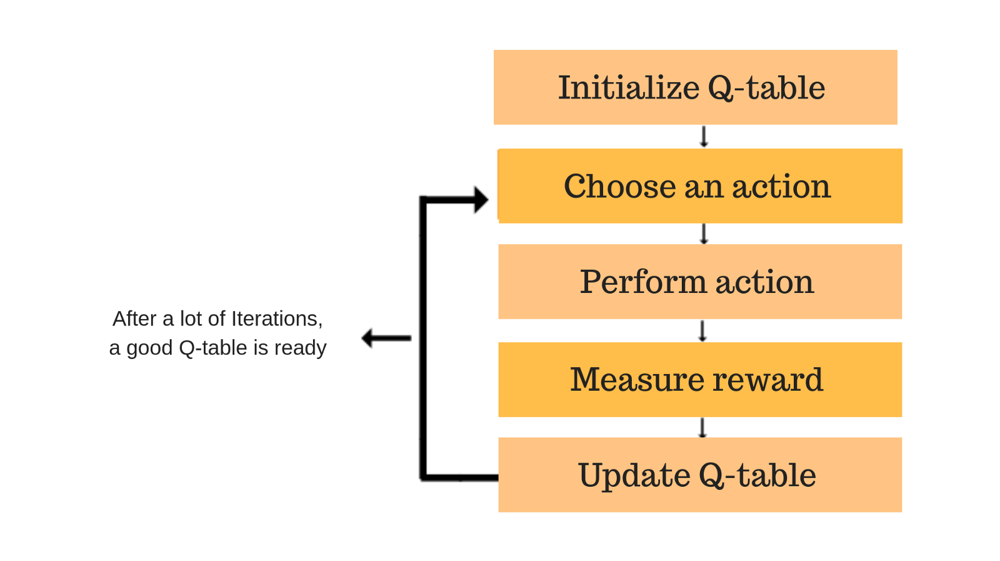
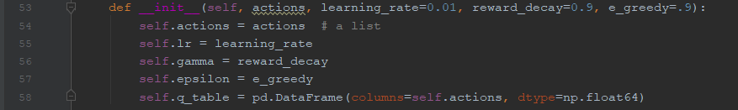
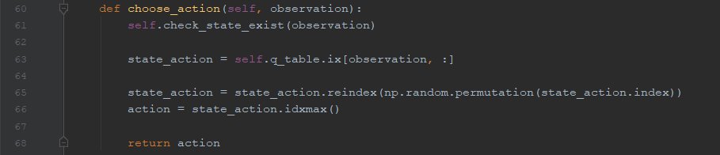
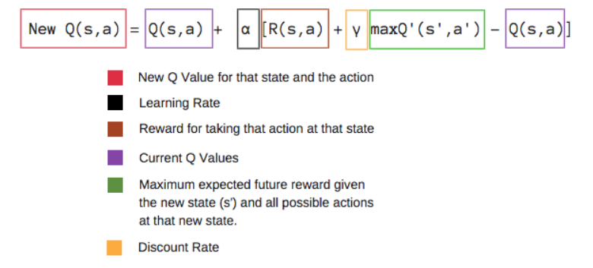
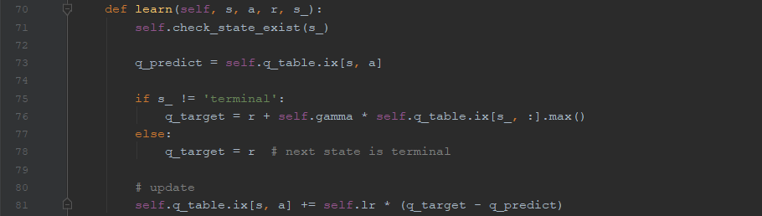
PySC2 Reinforcement Learning
Luis Romo and Marissa Jain
Email: luis.romo01@utrgv.edu
Department of Computer Science
University of Texas - Rio Grande Valley
Advisor: Dr. Dongchul Kim
Introduction
Real Time Strategy games provide an ideal testing environment for artificial intelligence and machine learning techniques because they are run in real time, provide incomplete information, and contain multiple elements that allow for many different strategies.
StarCraft II is a suitable challenge for machine learning. It is a Real Time Strategy game developed by Blizzard. The goal of the game is to collect resources, build a base, build units, and defeat your opponent while they attempt to accomplish the same.
Reinforcement Learning is a type of machine learning technique that enables an agent to learn in an interactive environment by trial and error using feedback from its own actions and experiences.
PySC2 is an environment for Reinforcement Learning research developed by DeepMind and Blizzard. It provides an interface for Reinforcement Learning agents to interact with StarCraft II and is designed to emulate human abilities.
The purpose of this project is to create an agent that is able to play and efficiently complete a StarCraft II mini-game through Reinforcement Learning.
Data Collection
The PySC2 package installation comes with all the required dependencies.
PySC2 has many maps pre-configured that are useful for testing agents with different purposes. They need to be downloaded into the SC2 Maps directory before they can be played.
The data used to teach the agent is created by the agent itself. Each time the agent runs through the game the value of how well the agent performed is calculated using the bellman equation and saved into a Q-table. This data is used to improve performance in the agents subsequent games.
Figure 1: Q-learning table process and formula
Methodology
We decided that we wanted our agent to focus smart movement. However, none of the minigames that were included in the PySC2 package contain a condition for rewarding the agent if it reaches a location while avoiding obstacles. So, we created a mini-game more suitable for our agents purposes.
Mini-games are created using the StarCraft 2 Editor. The editor allows us to create map boundaries, make regions, and add in our preferred physical elements of the game. Then the events and win conditions are coded into the map.
Figure 2: StarCraft 2 map editor
The win condition of our mini-game is for the player to collect the mineral without stepping into a beacon.
Data Preparation
Figure 3: Mini-game map used for our agent
The Q-learning table is the basis for how the agent is able to learn from its previous attempts. Its coded in a class containing four functions that coincide with the steps a Q-learning table goes through. The data is saved into a .csv file.
Figure 4: Functions from the Q-learning table class
The agent has eight actions to choose from. The map is split into four quadrants and four of the actions are created at the start to have the agent move within one of the four quadrants. These eight actions will serve as the columns in the Q-table.
Figure 5: Initialization of the actions
The state the agent can be in is defined by its x and y coordinates. The states serve as the rows in the Q-table. New rows of states are appended as the agent discovers new areas of the map.
The agent class is where the agent can access the .csv file and is told what specific actions to take. This is where the reward is calculated and the game resets at terminal.
Figure 6: Required functions for agent class
The step function makes observations of the environment and uses a .gz file and the .csv with the Q-Learning table class to decide which of the eight actions to take.
Figure 7: File access in the Step function
Experiment Results
Figure 8: Plot chart of the average performance of 12 agents tested for over 500 consecutive episodes
References
[1] M. Samvelyan et al., “The StarCraft Multi-Agent Challenge”, 2019. Retrieved from https://arxiv.org/pdf/1902.04043.
[2] Z. Pang, r. Liu, Z. Meng, Y. Zhang, Y. Yu and T. Lu, “On Reinforcement Learning for Full-length Game of StarCraft”, 2019. Retrieved from https://arxiv.org/abs/1809.09095.
[3] DeepMind. “Alphastar: Mastering the real-time strategy game starcraft ii”, 2019. Retrieved from https://deepmind.com/blog/alphastar-mastering-real-time-strategy-game-starcraft-ii/.
[4] Y. Hu, J. Li, X. Li, G. Pan, and M. Xu. Knowledge-guided agent-tactic-aware learning for starcraft micro-management. InIJCAI, pp. 1471-1477.
Acknowledgement
We would like to thank Dr. Kim for his advice, comprehension and support.

