Slide 1

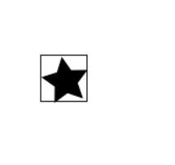
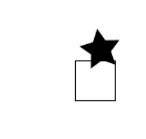
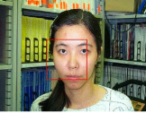
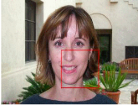
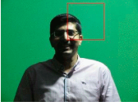
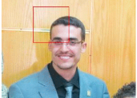
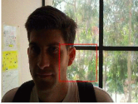
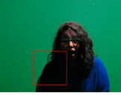
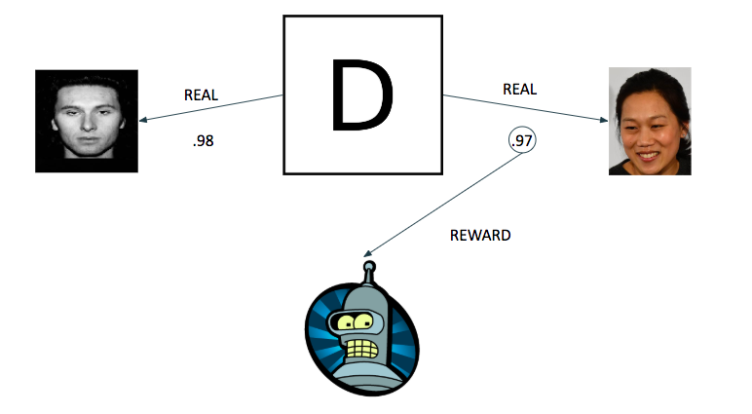
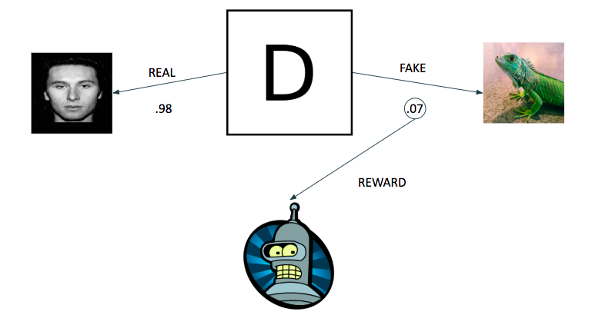

Object Detection: Reinforcement Learning and Generative Adversarial Network
Angel A. Cantu, Nami Akazawa
Department of Computer Science
The University of Texas Rio Grande Valley
Abstract
Current state of the art Object Detection methods, such as You Only Look Once (YOLO), require a pre-processing method of labeling images before training.. Manually labeling large amount images is both labor and time consuming. We attempt to implement a machine learning algorithm using both Generative Adversarial Network (GAN) and Reinforcement Learning (RL) for the purpose of detecting an object in some image, without the need to pre-process any image.
Reinforcement Learning
The specific Reinforcement learning algorithm we used is from OpenAI’s Gym environment. Gym is a toolkit for developing and comparing reinforcement learning algorithms. We define the details of the Agent as follows:
Environment: The image itself.
Actions: The agent outputs two integers that mark the center point of the bounding box within the image itself.
Observation: The observation after performing some action is the image with the bounding box.
Reward: Since the discriminator performs binary classification (“1” for real, “0” for fake), we can export the classification level of the last layer of the network and use it as a reward system for the Agent.
Results
First Phase - Proof of Concept
we first test in a simple environment: A single star in a white background
Second Phase - Face Detection
For the second phase, we jumped right into a much harder problem: Face Detection
Our data was grabbed from various datasets available online.
Good
Soso
Bad
Introduction
The task of the object detection is to detect instances of objects from a known class in an image and place a bounding box around the object.
In order to solve this task, machine learning approaches require ground-truth datasets where particular objects in images are labeled before training. We develop an algorithm to see if it is possible to perform the object detection on specific object without pre-labeled images.
Generative Adversarial Network
GANs were introduced by Ian Goodfellow et al as a unsupervised learning model. The basic model consists of two networks: generator and discriminator contest with each other in zero sum game. The generator’s goal is to find a mapping function from a latent space to a specific data distribution. The discriminator’s goal is to detect which incoming datas are real or fake. The discriminator needs to classify the generator’s generated images as fake in order to decrease it’s loss metric.
Our Approach
Using Generative Adversarial Networks, we replace the Generator part with an Agent. The agent’s objective is to select specific objects from the input image and send it to the Discriminator.
The Discriminator will evaluates the similarity between the Real (Class 1) and Fake data (Class 0). If the Agent finds the object and sends that cropped image to the Discriminator, then the Discriminator will classify it as Real (Class 1).
Future Directions
Multiple Bounding Boxes Detection (multiple faces)
Train with Multiple Objects
Try with different model architecture
Change bounding box sizes
Experiments
We tested various different methods for this experiment. One of them was to have both the discriminator and the agent train at the same rate. In other words, every time the agent performs its actions and crops an image, the discriminator is trained on that image and another image from the real dataset. This idea was tried to now allow any actor (discriminator or generator) to outperform the other one, and for both to achieve best performance at the same rate.
Another experiment was to have a pre-trained discriminator model make evaluations on the agent’s performance. This method does not train the discriminator whilst the agent is learning. The idea behind this was to “exploit” specific details about what the discriminator has learned about the object. For example, for faces, the discriminator would learn the details of eye location, mouth shape, nose shape,etc. If the agent crops locations of the images where a face-like object exist, then the discriminator should return high reward. The discriminator’s ground-truth is the face data and random crops from the agent’s data, to serve as non-face data.
Conclusion
In this experiment we test the potential of combining reinforcement learning and generative adversarial networks with the task of object detection. We show that an agent is capable of performing in a game that is akin to a zerosum game that, in turn, works in unity in a machine learning environment. This environment involves the task of object detection with the use of neural networks as intelligent judgers.
References
Joseph Redmon, Santosh Divvala, Ross Girshick: “You Only Look Once: Unified, Real-Time Object Detection”, arXiv:1506.02640, 2015.
Goodfellow, Ian J., Pouget-Abadie, Jean, Mirza, Mehdi, Xu, Bing, Warde-Farley, David, Ozair, Sherjil, Courville, Aaron C., and Bengio, Yoshua. Generative adversarial nets. NIPS, 2014.
John Schulman, Filip Wolski, Prafulla Dhariwal, Alec Radford: “Proximal Policy Optimization Algorithms”, 2017; arXiv:1707.06347.
Datasets
Various random generated shape
Face images from online resources.
Notes:
‹#›

