Slide 1
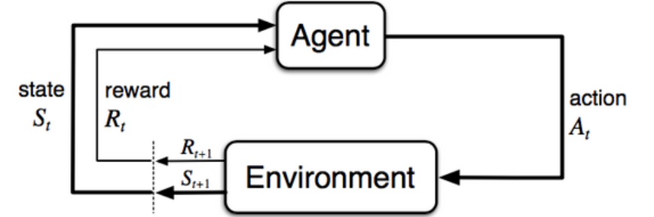
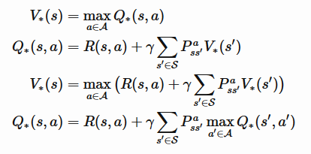
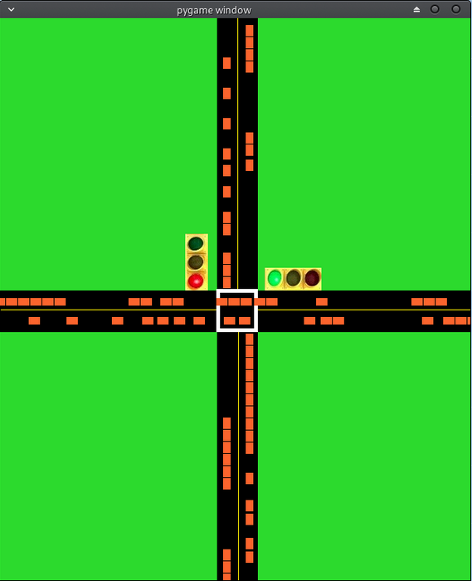
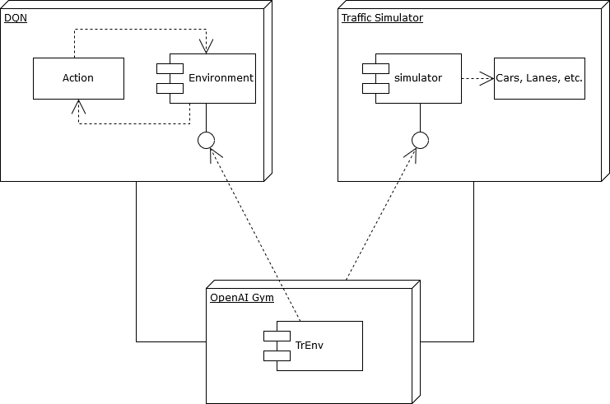
A Deep Reinforcement Learning Approach to Traffic Management
Osvaldo Castellanos, Advisor: Dr. Dongchul Kim
Department of Computer Science
College of Engineering and Computer Science
Methodology
The reinforcement learning algorithm that we are currently testing is the Deep Q-Network algorithm. To do so, we use a traffic simulator that interfaces with an api called gym.
The essence of the DQN algorithm is that the agent picks an action with the highest Q-value. The Q-value can be thought of us as the “Quality” of taking action A, in state S. The agent then learns by being able to store the consequences of that action, and updates a neural network to approximate the Q-value for the next set of actions, in the next set of states.
.
Abstract
Daily traffic congestion can be viewed as a result of inefficient road and vehicle management strategies currently in use. With recent advancements in machine learning, particularly in video games, we hope to show how deep reinforcement learning techniques may be applied to learn optimal ways of managing traffic lights at intersections, and thereby helping reduce congestion to a minimum.
Theory Model
Reinforcement learning has formal foundations in Markov Decision Processes (MDPs). An MDP is a 5-tuple that consists of:
S – set of states,
A – set of actions,
P – transition probability functions,
R – reward function,
G – discounting factor for future rewards
With this information, we can use algorithms based on the Bellman optimality equations to learn from an agent’s interaction with an environment which action will yield the highest reward.
Introduction
In this project, we aim to apply multi-agent deep reinforcement learning techniques to traffic signal control. We've developed a traffic simulator that allows us to test a traffic signal control agent in multiple environments. In addition to evaluating our algorithm to the state of practice simulators, we will investigate how multi-agent reinforcement learning algorithms can train a traffic signal agent to adapt to different events that cause traffic. For example, events such as cars stalling, accidents, and natural disasters like flooding. Our simulator gives us control over parameters that can simulate these conditions. We can specify environments with multiple roads, intersections, traffic lights, and specify if zones aren't accessible to drivers. Thus, given an environment where an event has taken place that causes traffic, the traffic signal controller can coordinate routes to circumvent traffic-heavy areas. Current research in traffic signal control that also applies multi-agent reinforcement learning train agents in specific, or even single, environments. Our goal is to train a system that can be practical in multiple settings, under multiple conditions. Overall, in this project, our goal is to apply the system to simulations of large-scale areas such as the Rio Grande Valley in South Texas.
Figure 3. Abstract model of the learning process
Conclusions and Future Work
We aim to extend the traffic simulator to support a network of multiple intersections, as well as, the ability to dynamically adjust the driving conditions of distinct lanes. These set of features will allow us to be able to test multi-agent reinforcement learning algorithms in this specific environment.
Additionally, we plan on developing more advanced features, such as: wider range of driving behaviors, support for multi-laned roads, advanced traffic signals such as protected left turns.
References
Liang, X., Du, X., (2018). Deep Reinforcement Learning for Traffic Light Control in Vehicular Networks. IEEE Transactions on Vehicular Technology.
Mousavi, S., Schukat, M., Howley, E.(2017) Traffic light control using deep policy-gradient and value-function-based reinforcement learning. IET Intelligent Transport Systems.
Gao, J., Shen, Y., Ito, M., Shiratori, (2017). Adaptive Traffic Signal Control: Deep Reinforcement Learning Algorithm with Experience Replay and Target Network.
Wierig, M. Multi-Agent Reinforcement Learning for Traffic Light Control.
Arulkumaran, K. Deisenroth, M., Brundage, M., Bharath, A., (2017). A Brief Survey of Deep Reinforcement Learning. IEEE Signal Processing Magazine.
Figure 2. Snapshot of an intersection in the traffic simulation.
Figure 1. How the api’s communicate during learning

