Slide 1
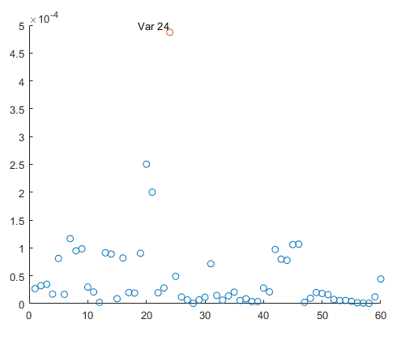
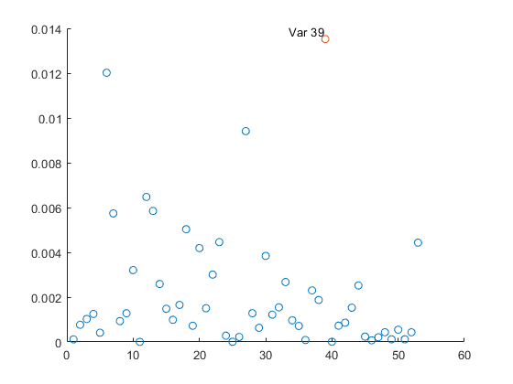
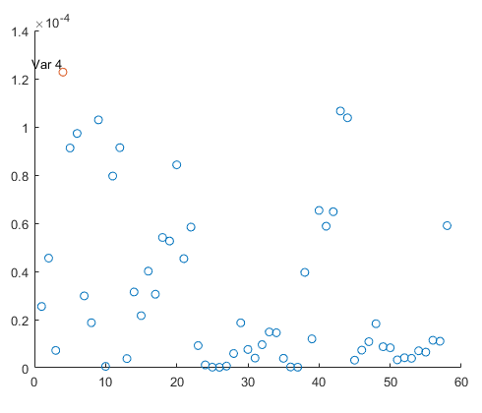
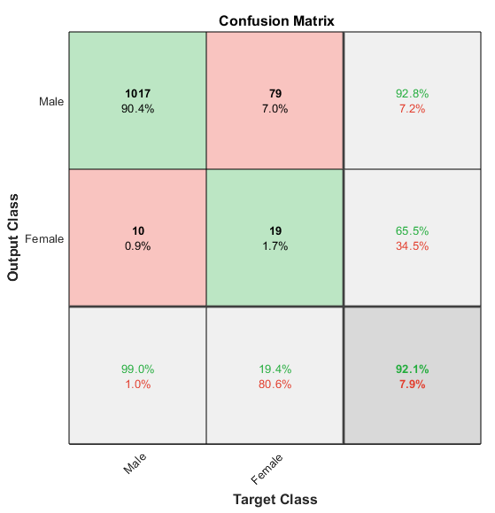
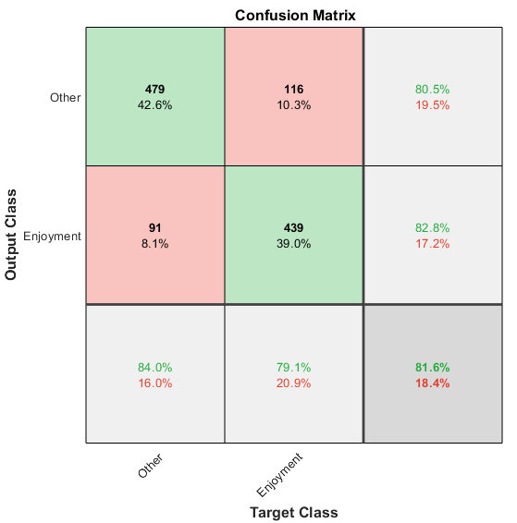
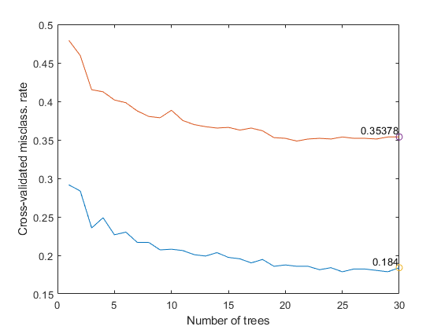
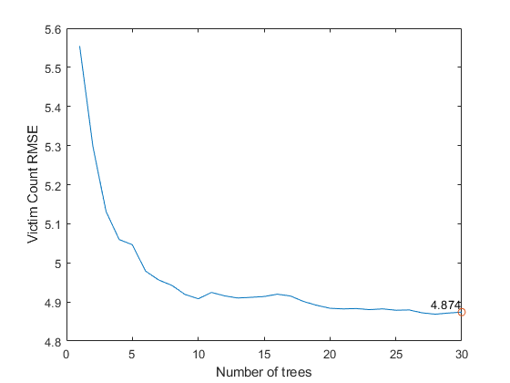
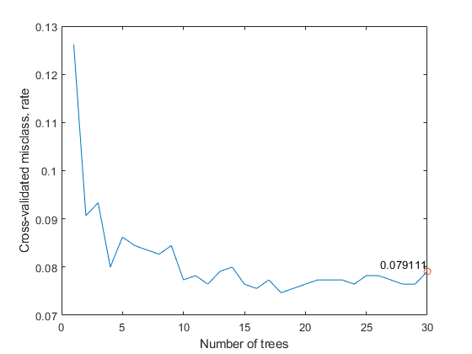

Using Machine Learning to Analyze Serial Killer Patterns
Mason Garza, Fernando Martinez
University of Texas at Rio Grande Valley | Department of Computer Science
ABSTRACT
RESULTS AND ANALYSIS
Motivated by the Ted Bundy tapes, we wanted to apply machine learning data analysis to analyze serial killers, and find potential patterns.
We gathered data from a large private database, the FGCU/Radford Serial Killer database, and tried to find predictive algorithms for the following.
Motivation
Number of Victims
Serial Killers’ Sex
We then conducted an analysis of the models produced by these algorithms in order to gain insight on how these feature were predicted.
Results
Motive
11 class: Attention, Enjoyment, Anger, Mental Illness, etc.
Binary class: Enjoyment and Other
Accuracy: 11 class model had 64.6%, Binary Class had 81.6% [Fig. 8]
Number of Victims
Range: 2 - 49
Average: 5
Accuracy: 4.7 victim error
Serial Killers’ Sex
Predominantly Male
Accuracy: 92.1% [Fig. 7]
Analysis
With random forest, by summing the changes in error when a split is made in the trees, we can estimate the importance of a predictor (PI).
The features with the greatest PI
Binary Motive: Whether or not the killer raped [Fig. 4]
Victims: The year of the first kill, and secondarily the presence of a possession trophy [Fig. 5]
Serial Killers’ Sex: The birth year of the killer, although this model has more predictors of significance [Fig. 6]
We had older models which were more accurate, but when we conducted an analysis of the models, we found that certain features were too unfairly related. E.g. the White Male feature was originally included in the Sex model. We prepared new models which eliminated these features.
BACKGROUND
Figure 4: PIs for Motive model
Figure 5: PIs for Victim model
Figure 6: PIs for Sex model
Figure 7: Serial Killers’ Sex Confusion Matrix
Figure 8: Binary Motive Confusion Matrix
FBI defines serial killing as “a series of two or more murders, committed as separate events, usually, but not always, by one offender acting alone”. Contrasted with Mass Murderers, who kill their victims in one act, and organized criminals who kill for an organization.
The literature on this subject is very limited. There are papers about applying machine learning to general crime data, which we read to inspired our methods.
Database originally included 2870 “serial killer” instances with 179 features.
EXPERIMENT
CONCLUSION
Preprocessed the data down to ≤ 60 features and 1125 instances.
Scraped data from multiple csv files, removed non serial killers, and older ones.
Formatted label data
Delete features missing more than 20% of data
Delete instances missing data from remaining features.
Non numerical data, and lists removed.
Motive: 11 Class Model & Binary model [Fig. 1]
Classification Random Forest with Bagging
Error measured with Misclassification Rate
Victim: Number of Victims [Fig. 2]
Regression Random Forests with Bagging
Error measured with Root Mean Squared Error
Serial Killer Sex: Binary [Fig. 3]
Classification Random Forest with Bagging
Error measured with Misclassification Rate
We can predict whether a serial killer will kill for enjoyment or for another motive with an 81.6% accuracy.
We can predict any motive with 64.6% accuracy.
Binary Classification model for Motive tends to weigh “Rape” and the sex of the victims greatly.
We were able predict the number of victims with an error of <5 victims.
Our model for predicting number of victims weighs the year and whether or not the killer kept possession trophies highly.
We were able predict the sex of the serial killers’ with 92.1% accuracy.
Our model for predicting sex considers the time period the serial killer was born it, usually it’s a year in the early 20th century.
Figure 1: Motive Error
Figure 2: Number of Victims Error
FUTURE WORK
Erase serial killers that started killing before 1930, and see the result on serial killers’ sex.
Try different data replacement methods to incorporate more data into the model.
Include a wider variety of data such as textual data, and lists.
Train more models for different features.
Figure 3: Sex Error
References:
[1] McClendon, Lawrence, and Natarajan Meghanathan. "Using machine learning algorithms to analyze crime data." Machine Learning and Applications: An International Journal (MLAIJ)2.1 (2015): 1-12.
[2] Kim, Suhong, et al. "Crime Analysis Through Machine Learning." 2018 IEEE 9th Annual Information Technology, Electronics and Mobile Communication Conference (IEMCON). IEEE, 2018.
[3] Radford FGCU Database

