Slide 1

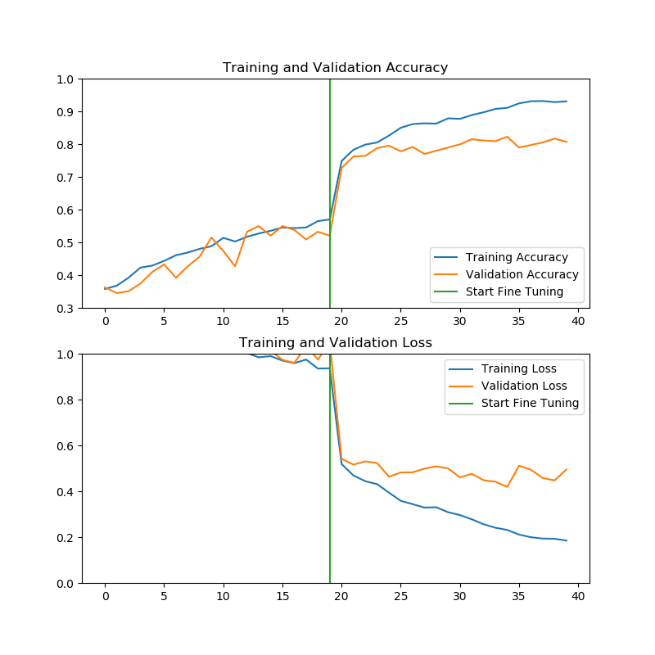
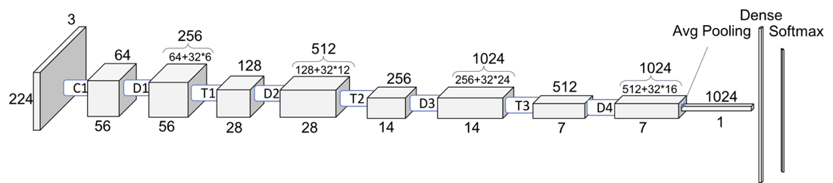

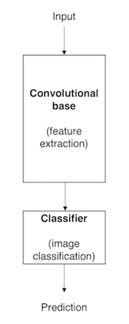
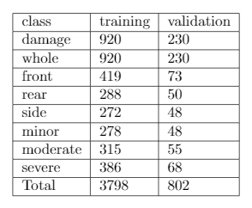
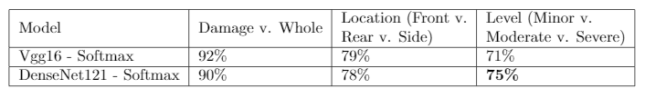
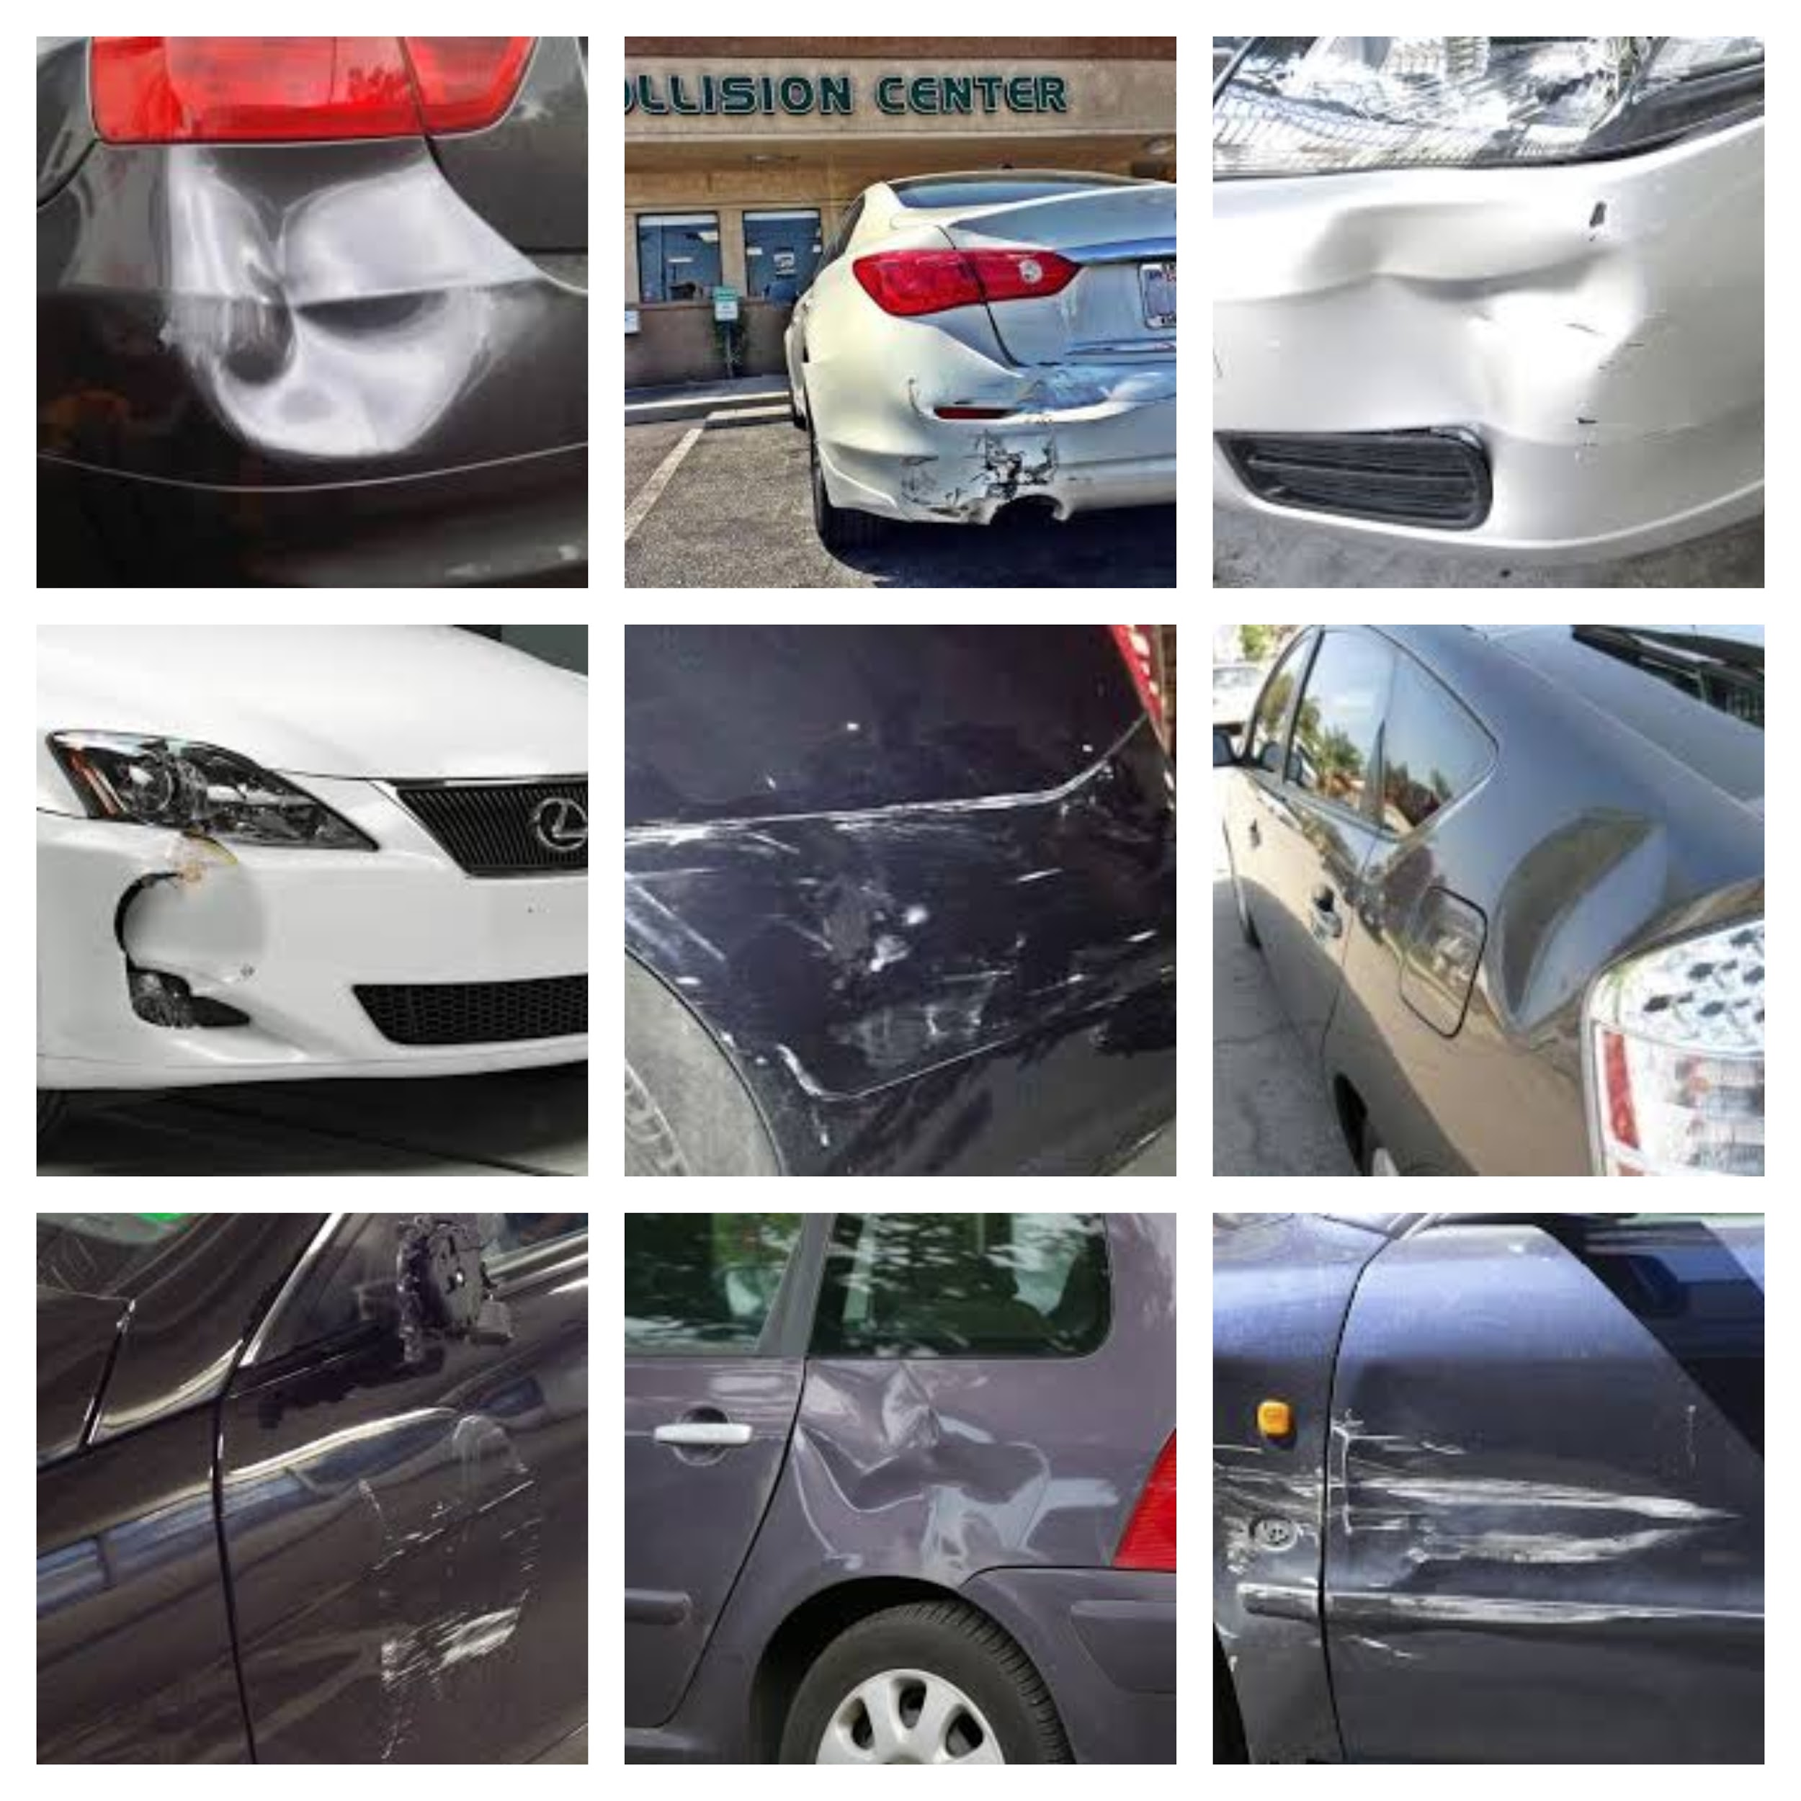
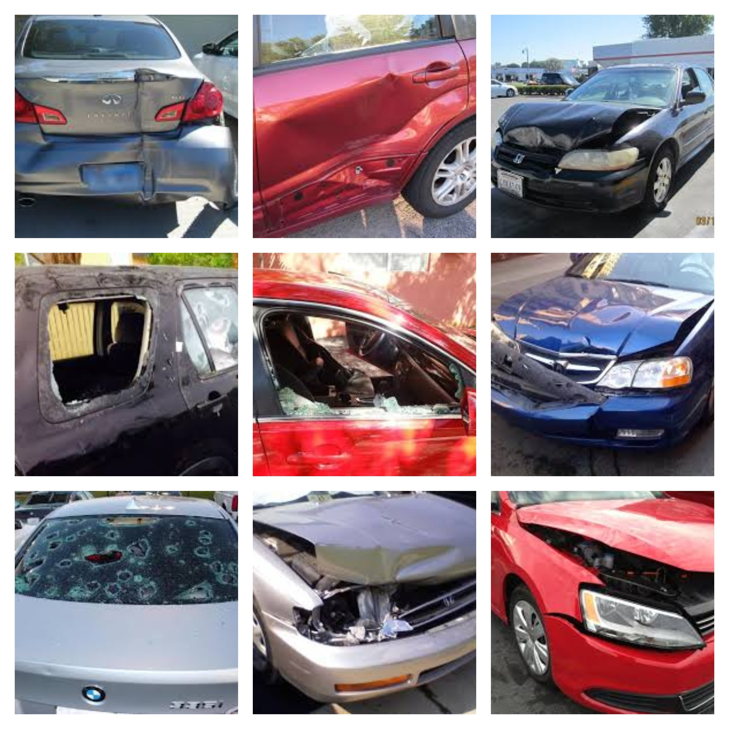
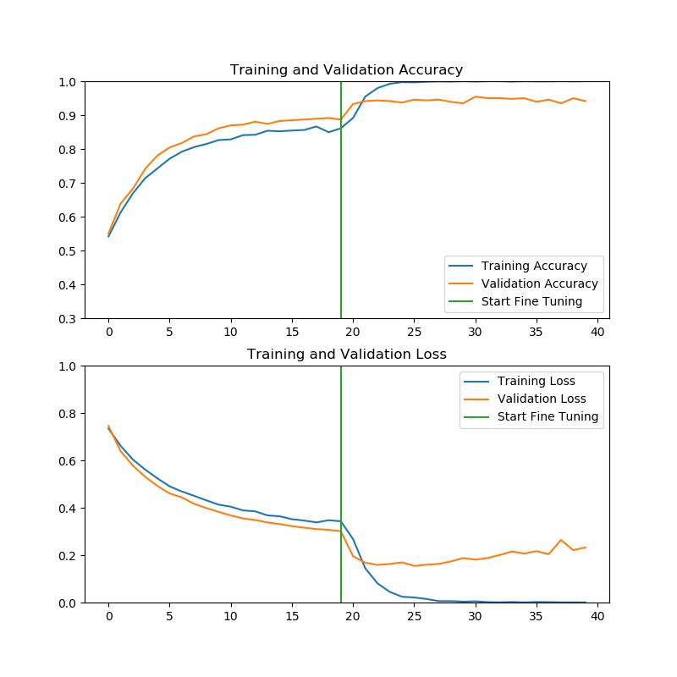
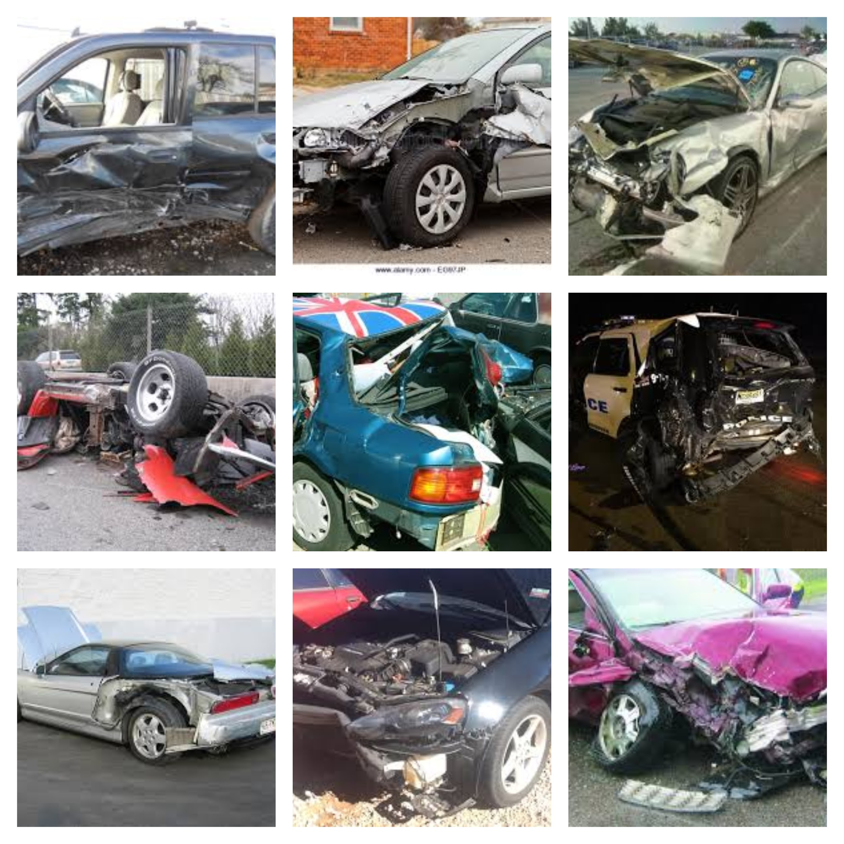
Car Damage Assessment
Adrian E. Gonzalez , David Parra
Department of Computer Science
College of Engineering and Computer Science
Abstract
Training a Convolutional Network from scratch (with random initialization) is difficult because it is relatively rare to have a large enough dataset. In this project we explore the problem of classifying images containing damaged cars to try and assess the monetary value of the damage. Because of the nature of this problem, classifying this data may prove to be a difficult task since no standardized dataset exists, and some of the clases utilized might not be discriminative enough. Utilizing a pretrained CNN model, we trained a classifier in order to categorize the dataset, testing 3 different cases:
damaged or not (damage vs whole)
damage location (front vs rear vs side)
damage level (minor vs moderate vs severe)
Methodology
Training settings:
Pretrained model: Densenet121 (imagenet)
Epochs = 20
Transfer Learning with Fine Tuning
Optimizer = RMSProp
Learning Rate = 1e-4
Learning Rate when Fine Tuning = 2e-5
2. Training strategy:
In order to train our model, we first froze the pretrained model layers in order extract the features and train the new classification layers with them. We then freeze the classifier and unfreeze the top layers of the model to allow the pretrained model update its weights. This technique, known as Fine Tuning is known to help increase accuracy.
.
Figure 2. DenseNet121 architecture
Figure 5. Accuracy and loss graph for Location case
Introduction
Modern car insurance industries waste a lot of resources due to claim leakages, which determines the amount they pay. Currently, visual Inspections and Validations are done manually, which can delay the claim processes.
Previous study have shown that classifying images is possible with a small dataset, by transferring and repurposing knowledge from model pre trained for a different task. Our goal is to build a Car Damage classifier using a pretrained model as a feature extractor that is able to detect the different damage types and give an accurate depiction given a car image. However, due to the limiting set of data, it can be result in being a determining factor.
Dataset
Figure 6. Accuracy and loss graph for Level case
After performing our tests, we achieved a higher validation accuracy compared to our previous experiments, which is more on par with the project we are referencing. In contrast, on the damage level case, our model gained a 4% accuracy over the reference.
Figure 3. Transfer learning architecture
Conclusions
To conclude, we illustrated that transfer learning can be a viable option to train a new classifier when the dataset size is small, since it provides a starting point to the model
Table 1. Amount of images per class in the dataset
Results and Discussions
Minor Damage
Moderate Damage
Future Work
The next part in the project is to construct a dataset to use the models to predict the monetary value of the damage in a car image using logistic regression.
An experiment we are considering is annotating images to train using a Mask R-CNN to try and achieve a more descriptive depiction of what the damage in the car is (ie. detecting damage in specific parts of the vehicle like bumper, windshield, etc.)
Table 2. Validation accuracy values reported by the reference project vs ours
Severe Damage
References
Kalpesh Patil, Mandar Kulkarni, Anand Sriraman, and Shirish Karande. Deep learning based car damage classification. pages 50–54, 12 2017
G. Huang, Z. Liu, K.Q. Weinberger, "Densely connected convolutional networks", CVPR, 2017.
Figure 1. Sample images from the dataset
Figure 4. Accuracy and loss graph for Damage v. Whole

