Slide 1

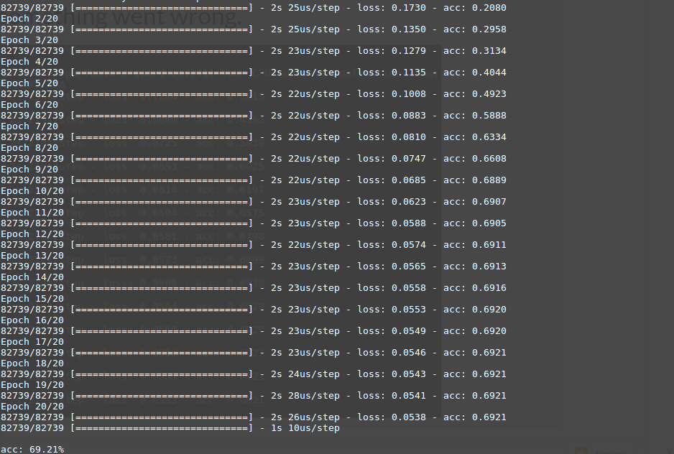
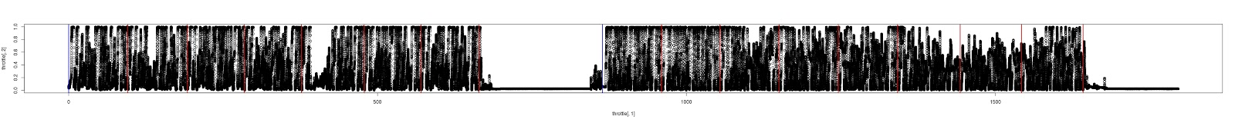
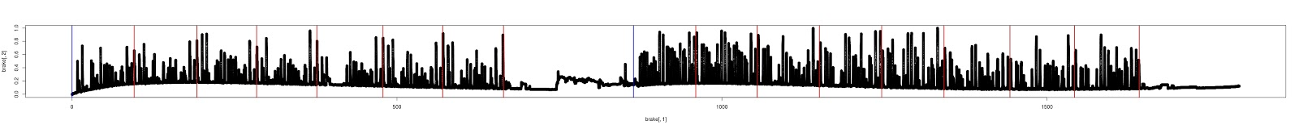
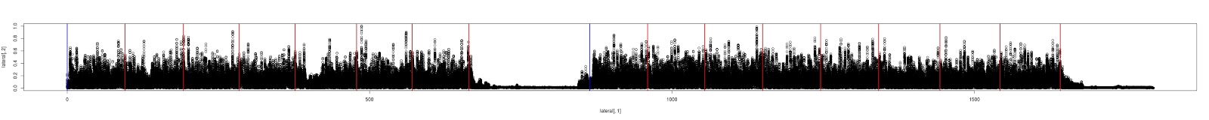
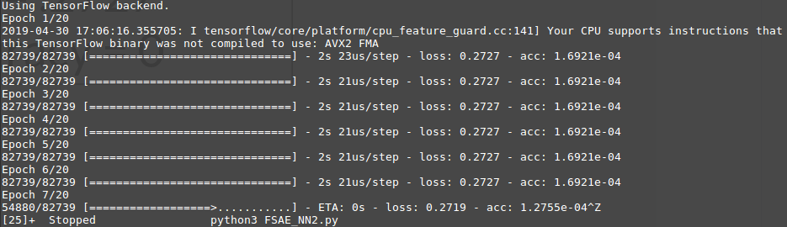
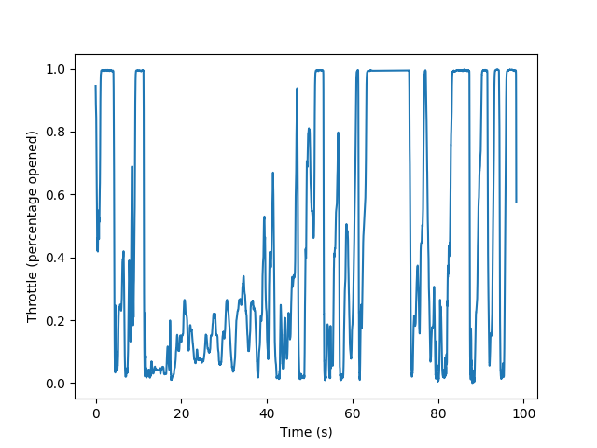
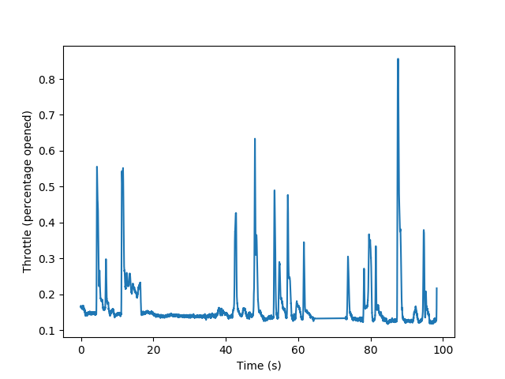
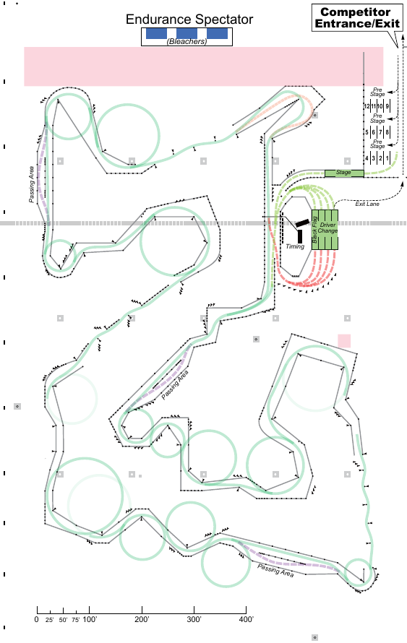
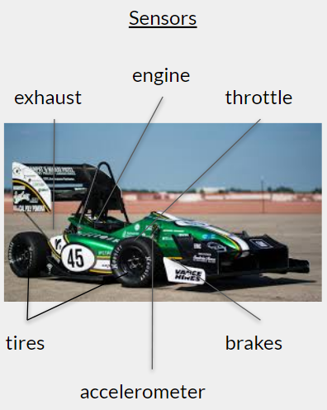
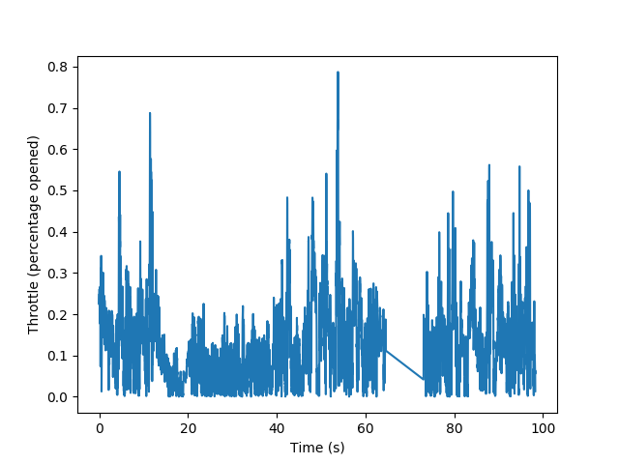
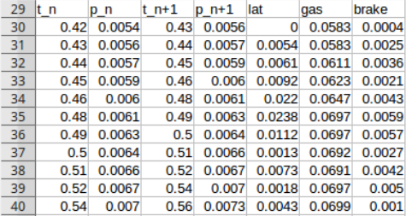
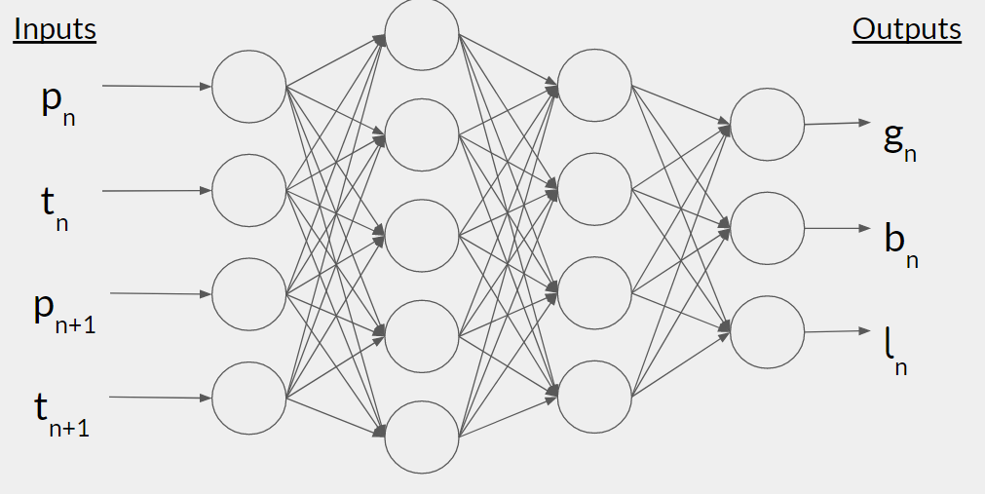
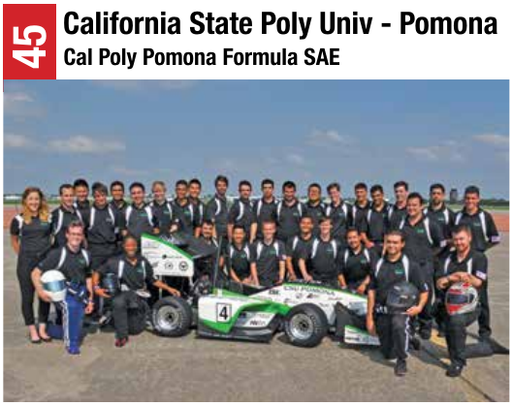
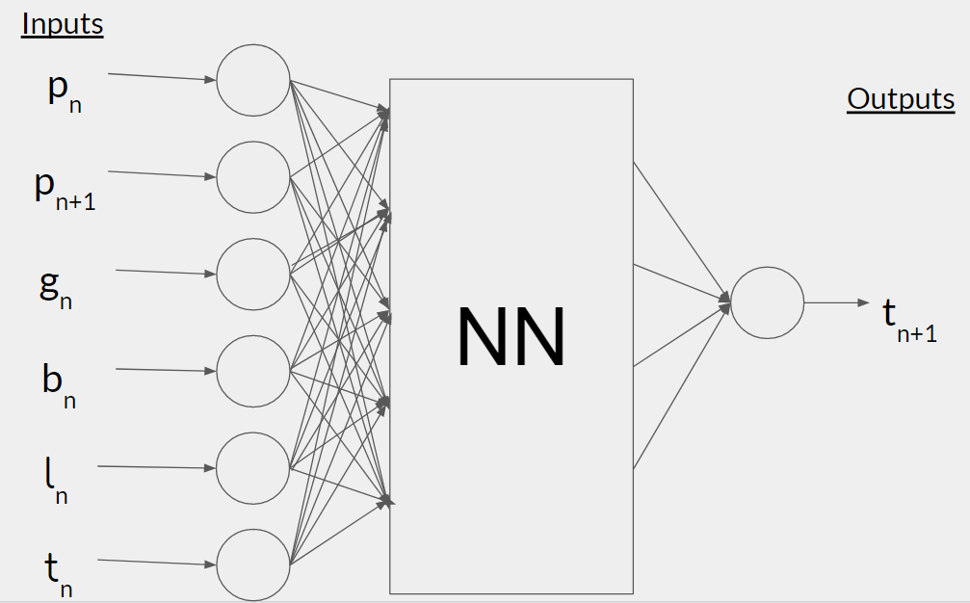
Towards Formula SAE Driver/Vehicle Optimization
Salvador Jimenez, Austin Luchsinger
Department of Computer Science
College of Engineering and Computer Science
Abstract
Many factors are considered when designing and racing Formula SAE racing cars. Recently, machine learning has sparked a significant shift in Formula 1 racing with an announcement that they will be transferring their infrastructure over to AWS. Currently, there are no machine learning techniques being used at the collegiate Formula SAE level. In this work, we use a Neural Network to try and learn the relation between throttle, braking, and turning parameters and lap time.
Data
The data that Cal Poly - Pomona provided was from the 2016 Formula SAE Lincoln event. One of the events at FSAE Lincoln was an endurance event where teams had to race around a track 15 times, with time for one pitstop and driver change. Of the data collected, the primary concern of Bronco Motorsports was the throttle, brake, and lateral acceleration data. Below is a plot of the raw data collected:
After some processing, we split the data up into laps, and compared the segments again. Due to some noise and processing challenges (specifically with positional data), there was a small amount of data loss.
Results
The first Neural Network architecture we set up achieve an accuracy of about 70%. This results of our run are shown below:
While this is not quite what we were hoping for, it is better than nothing. We did think though, that we could do better. It was after getting this result that we tried the second network setup shown in the last section. That network, however, produced even worse results.
This network couldn’t learn anything about the relation between throttle/brake/lateral acceleration and lap time. Despite our lackluster results, our approach provides evidence for future directions.
Future Work
We did not achieve the results we were hoping, however, we are currently working on new approaches. Since our data is all timestamped (and position-stamped) we now think that we should try time-series analysis. We had the right idea about learning the parameters of a specific lap segment, but we weren’t taking all of the previous lap segments into consideration. We have begun implementing an LSTM to learn/predict these parameters. We will write the results of our LSTM in our final report by the end of the week.
Introduction
Every year, all of the vehicles in the Formula SAE racing league are designed and built from scratch. No vehicle is ever used two years in a row. This means that these Formula SAE teams are constantly reevaluating which design aspects are most important when developing their vehicles. With the vast number of factors involved in racecar design, it can be difficult to determine which of these factors is most important. Machine learning may be able to provide greater insight into this challenge.
In recent news [1], the Formula One Group announced that it will be using Amazon Web Services Inc (AWS) and data analytics to make in-race predictions about which driver seems most likely to win the race. By analyzing current race information, and comparing it to 60 years worth of race results, expected winner predictions are made. While this is a nice application of machine learning that benifits the fans, it does little to help give the Formula One teams an edge on the competition.
At the collegiate level, Formula SAE teams are looking to evolve in the same way. It is common for FSAE teams to install sensors on their vehicles which track various statuses throughout a race. These sensors track various things such as tire pressure, brake temperature, throttle, engine temperature, lateral acceleration, and more. Normally, these readings are used for mid-race diagnostics and anticipating/preventing component failure. Following Formula 1’s lead, some FSAE teams are investigating the use of machine learning on the data they have been collecting.
The Problem
California State Polytechnic University – Pomona [2] is one of the schools that has begun seeking machine learning solutions for their problems. One of their members contacted us, requesting our assistance in extracting information from their prior race data. Specifically, they want to know how big of an impact the throttle, brake, and lateral acceleration have on lap time. In other words, of all the factors that the driver can control, which is the most critical?
Brake (percentage)
Lateral Acceleration (percentage)
Our Approach
Our goal was to learn the relationship between the 3 parameters (throttle, brake, acceleration) and lap time. At first, we wanted to use linear regression, as it is a good predictive model. The problem, however, is that the relationship seems to be non-linear. We then considered polynomial regression, as that is capable of learning non-linear relations, but this requires prior knowledge of how the factors relate to each other.
Thus, we landed on a Neural Network. This model seemed to best fit our needs, as Neural Networks are capable of learning non-linear relations with no prior knowledge about the factors. Below, we show the architecture of our Neural Network:
The concept behind this setup was simple: given a lap segment, what should the throttle, brake, and lateral acceleration be? As we show in the results section, the network was limited in what it could learn. Following this, we tried another architecture. Given the throttle, brake, lateral acceleration, current position, current time, and next position, can we learn what the next time should be? This architecture is shown below:
Acknowledgments
We would like to thank David Martinez and the California State Polytechnic University, Pomona for providing motivation and data for this investigation. We would also like to thank Dr. Kim for teaching the Machine Learning class which made our work possible, and for detailed discussions on how to approach this problem. Lastly, we would like to thank Angel Cantu for countless conversations about our project, and for his helpful software implementation recommendations.
References
Formula One selects AWS as Official Cloud and Machine Learning Provider.
29 June 2018.
www.formula1.com
Bronco Motorsports – Formula SAE team.
California State Polytechnic University, Pomona
www.cppfsea.com
A Beginner’s Guide to Neural Networks and Deep Learning.
https://skymind.ai/wiki/neural-network
A Beginner’s Guide to LSTM’s and Recurrent Neural Networks.
https://skymind.ai/wiki/lstm
Keras: The Python Deep Learning Library
https://keras.io
Notes:
1

