Slide 1

Self-Assembly of Any Shape with
Constant Tile Types using High Temperature
August 20, 2018
τ
Cameron Chalk¹, Austin Luchsinger², Robert Schweller², Tim Wylie²
¹University of Texas – Austin
²University of Texas – Rio Grande Valley

Slide 2
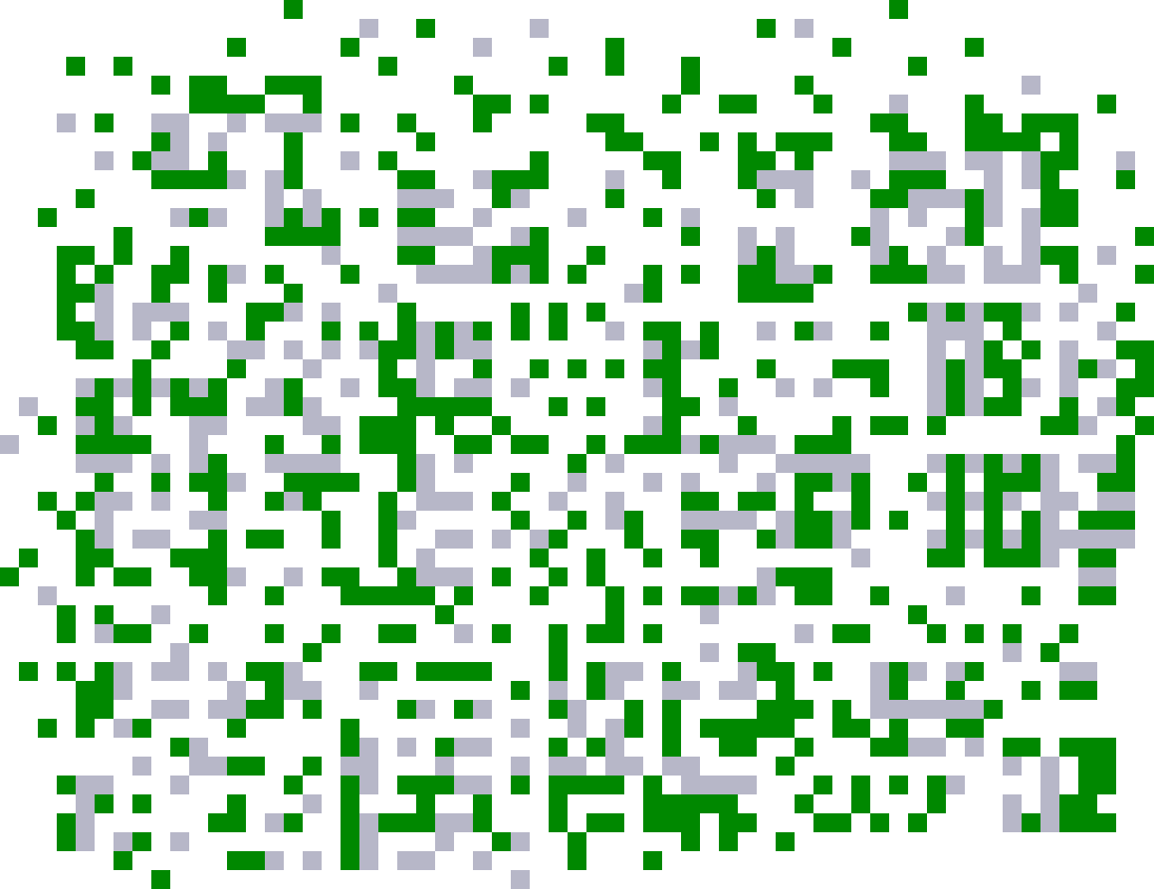
Self-Assembly
System monomers autonomously come together to form complex structures.

Slide 3
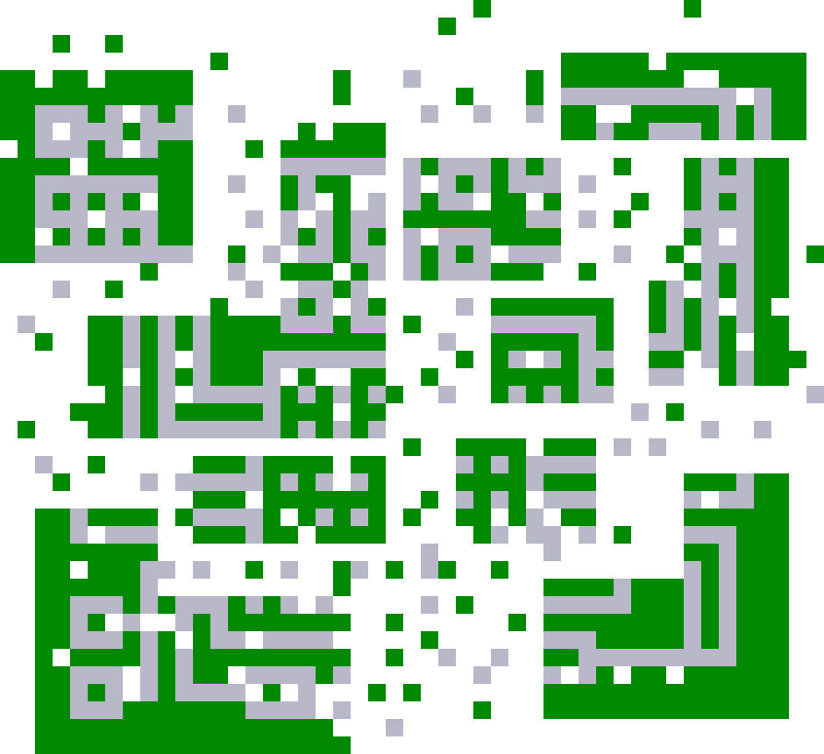
Self-Assembly
System monomers autonomously come together to form complex structures.

Slide 4
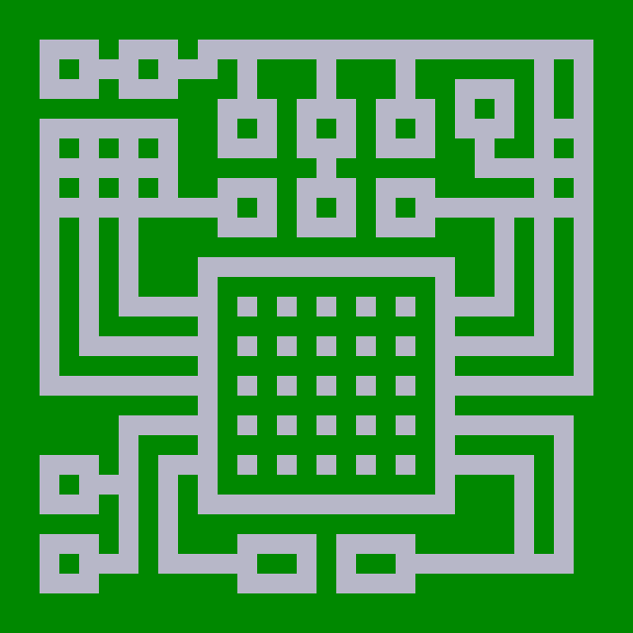
Self-Assembly
System monomers autonomously come together to form complex structures.

Slide 5
Self-Assembly
Chemistry
Biology
Notes:
This phenomenon is particularly abundant in the areas of Chemistry and Biology. One promising area has been an attempt to harness the power of DNA to self-assemble nanostructures.

Slide 6
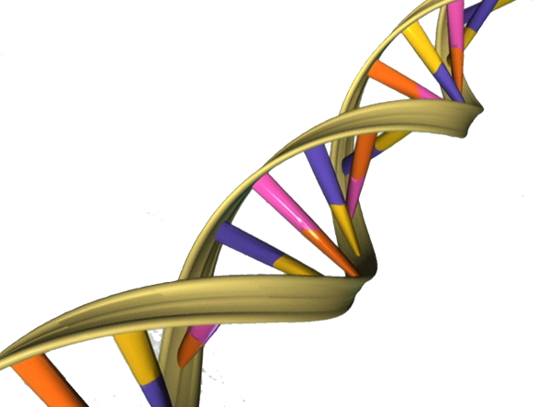
Self-Assembly
Chemistry
Biology
Notes:
This approach of using DNA self-assembly to engineer BLANK was pioneered by Ned Seeman, whose idea was essentially this:

Slide 7
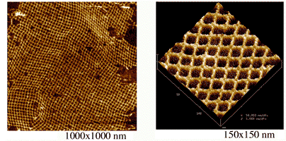
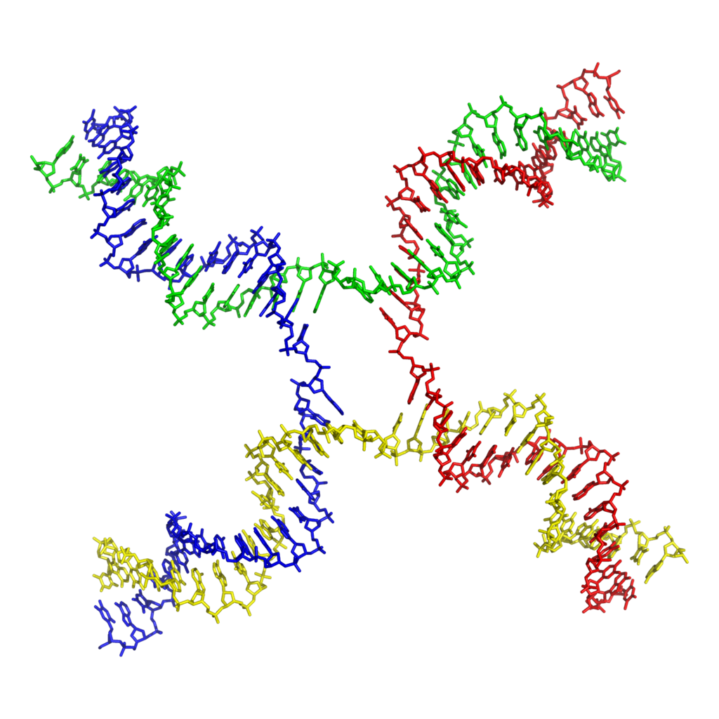
Self-Assembly
- Yan, H., Park, S.H., Finkelstein, G., Reif, J.H. & LaBean, T.H.
Notes:
Branched Junction Molecules. Atomic Force Microscope.

Slide 8
Tile Self-Assembly

Slide 9
Tile Self-Assembly
(Winfree, 1998)

Slide 10
Tile Self-Assembly
Green
Glue
Orange
Glue
Purple
Glue
Blue
Glue
(Winfree, 1998)

Slide 11
Tile Self-Assembly
Str(G) = 2
Str(O) = 2
Str(P) = 1
Str(B) = 1
(Winfree, 1998)

Slide 12
Tile Self-Assembly
(Winfree, 1998)

Slide 13
Tile Self-Assembly
Rotation
Translation
(Winfree, 1998)

Slide 14
Tile Self-Assembly (2HAM)
(Rothemund, Winfree, Adleman)
Tileset:
Temperature:
2
1
∞ counts of each
tile type

Slide 15
Tile Self-Assembly (2HAM)
Tileset:
Temperature:
2
1

Slide 16
Tile Self-Assembly (2HAM)
Tileset:
Temperature:
2
1

Slide 17
Tile Self-Assembly (2HAM)
Tileset:
Temperature:
2
1

Slide 18
Tile Self-Assembly (2HAM)
Tileset:
Temperature:
2
1

Slide 19
Tile Self-Assembly (2HAM)
Tileset:
Temperature:
2
1

Slide 20
Tile Self-Assembly (2HAM)
Tileset:
Temperature:
2
1

Slide 21
Tile Self-Assembly (2HAM)
Tileset:
Temperature:
2
1

Slide 22
Tile Self-Assembly (2HAM)
Tileset:
Temperature:
2
1

Slide 23
Tile Self-Assembly (2HAM)
Tileset:
Temperature:
2
1

Slide 24
Tile Self-Assembly (2HAM)
Tileset:
Temperature:
Terminal
2
1

Slide 25
Tile Self-Assembly (2HAM)
This system uniquely
produces a 3x3 square:
Tileset:
Temperature:
2
1
Number of tile types = 6

Slide 26
Tile Self-Assembly (2HAM)
This system uniquely
produces a 3x3 square:
Tileset:
Temperature:
2
1
Goal: Use as few tile types as possible.
Number of tile types = 6

Slide 27
Tile Self-Assembly (2HAM)
This system uniquely
produces a 3x3 square:
Tileset:
Temperature:
2
1
Goal: What is the minimum tile complexity for assembling an
n x n square?
Tile Complexity = 6

Slide 28
Tile Self-Assembly (2HAM)
This system uniquely
produces a 3x3 square:
Tileset:
Temperature:
2
1
Ω( )
Tile Complexity = 6
n x n squares:
log n
log log n
(Rothemund, Winfree, 2000)

Slide 29
Negative Glues
(Patitz, Schweller, Summers. 2011)
Tileset:
Temperature:
2
1
Str(R) = -1

Slide 30
Negative Glues
Tileset:
Temperature:
2
1

Slide 31
Negative Glues
Tileset:
Temperature:
2
1

Slide 32
Negative Glues
Tileset:
Temperature:
2
1

Slide 33
Negative Glues
Tileset:
Temperature:
2
1

Slide 34
Negative Glues
Tileset:
Temperature:
2
1

Slide 35
Negative Glues
This system produces
two terminal assemblies:
Tileset:
Temperature:
2
1

Slide 36
Negative Glues
This system produces
two terminal assemblies:
Tileset:
Temperature:
2
1

Slide 37
Negative Glues
This system produces
two terminal assemblies:
Tileset:
Temperature:
2
1
No Detachment!
Growth Only

Slide 38
High Temperature
Tileset:
Temperature:
τ
Glue Function:
Str(P) = τ
Str(B) = τ
Str(G) = 1

Slide 39
High Temperature
Tileset:
Temperature:
τ
Glue Function:
Str(P) = τ
Str(B) = τ
Str(G) = 1

Slide 40
High Temperature
Tileset:
Temperature:
τ
Glue Function:
Str(P) = τ
Str(B) = τ
Str(G) = 1

Slide 41
High Temperature
Tileset:
Temperature:
τ
Glue Function:
Str(P) = τ
Str(B) = τ
Str(G) = 1

Slide 42
High Temperature
Tileset:
Temperature:
τ
. . .
Glue Function:
Str(P) = τ
Str(B) = τ
Str(G) = 1
. . .

Slide 43
High Temperature
τ
Tileset:
Temperature:
τ
. . .
Glue Function:
Str(P) = τ
Str(B) = τ
Str(G) = 1
. . .
τ

Slide 44
High Temperature
Tileset:
Temperature:
τ
. . .
Glue Function:
Str(P) = τ
Str(B) = τ
Str(G) = 1
. . .
τ

Slide 45
Self-Assembly of Shapes
What if you wanted to assemble an arbitrary shape (S)?

Slide 46
Self-Assembly of Shapes
Problem: Given a shape S, design a tile system T that builds a scaled version of S.
Input:
Output:
S =
T =

Slide 47
Self-Assembly of Shapes
Problem: Given a shape S, design a tile system T that builds a scaled version of S.
Input:
Output:
S =
T =
Goal: Design a tile system which does this using as few tile types as possible.

Slide 48
Self-Assembly of Shapes
Model | No. of Tile Types
aTAM (Soloveichik, Winfree, 2007)
Negative Glue 2HAM w/ High Temperature
O( )
K(S)
log(K(S))
Notes:
The premier result for this question is that of Soloveichik and Winfree. The Kolmogorov complexity of shape S, K(S), is the number of bits in the smallest program which outputs S w.r.t. a universal Turing machine. They encode S in the number of tile types of the system.

Slide 49
Self-Assembly of Shapes
Model | No. of Tile Types
aTAM (Soloveichik, Winfree, 2007)
Negative Glue 2HAM w/ High Temperature
O( )
K(S)
log(K(S))
O(1)

Slide 50
Self-Assembly of Shapes
Model | No. of Tile Types
aTAM (Soloveichik, Winfree, 2007)
Negative Glue 2HAM w/ High Temperature
O( )
K(S)
log(K(S))
O(1)
How is this possible?
Notes:
We encode S in the temperature and glue function of the tile system.

Slide 51
Self-Assembly of Shapes
Model | No. of Tile Types | Temp. & Glue Function
aTAM (Soloveichik, Winfree, 2007)
Negative Glue 2HAM w/ High Temperature
O( )
O(1)
K(S)
log(K(S))
O(1)
Notes:
We encode S in the temperature and glue function of the tile system.

Slide 52
Self-Assembly of Shapes
Model | No. of Tile Types | Temp. & Glue Function
aTAM (Soloveichik, Winfree, 2007)
Negative Glue 2HAM w/ High Temperature
O( )
O(1)
K(S)
log(K(S))
O(1)
O( 2^{K(S)} )
Notes:
We encode S in the temperature and glue function of the tile system, rather than in the number of tile types.

Slide 53
Process Overview
Encode S in τ and glue function
τ
O(1) tile types

Slide 54

Process Overview
Encode S in τ and glue function
τ
Precise-width Rectangle
O(1) tile types
Self-Assembles

Slide 55
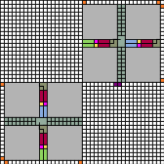
Process Overview
Encode S in τ and glue function
τ
Precise-width Rectangle
O(1) tile types
Seed Block which encodes the
program to assemble S
Self-Assembles
Self-Assembly Continues

Slide 56
Process Overview
Encode S in τ and glue function
τ
Precise-width Rectangle
O(1) tile types
Seed Block which encodes the
program to assemble S
Self-Assembles
Scaled Shape
Self-Assembly Continues
TM’s using O(1) tile types

Slide 57
Process Overview
Encode S in τ and glue function
(Soloveichik, Winfree, 2007)
τ
Precise-width Rectangle
O(1) tile types
Seed Block which encodes the
program to assemble S
Self-Assembles
Scaled Shape
Self-Assembly Continues
TM’s using O(1) tile types

Slide 58
Process Overview
Encode S in τ and glue function
(Soloveichik, Winfree, 2007)
τ
Incurred tile types
O( )
Precise-width Rectangle
K(S)
O(1) tile types
log(K(S))
Seed Block which encodes the
program to assemble S
Self-Assembles
Scaled Shape
Self-Assembly Continues
TM’s using O(1) tile types

Slide 59
Process Overview
Encode S in τ and glue function
τ
O(1)
Precise-width Rectangle
We can achieve:
tile types
O(1) tile types
Seed Block which encodes the
program to assemble S
Self-Assembles
Scaled Shape
Self-Assembly Continues
TM’s using O(1) tile types

Slide 60
Key Idea
Precise-width Rectangle
w
There exists a binary program P
which assembles S in
(Soloveichik, Winfree, 2007)
W can be thought of as a
unary encoding of program P

Slide 61
Precise-width Rectangle
Base assembly

Slide 62
Precise-width Rectangle
“Up” domino
u

Slide 63
Precise-width Rectangle
Signal-passing
u

Slide 64
Precise-width Rectangle
u

Slide 65
Precise-width Rectangle
u

Slide 66
Precise-width Rectangle
d
u

Slide 67
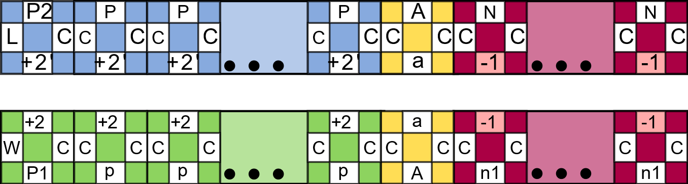
Precise-width Rectangle
Str(a) = 2τ -1
d
u

Slide 68
Precise-width Rectangle
d
u

Slide 69
Precise-width Rectangle
d
d
u

Slide 70
Precise-width Rectangle
d
d
u
u
d
d

Slide 71
Precise-width Rectangle
d
d
u
u
d
d

Slide 72
Precise-width Rectangle
d
d
u
d
u
d
u
u
d
τ iterations

Slide 73
Precise-width Rectangle
d
d
u
u
d
d

Slide 74
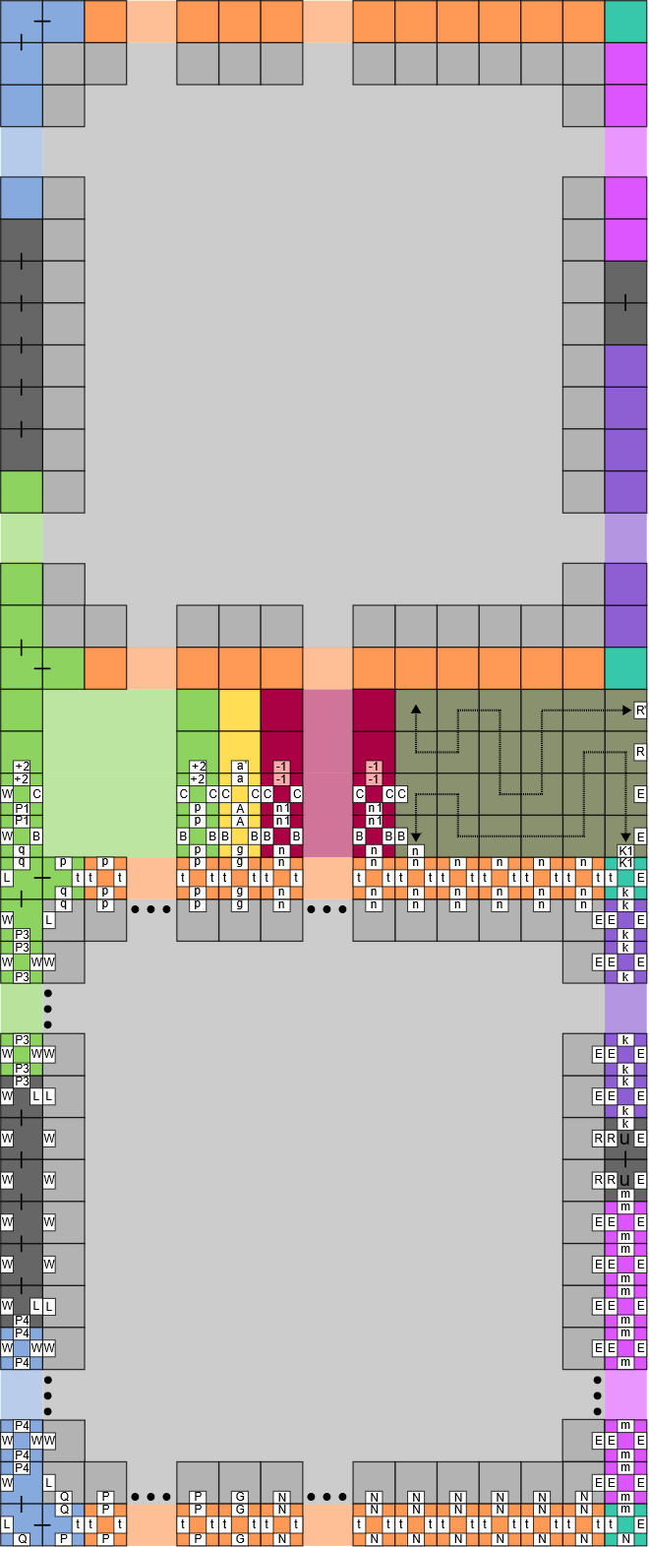
Precise-width Rectangle

Slide 75
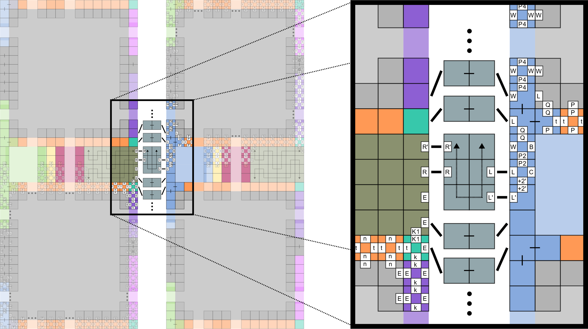
Precise-width Rectangle

Slide 76
Precise-width Rectangle
Str(a) = 2τ -1
d
u

Slide 77
Precise-width Rectangle
cτ

Slide 78

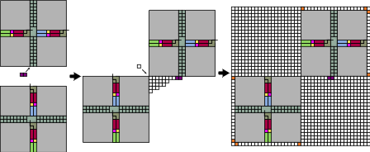
Seed Assembly

Slide 79
Seed Assembly
Unary Encoding of program P¹
¹Let P be the binary program used to assemble the shape via the construction of (Soloveichik, Winfree, 2007)

Slide 80
Seed Assembly
Conversion to P
via O(1)-size
TM simulation

Slide 81
Process Overview
O(1)-sized TM simulations of
(Soloveichik, Winfree, 2007)

Slide 82
Self-Assembly of Shapes
Model | No. of Tile Types
aTAM (Soloveichik, Winfree, 2007)
Negative Glue 2HAM (growth-only)
O( )
K(S)
log(K(S))
O(1)
Future Work
Can we lower the scale factor?
Can we achieve this without negative glues?

Slide 83
Thank You!
Notes:
Negative Glues – Experimental implementation by Paul Rothemund. Lazer-cut acrylic tiles are coated with patterns of hydrophilic or hydrophobic patches. This allowed implementation of self-assembly with both attractive and repulsive forces. (Using lateral capillary forces to compute by self-assembly)

